Slide 1

SmartUp Academy
Foundations Course
Lecture 15
Scalability

Slide 2

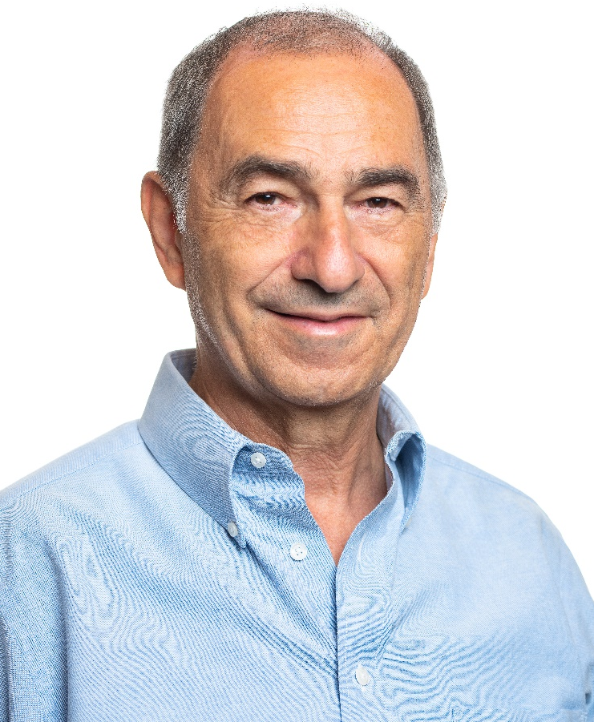
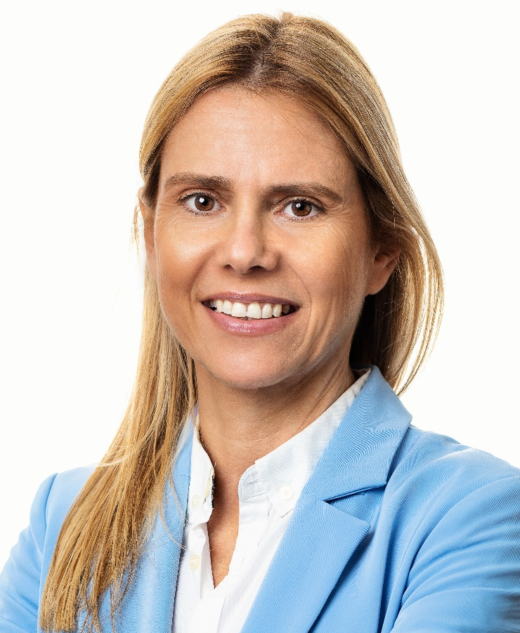

The SmartUp Founding Team
Yonatan Stern
Founder
And CEO
Libby Molad
Co-Founder and COO
Ayala Dinur Turgeman
Co-Founder
and CFO
Libby@smartupacademy.org
Yonatan@smartupacademy.org

Slide 3
9 Out of 10 Startups Fail – You Can Succeed
The three pillars of a SmartUp successful company:
Profitable
Fast growing
Modest investment
Our objective is to increase the success rate from “1 out of 10” to “1 out of 2” (… or 3) smartups succeed
Modest investment means less than $3m-$5m investment to bring a company to profitability, instead of $30m-$50m

Slide 4
The SmartUp, Infinite Game, Vision
If we increase company success rate by a factor of 3 or even 5
And if we reduce the investment per company by a factor of 3 or even 5
We – you and us – can grow the startup industry by a factor of 10, with the same amount of investment
And can have ten times as many successful founders - YOU ! ☺ ☺ ☺ ☺ ☺ ☺ ☺ ☺ ☺ ☺

Slide 5


SmartUp Academy
A program to teach the engineering profession of building successful companies (…work in progress)
Foundations course
15 lectures covering all aspects involved in building a company, from branding to marketing, to sales, to product, pricing, people, and more
Workshops – Specific Subjects
4-5 years Residency Program

Slide 6
What are Scalable Business Models?
Venture Capital (VC) firms prefer to invest in companies that have a scalable business model
A scalable business model means you can multiply your revenue without having to multiply your costs and resources proportionally
Venture Capital (VC) firms don’t like “non-scalable” business models

Slide 7
What Are “Non-Scalable” Business Models?
Non-Scalable business models are usually activities that require people
And that the number of people grows proportionally to the number of customers. Activities like:
Consulting
Services
Training courses
Extensive customer support
Etc.
VC Firms will not invest if a company’s business plan includes “non-scalable” elements. But are they really “Non-Scalable”? ?

Slide 8
Growth Engines vs. Scalable Business Models
Here is the SmartUp definition of a growth engine, taken from Lecture 7
A Growth Engine is a process that the company does, or plans to do, many times, repeatedly, in marketing or in sales, or in any other critical part or activity of the company
A Growth Engine is a scalable process that
You can double its Output
With a small increase in Input (efforts and investments)
It is not linear, a small increase in Input can yield a large increase in Output

Slide 9
Growth Engines vs. Scalable Business Models
Are Growth Engines just what VC’s call Scalable Business Models?
No – They are totally two different concepts
Venture Capital Scalable Business Models are generic business models that can scale well if implemented properly
VC Scalable business models usually require a large investment, and success requires a good amount of luck

Slide 10
Growth Engines vs. Scalable Business Models
SmartUp Growth Engines come to solve three different problems
Branding and Marketing – how to ignite growth from zero, using a relatively small investment, and how to maintain such growth through the life of the company
Successfully Introducing a new product concept to a market – Jobs To Be Done
Overcoming what traditionally are non-scalable processes – a huge competitive advantage

Slide 11
Examples of Scalable Business Models
Marketplace / Platform Models
In Labor and Services market
Fiverr (digital services)
Upwork (freelancers)
TaskRabbit (handyman/local tasks)
Care.com (caregivers/babysitters)
Rover (pet sitting/dog walking)
Thumbtack (local professionals)
DoorDash (food delivery)
Wolt (food delivery)

Slide 12
Examples of Scalable Business Models
Marketplace / Platform Models
In Transportation & Mobility:
Uber (ridesharing)
Gett (cab dispatcher)
Lyft (ridesharing)
Turo (car sharing)
Bird/Lime (scooter sharing)
BlaBlaCar (long-distance ridesharing)
SpotHero (parking spaces)

Slide 13
Examples of Scalable Business Models
Marketplace / Platform Models
In Commerce:
eBay (auction sales)
Craigslist
Etsy (handmade goods)
StockX (sneakers/collectibles)
Faire (wholesale marketplace)
Depop (used fashion)
Poshmark (used fashion)
Mercari (general resale)

Slide 14
Marketplace Models – Strengths and Weaknesses
Strengths:
Model benefits
They solve a real matching / coordination problem between supply and demand
They often benefit from network effects - more suppliers attract more customers and vice versa
Growth by network effects creates defensibility
They reduce transaction friction and build trust
They can achieve liquidity in specific geographic or vertical markets

Slide 15
Marketplace Models – Strengths and Weaknesses
Strengths:
Cost benefits:
Providers handle delivery and service, Platform handles matching and payments
They make money as a percentage of transactions without holding inventory
They have a strong unit economics once scale is achieved

Slide 16
Marketplace Models – Strengths and Weaknesses
Weaknesses
Chicken-and-Egg Problem: How to ignite the magic?
Hard to attract suppliers without buyers, and vice versa
Often requires heavy subsidies on both sides initially (Uber, WeWork)
Can be very expensive to reach critical mass in each market
Unit Economics Challenges:
Many marketplaces struggle with poor unit economics in early stages
High customer acquisition costs (CAC) that don't decrease as expected
Margin percent often needs to be high to be profitable, can drive away users
Many marketplaces are actually "buying" revenue through subsidies

Slide 17
Scalable Model – Product Led Growth (PLG)
Collaboration & Productivity:
Slack (messaging)
Zoom (video conferencing)
Discord (communication)
Figma (design)
Canva (design)
Notion (workspace)
Airtable (spreadsheets/databases)
Miro (whiteboarding)
Free for individual users – Upgrade to enterprise costs money

Slide 18
Scalable Model – Product Led Growth (PLG)
Sales & Marketing Tools:
Calendly (scheduling)
MailChimp (email marketing)
HubSpot (started PLG with free CRM)
SurveyMonkey (surveys)
Typeform (forms)
Loom (video messaging)
Developer & Technical Tools:
GitHub (code repository/collaboration) (Acquired by MS for $7.5b)
MongoDB (database)
GitLab (DevOps platform)
DataDog (monitoring)

Slide 19
Product Led Growth – Strengths and Weaknesses
Strengths
Lower Customer Acquisition Cost (CAC)
Word-of-mouth growth
Users find and adopt product themselves
Viral spread within organizations
Easier to identify expansion opportunities within companies
Bottom-up adoption leads to top-down purchases
Usage-based pricing allows deal size growth within a customer

Slide 20
Product Led Growth – Strengths and Weaknesses
Weaknesses
Product must be of very high quality in order to spread – big investment in product
The transition from FREE to payment is challenging – needs artistry ingenuity, and imagination to make it smooth and acceptable
Need a large user base for meaningful revenues – big investment in infrastructure and support
Big investment in making the product enterprise ready to start generating revenues

Slide 21
Scalable Business Model – LinkedIn Network Effect
LinkedIn – Co-Founded by Reid Hoffman in 2003, launched product in May of 2003
Prior to founding LinkedIn, Reid joined PayPal in 2000, as Senior VP of Business Development, reporting to then PayPal’s CEO Elon Musk
LinkedIn’s total funding before IPO was $155m
Had dinner with Reid Hoffman in 2005 in Silicon Valley to compare notes about ZoomInfo
… ZoomInfo used $3m to reach profitability

Slide 22
SmartUp Objectives and Vision
Increase the success rate of startup companies from “1 out of 10” to “1 out of 2” (… or 3)
Success is defined as a company that is:
Profitable
Growing fast
Modest Investment
Most Scalable Business models require a big investment and a good amount of luck

Slide 23
SmartUp Objective and Vision, The VC Ratio
The VC ratio = Value (at Exit) / Capital (invested)
A company that raised $30m and was sold for $300m, have a VC ratio of 10 = $300m / $30m
Not many companies are sold for $300m
A company that raised $3m and was sold for $30m, have a VC ratio of 10 = $30m / $3m
Many more companies are sold for $30m
A profitable, fast growing company can easily fetch $30m value

Slide 24
SmartUp Growth Engines
SmartUp Growth Engines come to solve three different problems
Successfully Introducing a new product concept to a market – Jobs To Be Done
Overcoming what traditionally are non-scalable processes – a huge competitive advantage
Branding and Marketing – how to ignite growth from zero, using a relatively small investment, and how to maintain such growth through the life of the company

Slide 25
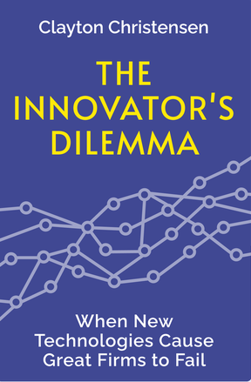
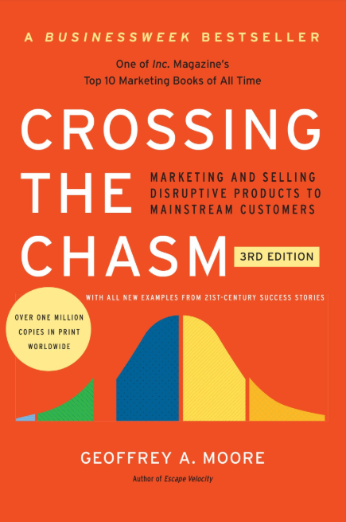
The Innovator’s Dilemma + Crossing the Chasm

Slide 26

The Innovator’s Dilemma
The Innovator's Dilemma was written by Clayton Christensen and published in 1997
The book became one of the most influential business books, particularly in how it shaped thinking about disruptive innovation.
Harvard Business Review (HBR) later named it one of the most important management books ever published.

Slide 27

Crossing the Chasm
Published in 1991 by Jeff Moore. One of the most influential business books
The first book to identify and explain why many promising technology startups failed to expand beyond early adopters
Introduced the notion of “Beach-heads” and elaborated on the concept of “the Whole Product” when it comes to technology innovation

Slide 28
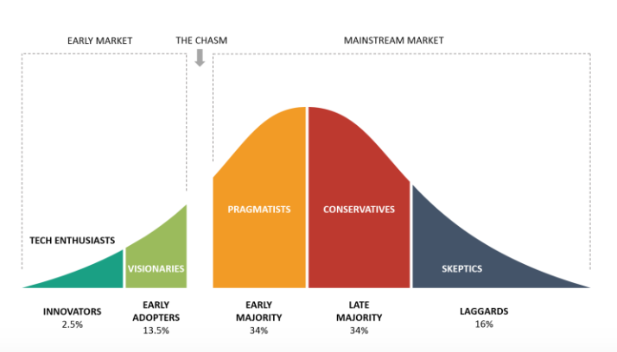
Crossing the Chasm by Jeff Moore, 1991
The Whole Product idea is similar to the concept of Jobs To Be Done
Customers don’t really want a product, they want what the product can do for them.

Slide 29
The Innovator’s Dilemma + Crossing the Chasm
Two very different problems
New products are hard to explain and comprehend, customers are slow to adopt them
New products are not mature, hard to use, fail often, and take many iterations, a long time, and lots of money to mature
The solution: Use “non-scalable” methods to grow and reach profitability, on modest investment, while solving these problems

Slide 30

Product Maturity – BioForum, BionData
A product to convert clinical trial data to the standard SDTM (Study Data Tabulation Model) format
Users are Biostatisticians, and the customers are CRO’s (Clinical Research Organizations) and pharma companies
SmartUp started working with BioForum at the end of 2021
Changed business model from product to continue to providing services, but with a higher margin
Largest customer – MediData, complex oncology trials data
Will generate $1.5m – $2m in 2025

Slide 31
Product Maturity – BioForum, BionData
Product is not yet ready
Fresh look by a new team at the SDTM process, done internally
The world is changing – AI revolution changes the technological and capabilities landscape
The company would have failed had we not changed the business model from product to service

Slide 32


Market Maturity
New products are hard to explain and comprehend
Infinipoint is a pioneer in the Device-Identity-as-Service security category to extend a true zero-trust security posture to devices. Infinipoint is the only solution that provides Single Sign-On (SSO) authorization integrated with risk-based policies and one-click remediation for non-compliant and vulnerable devices. This reduces risk by protecting access to an organization's data and services while transforming devices to support a world-class security posture. Infinipoint can do all this in a productive way that maintains business continuity with no disruption to the workforce.
- PR Newswire 17 Mar, 2022

Slide 33

Market Maturity
New products are hard to explain and comprehend
Novidea is the leading Insurtech provider of a cloud-native, data-driven insurance management system. Using an open API architecture, Novidea's software platform enables brokers, agents, MGAs, and carriers to modernize and manage the customer insurance journey, end-to-end, and drive growth across the entire insurance distribution lifecycle. The Novidea platform, built to leverage the power of Salesforce's Big Technology, provides a complete ecosystem spanning every aspect of an insurance business, including a 360-degree view of the customer and all stakeholders, an integrated customer-facing policy transactions, and the middle and back office. Brokers, agencies, and MGAs extract more value from their customer and policy data with actionable intelligence from any device, anywhere. Novidea supports more than 100 customers across 22 countries.

Slide 34
Market Maturity
New products are hard to explain and comprehend
Prospects don’t really want to change or make changes
Prospects are much more averse to risk than seek benefits, savings or improvements (….Kahneman)
Internal resistance to change by people who might be impacted
Prospects and markets are usually far less sophisticated than entrepreneurs think

Slide 35
Market Maturity
The more disruptive the product the harder it is to sell – incremental change is easier to absorb
Long sales cycles cost a lot of money and delay revenue
Possible Solution
Break the sales cycle into steps
Package each step as a product that is sellable
Turn problems into opportunities

Slide 36
Market Maturity – InteliChain
InteliChain – Demand forecasting tool
Initially aimed at small to medium companies
Priced at $10,000 / year, per business unit
Joined SmartUp in mid 2023
Roei Aviram, the founder & CEO, used to work at E&Y, managed many consulting jobs, and delivered many courses
Two small design partners
Several lengthy sales cycles

Slide 37
Market Maturity – InteliChain
We were looking for a Branding Growth Engine + some revenues
Roei had several courses that he already delivered in various venues
A new Intelichain product was born

Slide 38




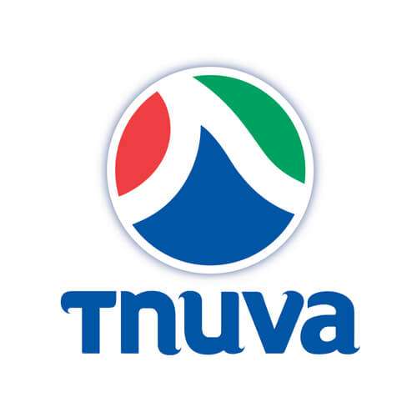



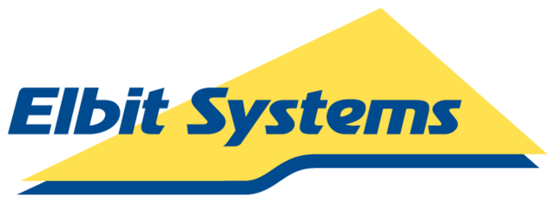








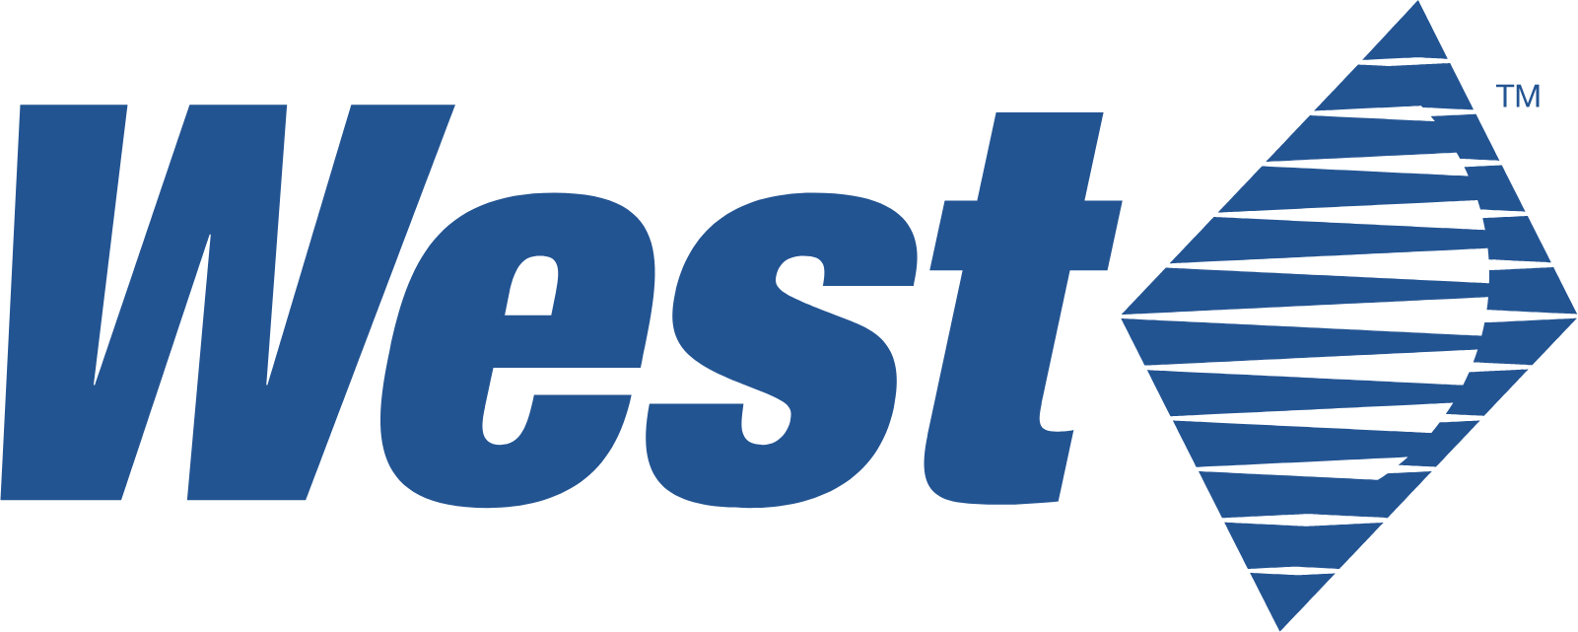










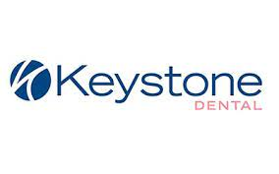











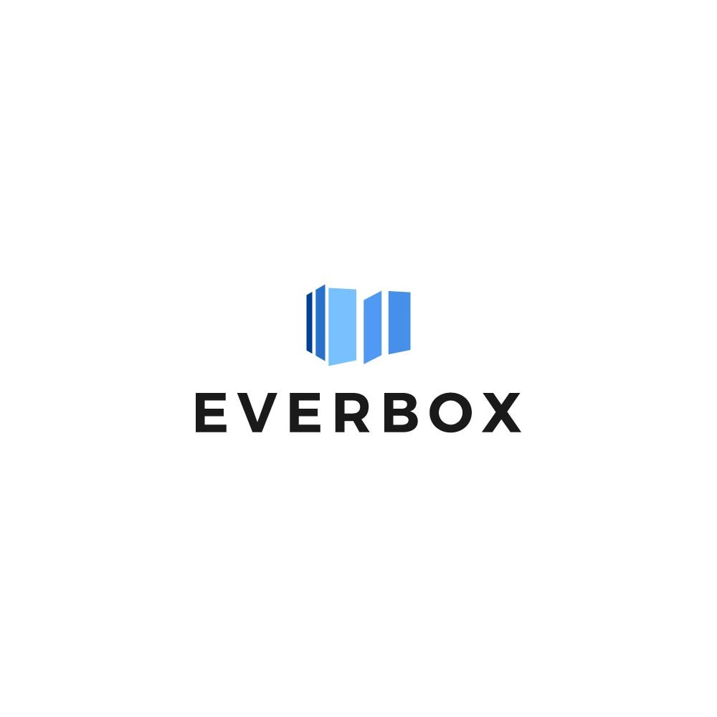




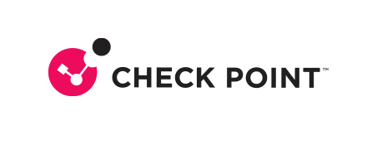









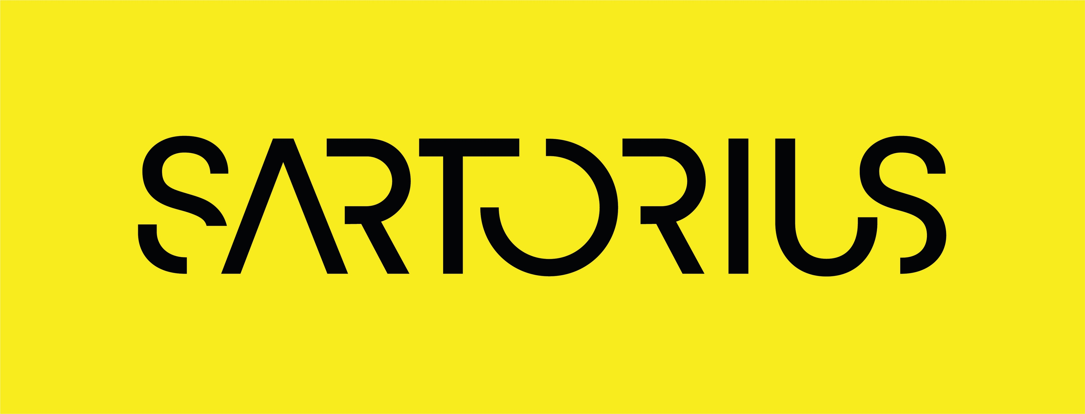
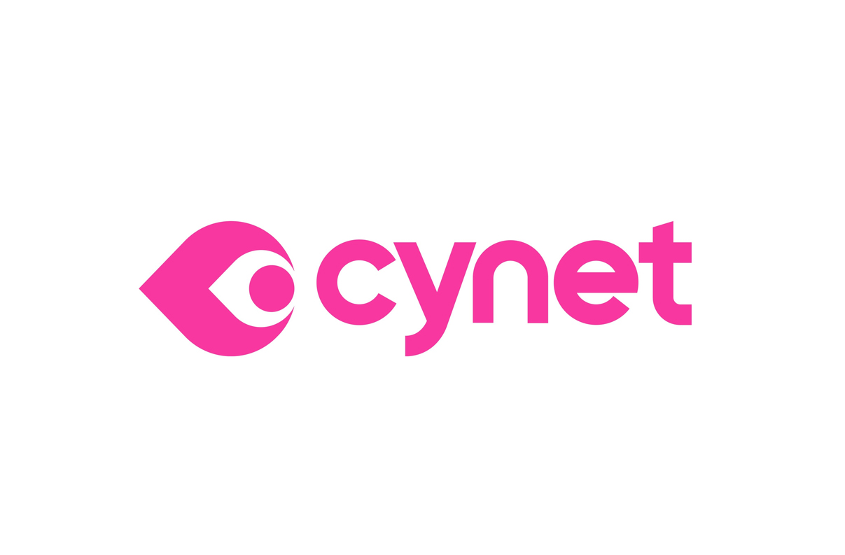


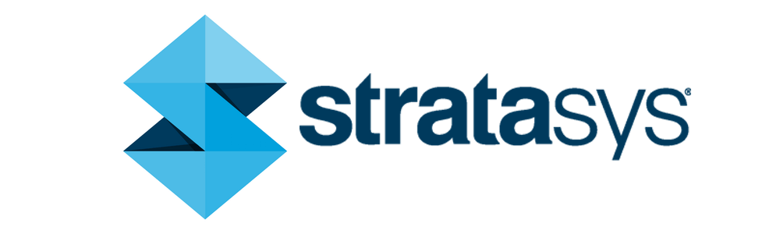




Intelichain’s Customers
And more…

Slide 39
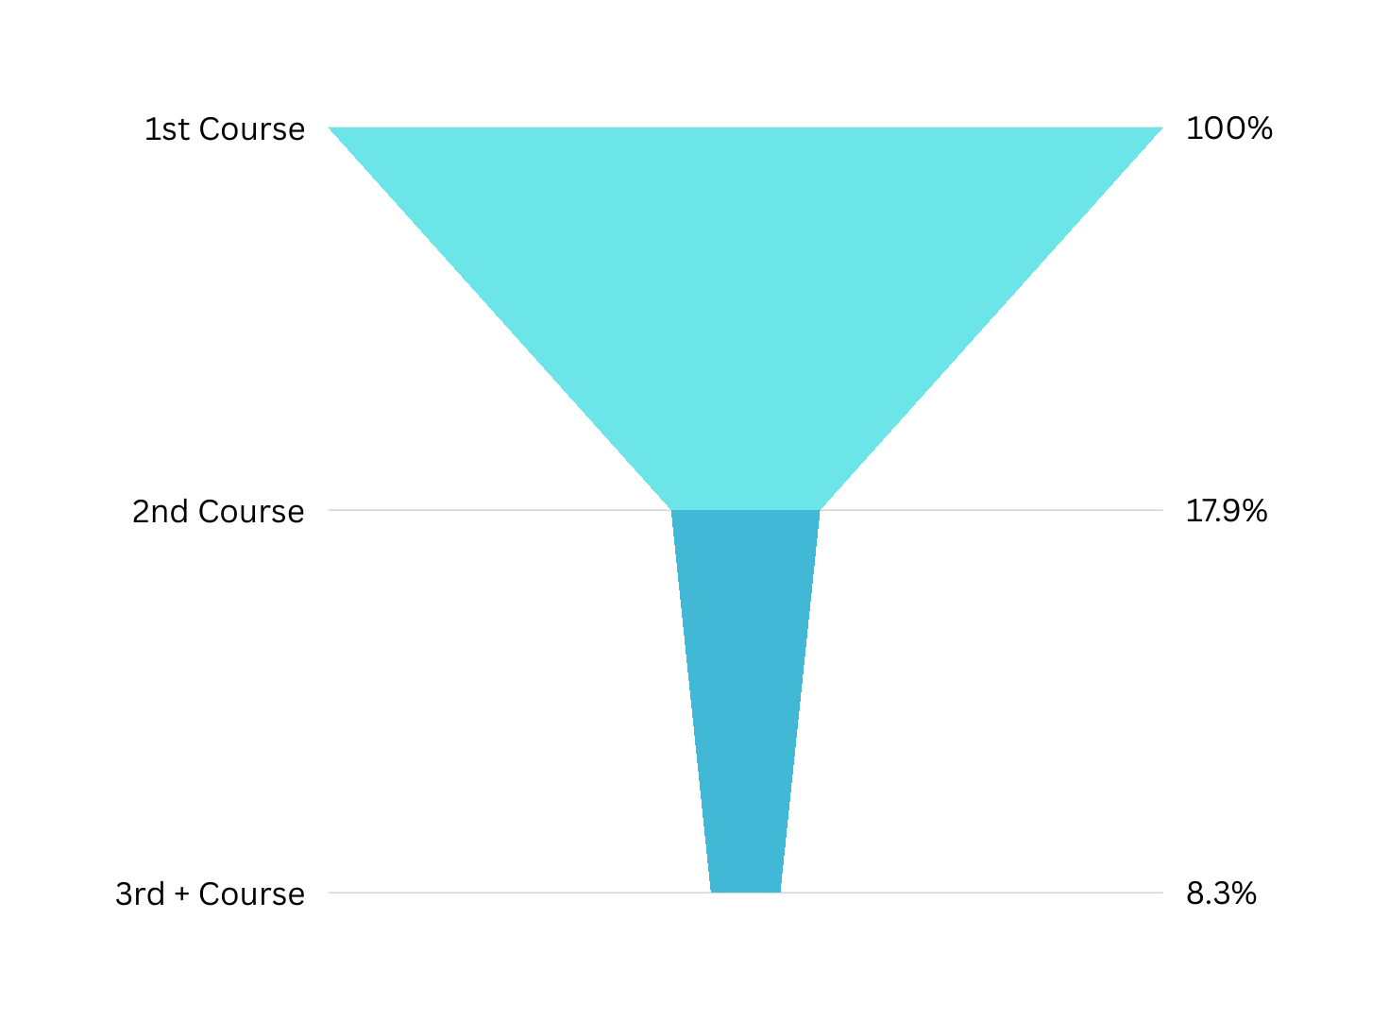
Over 25% of the Companies Returned for Another Course/s
Number of Companies by Courses Taken

Slide 40
Market Maturity – InteliChain
The sale cycle:
Several meetings, over 2-3 months, to
Understand customer needs
Explain and demo the product
Agree on next steps
Proof of Concept (POC) – Free use of the product for 1-2 months
Negotiate a deal
Sell (… hopefully)

Slide 41

Before VAP: 7 Steps Sales Funnel – Plain Vallina
# | Process | What we need in this meeting
1 | Qualification Meeting | Understanding of the client’s current process and pain-points (in his own words), the dynamics of stakeholders, budget
2 | Value-based Product Demo | (1) Build a tailor-made demo (id required set another meeting with planning managers to better understand some of the pain) (2) Build a storyline focusing on business pain
3 | POV – step 01: POV Preparation | (1) Team, Data & logics preparation – Define the POV team, the tested period, the inputs and outputs, work routines (2) Business preparation - success criteria (% of reduction of pain to purchase Intelichain), decision process,
4 | POV – step 02: Value Demonstration Workshop | (1) Day 1: Quantify and agree on the “Planning Pain” (cost of over & under-forecast) (2) Day 2: Quantify and agree on the “Planning Vale” (cost saving resulting from improved forecast accuracy over) (3) Day 3: Training on the software
5 | POV – step 03: Presentation to senior management | Present top management the work we have done so far showcasing: (1) Hard benefits - how success criteria was achieved (2) Soft benefits – time saved, single source of truth, automatic KPIs, long-term planning, segmentation and analytics
6 | Commercial terms & IT | Make sure legal & IT terms and conditions are aligned
7 | Deal Closing/ Access Given | Annual subscription signed, access is given to company’s users
Introduction & Value Alignment
Proof of Value (PoV)
Commercial

Slide 42
Let‘s make it a professional program and get paid $ $ $ $
# | Process | What we need in this meeting
1 | Qualification Meeting | Understanding of the client’s current process and pain-points (in his own words), the dynamics of stakeholders, budget
2 | Value-based Product Demo | (1) Build a tailor-made demo (id required set another meeting with planning managers to better understand some of the pain) (2) Build a storyline focusing on business pain
3 | POV – step 01: POV Preparation | (1) Team, Data & logics preparation – Define the POV team, the tested period, the inputs and outputs, work routines (2) Business preparation - success criteria (% of reduction of pain to purchase Intelichain), decision process,
4 | POV – step 02: Value Demonstration Workshop | (1) Day 1: Quantify and agree on the “Planning Pain” (cost of over & under-forecast) (2) Day 2: Quantify and agree on the “Planning Vale” (cost saving resulting from improved forecast accuracy over) (3) Day 3: Training on the software
5 | POV – step 03: Presentation to senior management | Present top management the work we have done so far showcasing: (1) Hard benefits - how success criteria was achieved (2) Soft benefits – time saved, single source of truth, automatic KPIs, long-term planning, segmentation and analytics
6 | Commercial terms & IT | Make sure legal & IT terms and conditions are aligned
7 | Deal Closing/ Access Given | Annual subscription signed, access is given to company’s users
Introduction & Value Alignment
Proof of Value (PoV)
Commercial

Slide 43
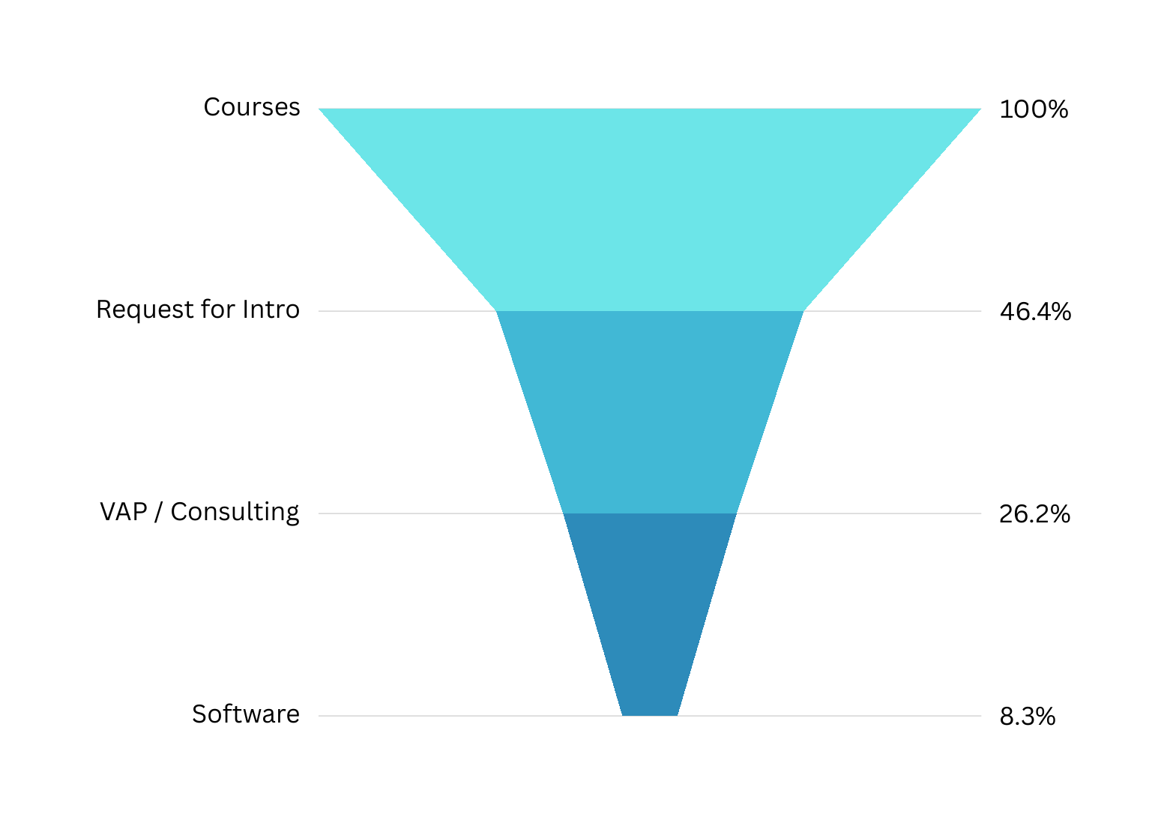
A Fully Monetized Sales Funnel: From Courses to Software
Number of Paying Customers by Product / Service

Slide 44





Value Analysis Program
4-6 weeks program
“Pain” Identification
Value Realization
Goal Setting
High Value Demo
Proof Of Value on The software
1
2
3
4
5
If we had a magic wand, and we could have 100% forecast accuracy, what would be the financial value?
Back to reality, how much is actually reducible
According to the findings what should be the goals
Do I believe that Intelichain can deliver my goals?
Do I like using Intelichain?

Slide 45

InteliChain – Turn Problems to Opportunities
The market immaturity offeres many branding and business opportunities
Courses
Consulting
Maturity Assessment
Agile S&OP

Slide 46

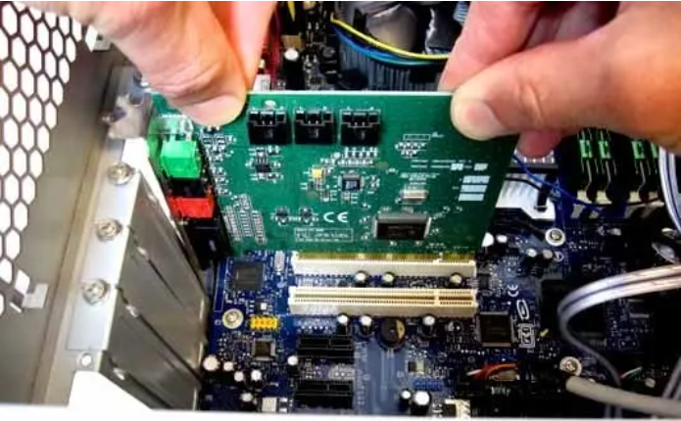
Growth Engines
Overcoming what traditionally are non-scalable processes – a huge competitive advantage
CardScan technical support

Slide 47
Growth Engines – Peach.Video

Slide 48
Growth Engines vs. Scalable Business Models
SmartUp Growth Engines come to solve three different problems
Branding and Marketing – how to ignite growth from zero, using a relatively small investment, and how to maintain such growth through the life of the company
Successfully Introducing a new product concept to a market – Jobs To Be Done
Overcoming what traditionally are non-scalable processes – a huge competitive advantage

Slide 49
The End ☺

Slide 50
Growth Engines
Explain what growth engines are
Provide examples
SEO
Growth Engine Inverted – How to take non-scalable processes and turn them scalable, thereby allowing the company to grow without adding people !!!

Slide 51
The Innovator’s Dilemma + Crossing the Chasm
Two very different problems
New products are not mature, hard to use and fail often, and take a long time, many iterations, and money to mature
New products are hard to explain and comprehend, customers are slow to adopt them
The solution: Use “non-scalable” methods to grow and reach profitability, on modest investment, while solving the problems

Slide 54
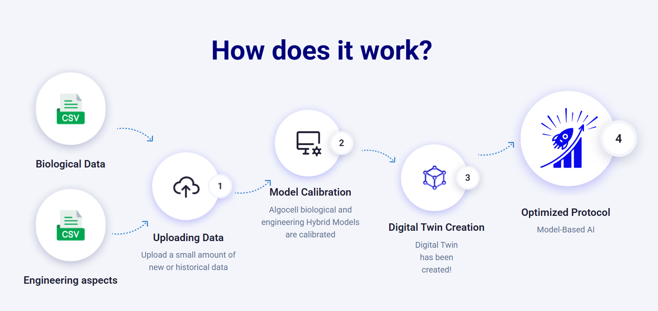
Product Maturity
AlgoCell – https://algocell.ai/
We are optimizing bioprocesses by utilizing hybrid models, digital twins, and advanced AI technologies.
By using our platform, you will have easy access to all of these powerful tools!

Slide 55
Innovator’s Solution – Jobs To Be Done
Customers want solutions – Not products

