Slide 1


SmartUp Academy
Foundations Course Lecture 14
9 out of 10 VC Backed Startups Fail.
Why Fail if You Can Succeed

Slide 2
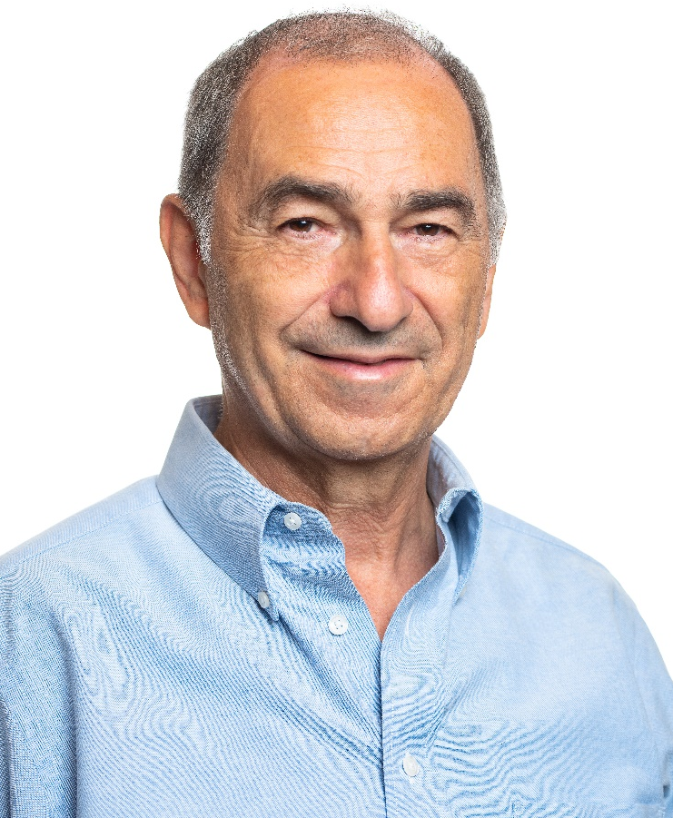
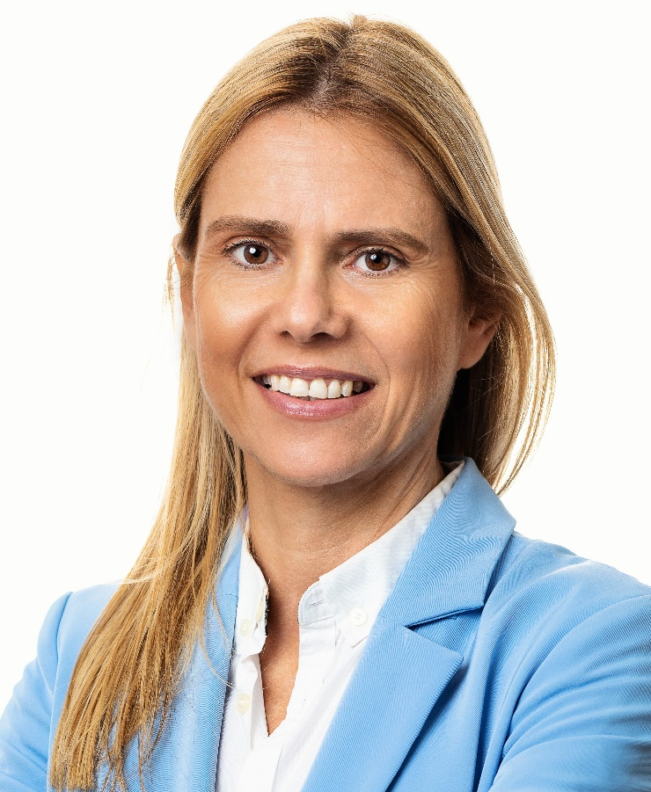
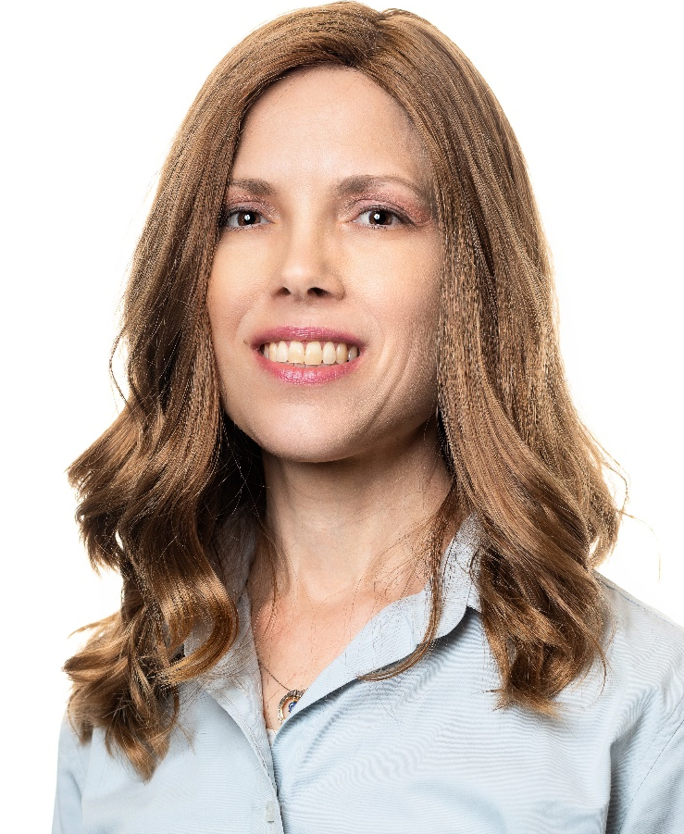

The SmartUp Founding Team
Yonatan Stern
Founder
And CEO
Libby Molad
Co-Founder and COO
Ayala Dinur Turgeman
Co-Founder
and CFO
Libby@smartupacademy.org
Yonatan@smartupacademy.org

Slide 3
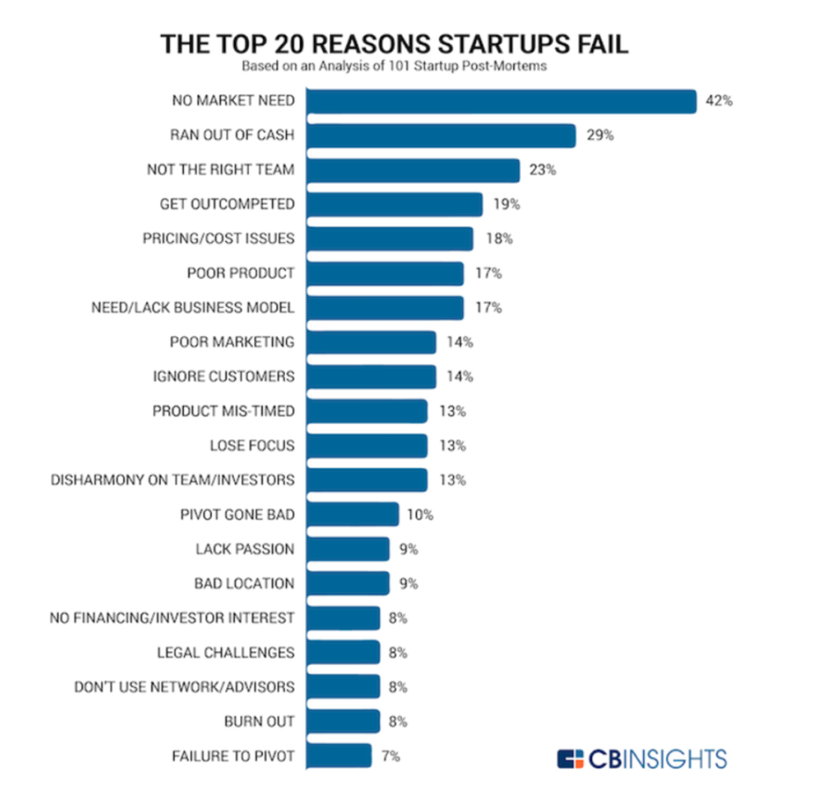
9 Out of 10 Companies Fail
Why do they fail?
Can we significantly increase the success rate?
Surveyed 101 companies, each company gave about 3 reasons
When there are so many answers it means – none of them is the REAL ANSWER

Slide 4
9 Out of 10 Companies Fail
Why do they fail?
VC firms see hundreds of companies every year
Of those they select and invest in 2-4 companies every year, after a long and thorough due diligence
They invest in the top of the top of companies:
Superb teams with extraordinary talent
Huge potential market
A disruptive solution for a big problem
And yet – 9 out of 10 fail

Slide 5
Deeper Analysis of Startup Failures
If 90% of well funded talented teams fail – there must be a root cause for it
The root cause can be summed up in one word – Startup companies don’t have enough TIME to succeed
Building a new company from the ground up is a long process of trials and errors
A process based on many trials and errors takes a long time to mature until it works efficiently

Slide 6
Deeper Analysis of Startup Failures – Need for an Exit
VC investors don’t have time – their business model dictates an Exit in 7 to 10 years to return the money to their investors
In an Exit, shares in the company convert back to money by:
Being acquired (M&A) by another company
Or, preferably an IPO on the NYSE
For a company to go public in a US Stock Exchange it needs to have:
Revenues of $100m and up
Year over year growth rate of 20% or more
Preferably profitable

Slide 7
Need an Exit – Initial Public Offering (IPO)
Very big Exits are usually when companies go public (IPO, Initial Public Offering) in the USA on Nasdaq or NYSE
A reality check of Israeli venture backed companies:
Since year 2000, about 1,000 companies were founded every year. Total of more than 20,000 companies were created
In that period less than 100 companies went public and only 38 companies were valued at more than $100m, of which 24 went public during the hype of 2020-2022
Less than 1 in 500 or less than 0.2%

Slide 8
Need for an Exit – M&A
Companies get acquired for many reasons, most common are:
They are bought for their business success, growing fast and are profitable
They have a unique technology or product the buyer needs
They are in trouble and are a bargain
The buyer actually just wants the team
Many other reasons
Most acquisitions are done without disclosing deal value or structure – Smartup is conducting research on Israeli M&A

Slide 9
Why do Companies Fail? They Run Out of Money
To achieve a meaningful Exit in such a short time, VC firms encourage companies to grow as fast as possible
To support the growth VC firms invest large sums of money and encourage the companies to invest it in:
Large engineering teams to develop the product
A full organization to support growth
Product management and marketing
Why do they run out of MONEY?
Simply because sales don’t ramp up fast enough to cover costs

Slide 10
Time is Money ← → Money is Time
Companies move along two parallel dependent dimensions – TIME and MONEY
They need TIME to develop the product, to figure out marketing and sales, and to grow revenue until it covers costs
They need MONEY to pay for operations until revenues cover expenses and they start generating cash
They raise another round of financing
Or they run out of money and shut down Or they get acquired ….

Slide 11
MONEY is TIME
A company raised $5,000,000, how long will it live?
Assume each employee earns 30,000 shekels per month
Company salary expense with benefits and taxes, add 30% = 39,000 shekels
Salaries are 75% of company wide expenses = 52,000 shekels
Dollar exchange rate $1 = 3.6 shekels
Monthly cost per employee = $14,450
Annual cost per employee = $173,000

Slide 12
Money is Time ←→ TIME is MONEY (raised $5,000,000)

Slide 13
Money can buy Time – but it is not always available
Why not raise a lot of money, but spend just a trickle?
The more money a company raises, the higher the investors’ pressure to invest it faster – Need ROI, a Return On Investment
Raising additional rounds of financing depend on three factors:
Accomplishments of the company to date
Market conditions
Market appeal of the product and the industry
In most cases, additional rounds become harder and harder, and heavily dilute the founders

Slide 14
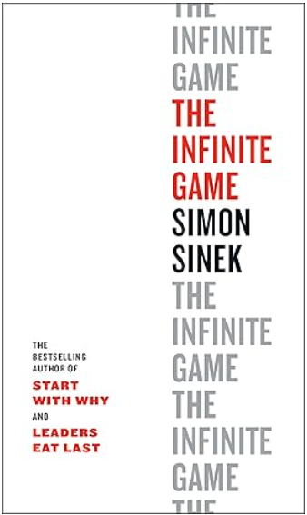
Why Fail if You can Succeed? Here is How
Change the goal of the company from an EXIT finite game, to an Infinite Game
Change the goal of the company from an EXIT To being PROFITABLE as early as possible
Profitability means that every month your sales generate more money than your expenses
Profitability guarantees your company’s survival
Profitable companies stand a much higher chance for a lucrative high-value Exit

Slide 15
Why Fail if You can Succeed?
Changing your goal from a finite game of an Exit to the Infinite Game of Profitability will greatly increase your chances of success
A successful company is defined as:
Profitable
Fast growing
With a modest investment

Slide 16
Impact of Pursuing the Infinite Game of Profitability
The change in company objective from Exit to Profitability will impact EVERYTHING your company does
Focus on sales from day one, keep expenses to absolute minimum
The sequence of activities – Branding first, product development next
The markets you target first – a beach head, and then expand
Jobs To Be Done – What you sell
Better not to be first

Slide 17
Impact of Pursuing the Infinite Game of Profitability
This change in company objective from Exit to Profitability will change EVERYTHING your company does – Continued
The products you develop – incremental vs. disruptive innovation, taking advantage of Enablers
The team you build, who and when you hire
The business model, pricing, packaging, the complete product
The pace your company grows – growth engines, for low cost (CAC) organic growth

Slide 18
Sequence of Activities – Branding First
Virtually all companies start with building their product, assuming they have nothing to sell before at least a prototype
To build a product, you hire a team, and build a fixed and growing expense
Field of Dreams – “If you build it they will come”
You can’t sell if nobody ever heard about you
Developing a product is much easier than selling it
It takes time to educate a market – Start early

Slide 19
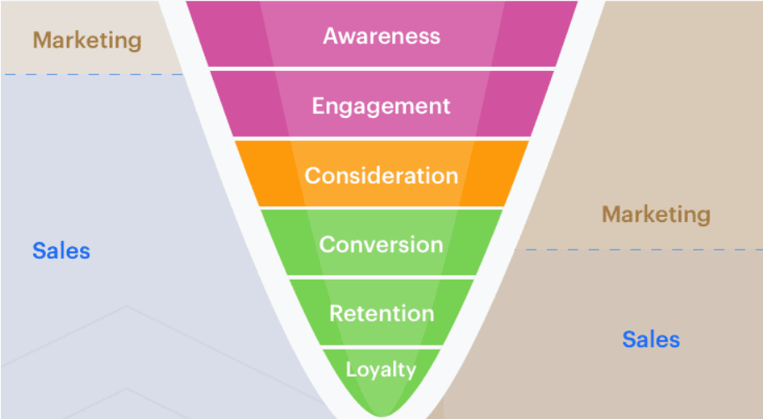
Branding First – Classical Marketing Funnel
Traditional
Sales & Marketing
Internet Based
Sales & Marketing
Branding

Slide 20
Branding First
Instead of building the product, invest the pre-seed, or Friends & Family money, in launching branding activities
Branding Growth Engine – The most important innovation !!
Strong branding will create tangible value in various ways:
Much larger top of the sales funnel – increase sales
Reduce cost of sales (CAC)
Gain deeper understanding of the market
Identify potential early market beach heads, and even additional revenue streams
It will make it easier to raise additional money

Slide 21
The Markets You Target
Every big market is composed of many small market segments that are different from one another
It is much easier to penetrate a “Beach Head”, a small specific segment that responds to your branding
Selling to a small market segment is enough to make your company profitable
It is easier to expand from segment to segment than to attack a big complex market
No need to think of how you address a huge market, start small and focus on profitability

Slide 22
Better Not be the First
Being first is overrated – Innovation is incremental and evolves over time
Let other companies educate the market – it is a very expensive and long process
Google, Facebook, WhatsApp, Amazon, Intel, and most other successful companies were not the first to market
They analyzed their predecessors and improved on their offerings
You don’t need to be first – Strive to be the best
The FULL product – the devil is always in the details

Slide 23

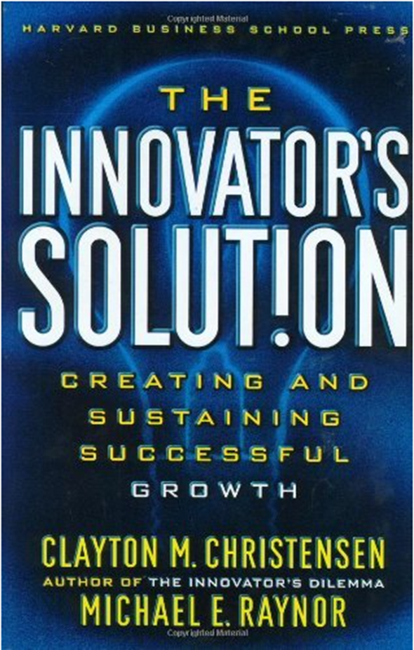
Jobs To Be Done – Clayton Christensen

Slide 24
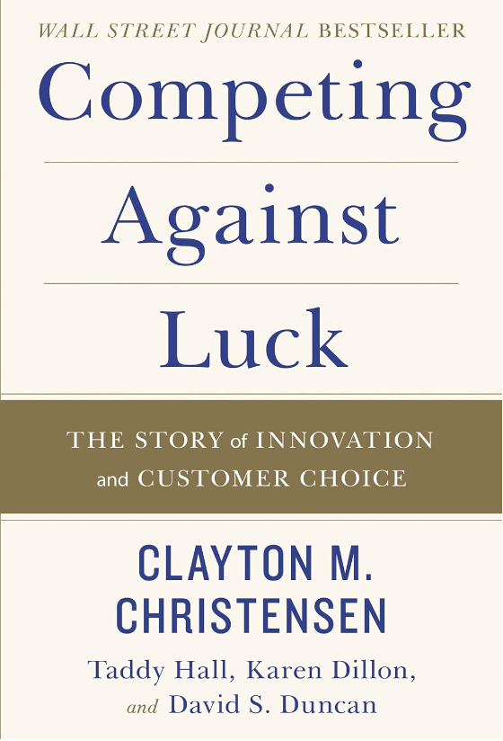
Recommended Reading
After years of research, Christensen and his co-authors have come to one critical conclusion: our long held maxim--that understanding the customer is the crux of innovation--is wrong. Customers don't buy products or services; they "hire" them to do a job. Understanding customers does not drive innovation success, he argues. Understanding customer jobs does. The "Jobs to Be Done" approach can be seen today in some of the world's most respected companies.

Slide 25
Jobs To Be Done (JTBD) – Methodology
What is Jobs-to-be-Done?
Jobs To Be Done (JBTD) theory is based on the idea that people and companies buy products and services to accomplish specific jobs in their lives or business
In most cases they don’t really need the product, they need what the product is supposed to do for them
Instead of focusing on the product or the customer, JTBD shifts the perspective to the job itself
It’s about understanding what customers are trying to achieve and how they go about it

Slide 26
Jobs To Be Done – Market Segmentation
The Jobs To Be Done theory immediately implies that market segments for a product are defined along four dimensions
Functional – what is the specific job customers want to do
Contextual – in what context does the need arise
Emotional – what are the emotional aspects involved in doing the job
Social – what are the social aspects of fulfilling the job

Slide 27
The Products You Develop
Disruptive technology and disruptive products are over rated
Many very successful companies have no disruptive technology, but a disruptive business model
Gett – a cab dispatcher
Pango – a parking meter
Amazon – a maniacal focus on operations
Wolt – a scalable and efficient delivery service

Slide 28
The Products You Develop - Enablers
Enablers – existing things that open the door to great business opportunities
“Jobs To Be Done” can be done more easily by leveraging Enablers in innovative ways
Existing technology enablers:
Smart phones with camera, GPS, mapping apps, internet phone calls,
Video meetings (Zoom), Speech to text, translation,
ChatGPT and other generative AI tools – image and video creation,
3D printers, drones,
The sharing economy – Uber, AirBnB, Cultural norms
Unique international personal ID number → your phone number

Slide 29
The Team You Build - Team Size
It takes time and it is very hard to find, attract and recruit great people – start small and be very selective
Small teams are far more productive and efficient
More people does not mean faster results. It takes time to turn a group of people to a well functioning team
Smart people can be multi-disciplinary. Leverage the people you have before you hire more people
Every person adds overhead – avoid hiring as long as you can
Conclusion - Hire as few people as possible !!!

Slide 30
Team Size – The Laws
Price’s Law
50% of the work is done by the square root of the total number of people who participate in the work (like the 80/20 rule. Pareto rule)
Parkinson's Laws:
Work will expand to fill the time allotted for its completion
In every organization people promote themselves by hiring a team to do their job. When you can’t go up, you build down.

Slide 31
Pricing and Packaging
In B2B, companies are not that sensitive to pricing, especially when there is no comparison
Companies are very sensitive to “Jobs To Be Done”, and to risks, and to ease of use
You want to charge as much as possible – Profitability, while not losing customers. Trial and Error + Art
Different price points dictate different selling strategies
For no-touch sale on the web – Less than $1,000
For sales person engagement – Over $5,00 per customer

Slide 32
Pricing and Packaging
Build the pricing structure so that different customers can pay different prices based on user or value: Seats, Data, Units,
Spell the price monthly, based on annual commitment paid upfront → huge impact on cashflow
Renewals – make sure your product collects valuable historyto insure automatic renewal (CRM…)

Slide 33

SmartUp Academy
A program to teach the profession of building successful companies
The three pillars of a successful company:
Profitable
Fast Growing
Modest Investment
The Foundations Course
14 weeks intensive course
Full materials and registration forms on our site
4-5 years Residency Program

