Slide 1

SmartUp Academy
Foundations Course
Lecture 13
People Challenges
Employees, Customers

Slide 2

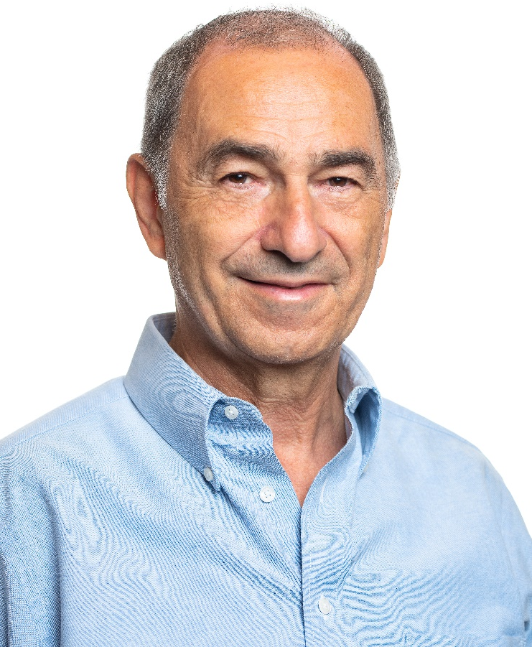
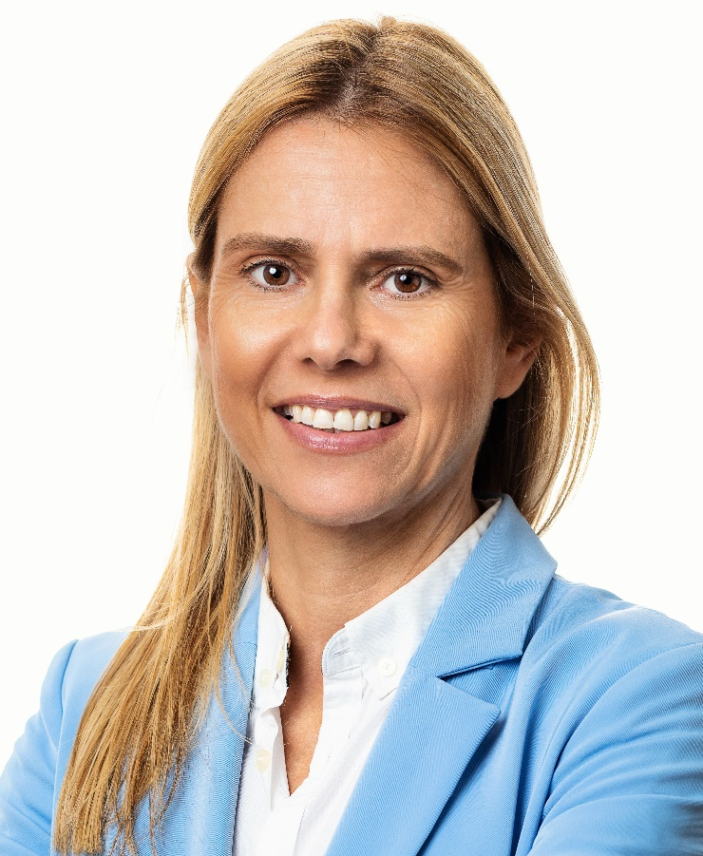
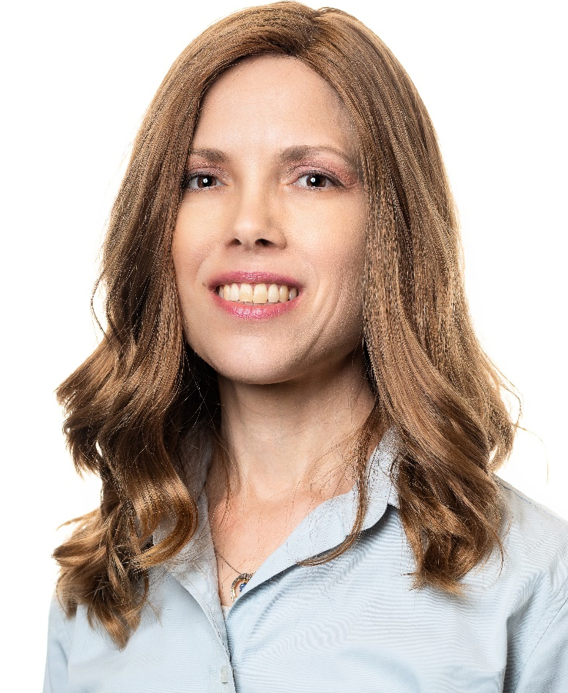
The SmartUp Founding Team
Yonatan Stern
Founder
And CEO
Libby Molad
Co-Founder and COO
Ayala Dinur Turgeman
Co-Founder
and CFO
Libby@smartupacademy.org
Yonatan@smartupacademy.org

Slide 3


SmartUp Academy
A program to teach the engineering profession of building successful companies (…work in progress)
The Foundations Course
  The three pillars for a successful company:
    Profitable
    Fast growing
    Modest investment
Workshops – Specific Subjects
4-5 years Residency Program

Slide 4
People are the most complex part of your job
Lecture Agenda
People are unique – not aware of any reliable assessment tool
Leadership – Personal stories
Leadership – Company personality
Co-Founders
Team size

Slide 5
People are the most complex part of your job
Lecture Agenda - Continued
Hiring criteria, hiring dilemmas and hiring process
Compensation
Morale
Firing and layoffs

Slide 6
People are the most complex part of your job
Business would be so easy if not for the employees and the customers -- People
Your team is the most important asset on the road to success
Building an effective team is a complicated challenge
Your team represents about 70%-80% of your budget
and 100% of your success or failure

Slide 7
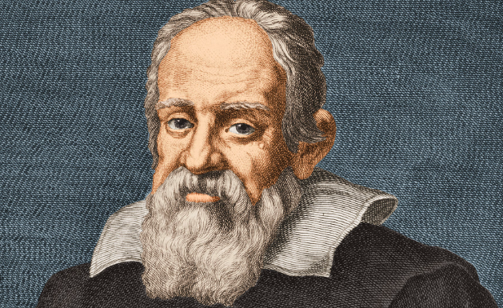
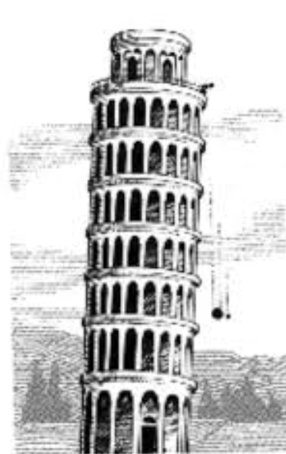
The Language of Business
Moving from Science to Business
“Mathematics is the language in which God has
written the universe !” Galileo Galilei 1564 – 1642
Galileo was the first to write an equation in
physics, and paved the way to Newton
What is the language of business?
Money !!

Slide 8
People – The Other Language of Business
Business would be so easy if not for the employees and the customers -- People
Each person is unique, and in small companies it makes a huge difference
Unfortunately, I am not aware of any reliable way to predict people’s performance in your company
The following discussion is my perspective based on my experience and my personality

Slide 9
Leadership –Personal Stories
ZoomInfo – Founded in 2000, moving back to Israel in 2004
3 Presidents – 3 stories
    Gary H. – President ZoomInfo 2003-2005,
    CEO, Thomson Business Intelligence 1997-2001, NetProspex 2006-2015
    Bryan B. – President ZoomInfo 2006-2008,
    CMO, Monster Inc. 2003-2005, Chief CorpDev ZoomInfo 2008-2010,
    Co-Founder and COO Bizo Inc. 2008-2014, President ClearGov 2017-Present
    Sam Z. – President ZoomInfo 2008-2011,
    CEO BuyerZone 1999-2008, COO CarGurus 2014-Present

Slide 10
Leadership –Personal Stories
CardScan – Founded 1993, Acquired 2006
Steve W. – CardScan, VP of Sales 1995- 1997,
CEO AnyDay.com 1998-2001, acquired by PalmPilot
Lesson Learned:
  People are different in different situations, and their performance can vary dramatically
  Getting fired by Yonatan probably brings luck and a lot of value ☺

Slide 11
Leadership – Company personality
Leadership is personal – Each CEO is unique
Companies have a DNA, created and infused by the personality of the CEO
Mismatch in style and personality is a major reason of why good people with great track record might fail in a different company
What is the DNA and the personality of your company?

Slide 12

Leadership – Company Personality
My company DNA
An Infinite Game – building a great company
Not a Finite Game, not seeking an Exit
This is an important principle, and at the core
of the SmartUp Methodology
A clear “flag on the mountain” – “SmartUp Academy
aims to teach entrepreneurs how to build successful companies: profitable, fast growing, with a modest investment”

Slide 13
Leadership – Company Personality
My company DNA
We seek and appreciate measurable results – not hard work
Transparency – there are no secrets, except for compensation
Decision making – keep it as clear and as simple as possible
Participation – people are smart, everyone has a voice
Recognition – I go out of my way, in every meeting, to attribute ideas and results to the people who deserve it

Slide 14
Leadership – Company Personality
My company DNA
We are here to have fun, we want you to enjoy what you do
NO politics, focus on the job to be done, not on territorial wars
No ego – It is “we”, not “I”
“Not my job” means you don’t have a job anymore

Slide 15
Leadership – Company Personality
My company DNA
We want you to experiment with new ideas – within reason
We hire top notch people and pay average salaries
No bonus plan – we do profit sharing
At the end – we are all people…. ☺ ☹

Slide 16
Leadership – Company Personality
As leaders - It is very important to write, for yourself, in explicit terms, your leadership style and values, what you are good at and what you need help with
Ask your people to help you – what they see from their perspective is different than what you think – we all lie to ourselves
And then… communicate it clearly to your people and use it as guidance when hiring new team members

Slide 17
Co-Founders
Do you have co-founders?
How many co-founders and why?
Why do you have co-founders?
How did you choose your co-founders?
Would you do it again?
My story
An alternative option – Angel investor as a co-founder

Slide 18
Team Size
In the early stages of the company – Terra Incognita, Unknown territory
You need time to experiment, understand, and find your way
Available Time = (money in the bank) / (monthly expense)
Salaries represents about 70%-80% of your monthly expense
Hiring a person is an inflexible long-term expense
Before you hire developers – start a branding, marketing and sales process, and initially do it yourself

Slide 19
Team Size – The Laws
Parkinson's Laws:
Work will expand to fill the time allotted for its completion
In every organization people promote themselves by hiring a team to do their job. When you can’t go up, you build down.
Price’s Law
50% of the work is done by the square root of the total number of people who participate in the work
(like the 80/20 rule. Pareto rule)

Slide 20
Team Size
Small teams are far more productive and efficient
More people does not mean faster results – in many cases it is the opposite
Smart people can be multi-disciplinary. Do you really need a product manager, a UI designer, a UX expert?
The hidden structure – Org chart and official leadership vs. Actual Influencers
Leverage the people you have before you hire more people
Conclusion - Hire as few people as possible !!!

Slide 21
Team Size
Every person adds overhead – avoid hiring even for administrative work
Musical chairs – ignore titles, shift tasks around, give people tasks they enjoy doing
Act swiftly to terminate non-performers and no-matches
You can get specific know-how by paying consultants by the hour, no need to hire full time people
Advisory panel – retired execs are a great source of advice, connections and know-how

Slide 22
Hiring Criteria – Personal Qualities
What are the personal qualities you look for in a candidate?
Do you have a clear and explicit list of qualities?
Do they match the DNA and personality of the company?
I look for three qualities
          Very smart
          Focused on results
          No ego

Slide 23
Hiring Process
Hiring the right people is one of the most complex decisions you have to make
Hiring is a multi dimensional puzzle. Does the person have the right:
      skills and brains
      experience
      personality, attitude – does the person match the company style and DNA
      salary expectations
      Commitment
      More….

Slide 24
Hiring Dilemmas
Who would you hire?
    An experienced person who did the specific job you need, two or three times already, or
    The “up and comer” who didn’t do the specific job, and wants to move up to the next level
The Peter’s Principle - In an organization, every employee tends to rise to his level of incompetence

Slide 25
Hiring Dilemmas
Who would you hire?
    A person with 20 years experience who wants a high salary
    A person with much less experience at a much lower salary
Often, the highly experienced person does not want to do the nitty gritty work and you end up hiring additional people
Many times, you can get a (retired?) experienced person as a consultant by the hour, to share their expertise with the up and comer doers – “How to learn from consultants” idea

Slide 26
Hiring Process
What is your hiring process?
    What is your process for deciding who to bring in for an interview?
    How many interviews, and with whom?
    Do you give a test? What is the test? How much do you trust the test to be predictive for success?
    Do you use an outside service for IQ and personality evaluation?

Slide 27
Hiring Process – Reference Checking
Mistakes in hiring are painful and expensive
Deep and extensive reference checking can eliminate some mistakes
Think about it almost as a “Detective Story”
You start with the references the person gave you and get as much detail as possible about events
You ask the references for additional people and ask about same and additional events
You keep going while correlating the responses, until you get a coherent picture

Slide 28
Compensation
How well do salaries match a person’s performance?
Does a higher salary make a person work harder?
Salary is not a motivator, but it can be a demotivator
Salary comparison, inside and outside the company
The insidious effect of a high salary that does not match performance
Bonus plan pitfalls
Stock Option plan pitfalls

Slide 29
Morale
Morale is high when the company does well. It is low when the company fails
People strive for attention – (not sex - Freud was wrong ☺)
“Employee of the Month” pitfalls
Public recognition pitfalls – The “night on town” idea
Leadership has the highest impact on morale
Frankly sharing problematic issues – keeps morale high
If hard decisions are needed – do them openly and swiftly

Slide 30
Firing and layoffs
Firing is different from a lay-off
Did you fire anybody?
What brings you to fire a person?
Did you ever regret firing a person?
How long does it take to reach a decision to fire a person
Did you ever fire anybody too soon?
The full cost of not acting on time – The cost of a delay is double the money

Slide 31
People are the most complex part of your job
Lecture Agenda – Summary
People are complex and perform differently in different situations
People are unique – Not aware of any reliable assessment tool
Leadership – Personal stories
Leadership – Company personality
Co-Founders
Team size

Slide 32
People are the most complex part of your job
Lecture Agenda - Summary
Hiring criteria, hiring dilemmas and hiring process
Compensation
Morale
Firing and layoffs

Slide 33
Building a Team – The End
Thank you

Slide 36
SmartUp Foundations Course – The team
Leadership is personal – Founder/CEO sets the company DNA
How to make people productive and happy – title vs. jobs
Compensation pitfalls – annual review, bonus structure, stock options, salary fairness, new employee salary vs. salary increase, ”exposed” pay chart, “Employee of the month” vs “Night on town”
Company morale
Paying attention – feedback
Openness, transparency, listening
Official org chart vs. actual influencers
When to fire and how to fire – time is money squared

