Slide 1

SmartUp Academy
Foundations Course
Lecture 11
The Lean Startup, and Market Beachheads

Slide 2




The SmartUp Founding Team
Yonatan Stern
Founder
And CEO
Libby Molad
Co-Founder and COO
Ayala Dinur Turgeman
Co-Founder
and CFO
Libby@smartupacademy.org
Yonatan@smartupacademy.org

Slide 3


SmartUp Academy
A program to teach the engineering profession of building successful companies (…work in progress)
The Foundations Course
The three pillars for a successful company:
Profitable
Fast growing
Modest investment
Workshops – Specific Subjects
4-5 years Residency Program

Slide 4
The Lean Startup, and Market Beach-heads
Review of the main points of the book “The Lean Startup”
Compare them to certain points of the SmartUp methodology
Expand on the concept of Market Beach-heads and Growth Engines and their impact on profitability, fast growth and modest investment
Oded Napchi presents his company Meetaverse, to discuss Beach-heads and Growth Engines
Discuss two other examples –
ZoomInfo market expansion from recruiting to sales
ZoomInfo Company Attributes

Slide 5
The Lean Startup, and Market Beach-heads
Extend the notion of “Market Product Fit” and discuss two options:
Selling a product to “Get the Job Done” or
selling a service to “Get the Job Done”
The subject of our next lecture

Slide 6
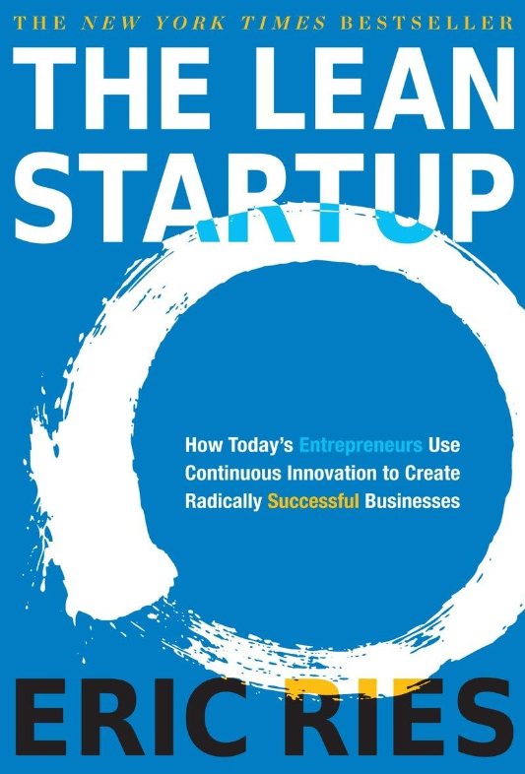

The Lean Startup

Slide 7
The Lean Startup
A highly popular “bible” in the startup community
Focuses mainly on the important task of “Product-Market fit”
What does “Lean” mean in this context
However… the book provides a methodology only for the process of “Product Market Fit”.
It does not provide a methodology for the entire challenge of building a successful new startup

Slide 8
The Lean Startup Method
THE LEAN STARTUP METHOD
Excerpt from the book introduction
This is a book for entrepreneurs and the people who hold them
accountable. The five principles of the Lean Startup, which inform
all three parts of this book, are as follows:
Entrepreneurs are everywhere
Entrepreneurship is management
Validated learning
Build-Measure-Learn cycles
Innovation accounting

Slide 9
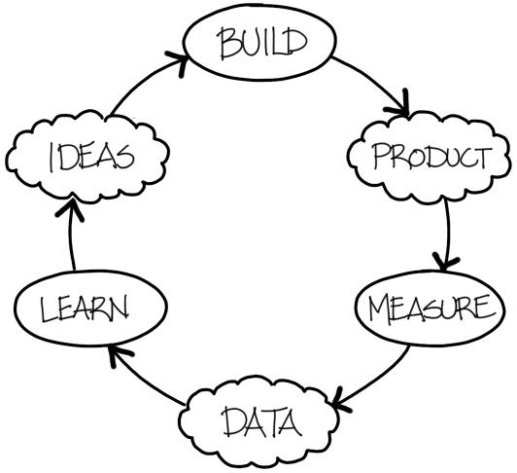
The Lean Startup Method
Excerpt from the book introduction
Build-Measure-Learn
Build-Measure-Learn. The fundamental activity of a startup is to turn ideas into products, measure how customers respond, and then learn whether to pivot or persevere.
All successful startup processes should be geared to accelerate that feedback loop.

Slide 10
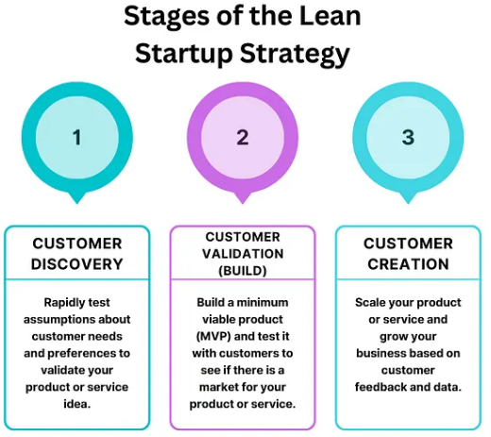
MVP – Minimum Viable Product

Slide 11
SmartUp – Market Beachheads
For every product there are many potential markets, or market segments, that differ from one another in various ways
What feature solves which problem
The importance of the problem being addressed
How well the product addresses the problem
The way the language in which the problem is described or defined
Price sensitivity
How easy or hard it is to create a list of potential prospects
And many more ….
Let’s play some market segmentation games:
x

Slide 12
Restaurant Delivery
What is the difference between 10Bis and Wolt?
10Bis was targeting companies not individuals
Solved the lunch problem in high tech
Daily limits
Delivery limited only to the business
Evolved to a company benefits card
Wolt was targeting individuals
Focused on arrival time
Users pay for delivery
Chat directly with restaurant
Evolved to a full shopping and delivery service

Slide 13

Different market segments for VPN
Ideas?

Slide 14
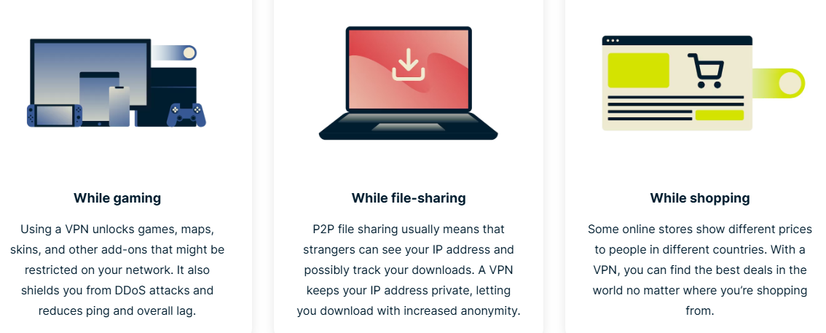
When should I use a VPN?

Slide 15
Fitbit, Dropbox
Fitbit different market segments
People who exercise for fitness and want to track activities
People who exercise for weight loss
People who want or need to track their heartbeat
New feature – connect to a caregiver – alert when something happens
Dropbox different market segments
Automatic instantaneous backup
One place for all your data across many devices
Shared files among team members
Sharing very large files via links
…..

Slide 16
SmartUp – Market Product Fit
The most difficult aspect of building a new company is to find paying customers and to generate sales and income
A logical approach is therefore that the first thing you should do, before building an MVP, is identify market segments that respond to your messaging
But how can you do it without a product ?

Slide 17
How to Discover Your Company’s Beachhead?
Marketing is about telling a story in text, pictures, or video – there is NO NEED FOR a real product yet
Can use Google AdWords, LinkedIn, Facebook, emails, and other available marketing tools
Focus on two things:
The messaging
The responding market segment – the Beachhead
The Dropbox story
Swap from “Product Market Fit” to “Market Product Fit”

Slide 18
SmartUp – Market Product Fit
By first identifying your market beachhead, and by talking to prospects you solve two major challenges at once
You discovered a process and messaging that make potential prospects respond to you
You can develop a product or a service that fit their needs at a price they will pay
And… you can do it at a minimal cost, before spending money on a team and product development

Slide 19
SmartUp Market Beachheads and Growth Engines
Growth Engines – Lecture 7
A Growth Engine is a scalable process that
You can double its Output
With a small increase in Input (efforts and investments)
It is not linear, a small increase in Input can yield a large increase in Output
A Branding Growth Engine is a process, a tool or content, that engages your prospects by
Giving them value !!
At a very low cost to you

Slide 20
Examples of Growth Engines
Facebook and LinkedIn – Provide access to your address book
Zoom Communications – free video conferencing ( & Corona…)
ZoomInfo – published a large directory of people in business
TickChak Live
Opster – content about Elastic’s error log messages
Branding and Marketing Growth Engines lead to:
Profitability
Fast growth
Modest Investment

Slide 21
Meetaverse Presentation – Oded Napchi

Slide 22
Market Beachheads and “Jobs to be Done”
How to accomplish “Jobs to be Done”?
Sell a product to “Get a Job Done” or
Deliver a “Job Done”
Many products are too complex for customers (Salesforce, Wix, accounting software, ….)
A thriving market of consultants and Value Added Resellers (VARs)
Many times it is easier to sell a “Job to be Done” as a service delivering the job done
The service is provided by using internal technology (product) to reduce costs and increase scale

Slide 23
Market Beachheads and “Jobs to be Done”
Much easier to sell the “job done” than to sell a product
In many cases the market for the “job done” is much larger than for a product to “get the job done”
Customers pay for the internal product development and the end-result is a much better product because it is heavily used internally
A great way to identify market beachheads
Intelichain – a product or a solution?

Slide 24
Market Segmentation – ZoomInfo Case Study
Founded in 2000
Started selling in 2001 – Market segments not clear, pricing and packaging not clear
Recruiting market – three broad segments
Internal HR departments
Recruiting agencies – specialize in technical, sales, marketing, etc.
Head hunters
Stumbled upon Fortune 500 group of VP of HR
Expanded to head hunters

Slide 25
Market Segmentation – ZoomInfo Case Study
Sales
2002 – $1.0m
2003 – $3.0m
2004 – $6.5m
2005 – $8.5m
Published the ZoomInfo directory – a huge growth engine
Expanded from head hunters into Sales
Product did not fit the market
Headhunters – looking for a needle in a haystack
Sales people – want the entire haystack, but just 5 fields: name, title, company, phone number, email

Slide 26
Market Segmentation – ZoomInfo Case Study
2010 – 2015 A new set of competitors came to the market.
Predictive sales and marketing platforms, such as: Mintigo, Infer, Lattice, LeadSpace, EverString, and others
Helping companies define their Ideal Customer Profile (ICP) from data in the CRM
All competitors failed, but the problem of identifying ICP is critical and not solved
Additional competition came from a new set of people-information players: Lusha, Apollo, Pipl, and many others

Slide 27
Ideal Customer Profile
Ideal Customer Profile is unique to each company based on what they sell and the packaging and pricing of their product or service
Examples: Who are the ICP for these products
Refrigerated trucks
Patent litigation
Gas chromatography analyzer
Marketing Automation platform
Night vision goggles
Etc. Etc.

Slide 28
Ideal Customer Profile – Company Attributes
Extended ZoomInfo product to include “Company Attributes”
Company attributes is an unlimited list of attributes, or tags, ZoomInfo can attach to any company.
Such as:
Number of sales people
The ratio of software engineers to sales people
The ratio of VP level execs to total number of employees
Sales per employee
Is the CEO a woman
Does the company have a manufacturing facility
Does the company have a warehouse
Is the company using a CRM and which one
And on and on …..

Slide 29
Ideal Customer Profile – Company Attributes
How can it be done?
Number of sales people – ZoomInfo count by title
The ratio of software engineers to sales people – ZI count by title
The ratio of VP level execs to total number of employees - ZI count by title
Sales per employee – Mainly for public companies from SEC filings
Is the CEO a woman – Analyze the name of the CEO
Does the company have a manufacturing facility – Titles, Job postings, can provide geography as well
Does the company have a warehouse – Title, job postings
Is the company using a CRM and which one – Title, job posting, website hooks
And on and on …..

Slide 30
Ideal Customer Profile – Job to be Done
An open opportunity….
Probably better done as a service
Can easily be extended to vertical markets – specific lists of ICPs to specific market segments
For example:
A list of all companies that have truck fleets of more than 5 trucks
A list of all companies that have chemical analysis labs
A list of all companies that have more than 10 software engineers

Slide 31
Do we have more time?

