Slide 1

SmartUp Academy
Foundations Course
Lecture 10
Why startups fail,
and How to Build a Successful Startup

Slide 2

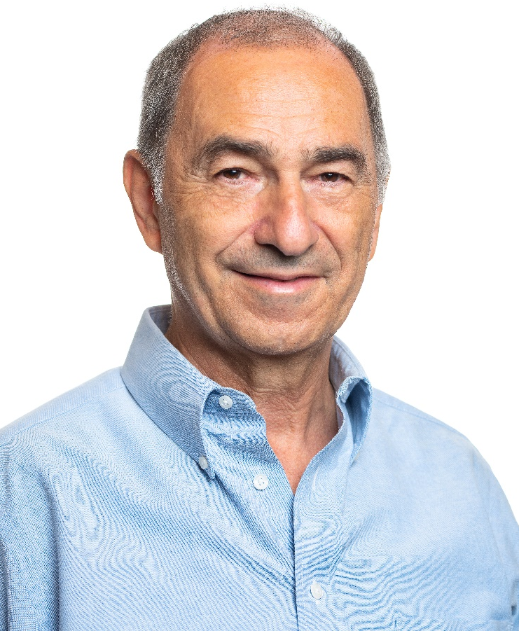
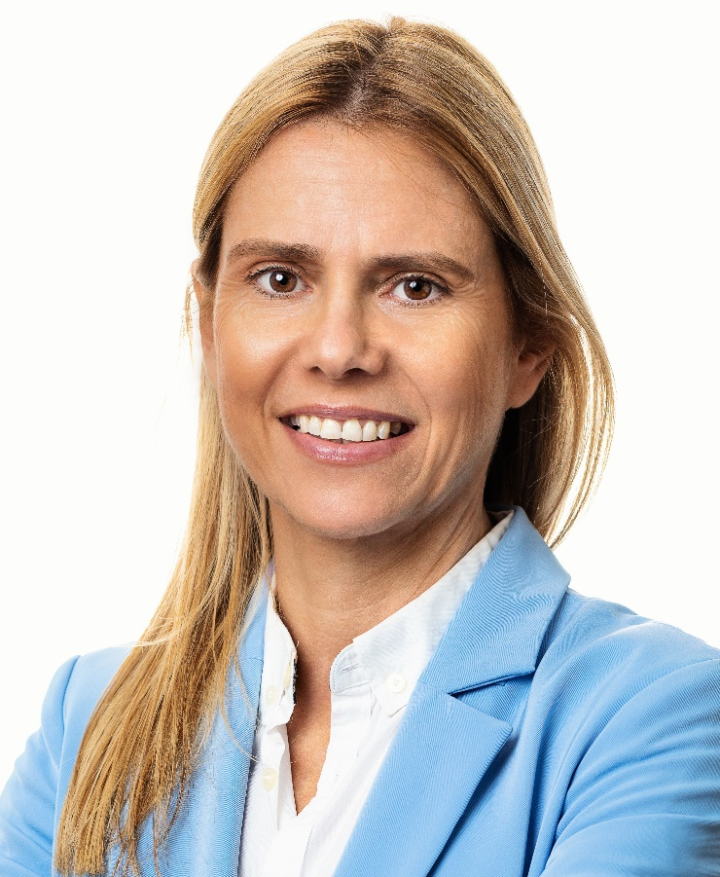

The SmartUp Founding Team
Yonatan Stern
Founder
And CEO
Libby Molad
Co-Founder and COO
Ayala Dinur Turgeman
Co-Founder
and CFO
Libby@smartupacademy.org
Yonatan@smartupacademy.org

Slide 3


SmartUp Academy
A program to teach the profession of building successful companies (…work in progress)
The Foundations Course
The three pillars for a successful company:
Profitable
Fast growing
Modest investment
Workshops – Specific Subjects
4-5 years Residency Program

Slide 4
Why Startups Fail & and How to Build a Successful One
Follow the life of a typical first-time entrepreneur and his co-founder
Follow the process of fund raising from angel investors and Venture Capital firms
Explain the ecosystem of venture capital and its impact on companies
Explain the mathematics of fund raising and dilutions
The tightrope walk of not yet profitable, Venture Backed startups, and why 9 out of 10 fail

Slide 5
Why Startups Fail & and How to Build a Successful One
Analysis of the case study
The SmartUp way and how to avoid the pitfalls described above
Why founders who follow the SmartUp methodology have a
Higher probability that their startup will enjoy long term success
Higher share of the company and a much higher payoff
Ask Questions

Slide 6
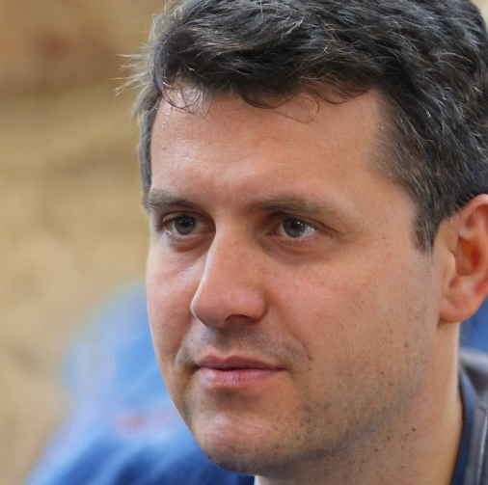
How to Build a Startup?
Meet Joe –
Joe is a top-notch engineer with a great disruptive idea:
Online mental health services – matching providers with people who need help
Joe has already quit his day job
He has enough savings to live for 6 months without a salary
And arranged $20,000 - $50,000 to invest in his idea (his own savings and some from friends & family)

Slide 7
First-Time Founders - Typical Order of Activities
What would Joe do now?
Joe is lost
He has a clear vision of how his app should look and function
He wants to raise money to hire a team and develop the product
doesn’t know how to raise money
needs help
Joe looks for a co-founder to: Why do you want a co-founder?
Provide companionship, emotional support, risk sharing
Complement his skills, knowhow, and experience
Venture Capital firms want a team, not a lone founder

Slide 8


Co-Founder
How to choose a co-founder?
Usually from a small, random, circle of acquaintances
Joe met Julie, his neighbor’s college roommate
She has an MBA from Harvard, and was VP Sales at a startup company that failed (9 out of 10)
Julie, as co-founder, gets 50% of the equity
Joe now owns 50% of the company
is born (Namelix)

Slide 9

New Startup – Typical Order of Activities
Now, as a team, its time to raise money !!
Preparations for fund raising – a Pitch Deck
As Julie knows, a typical pitch deck looks like that:
The problem the company targets – Mental health care
A disruptive solution – Online service, more accessible, more affordable
Potential market size – MUST be at least $1 billion, preferably bigger. Taken from some market research
Competition
The team
Financial models – they always look like this (Hockey Stick)

Slide 10
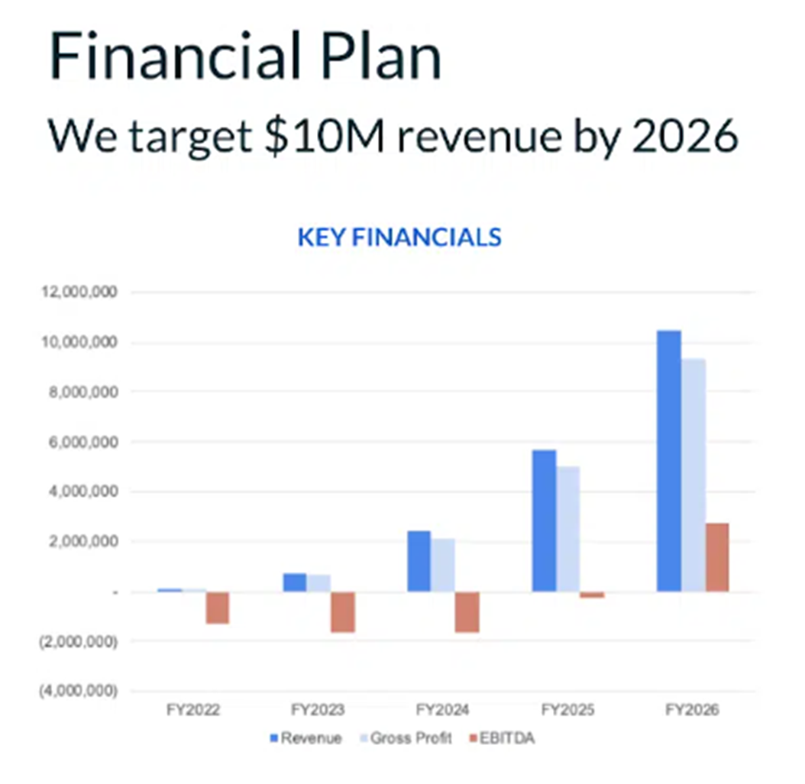

Slide 11
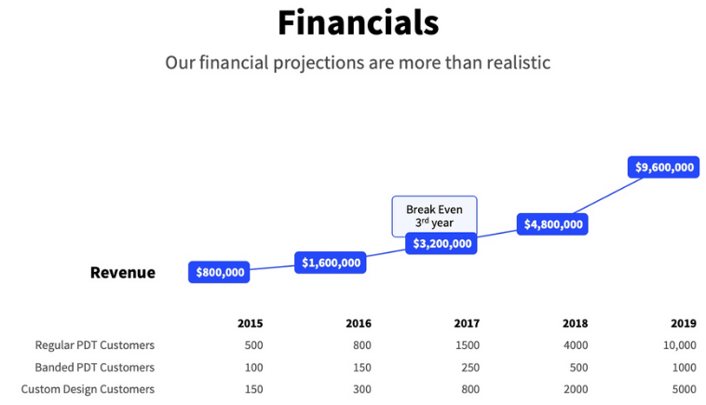

Slide 12
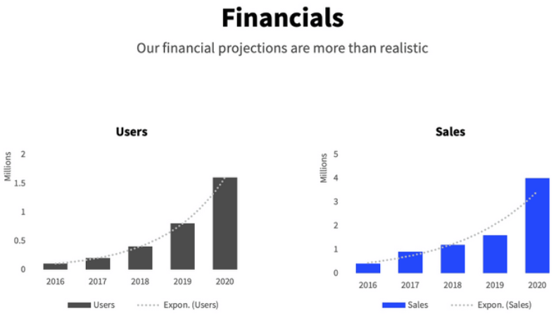

Slide 13
New Startup – Typical Order of Activities
Preparations for fund raising – Pitch Deck
The problem we target
Our disruptive solution
Potential market size – MUST be at least $1 billion, preferably bigger. Taken from some market research
Financial models – they always look like this
Success ☺
After 6 months, raised $1m in a seed round
For 20% of the equity
Joe now owns 40% of the company

Slide 14
Typical Order of Activities – Product Development
Hired a team
2 founders – Joe and Julie
5 engineers
2 licensed psychologists
Product Manager
Office manager
Rented an office
Expenses reach $100,000 / month
Money in the bank will last less than a year
Julie and Joe start working on a Round A effort, this time from Venture Capital firms

Slide 15
When Can a company Raise Money?
Good times to raise money
Concept stage – a good team with an interesting disruptive idea
Proof of concept accomplished – working prototype or product
Early traction – Showing interest of several beta users
Product Launch – Product is ready and has several customers
Scaling Stage – Proven selling process, ready to scale, need funding to scale

Slide 16
When is it Hard to Raise Money?
Hard times to raise money
Death zones in between the milestones in the previous slide:
Development phase – from concept stage to a working proof of concept, or better yet, working product
From working proof of concept or product to beta users’ validation
From beta users to early paying customers
From first customers to a working sales process
From sales to a proven growth trajectory (no flat sales)

Slide 17
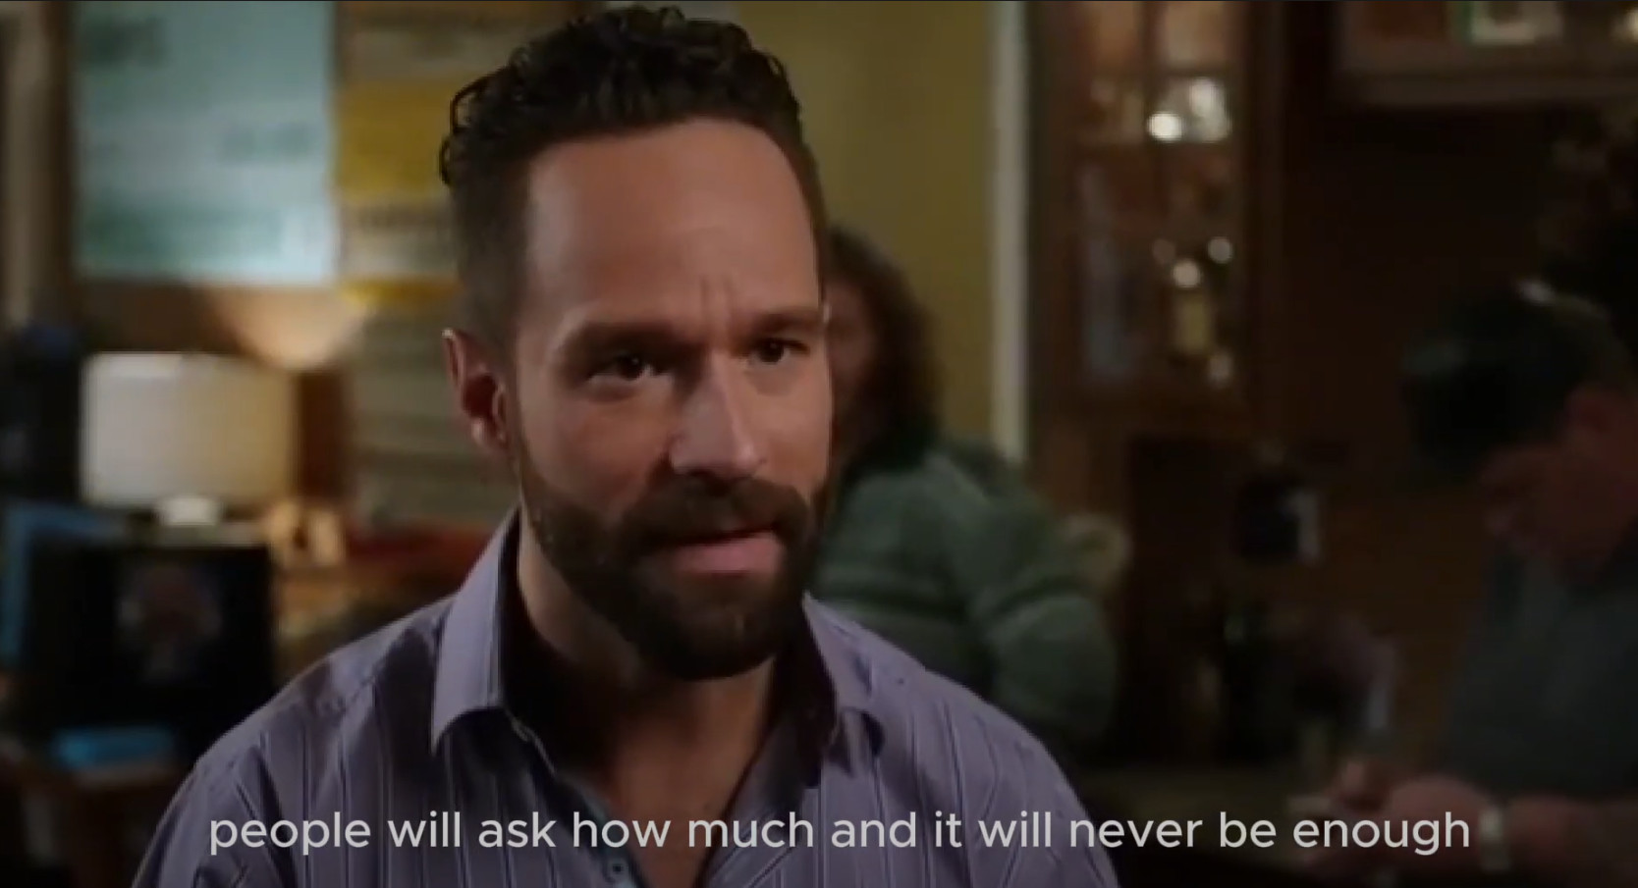
“No Revenue” Clip
https://drive.google.com/file/d/1hmBUGk-Zwv8cMxuJWuHiMuhlrAthehEd/view?usp=sharing
https://drive.google.com/file/d/1hmBUGk-Zwv8cMxuJWuHiMuhlrAthehEd/view?usp=sharing

Slide 18
Venture Capital Historical Market Cycles
Cold Periods (Difficult to raise money)
for the period 2000 to 2024:
2000-2003: Post dot-com crash
2008-2010: Financial crisis impact
2016-2017: Brief cooling period
Late 2021-2023: Significant pullback
About 12 years, or half the 24 year period

Slide 19
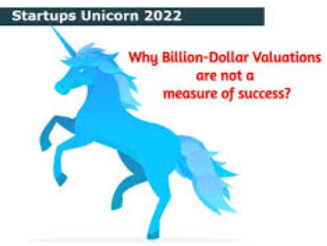
Venture Capital Historical Market Cycles
Hot Periods (Easier to raise money) from 2000 to 2024:
2004-2007: Web 2.0 boom
2011-2015: Mobile/social media wave
2018-2021: Particularly intense period with peak in 2021
- Record valuations and deal sizes
- Growth of mega-rounds ($100M+)
- Rapid deal closings with less due diligence

Slide 20
Venture Capital Historical Market Focus
2000-2010:
Enterprise software
Clean tech (especially 2006-2008)
Early social media
Mobile infrastructure (3G, iPhone)
2011-2020:
Consumer mobile apps (iPhone, Android)
SaaS/Cloud services
Fintech
AI / ML (Machine Learning) (especially 2016 onward)
Digital health
E-commerce

Slide 21
Venture Capital Historical Market Focus
2020-2023:
Remote work tools
Digital health
Crypto/blockchain (until late 2022)
Enterprise AI
Climate tech
Consistently Challenging Sectors:
Hardware (except during specific trends like IoT, AI chips)
Capital-intensive manufacturing
Traditional retail
Non-tech enabled services
Deep tech with long development cycles

Slide 22
The Challenge of Raising Money from VC
If a company is not profitable it needs to continually raise money
Ability to continue to raise fresh money depends on at least 4 elements:
The company’s stage (death zone?)
The company’s internal situation (burn rate, relationship with the board, relationships among founders,….)
Venture Capital industry market cycle point (hot or cold)
Venture Capital industry market focus
If you can raise money – raise as much as possible !!!

Slide 23
First-Time Founder – Order of Activities
Joe and Julie raised $1m seed round, have a small team, they are in product development stage, working on a proof of concept
Expenses are about $100,000 a month, need to raise money from Venture Capital
Success !!!! Bingo !!! Raised $5m from High Flying Ventures (HFV), at a pre-money valuation of $10m
Round dilutes founders by 33%, Joe now owns 26.67%
High Flying Ventures want to accelerate company growth and push Joe and Julie to ramp up

Slide 24
First-Time Founder - Order of Activities
The team grows to 20 people, expenses grow to $350,000 a month, and within a year they have a product in beta
But… money in the bank is down to $1m, time to raise money again to launch sales and marketing
Good time to raise money, product is ready, it demos well, is in beta with 10 providers who like it, good inflection point
The VC market is hot
Success !!!! Bingo !!! Raised $15m in round B from 3 new venture funds, at a pre-money valuation of $15m
Round dilutes founders by 50%, Joe now owns 13.33%

Slide 25

First-Time Founder – Scaling Up Fast
Julie starts hiring many people in marketing, sales, customer success, operations, …..
The team grows to 50 people in just a few months
Everyone is busy with hiring, interviews, meetings, getting to know one another, setting up processes, meetings, meetings,
The office is in a buzz of activity
Expenses grow to $750,000 per month ….
And Joe notices that the new team is busy, but no results are coming out

Slide 26

First-Time Founder – Clouds and Stress
He argues with Julie, because they fall behind their plan and the promise to the board to sign up 1,000 service providers
They also have a hard time finding paying clients for the service providers they have signed up
Tensions grow
Julie launches expensive campaigns to sign up mental health providers and paying clients – insufficient results
Tensions grow between Joe and Julie, the board gets involved
Julie is asked to leave

Slide 27
First-Time Founder – Stress and Panic
Linda, the Director of Marketing, is asked to take over sales and marketing, and to reduce expenses – letting go of 15 people in the team
Expenses go down to $600,000 a month, but there is only $5m left in the bank, about 9 months of operation
Morale spirals down, some key people leave
Theriva is getting ready to raise another round
But…. Without a working business model
And a VC cold period
It is getting hard to raise any money

Slide 28
Theriva – Ray of Hope
A new VC investor, Ray of Hope Ventures, is found but…. at the following terms:
Theriva will raise $10m
$5m will come from Ray of Hope, and $5m will come from the existing investors
The pre-money valuation will be $10m (Down round. Post money valuation of last round was $30m)
The investment will be done as Participating Preferred
The company will hire a new CEO to lead a turn around or a pivot
The round dilutes Joe by 50%, Joe now owns 6.67%

Slide 29
Fund Raising Dilution Impact
Terms, and simple equations
Up round – when the new financing round is done at a Pre-money valuation that is higher than the previous round
Down round – when the new financing round is done at a Pre-money valuation that is lower than the previous round
Common Stock – the type of shares founders get
Preferred Shares – the type of shares investors get – vary from deal to deal, contain protections and usually also precedence to funds
Participating Preferred – Investors take their investment out before everybody else, and then participate with all the share holders

Slide 30
Fund Raising Dilution Impact
Terms, and simple equations
Pre-money Valuation = The value of the company before the investment (money) is invested (example: $10m)
Investment = The amount of money invested (Example: $5m)
Post-money Valuation = Pre-money Valuation + Investment Example: $15m = $10m + $5m
Dilution = percent the new investor now owns = Investment / Post-Money. Example: Dilution = 33.33% = $5m / $15m
Our founder raised $1m Seed round and was diluted by 20% What was the Pre-money valuation?

Slide 31
Fund Raising Dilution Impact

Slide 32
Fund Raising Dilution Impact

Slide 33
Fund Raising Dilution Impact

Slide 34
Fund Raising Dilution Impact

Slide 35
Theriva – Sunshine
The new CEO is an experienced entrepreneur and a success
Made a pivot from signing up individual clients to selling mental health services to large companies as a benefit to employees
In about 2 years he is able to enter an M&A transaction and sell the company for $25m
How much money did Joe make?
How much money did Ray of Hope make?
Did the angel investor make money? The other investors?

Slide 36
Who Gets What at the M&A Transaction

Slide 37
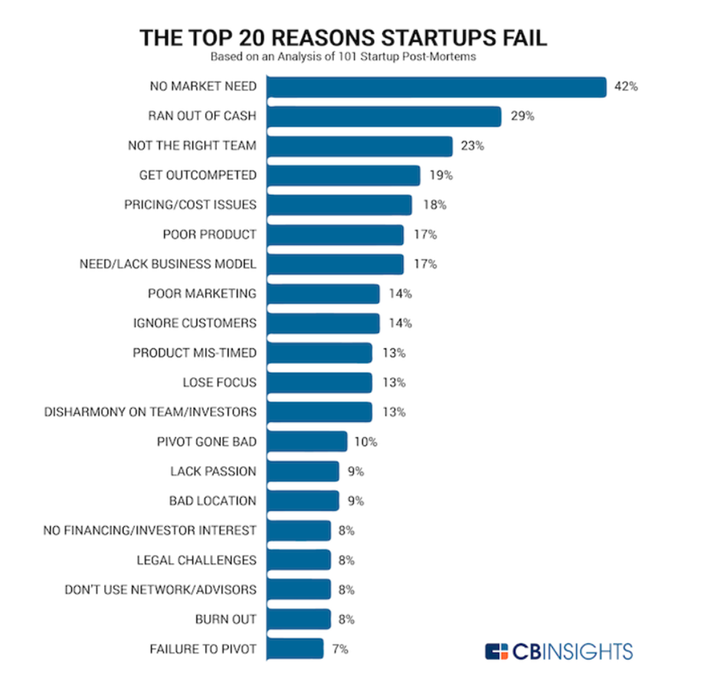

Why Companies fail?
9 out of 10 VC backed startup companies fail. Here is why
Ran out of cash = 29% but in reality, it is close to 100%
No sales = No market need + Get outcompeted = 61%
Not the right team + Disharmony of team = 43%

Slide 38
Why Do 9 out of 10 Startup Companies Fail?
Typical order of activities:
Idea
Find co-founder(s)
Try to build a prototype, or proof of concept
Write a pitchbook
Raise money – usually at least a few hundred thousand dollars, preferably more
Hire a team and proceed with building the product
Team = rigid monthly expense
If sophisticated – Lean Startup (show book)
Vicious spiraling cycle of raising money while growing expenses and burn rate

Slide 39
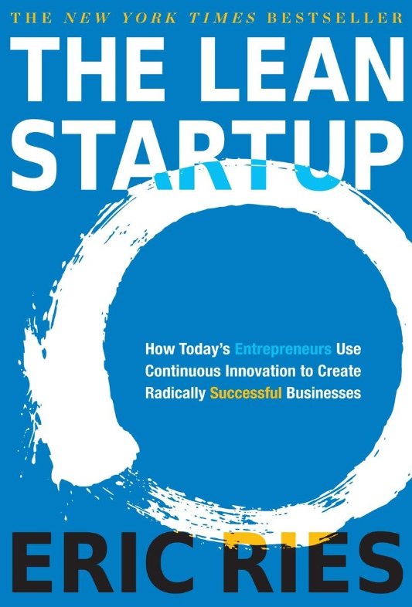

The Lean Startup

Slide 40
Why Do 9 Out of 10 Startup Companies Fail?
The critical transition is from product development to sustainably growing sales – Growth Engines !!
The Business Model is the Product
Every month of delay in sales costs hundreds of thousands of dollars – putting the company in grave danger
Sales are complex and unpredictable
Invert the order – Start with sales !!!

Slide 41
How to Build a Smartup?
Meet Joe –
Joe is a top-notch engineer with a great disruptive idea:
Online mental health services – matching providers with people who need help
Joe already quit his day job
He has enough savings to live for 6 months without a salary
And arranged $20,000 - $50,000 to invest in his idea (his own savings and some from friends & family)

Slide 42
First-Time Founders - SmartUp Order of Activities
What would Joe do now?
Joe is lost
He has a clear vision how his app should look and function
He wants to raise money to hire a team and develop the product
doesn’t know how to raise money
needs help
Joe looks for a co-founder to: Joe joins SmartUp
SmartUp asks Joe, the engineer, to sell his concept to see for himself if and how he can make money.

Slide 43
First-Time Founders - SmartUp Order of Activities
Joe needs to talk to two groups
Service providers – Mental health professionals
Clients – people who want help
Service Providers
Joe asks friends to make intros and also just calls psychologists and social workers
It seems many providers prefer the face-to-face traditional approach
They are also worried about an online platform where they look like selling themselves, which is against their tradition
They insist on keeping their face-to-face rates even for online sessions – The price advantage disappears

Slide 44
First-Time Founders - SmartUp Order of Activities
Clients
Clients prefer to meet a provider who is recommended by a friend or family
Clients like the concept, but only if the price is significantly lower than face-to-face meetings
Follow the money – if there is demand there will be supply
Joe focuses on understanding what clients want
When talking to friends he realizes that some are “connectors”
A new direction to explore – the venerable “Pivot”

Slide 45
First-Time Founders - SmartUp Order of Activities
BeBuddy idea is born
Debated different beachhead ideas for clients
Libby tested these beachhead ideas using Facebook ads to different Facebook groups
Ran several campaigns and got about 100 people to fill out a survey
Talked in person to a few dozen of them
Spent $2,500 on the campaign
…. Libby became busier with SmartUp ☺

Slide 46
The SmartUp way
First and foremost, try to “sell” your product (idea) to (potentially) paying prospects
Reach these prospects through systematic marketing processes (Extending The Lean Startup concept also to marketing)
A CEO that is not focused on sales from day 1 is not a CEO

Slide 47
The SmartUp way
Use tools like Figma or Generative AI to demonstrate the “product”
Prepare a list of prospects – use Apollo, ZoomInfo, LinkedIn, and other lists --- creating the queries will teach you a lot
Try to reach out to them – email, phone, LinkedIn connections LinkedIn ads, Google AdWords, Reddit, Facebook groups, Facebook ads, …..
For very short money you will learn three very important things
What specific messages certain prospects respond to
Which market beachheads responds to these messages and why
How to reach out to them – top of the sales funnel

Slide 48
The SmartUp way – Branding and Marketing
Branding is a process that makes a change in the minds of people – at the minimum they now know your name
Marketing is a process to slightly change the behavior of people – to respond to some “call to action” At the minimum they now open your email, click on your ad or set up a meeting
Start thinking about how to create a brand for your company – focus on the problem you try to solve, not on the solution

Slide 49
The SmartUp way – Business model
A business model is a critical element that can make or break your company
It involves answering the following questions (and more)
Who are your customers
Packaging - What exactly do you sell them
Software
Solution
Consulting
Other? (i.e. energy companies…)
Pricing, of different elements of your packaging
To be discussed in a future lecture

Slide 50
The SmartUp Way – Invert the Order of Activities
Most importantly – Do all the above before you spend money on product development
Instead of looking for a co-founder play the sales game and get instant feedback – it is priceless
Use what you learned about the sales funnel, packaging and price points to build a more realistic sales model
It will be much easier to raise money with a business model backed by the results of your research

Slide 51
Why Startups Fail & and How to Build a Successful One
Follow the life of a typical first-time entrepreneur and his co-founder
Follow the process of fund raising from angel investors and Venture Capital firms
Explain the ecosystem of venture capital and its impact on companies
Explain the mathematics of fund raising and dilutions
The tightrope walk of Venture backed, not profitable, companies and why 9 out of 10 fail

Slide 52
Why Startups Fail & and How to Build a Successful One
Why 9 out of 10 VC backed startup companies fail
Analysis of the case study
The SmartUp way
Questions ?
Thank You

Slide 60
‘Organic’ startup ideas
Most great startup ideas are the result of a founder being unable to find a good solution to their own pain.
In the words of Paul Graham:
“At Y Combinator we call ideas that grow naturally out of the founders’ own experiences – ‘organic’ startup ideas. The most successful startups almost all begin this way.”

