Slide 1

SmartUp Academy
Foundations Course
Lecture 9
Sales

Slide 2

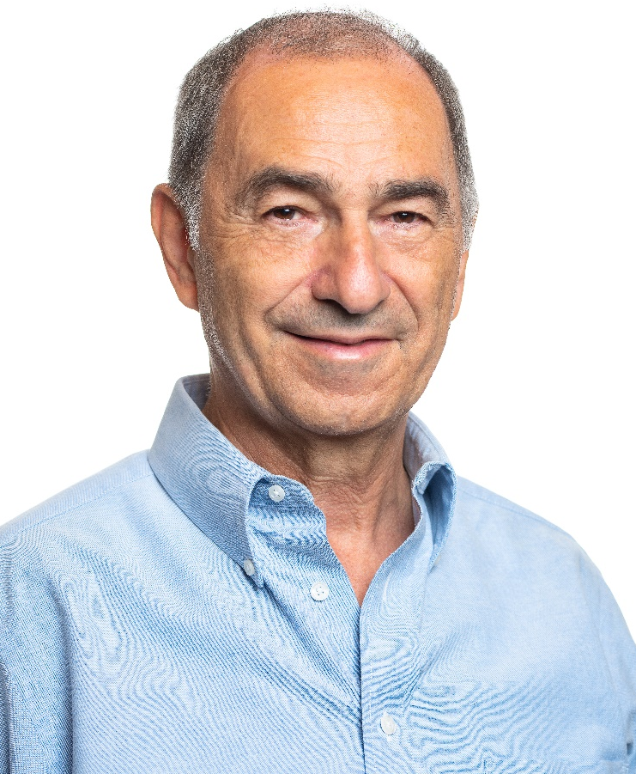
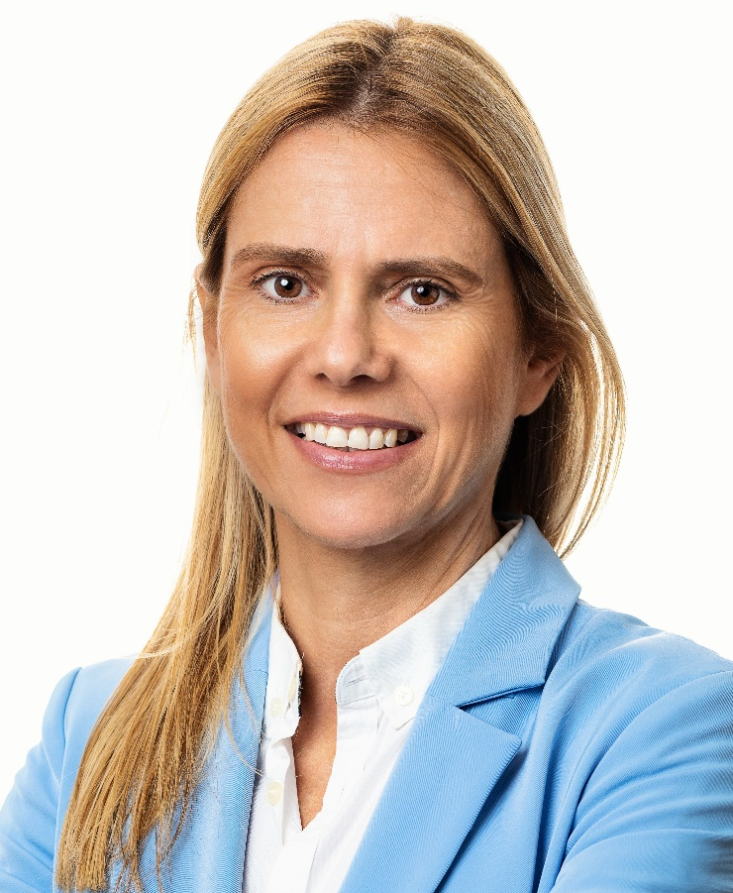

The SmartUp Founding Team
Yonatan Stern
Founder
And CEO
Libby Molad
Co-Founder and COO
Ayala Dinur Turgeman
Co-Founder
and CFO
Libby@smartupacademy.org
Yonatan@smartupacademy.org

Slide 3


SmartUp Academy
A program to teach the profession of building successful companies (…work in progress)
The Foundations Course
The three pillars for a successful company:
Profitable
Fast growing
Modest investment
Workshops – Specific Subjects
4-5 years Residency Program

Slide 4
Foundation Course – Sales
Direct Sales
eCommerce
Sales people
Sales Channels
Retailers
Resellers
Distributors
Partners
Demand generation
Sales Strategy – eCommerce or Sales People?

Slide 5
Foundation Course – Sales
Sales Strategy and Pricing
Price elasticity in consumer products (B2C)
Price elasticity in business products (B2B)
B2B Sales – Who is the customer? Business wise
B2B sales complexities – Two dimensional
Marketing Funnel
Sales Cycle

Slide 6
Foundation Course – Sales
Sales Cycle elements
Sales Cycle complexities
InteliChain case study
B2B Pricing
The value of a lead
Lead processing
International sales
B2B Sales Cycle time and cost
Major take aways

Slide 7

The Biggest Asset of a Company
What is the biggest asset of a company?
Technology ?
People ?
Products ?
Patents ?
Brand ?
CUSTOMERS and USERS

Slide 8
The Biggest Asset – CUSTOMERS and USERS
LinkedIn (Reid Hoffman – PayPal, 2003 – 2016, Microsoft)
433m users
$26B, acquisition value
$60/user
WhatsApp (2009 – 2014, 55 employees, Facebook)
420m users,
$19B, acquisition value
$45/user
Waze (2008 – 2013, Google)
50m users,
$1.1B, acquisition value
$22/user

Slide 9
The Biggest Asset – CUSTOMERS and USERS
Why are these high valuations for each user?
Because it is VERY HARD to get customers and users
What is the difference between Customers and Users?
Users are the people using the product (Google search, Facebook, WhatsApp, Waze, LinkedIn, Instagram, …)
Customers are those who pay money for something:
Advertising to users (Google AdWords, Meta Ads, …)
Upgrade free users to paying business customers (Zoom.us, LinkedIn Sales Navigator, WhatsApp for Business, Slack…. )
Other (Waze? ... )

Slide 10
Sales – Path to Customers
In most situations the customers and the users are the same, → or at least work for the same organization
Demand Generation processes
Demand Generation is always the responsibility of the company that created the product or service
Channels never create demand, they fulfill demand created by the company
Branding first

Slide 11
Path to Customers - Sales Channels
Direct sales
eCommerce on the company website. No touch
Sales people
Outreach – cold calling
Inbound – responding to leads
Indirect sales
Retailers (CardScan AA ads cycle, Paul Olean.... ), eTailers,
Resellers – [International] (Story of Monster…. ),
Distributors – [International]
Partners – [International] (PaperPort (click) ,)

Slide 12
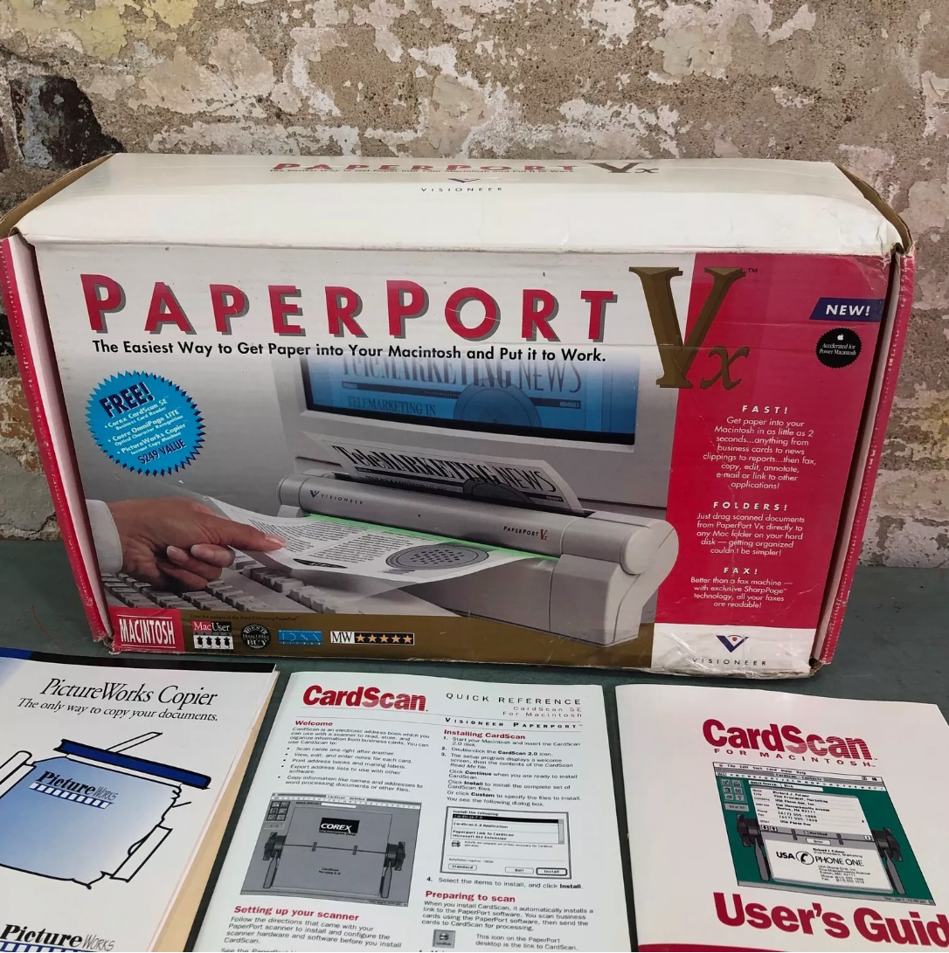
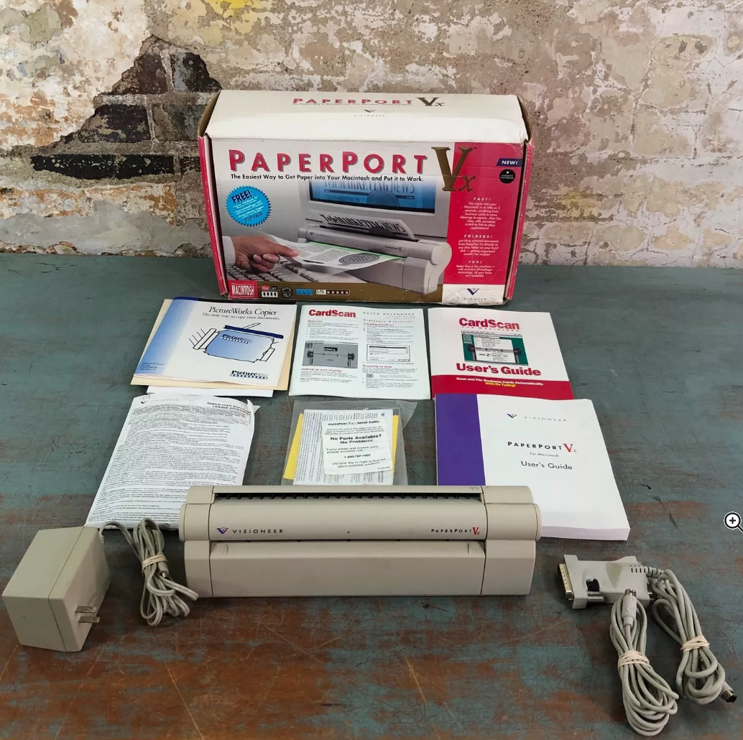
Visioneer PaperPort

Slide 13
Company Biggest Asset – Its Customers
It is critical for a company to OWN its customers directly, in B2B the purchase agreement should be with the company
Customers should have direct relationships with the company
Customer service and customer support are assets – not liabilities. If customers complain – fix it !!
A company should focus on:
A strong brand – Branding First
Demand generation – Growth Engines
Delighted customers

Slide 14
Which Sales Strategy to Choose?
Sales people or eCommerce?
Depends on:
Type of customers, and price of the product
Consumer (B2C)
Business (B2B)
Can be both (Zoom.us , LinkedIn, Slack, ….)
B2C Consumer product sales are usually at low prices – maximum a few hundred dollars (Exceptions – cars, houses, college education - payment spread)
Outbound sales are rare – usually consumers initiate the purchase
B2B sales are usually at much higher prices – a few thousand dollars and up.

Slide 15
eCommerce vs. Sales People
eCommerce
Product should be self explanatory, easy to understand
Low price, up to about $1,000
Totally dependent on a relatively strong brand
Totally dependent on effective demand generation campaigns
Works 24/7
Very efficient – low sales cost, no salaries
Fixed prices

Slide 16
eCommerce vs. Sales People
Sales people
Almost a must when the product is new and complex
Price must be high – at least $5,000 per deal if there is a good lead flow, otherwise – higher !! A salesperson wants to make $100,000 a year, needs to sell at least $500,000. Hard to achieve with small deals
The economics work only for larger deals
Easier to start than eCommerce – can penetrate the market just by systematic hard work. Cold calls, BDRs
Easier to reach profitability because of deal sizes

Slide 17
eCommerce + Sales People
Hard to combine eCommerce with Sales People
The ZoomInfo story
Sequence of activities – sales people block the process
Product differentiation – quantity is not enough
Pricing mismatch
Successful models – First Free (Zoom.us, Slack, Apollo), or first eCommerce (SalesForce, Zoho, HubSpot)
Then sales people call active companies for corporate deals
Corporate solutions are better differentiated
The problem – it takes longer to make money

Slide 18
Price Elasticity – Consumer Pricing (B2C)
Price depends on product and market positioning
Price elasticity ? How about ZERO ?
No barrier for use (Google, Facebook, TikTok, Zoom, LinkedIn, Waze, WhatsApp, ….)
But how do you make money?
Advertising – Google, Facebook, TikTok. Need huge scale
Business features – Zoom.us, LinkedIn, Slack, WhatsApp (delayed)
Waze - ??
Advertising model at small scale – Magazine model, focusing on a small specialty domain

Slide 19
Price Elasticity – Consumer Pricing (B2C)
Price points for consumer products
What is the difference in demand between
$19.95
$29.95
$39.95
The difference in value is that the company needs half the customers to generate same income
Need to test and calculate the curve of income (number of deals) x (price) for the various price points
Common wisdom (psychological) price points
Single digit - $9.95
Starts with 1 - $19.95
Mid way - $49.95

Slide 20
B2B Sales – Who is the Customer?
When we say “Business to Business” who is the customer?
Huge variation, very different buying processes
Very small companies – 1 to 10 employees, similar to consumers
Small companies, less than 100 people – relatively simple buying process
Medium companies – a few hundred to a few thousand employees. More complex buying process, purchasing dept., legal, security, IT,
Large companies – sale cycle can be years
Hospitals, clinics – highly regulated, safety issues,
Cities – need to publish a tender, can be highly political... (recycling..)
Government branches – Can be highly political …
K-12 schools – low budget, complex process
Universities and Colleges
Etc. etc. etc. Each has it unique challenges

Slide 21

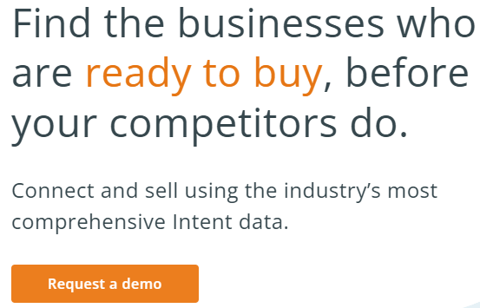
B2B Sales – Who is the Customer?
B2B sales are complex because they are two-dimensional
The first dimension is the company itself, which is the real customer
The second dimension is the people who make the decisions
The data to decide if a company can be a prospect is a new frontier of data and insights
ZoomInfo “company attributes”
“Intent” to buy is highly revered
A possible tool – Bombora.com
Other tools – G2.com, TrustRadius

Slide 22
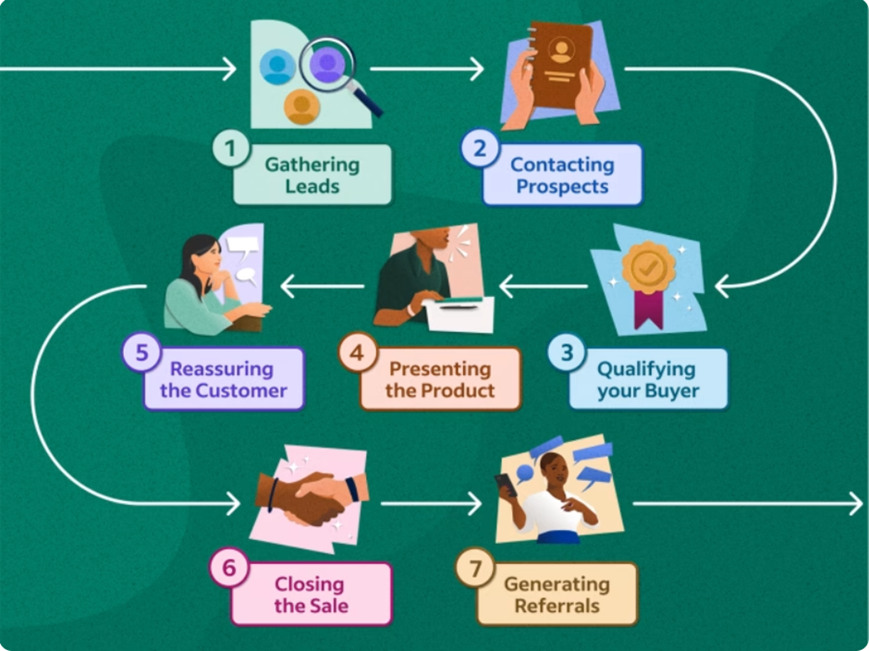
Sales Cycle

Slide 23
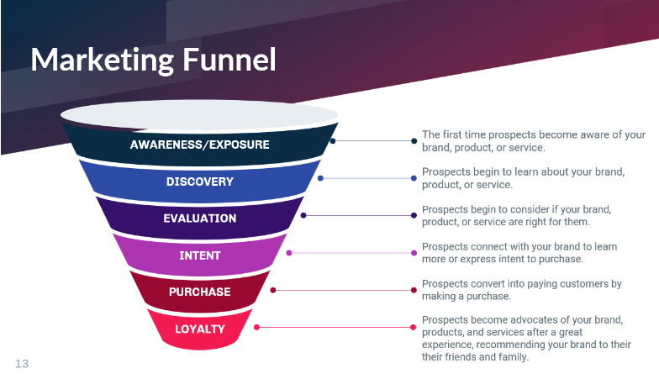
Marketing Funnel

Slide 24

The Full Real Process
Branding First – Sales is a long process Start as early as possible

Slide 25
B2B Sales Cycle Elements
There are many elements involved in a B2B sales process, here are some
Identifying the champion(s) inside the company
Defining the needs
Determining the value, payback analysis
POC – Proof of Concept
Budget existence
Negotiations, pricing, payment terms,
Implementation process

Slide 26
B2B Sales Cycle Elements
There are also many people involved in the purchase process, and who makes the final decision?
The “champion”
Other users or people impacted
Top management
Purchasing
IT – integration and security
Legal
CFO
Each company is different, and internal politics also play a big role

Slide 27
Understanding the Company’s B2B Sales Cycle
It is highly recommended that the founder, CEO and other top executives be handling the first sales directly
B2B Sales Cycle – common roadblocks
New concept, new product – lack of familiarity
New product – no budget
Payback – return on investment is not clear
Internal conflicts
Packaging, pricing and value are not well aligned
Because of B2B’s sales cycle complexity it takes time and many iterations to streamline the packaging and the process
Time is MONEY

Slide 28
B2B Sales Cycle – InteliChain’s Case Study
Joined SmartUp Residency program in May 2023
InteliChain – Demand Planning and Forecasting product
Competes with many well-established high-end products
In the S&OP (Sales and Operations) market
Claim to fame:
Targeting the small and medium company market
Much lower price than the high-end competitors
Sleek modern-looking user interface
Sophisticated forecasting algorithms improve accuracy
Ease of integration and ease of use through Excel files

Slide 29
B2B Sales Cycle – InteliChain’s Case Study
Founder, Roei Aviram, was a senior consultant at E&Y S&OP practice. Likes teaching
InteliChain had two design partners, but no sales
Lengthy, not converging, sales cycles with first few prospects
Free one month Proof of Concept (POC) was part of the sales cycles
Conclusions:
The market is fairly embryonic – customers don’t really understand the process of S&OP
Customers are used to spreadsheets and “rule of thumb” when it came to forecasting
Customers were hungry for more education and more hand holding

Slide 30
B2B Sales Cycle – InteliChain’s Case Study
The new approach
Instead of selling a product, Intelichain is now positioned to provide a complete solution:
Knowledge Methodology
Technology
No competition on the complete solution
Selling courses – income of $20K - $30K monthly
Selling “Value Analysis Program” consulting packages at $7,200 (used to be the free POC)
Price of the system is now $40K - $50K annually instead of $10K
Will generate about $400K in 2024

Slide 31
Price Elasticity – B2B Pricing
Within reason, companies are less sensitive to price than people assume – they are much more sensitive to three other elements:
Performance – will it solve the problem they try solving
Risks – what risks come along with the product (internal and external)
Total cost of ownership – implementation, salaries, friction, etc.
Purchasing will always negotiate the price – but they are not the ones buying the solution
It is not their personal money… !!!
Payback is always hard to show – trivialize it
Low price compared to other solutions might mean low quality

Slide 32
Direct Sales
Leads or Cold Calling?
The value of a lead:
Contact information is given
Permission to call is given
Prospect has a need, and is already in the “Intent” stage
Lead generation is the most important growth engine
Leads are the most efficient way to initiate a sales process
Having a good lead flow simplifies hiring of sales people (B-)
No cold calling – many sales people are not good at it
Prospect has a need and intent, and is already somewhat educated

Slide 33
Efficient Direct Sales Processes
Companies that can blend FREE or Low Cost products with business upgrades enjoy both worlds
Examples:
Zoom.us – Real consumer product. Free for consumers, brilliant differentiator for businesses
LinkedIn – Real consumer product. Business apps (Sales Navigator, Recruiters) and advertising on top of it.
WhatsApp – Real consumer product. Now selling corporate solutions
Slack – Free, brilliant differentiator for businesses (memory)
Wix – Free, upgrades cost money
HubSpot – Free, but their free product is very limited

Slide 34
Lead Processing
Leads must be called back within 5 minutes !!
Lead processing
Lead enrichment process
Add details about the person prospect, mainly title, and interaction history from Marketing Automation platform
Add details about the company prospect – type, size, location, industry, and many others that are pertinent to the product sold. (ZoomInfo company attributes)
Lead qualification and lead scoring
Based on the enrichment process give the lead a score
Lead distribution
Most leads are not of high quality, distribute to BDRs
High score leads distributed to competent sales people

Slide 35
International Sales
Focus on USA sales
Very large uniform market, the largest in the world
Speaks English, sophisticated, tech savvy
Familiar to us
Branding is international by nature, working through “location blind” channels (Google, LinkedIn, Facebook, etc....)
Most connections and meetings are done electronically – email, phone calls, Zoom meetings, WhatsApp, Slack, ...
Most presentations and demonstrations are done via Zoom

Slide 36
International Sales
The need for personal one-on-one meetings is minimal – actually most customers prefer Zoom meetings (faster)
However, having real Americans as sales people is a huge advantage
Plenty of Americans in Israel ☺
Can manage “work ←→ family” balance with US EST time (Alex...)
Company can set up a Virtual Office with a US address
If a USA office is a must – pick Newark as your location ☺
Need to deal with wire transfers, and USA taxes and regulation compliance – SmartUp can help

Slide 37
B2B Sales Cycle time and cost
B2B sales cycles, from lead to deal closure, can range from one month to years
Two to six months sales cycle is typical
Longer if no leads, and need to do cold calling
Payment terms can be net 60 or net 90
Building a lead generation process can easily take 6-12 months
Hiring and training sales people takes 6-12 months

Slide 38
B2B Sales Cycle time and cost
In many B2B companies, the time from when the company starts it sales efforts, to generating some money from sales, is 12 to 24 months
Most startup companies do not start selling before they have a product
By then, they have 20-30 people, and a burn rate of at least $400K - $500K a month, or $5m-6m a year
Starting a sales process well before having a product can save $5m-10m, and many times can save the company from failing

Slide 39
Benefits of Starting Branding and Sales Early
In addition to saving money, starting selling early can identify major issues with the product, the packaging, true market needs, or market maturity
It is much simpler to make a PIVOT when the company has few employees and just a rough idea of the product

Slide 40
Major Take Aways
Customers and Users are the biggest asset of a company
Own your customers (even in America)
Order of operations: In parallel
Branding strategy and efforts
Lead generation processes
Direct sales
Get customers
Product ideas
Talk to prospects
Develop the simplest product
Expand product, if needed

Slide 41
Major Take Aways
Lead generation processes are the company’s most important growth engine
B2B sales cycles are complex – think creatively about the process to make customers pay for the different steps
Keep prices up – much easier to make money ☺ Companies are less sensitive to pricing than they claim

Slide 42
The End ☺

