Slide 1

SmartUp Academy
Foundations Course
Lecture 8
Enablers, Innovation, and StartUp Creation

Slide 2


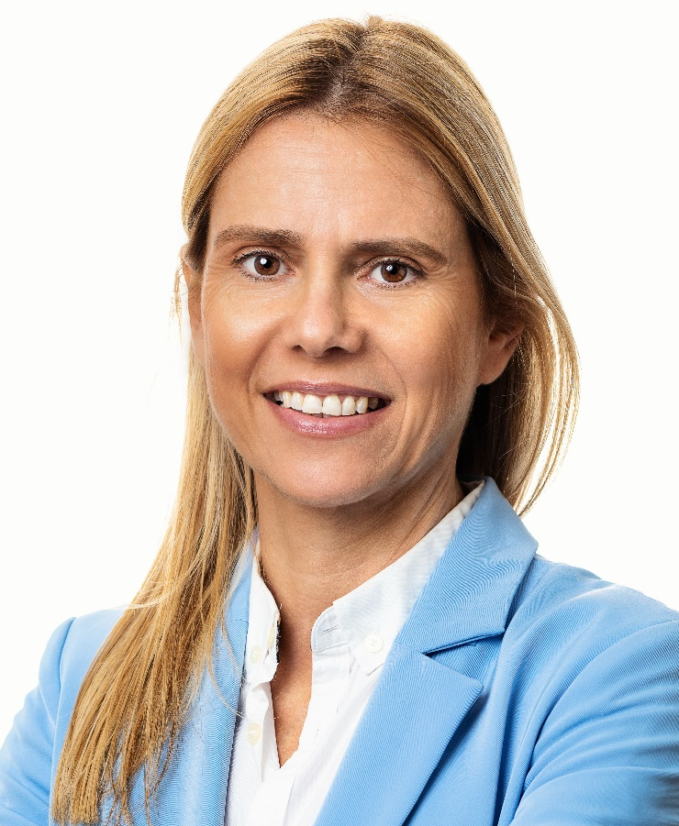

The SmartUp Founding Team
Yonatan Stern
Founder
And CEO
Libby Molad
Co-Founder and COO
Ayala Dinur Turgeman
Co-Founder
and CFO
Libby@smartupacademy.org
Yonatan@smartupacademy.org

Slide 3


SmartUp Academy
A program to teach the profession of building successful companies (…work in progress)
The Foundations Course
The three pillars for a successful company:
Profitable
Fast growing
Modest investment
Workshops – Specific Subjects
4-5 years Residency Program

Slide 4
Lecture Outline – Enablers, Innovation, StartUp
What are enablers, and what do they enable –
Internet,
iPhone,
Drones,
ChatGPT,
Machine translation,
DNA sequencing,
CRISPR,
SpaceX reusable rockets,
Face recognition,
Cloud computing
….

Slide 5
Lecture Outline – Enablers, Innovation, StartUp
Innovation is easy and inexpensive when using such Enablers
The idea here is that a huge amount of innovation can occur with no need to develop new “disruptive” technologies
Examples of new companies and products that effectively used Enablers in innovative ways
iPhone + Internet + GPS – Gett, Uber, Wolt, Waze, Pango,
Reusable rockets – Skylink
DNA sequencing – 23&Me

Slide 6
Lecture Outline – Enablers, Innovation, StartUp
Where and how to implement these Enablers and innovation potential
Growth Engines –
Branding & Marketing
Product development
Sales
Operations
And many more
New StartUps to open new markets, or penetrate existing markets with better and cheaper products or services
What is needed to effectively use Enablers to create new startups?

Slide 7
Lecture Outline – Enablers, Innovation, StartUp
Bottom Line – You don’t need “Disruptive Technology” to build a successful company
What is needed:
Deep understanding of the “Jobs To Be Done”
Focus on branding and marketing
Focus on customer delight
Smart use of Enablers to deliver the solution or service to fulfill the “Jobs To Be Done”
Building the company on Growth Engines, many of them use Enablers, to scale the operation at minimal cost

Slide 8
Four Enabler classes
Enablers can be divided into 4 classes
Technological
Infrastructure
Social Norms
Big Company Actions
Many innovations have aspects of more than one class
They might start as a technological innovation mature into an infrastructure and impacts social norms and business actions
Or, start as a business and evolve to change social norms

Slide 9
Jobs To Be Done – Market Segmentation
The Jobs To Be Done theory immediately implies that market segments for a product are defined along four dimensions
Functional – what is the specific job customers want to do
Contextual – in what context does the need arise
Emotional – what are the emotional aspects involved in doing the job
Social – what are the social aspects of fulfilling the job

Slide 10
Types of Enablers – Enabling Factors → Innovations
Technological
ChatGPT - Will discuss later
mRNA – Messenger RNA, Covid-19 vaccine developed in record time
Machine translation
DNA sequencing – 23&me, genetic testing for diseases,
SpaceX reusable rockets – About 13 launches per month. SkyLink (Current 6,000 satellites, planned 12,000)
Image recognition – Google photos, Zebra Medical Vision (Nonox, 2021), Medical imaging analysis and diagnostic, pathology analysis
Face recognition - ClearView.ai
3D printers
Drones

Slide 11
Types of Enablers – Enabling Factors → Innovations
Infrastructure
Internet – In the 1990s, Out of ARPANET (1969)
3G – Year 2007. Internet via cellular networks, iPhone
IBM PC compatible open specs, published in 1981.
Computer standards – only two prevailing operating systems: Windows & MacOS, and iPhone & Android. One (W3C) browser standard
Standards - Microsoft Office, SalesForce, QuickBooks, Adobe FDF,
Zapier, Make, Boomi, MuleSoft – to easily integrate systems to create a workflow

Slide 12
Types of Enablers – Enabling Factors → Innovations
Infrastructure – Continued
International payment systems
Cloud Computing – AWS launched in 2006
Open Source software
Huge amounts of free information on the Internet. Wikipedia, Freedom of Information Act (1967), EDGAR,

Slide 13
Types of Enablers – Enabling Factors → Innovations
Social Norms
Zoom meetings – Huge impact on sales processes. No need to open a US office (+ International payment systems + Tax calculator)
The “gig” economy – Uber, Wolt, Fivvr, UpWork, TaskRabbit, ...
People ride with strangers – Uber People stay with strangers – AirBnB
Work from home – Slack
Social platforms and social media
Influencers –
People publish pictures and videos in huge quantities - ClearView.AI, infinite data sets for algorithm training

Slide 14
Types of Enablers – Enabling Factors → Innovations
Big Company Actions
Apple iTunes – every song for $0.99
Spotify, Netflix – Fixed monthly price for unlimited use. Impact on publishers
Amazon Marketplace – anybody can open a wide-reaching store
Google AdWords – a universal ad platform
IBM PC compatible vs. Microsoft closed business model
Net neutrality
2FA (2 Factor Authentication) → A Universal Personal ID number Mine is +972526200085, my wife’s Ziva is +972526200086

Slide 15
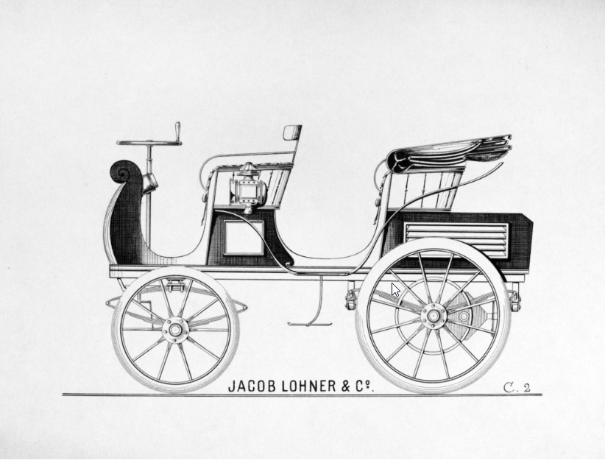
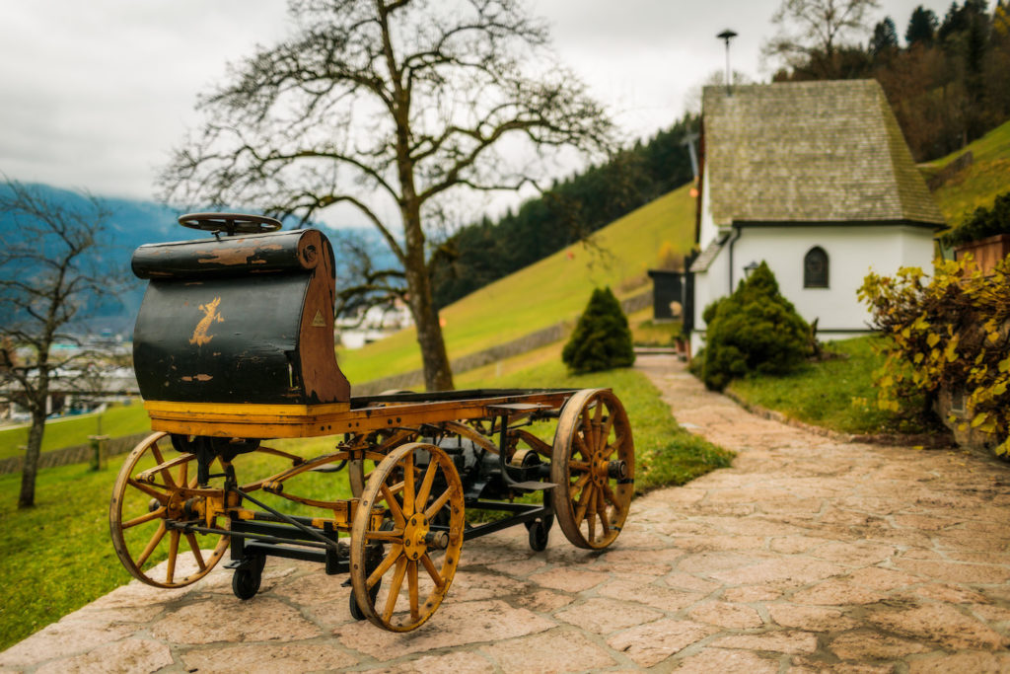
Innovation Enablers – Electric car
Very popular in the early days, circa 1900-1910
Easier to drive than a gasoline car that needed a hand crank
Quieter, no pollution
Perfect for short drives, range of 80 km, cost about $1,750

Slide 16
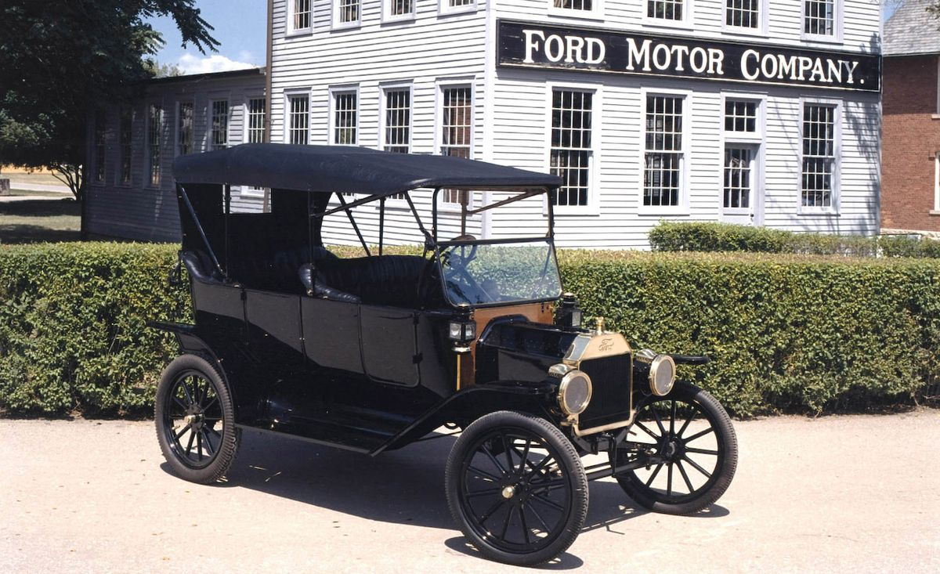
Innovation Enablers – Electric car
Ford Model T, introduced in 1908
Costs $650
Gas allowed longer range trips
Better road system encourages longer rides - Disabler
Electric engine starter – no need for a hand crank
Crude oil discovered in Texas, cheap gas
More than 15 million Model-Ts were built over its 19-year life span
Electric cars disappear by 1935

Slide 17
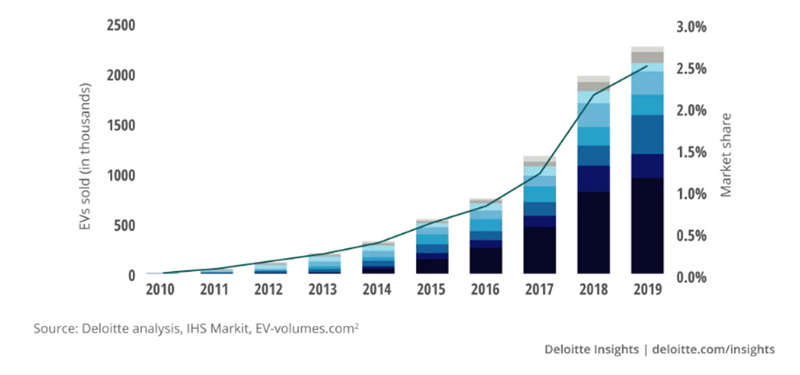
Innovation Enablers – Electric car
The chain of enablers that brought electric cars back
Electric car sales growth since 2010

Slide 18
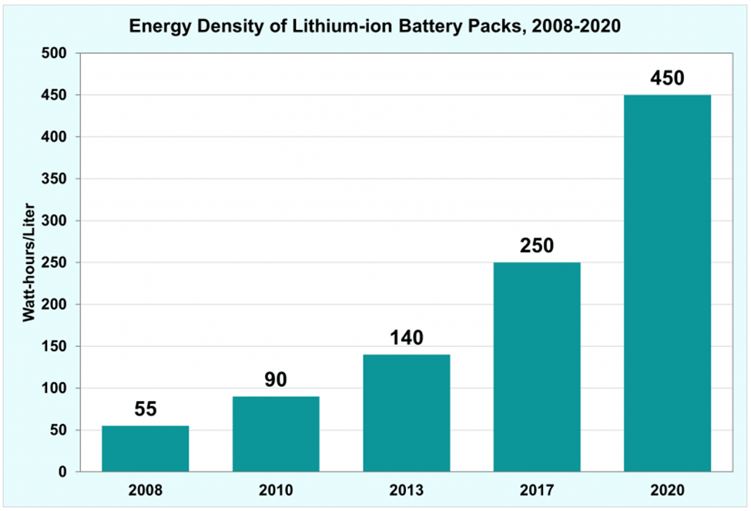
Innovation Enablers – Batteries
Electric cars have better batteries allowing 400 km range
Batteries improve almost 10-fold in twelve years Why?

Slide 19
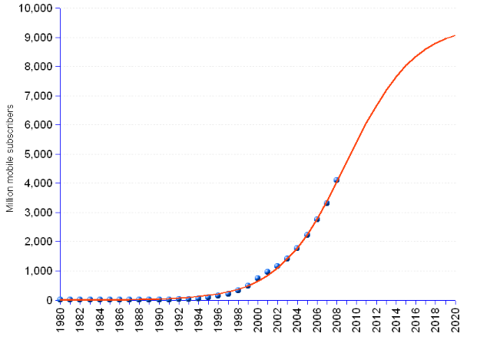
Innovation Enablers – Batteries
Growth in cell phone use
From about 1B in 2000
To about 9B in 2015
Similar growth in laptops and other mobile gadgets

Slide 20
Innovation Enablers – What made the iPhone?
What do you use the iPhone for?
80% of the time on phone calls
50% of the time on phone calls
25% of the time on phone calls
10% of the time on phone calls
OK, let’s vote

Slide 21
Innovation Enablers – What made the iPhone?
What do you use the iPhone for?
Social media – Facebook, TikTok, Instagram, WhatsApp, LinkedIn, etc
Web browsing
Communication – Email, WhatsApp, SMS,
Gaming
Navigation – Waze, Google maps, Apple Maps
Other
The iPhone is a hand-held personal computer with GPS
All apps require Internet connection – Cellular or WiFi

Slide 22
Innovation Enablers –iPhone Enablers circa 2007
Cellular Data – 3G
Deployed in 2001, Compared to 2G, 3G had four times the data transferring capabilities reaching up to 2 Mbps on average.
Video streaming, video conferences, and live video chat became real.
Emails also became another standard form of communication over mobile devices.
What made 3G revolutionary, was the ability to surf the internet and stream music on mobile.
GPS
1999: GPS-enabled cell phones become commercially available for the first time.
2000: The U.S. Government revokes a plan from 1990 that purposely made GPS less accurate as a defensive mechanism. As accuracy skyrocketed, many industries, including forestry, fishing, and freight management, started using GPS.
2001: Personal GPS products surge, including in-car navigation systems.

Slide 23






Innovative Technology, Enablers and StartUp Creation
The tale of six companies – What are the lessons?
Zoom Information (ZoomInfo 2000-current, SEO,Xobni)
NetProspex (Gary Halliwell, 2006-2015, 27.5, D&B 125, De Beers, Thomson Reuters, Investext)
Plaxo (Sean Parker, Napster 1999, 2002, 28.3, Comcast 2008-2017, FaceBook, Spotify)
Jigsaw (Jim Fowler 2004-2010-2020, 18.0, SalesForce Data business, data.com ..., )
DiscoverOrg (Henry Schuck, 2007, 2019)
Apollo.io (2015, 251.3, 1.6b in 2023, Gmail)

Slide 24
Innovative Technology and StartUp Creation
The tale of 6 companies – Lessons and take aways
“Disruptive” technology (ZoomInfo) is hugely overrated
There is a big gap between a technology and generating money at scale
Many entrepreneurs start by thinking, adopting or inventing some “disruptive” technology
Instead, they should focus on understanding the “Jobs To Be Done”, and then look around for Enablers to get the Jobs Done easily and at a low cost
Oh…. and start with Branding – “Branding First”

Slide 25
Innovative Technology and StartUp Creation
The tale of 6 companies – Lessons and take aways
At the end, success comes from happy and loyal customers not from technology
Long term value of a company is measured by the number of customers they attract, their revenue and their profits – not its technology
Technology is easy to duplicate Customer satisfaction is hard to maintain
Obsessive focus on customers, operations, efficiency
Growth Engines – taking advantage of Enablers

Slide 26

The Story of Capital-IQ
Founded in 1998 by three seasoned investment bankers, Randall Winn, Steve Turner, and Neal Goldman
Wanted to open a more efficient investment bank so they can profitably serve the low end of the market
For that, they developed a database of information about companies – a pure novelty
The database was populated manually by low cost researchers
Developed a simple computerized process to aid data entry
Acquired an Indian company with hundreds of people to populate and keep the database up to date
Can you do it today more efficiently?

Slide 27
The Story of Capital-IQ
They were not able to build their efficient investment bank, but many investment bankers were interested in their database
They deeply understood the “Jobs to Be Done” and pivoted their business to selling access to the Capital IQ database
Sold Capital IQ in 2004 to McGrow-Hill for $200m
Neal Goldman founded Relationship Science in 2010
Randy Winn invested in DiscoverOrg in March 2018 and is on the board of ZoomInfo

Slide 28
Enablers – ChatGPT, a blueprint for a StartUp
ChatGPT can extract specific information from free text, like web pages, contracts, receipts, emails, and more
Jobs To Be Done – Back office, paperwork, of many companies and operations
SCALE – simple jobs become complex and valuable as the scale grows

Slide 29
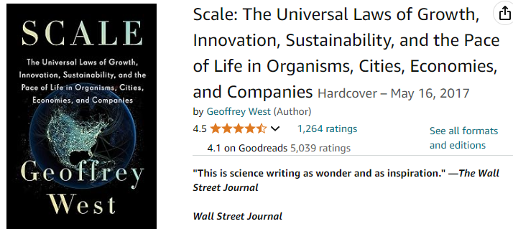
Growth Engines are about achieving scale at a low cost

Slide 30
Enablers – ChatGPT
The purpose of many business software applications, like a CRM, is to aid efficient scaling up
BUT not all operations scale up easily. Usually, the problem is with converting the input from human interaction to a database that can be queried and manipulated (think “forms”)
Many people think of ChatGPT as “generative AI”, creating something new
But ChatGPT huge business value as an Enabler is in understanding human language and human interaction and combining it with a bigger Jobs To Be Done

Slide 31
Enablers – ChatGPT, a blueprint for a StartUp
Case Study – companies that have many locations – offices, stores, warehouses, around the world
Each location is rented from a different landlord, different contract, different laws, different size, dates, etc.
Currently these companies keep a spreadsheet with basic information about each location, maintained manually
ChatGPT was trained to extract some 30-40 pieces of data from each contract and put them in a database

Slide 32
Case Study
The database was enriched with local information for each location, like:
Average rent per sqf charted over time for that area
Updated list of other available offices in the area, with price comparison
Number of people in each location and the ratio of people to space
Trends in the area – population growth, other businesses coming and going, etc.
The value of data grows significantly when it is enriched by adding more dimensions to it

Slide 33
Case Study II – Small Business Accounting
Most small businesses do their accounting only because they must, by law, pay proper taxes (VAT and income tax)
Accounting reports are not operational reports and thus are fairly useless for the owners as a tool to make day to day decisions
Most small business owners manage their business by experience, intuition and gut feeling without financial reports
Enabler – many small companies use Chashavshevet (חשבשבת) accounting software that have an API to access the data
Enabler – Open Banking law (בנקאות פתוחה) enables account holders to access their account by API

Slide 34
Case Study II – Small Business Accounting
A small startup developed a simple application that took the data from the accounting software and from bank accounts and created simple operational reports
When he showed these reports to several small businesses, what caught their attention was the amount of money they were owed by customers and not collected
A new product idea was created – a simple collections application
Now think about QuickBooks as the Enabler….

Slide 35
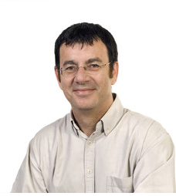
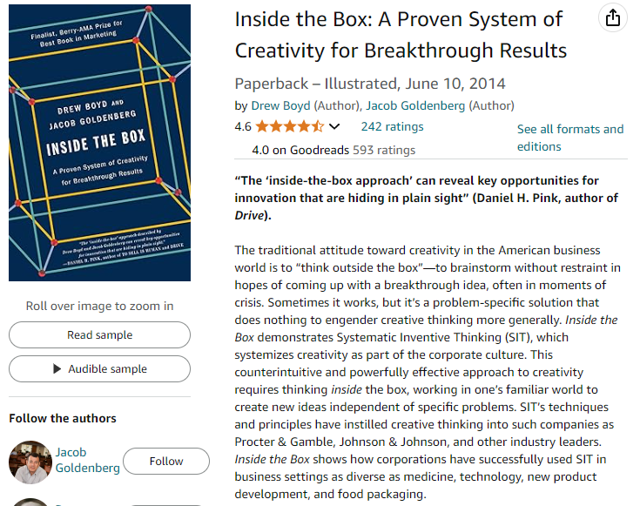
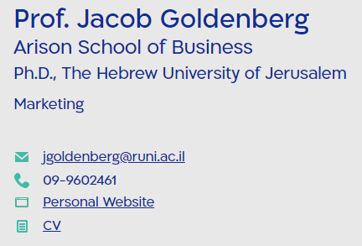
Enablers – Think Inside the Box

Slide 36
Enablers – Growth Engines, Think Inside the Box
Growth Engines – Enablers as part of the ‘inside-the-box approach’ can reveal key opportunities for innovation that are hiding in plain sight
Any activity that requires more people as it grows should be analyzed as a candidate for a Growth Engine
As the scale of the operation grows – Growth Engines are a must
Enablers offer the ability to build a solution or provide the service at a fraction of the original cost

Slide 37
Enablers – Think Inside the Box
Enablers – a way to generate ideas for products or services that do not exist today, or that can be improved
Ability to build a solution or offer the service at a fraction of the cost it used to be
Enablers evolve and change – each change offers new opportunities
Creative thinking about combining existing Enablers can open up opportunities

Slide 38
Enablers – Think Inside the Box
Not just software – even operations, like “Deel provides global compliance services, including payroll reports and analytics”
SimpleClosure is a start-up that helps other start-ups wind down their operations. ☺

Slide 39
Enablers First? or “Jobs To Be Done First”?
“Jobs to Be Done” First, and then use Enablers to “Think Inside the Box”
Knowledge of your customers’ processes, needs, and “Jobs To Be Done” is a big asset
Founders who come from the customer side have a huge advantage – Capital-IQ
Founders who don’t come from the customer side should “hire” that knowledge before investing in developing a product

Slide 40
“Hiring” knowledge
Don’t ask about “problems”, ask to understand the details of the process, any process
Most processes can be improved !!!
People you can ask:
Friends and family
Retired executives and retired workers
Past workers (LinkedIn bio’s)
Use LinkedIn intros (Expendi) for research conversations
“Round table” conversations to compare notes about same process in different companies

Slide 41
“Hiring” knowledge
At a later stage you might consider an Advisory Board
Don’t boil the ocean. Start by making a simple product that offers small improvements at low cost
[An idea regarding Gong ($583m) and Chorus ($100m) ]
Gaining real paying customers is critical to understanding their Jobs To Be Done. Customers complain.

Slide 42
Lecture Outline – Enablers, Innovation, StartUp
Bottom Line – You don’t need “Disruptive Technology” to build a successful company
What is needed:
Deep understanding of the “Jobs To Be Done”
Focus on branding and marketing
Focus on customer delight
Smart use of Enablers to deliver the solution or service to fulfill the “Jobs To Be Done”
Building the company on Growth Engines, many of them use Enablers, to scale the operation at minimal cost

Slide 43
Questions

