Slide 1

SmartUp Academy
Foundations Course
Lecture 7
Growth Engines

Slide 2




The SmartUp Founding Team
Yonatan Stern
Founder
And CEO
Libby Molad
Co-Founder and COO
Ayala Dinur Turgeman
Co-Founder
and CFO
Libby@smartupacademy.org
Yonatan@smartupacademy.org

Slide 3

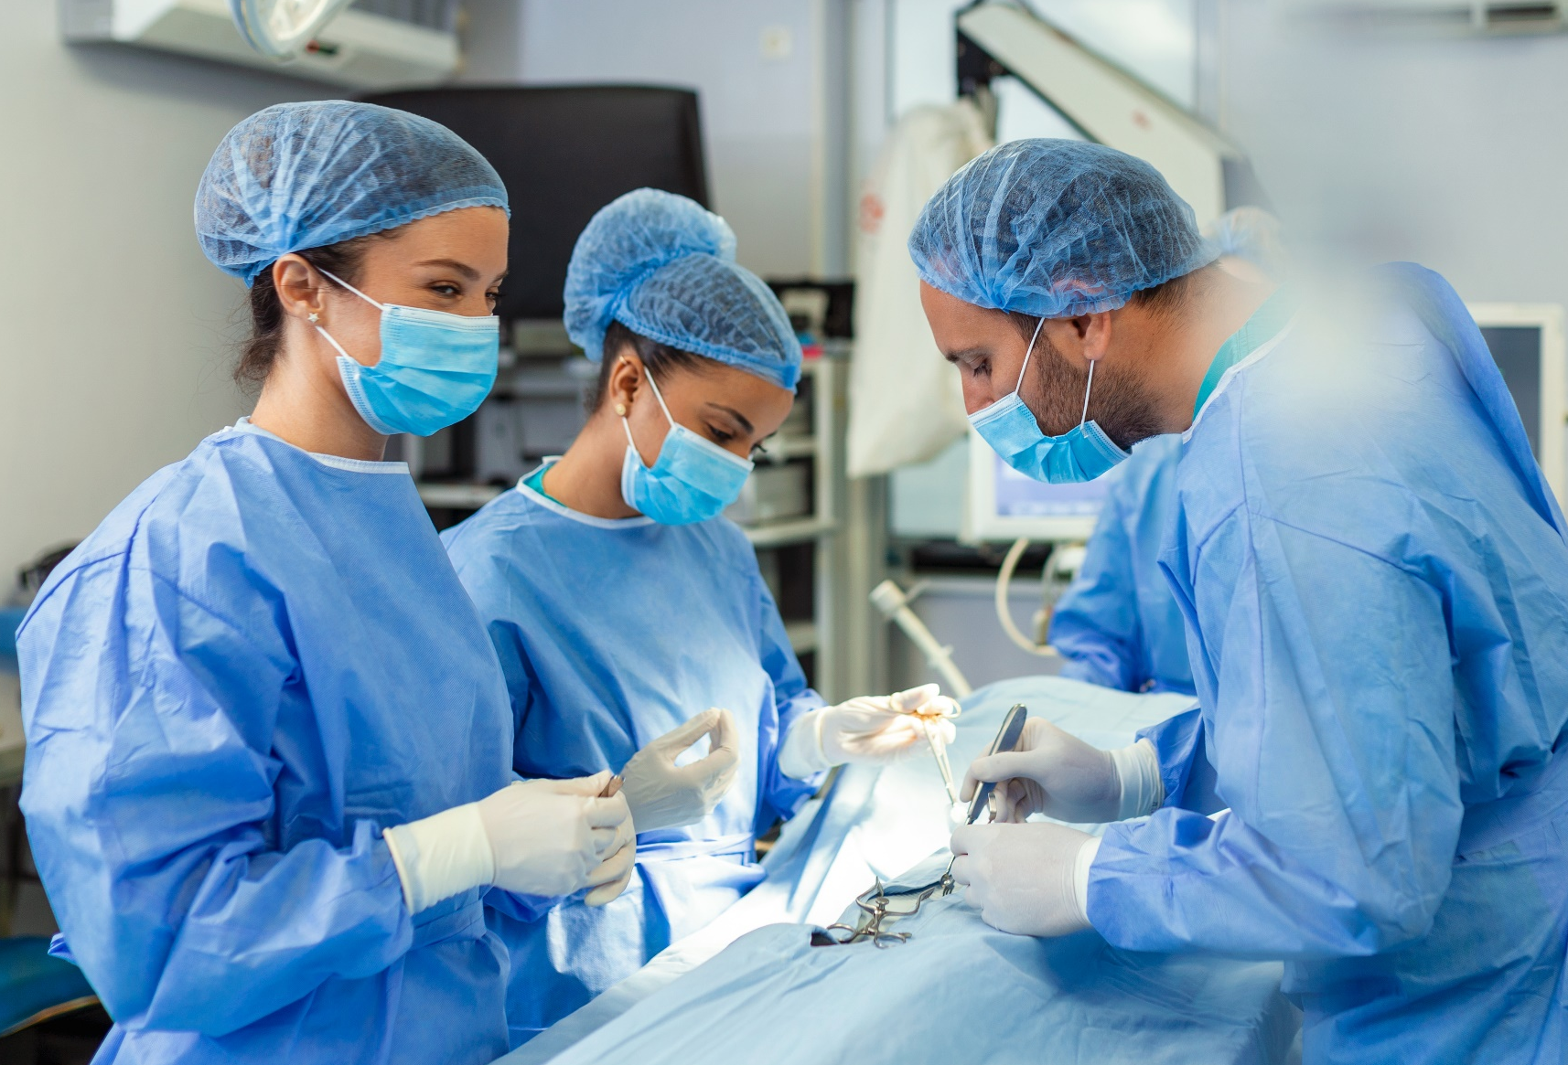
SmartUp Academy
A program to teach the profession of building successful companies (…work in progress)
The Foundations Course
  The three pillars for a successful company:
    Profitable
    Fast growing
    Modest investment
Workshops – Specific Subjects
4-5 years Residency Program

Slide 4
Foundation Course
Previous Lectures
The Venture Capital Model compared to the SmartUp model
  What is a Venture Capital firm and how they work
  An Exit in 7 years or Profitability
  The Infinite Game
Branding First – The concept
Branding First – How
  SEO Long Tail
  Repetition - Absolut Vodka
  Thought Leadership – Gartner Magic Quadrant
  Inc. 5000 – competition

Slide 5
Foundation Course
Previous Lectures
Business Model spreadsheet and targets
  Number of months to Profitability
  Investment needed
  Number of months to repay investment
Business Model – Pricing models
  Different pricing for different market segments
  Pricing depends on positioning
  Strive for premium prices – profitability

Slide 6
Foundation Course
Previous Lectures
Jobs To Be Done
  Functional – what is the specific job customers want to do
  Contextual – in what context does the need arise
  Emotional – what are the emotional aspects involved in doing
  the job
  Social – what are the social aspects of fulfilling the job

Slide 7
What is a Growth Engine?
A Growth Engine is a process
That the company does, or plans to do
  Many times
  Repeatedly
  In any part or activity of the company. Like:
            Branding
            Marketing
            Manufacturing
            Sales
            Accounting
            Customer support
            Recruiting
            Etc. etc.

Slide 8
What is a Growth Engine?
A Growth Engine is a scalable process that
  You can double its Output
  With a small increase in Input (efforts and investments)
  It is not linear, a small increase in Input can yield a large increase in Output
Growth Engines are keys to accomplishing the goals of:
  Profitability
  Fast Growth
  With modest investment

Slide 9
What is NOT a Growth Engine?
Many processes in a company are viewed as growth opportunities, but they are not Growth Engines, because they are not scalable:
  Strategic partner
  Very large customer
  Important distributor
  Critical tradeshow
  Writing blogs, writing articles, issuing press releases
  The next big feature in the product
Company attention must be focused on identifying and building Growth Engines in every part of the company

Slide 10
Growth Engine – SEO Long Tail Branding
Many well-known companies use SEO Long Tail as their branding Growth Engine
Small amount of engineering + user participation – scalable Output
  LinkedIn – People and companies build their own pages
  TripAdvisor – Basic information by TripAdvisor, rich content added by users
  Yelp – Basic information by Yelp, rich content added by users
  Facebook – Network effect
  Zillow – A page per address, automatically enriched from many sources
  Amazon – A page per every possible product

Slide 11

Opster
Opster- Tools for DevOps engineers to manage and optimize mission critical ElasticSearch clusters
      Did anybody here understand what that means?
Who are Opster’s prospects?
      ElasticSearch DevOps engineers
How on earth can we target these elusive people?
      They are busy and they don’t respond to emails

Slide 12
Opster – In Search of a Branding Engine
Focus on the problem - not on your solution
  When Opster started, we had nothing to sell. Product vision was murky
  We asked ourselves – What do DevOps engineers do when encountering a problem with their ElasticSearch installation?
  In many cases the ElasticSearch system produces an error log that is written to their log file
  Here are random examples of real error logs

Slide 13
Opster
Error Log examples
  Could not lock IndexWriter isLocked
  Delaying allocation for unassigned shards; next check in
  Suspect illegal state: trying to move shard from primary mode to replica mode
  Failed to start monitoring service
  Using discovery type and seed hosts providers
  All shards failed
  Term query does not support array of values
  No mapping found for ” + fieldName + ” in order to sort on
  high disk watermark [90%] exceeded on
  Mapping update rejected by primary

Slide 14
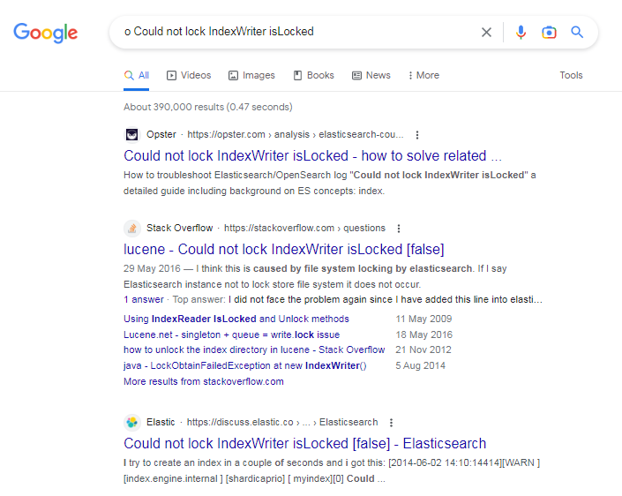
Opster - the Power of Long Tail
Ahead of StackOverflow and Elastic itself
Opster
StackOverflow
Elastic.com –
The originators of ElasticSearch

Slide 15
Opster
Branding SEO Growth Engine - How to automatically create thousands of content pages?
  Wrote a script to extract all error logs from ElasticSearch open-source code
  Initially extracted about 700 different error logs.
  Later, some 3,000 error log pages published on Opster
  Opster published these 700 pages produced automatically – low quality content
  60 or so pages generated 80% of the traffic – manually enriched their content. High quality content creates a strong brand

Slide 16
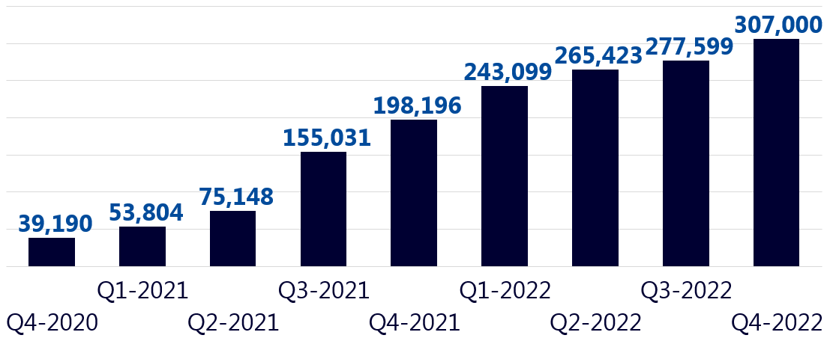
Opster – Growth Engine Scalable Output
Traffic results per quarter

Slide 17
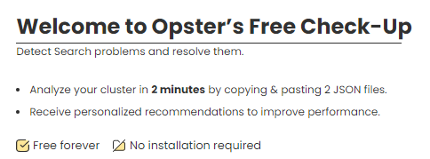

Opster – Lead Generation Growth Engine
BUT – Traffic is not yet leads
  Developed CheckUp – a FREE simple tool to identify problems based on 2-3 files taken from an Elastic cluster
  Users needed to create an account to run CheckUp
  Scalable Growth Engine – Fixed, low product development cost.
  Works 24/7, converts traffic to users, and users to leads
  Growth Engine – Very low Customer Acquisition Cost (CAC)

Slide 18
Opster – Users and Leads Growth Engine
Number of New Registered Users
Total Number of Registered Users

Slide 19
Opster – Content Creation Growth Engine
Objective – Continuous creation of useful, high quality, technical “how to”s about Elastic’s database and platform
The Problem - Only good engineers can produce such content. Good engineers are busy coding, and don’t like writing articles
Technical Writing Growth Engine
  Opster’s technical experts created a curated list of desired articles
  Hired freelance Elastic experts who like writing, paid $300 per article
  Reviewed the articles by Opster’s technical experts
  Continued working only with the freelancers who passed the quality test
  Edited the article’s English and published
Consistently published several articles a week

Slide 20
Opster – The value of Growth Engines and a brand
In October of 2023 Elastic acquired Opster for its AutoOps tools, content and brand
Integrating Opster’s AutoOps tool into Elastics products, and making it available to its tech support engineers
Elastic also took Opster’s marketing team to recreate a “content creation engine” to build high quality content for ElasticSearch ☺

Slide 21


Growth Engine – Customer Support
The year: mid 1990’s. Before USB
The problem: difficult, long, and cumbersome installation on a PC
The more units sold → the more support people
When we reached 4 support people we knew we needed a solution

Slide 22


Growth Engines – Apple iPhone vs Samsung
Who here bought a Samsung phone?
Why did you choose the model you chose?
How did you decide in which store to buy the phone?
How did you decide when to time the purchase?

Slide 23
Growth Engines – Apple iPhone vs Samsung
 | Samsung | Apple iPhone
Unit sales in 2023 | 271 million units | 238 million units
Market share in Q3 2023 | 20% | 16%
Revenues from phones in 2022 | $246 billion in its mobile division | Over half of $394 billion, say $200 billion

Slide 24
Growth Engines – Apple iPhone vs Samsung
 | Samsung | Apple iPhone
Share of the phone industry profits | 15% | 75%
Gross margin per phone | Less than 20% | Over 55%
Market capitalization August 2024 | Less than $400 billion | $3.2 trillion = $3,200 billion

Slide 25
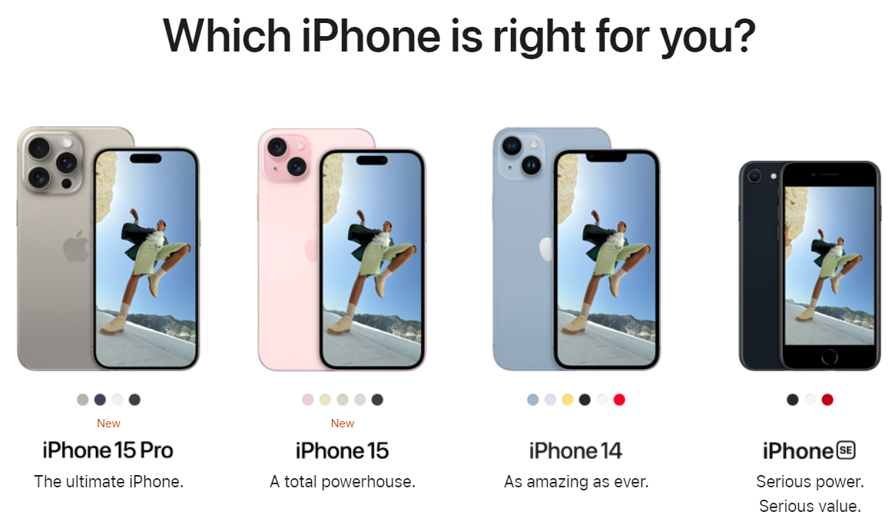
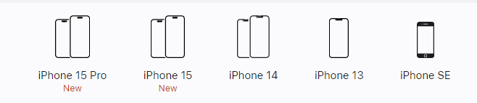
Growth Engine – Apple iPhone vs. Samsung
The full selection on Apple’s site

Slide 26
Growth Engines – Apple iPhone vs Samsung
 | Samsung | Apple iPhone
Number of models introduced each year | 30-40 models: Galaxy S, Galaxy Note, Galaxy A, Galaxy M, Galaxy Z Fold, Z Flip | ONE: iPhone 15 Still selling older iPhone 14 and iPhone 13
Price variation by store | Can vary | None
Price variation by dates or promotions | Can vary | None

Slide 27
Growth Engines in Operations
Wolt – Delivery persons are not employees
  They are called “Wolt Courier Partner” – “you can earn money by delivering orders to local customers… when and where you want…. “
  Flexible arrangement for Wolt, no fixed employment cost
  Pay per delivery, no delivery no cost
  No benefits, no medical insurance, no vacations,
Amazon Delivery Service Partner Program
  “Learn the basics about being the owner-operator of your own Amazon delivery business.” “Work as an independent contractor for Amazon”
  “Set your own hours. Hire and manage employees and delivery shifts”
  “Receive fixed monthly payments based on the volume of packages delivered”

Slide 28
Growth Engine in Operations
Production and fulfillment operations
  Manufacturing in Taiwan and warehousing in the USA – on the supplier
  A contractor produced the box, materials and disks
  The contractor got an order from CardScan, pulled scanners from supplier, assembled, and shipped
  Only then CardScan Inc. paid for anything
  CardScan Inc. did not carry any inventory, or fixed costs
Retail operations
  Moved to consignment and weekly payments based on actual sales

Slide 29
Growth Engine in Operations - Collections
At ZoomInfo we collected 99.3% of invoices every single year
Was accomplished by a single person – Donna Angelucci, even when the company approached $100m in sales
Process:
  Sent constant reminders before the payment was due
  Immediate follow up if payment was not received
  Small customers could pay only with credit card, before an account was opened
  Immediate escalation to the salesperson on non-paid bills
  (caught fraud)
  Non-paying customers were shut down
  Attention, follow up, attention, follow up

Slide 30
How to Build a Growth Engine?
Evaluate the benefits – what if it can easily be scaled up?
Ask - What stops it from being scalable?
Inhibitors
What is the most common Inhibitor ?

Slide 31
Growth Engine – The Biggest Inhibitor
People
Hard to find the right people – ALWAYS
Hard to recruit – a huge task, expensive, inefficient
Questionable results – basically like gambling
10% of recruits are a joy, 10% are a disaster, 80% are in between
Price’s Law (Named after Derek J. de Solla Price, a British sociologist/historian, 1965)
50% of the work is done by the square root (√) of the total number of people who participate in the work (like the 80/20 rule)
A small percentage of individuals in any organization / group are responsible for most of the total output and results.

Slide 32
Growth Engine – The Biggest Inhibitor – People
Parkinson's Laws:
In every organization people promote themselves by hiring a team to do their job
Work will expand to fill the time planned for its completion
Yonatan’s Laws:
Managers spend most of their valuable time on employees they end up firing
Every three people cause another person to be hired

Slide 33
The Biggest Inhibitor to Profitability – People
70% - 80% of any technology company costs are around people (salaries, overhead, travel, amenities…)
People and salaries are rigid fixed costs – and salaries always go up
Rule number 1 for building Growth Engines is to replace work done by people, with software and processes that require less people
Sales per employee – a very important measure and indicator for profitability

Slide 34
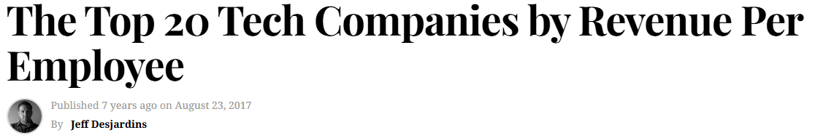
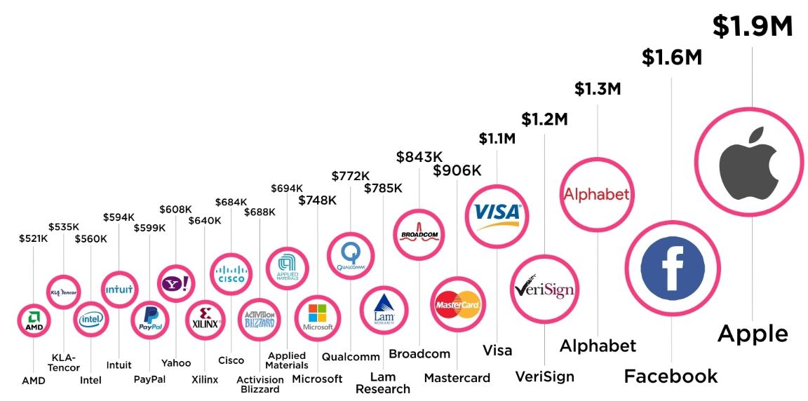

Slide 35
How to Build a Growth Engine
Inhibitors and Friction vs. Enables
Inhibitors are all the things that stand in the way of scaling up a process
Friction are all the things that just slow down the process
Enablers for a Growth Engine fall into two broad categories
  Continuous removal of inhibitors and friction
  New ideas how to do things efficiently

Slide 36
Sales Growth Engines
Sales Growth Engine - a dilemma
  Build a sales organization – Number of people linear with sales growth
  Develop eCommerce and sell online – Good only for small transactions
  Do both: Free → to eCommerce → to Corporate sale
  (HubSpot, Zoom video, Zoho, SalesForce, Slack, LinkedIn, Google Workspace, …)

Slide 37
Sales Organization – Quasi Growth Engine
Sales organization – PEOPLE
Sales growth linear with the number of sales people
Key parameter: Cost of sales
  Cost of sales = (total cost of the sales organization) / (revenue generated)
  Cost of sales between 15% to 25% of sales, revenue
Levers to reduce Cost of Sales in linear growth situation
  A stable and reliable source of leads
  Clear path, and training to reach quota in a few months
  Build the entire process and compensation plans for B Players
  Stability – make sure the plan allows B people to succeed

Slide 38
Growth Engine - Sales
Some common direct sales friction items
  Fixed price vs. price negotiation (supermarket vs. bazaar)
  Discounts
    Lengthen negotiations
    Discounts stay forever
    Risk angering other customers
  Promotions
  “You get this price if you buy before the end of the month…”
  Small customers negotiate and waste time more than big customers
  Big corporation customers have strict internal processes
    Internet security, SOC2, data security
    Legal, compliance with laws,

Slide 39
Growth Engine - Sales
Some common sales friction items
Complicated, not clear pricing scheme. The simpler the better
Complicated product options
Multiple decisions vs. one decision
  Automatic renewals
  Amazon Prime – free two-day shipping on all products. Dramatically increased sales. Now, more than 200 million subscribers, at $139/year, close to $30 billion annually
  Microsoft Office - $99/year bundle. Word, Excel, PowerPoint, Outlook
  Apple and Google phone app stores
  All inclusive vacations – cruises, ClubMed,
  Other examples?

Slide 40
Growth Engine – Branding and Marketing
Marketing is the process to generate leads and sales
Branding is the growth engine behind, making marketing easier
What are the inhibitors when doing common marketing activities?
Email campaigns – most people don’t read spam mail
Advertising – expensive, usually poor results, high CAC
Tradeshows – expensive, not scalable
Content, blogs, press releases – hard to create new and interesting content on a regular basis
Webinars – hard to produce, hard to bring people

Slide 41
Growth Engine – Branding
SEO Long Tail
Free products
Ideas for easily created interesting and engaging content
  Thought Leadership – Research
    People love and believe graphs and charts – factoids
    Call and interview potential customers. Collect data
    Start publishing a newsletter with factoids, and a new survey
    Call and interview more customers, and repeat the process
    Continue to collect data from cold calls
  Organize and record Round Tables of industry leaders, by Zoom
  Engage freshly retired industry leaders

Slide 42
Quasi Growth Engine – Marketing
Many marketing activities cost a lot of money, especially advertising
Focus on scalable ad campaigns – scale up if successful
To build a Growth Engine – analyze return on investment
Return on investment should be short term, hopefully first sale
The problem of attribution – which investment actually brought the deal?

