Slide 1

SmartUp Academy
Foundations Course
Lecture 6
Jobs To Be Done (JTBD)

Slide 2




The SmartUp Founding Team
Yonatan Stern
Founder
And CEO
Libby Molad
Co-Founder and COO
Ayala Dinur Turgeman
Co-Founder
and CFO
Libby@smartupacademy.org
Yonatan@smartupacademy.org

Slide 3


SmartUp Academy
A program to teach the profession of building successful companies (…work in progress)
The Foundations Course
  The three pillars for a successful company:
    Profitable
    Fast growing
    Modest investment
Workshops – Specific Subjects
4-5 years Residency Program

Slide 4
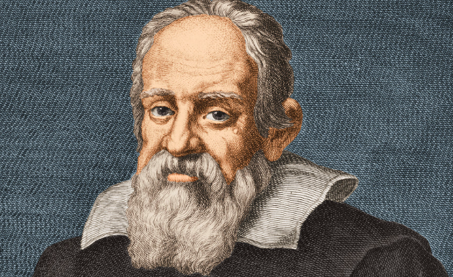
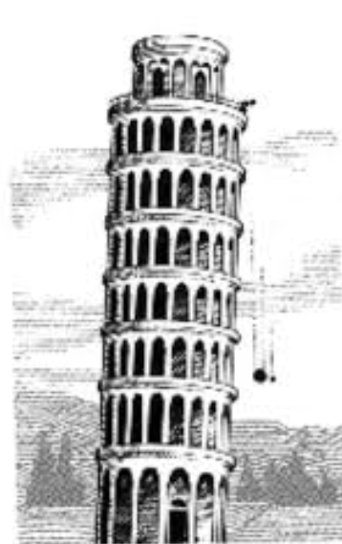
The Language of Business
Moving from Science to Business
“Mathematics is the language in which God has
written the universe !” Galileo Galilei 1564 – 1642
Galileo was the first to write an equation in
physics, and paved the way to Newton
What is the language of business?
Money !! Models to evaluate options
Every decision has to be expressed in monetary terms

Slide 5
The SmartUp Business Model - Successful Companies
The three pillars of a successful company, and how they are measured:
  Profitable - How long does it take for the company to become profitable (cash generating), in months
  Modest investment - How much money is needed before the company starts to generate cash
  Fast growing - How long does it take to pay the investment back, in months

Slide 6
What is a Business Model?
In simple terms – How is your company going to make money?
A complex combination of many parameters, from the product or service, to customer profiles, to pricing and packaging, to costs and infrastructure, and much more
Decisions made when conceiving the Business Model are the most important decisions a company makes !!!
Building the business model is usually an iterative process of trial and error to select, adjust, and refine all parameters
Often times – a Pivot. A major, sometimes very expensive, reshuffle of a company’s business model

Slide 7
Business Model Key Questions
In the process of building a business model, the following “Wh” questions need to be addressed
    Who are the users?
    What problem users try to solve? What job to be done?
    Who pays for it?
    What exactly do they pay for? Pricing elements …
    Where do they pay?
    How much do they pay?
    When do they pay?
    How do they pay?
    And many more questions….

Slide 8
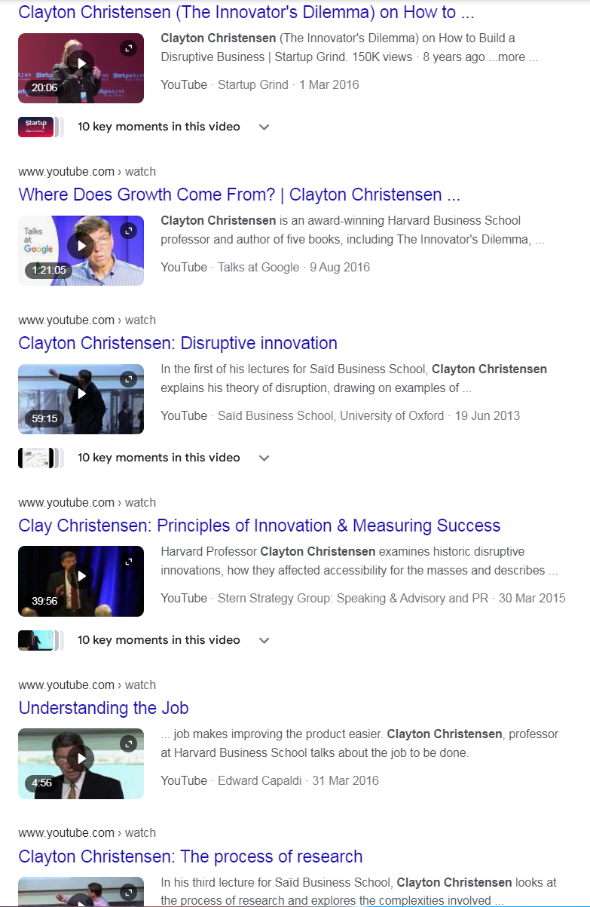
Clayton Christensen – Videos
Clayton Christensen (1952 – 2020) was an American academic and business consultant who developed the theory of "disruptive innovation", which has been called the most influential business idea of the early 21st century. Christensen introduced "disruption" in his 1997 book The Innovator's Dilemma. Christensen was awarded a Rhodes Scholarship and spent two years studying applied econometrics at Oxford University, then did an MBA and a Doctorate at Harvard, where he later became a professor at the Business Administration school of Harvard (HBS)

Slide 9
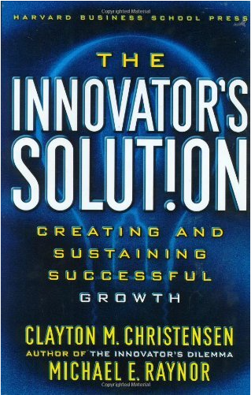
Recommended Reading
The authors identify the forces that cause managers to make bad decisions as they package and shape new ideas and offer new frameworks to help create the right conditions, at the right time, for a disruption to succeed. This is a must-read for all senior managers and business leaders responsible for innovation and growth, as well as members of their teams.

Slide 10


The Innovator’s Solution פתרון החדשנות

Slide 11
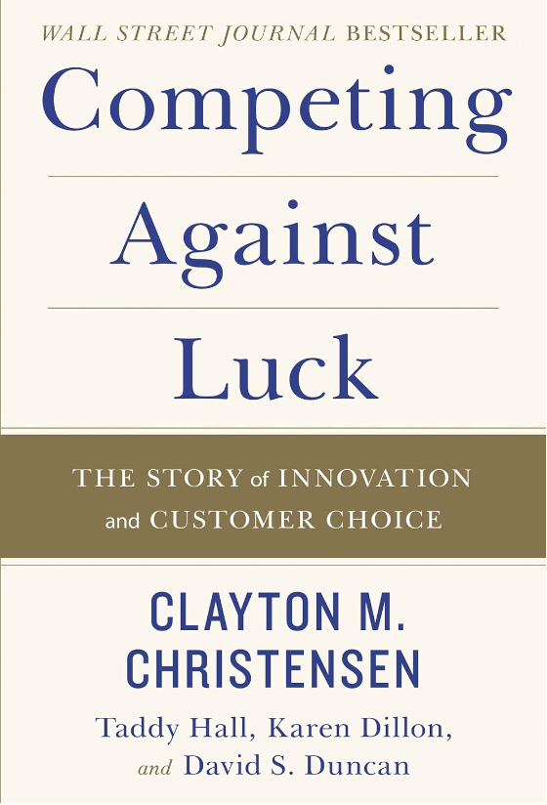
Recommended Reading
After years of research, Christensen and his co-authors have come to one critical conclusion: our long held maxim--that understanding the customer is the crux of innovation--is wrong. Customers don't buy products or services; they "hire" them to do a job. Understanding customers does not drive innovation success, he argues. Understanding customer jobs does. The "Jobs to Be Done" approach can be seen today in some of the world's most respected companies.

Slide 12

The Story of Rosh Intelligent Systems
Founded in 1984, my second company
Investors:
  Elron – Uzia Galil – Seed money
  Athena Ventures – Dan Tolkowski
  Then more… raised $12m in total
Product: An Expert System (AI), to help field service engineers fix complicated equipment
Customers: Philips Medical, Xerox, Applied Materials, Varian, Lam Research,
As a condition to the investment we had to talk to a dozen potential customers, face to face, to validate the need for the product idea

Slide 13
Rosh Intelligent Systems
Moved to the Boston in 1989
The company grew continually, year after year, to $4.5m in revenues in 1992
Was never profitable
Then one day I talked to one our bigger customers and asked him a thorny question …
You asked the wrong question

Slide 14
Rosh Intelligent Systems
What is the right question?
If you have only $100,000 in your budget, would you buy the product of Rosh Intelligent System, or would you buy something else?
And what is it? And why would you buy it?
Jobs To Be Done – Look at the situation from the customer’s perspective, not your perspective

Slide 15

Jobs To Be Done – Milkshake
The Innovator’s Solution foundational story

Slide 16

The ZoomInfo Story – Jobs To Be Done
Founded in 2000 – Deep AI technology
Started selling in 2002.
  $1m in 2002
  $3m in 2003 – company reaches profitability
  $6m in 2004
The market is recruiters, headhunters and HR in big companies
The market of data for sales and marketing looked much bigger – go for it !!
….. and a big surprise

Slide 17
Jobs To Be Done (JTBD) – Methodology
What is Jobs-to-be-Done?
  JTBD theory is based on the idea that people buy products and services to accomplish specific jobs in their lives
  These jobs can be:
    Problem-solving – car got stuck, back-pain, increase sales
    Functional tasks – house cleaning, manage inventory, collections,
    Emotional needs – gaining respect,
    Social aspects – dress for a party, exhibit success,
    Goals – losing weight, changing a job, getting promoted,
  Instead of focusing on the product or the customer, JTBD shifts the perspective to the job itself. It’s about understanding what customers are trying to achieve and how they go about it.

Slide 18
Jobs To Be Done – Market Segmentation
The Jobs To Be Done theory immediately implies that market segments for a product are defined along four dimensions
Functional – what is the specific job customers want to do
Contextual – in what context does the need arise
Emotional – what are the emotional aspects involved in doing
the job
Social – what are the social aspects of fulfilling the job

Slide 19
JTBD – Market Segmentation – Garments
Functional – shirt, pants, skirt, dress, underwear, bikini,
pajama, suit, ...
Contextual – at work, on the beach, gala evening, skiing,
company party, exercising, at a wedding, ……
Emotional – who am I?
Does it hide my …?
Does it go well with my eyes?
Social – Do I look impressive enough?
Do I look over dressed?
I can’t believe I really wore it

Slide 20
Jobs To Be Done – iPod
What is the Job To Be Done for the Apple iPod?

Slide 21
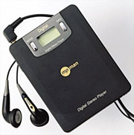
JBTD - MP3 Music Players - First Movers
South Korea - Saehan’s “MP Man” – 1998
An MP3 player with 6-10 songs on a flash drive
Despite questionable reception at the CeBIT trade show in Hannover, 50k units were sold in the first year for ~$200 each
"No matter how the Korean staff tried to explain what an MP3 player was, people didn’t understand why they needed such a device because they could listen to music with CDs or cassettes"
JR Bum, President of German Tech company MPIXAR

Slide 22
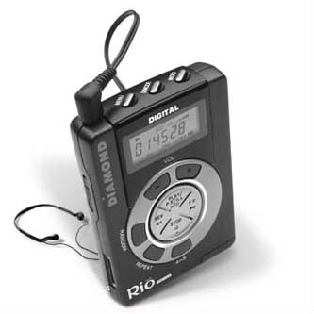
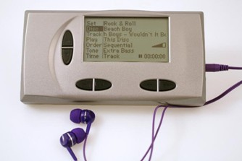
Music MP3 Players - First Movers
1998 - Diamond’s Rio - 200k units sold
30 minutes of music. Price $200
1999 - Compaq Personal Jukebox - 80 hours of music for $750
1999 - RioPort - First Internet online music download service
1998-2001 - Market is flooded.
50 different MP3 player devices available in the US alone

Slide 23
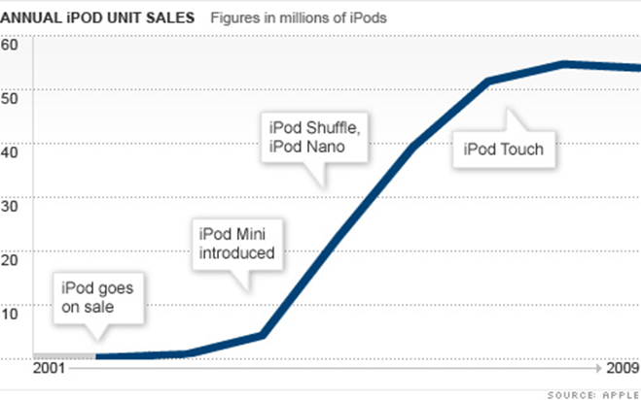
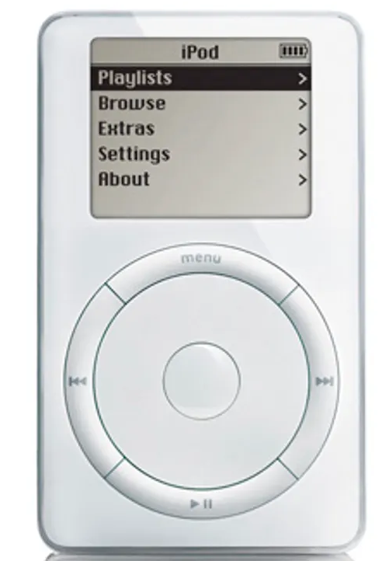
Music MP3 Players – the iPod

Slide 24
Jobs To Be Done – iPod
What is the Job To Be Done for iPod
Why was the iPod so successful? What other “Jobs To Be Done” did it solve?
The concept of Enablers
What was the next logical step?
Streaming – Spotify
What about other media?
  Movies
  Books

Slide 25

Jobs To Be Done – B2B Example, IBM
Thomas Watson, president of IBM, is reputed to have said in the late 1940’s : "I think there is a world market for maybe five computers."
IBM – The king of mainframes in the 1960s to the 1980s
Functional – Business administrative functions (Accounting, ..)
Contextual – Big companies, mainly banks and Fortune 500
Emotional – Blue suits, Fear, Uncertainty, Doubt (FUD), Social – Your competitors already benefit from it

Slide 26
Jobs To Be Done – B2B Example, IBM
History continues
IBM – Posted $8 billion loss in 1993, and hired a new CEO, Lou Gerstner from RJR Nabisco, and American Express
Turned IBM from a computer manufacturer to Professional and Managed services to same customers
In 2023 it made $7.5 Billion net profit on sales of $62 Billion

Slide 27
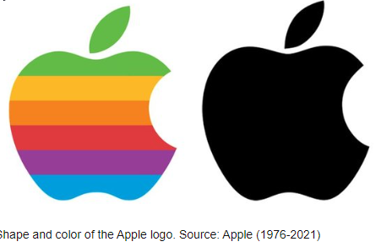
John Scully – Apple Computer
In 1983, Steve Jobs hires John Scully from PepsiCo, where John served as president from 1977 to 1983
John Scully increase Apple’s sales 10 fold in 10 years, from $800 million in sales to $8 billion in sales by 1993 !!
John had major disagreements with Steve Jobs and ousted Steve from Apple in 1985
John Scully was ousted from Apple in 1993 when company’s performance declined
In 1996, when Apple was on the verge of bankruptcy, Apple’s board asked Steve Jobs to come back as CEO
The rest is history ☺

Slide 28
Jobs To Be Done (JTBD) – Methodology
The process of identifying the “Jobs To Be Done” faces two big challenges and difficulties:
  For products that don’t yet exist, potential users have difficulty expressing their desires, and correlating their needs to the envisioned product
  For existing products, it is usually not simple to differentiate between the product and the Job To Be Done

Slide 29
Jobs To Be Done (JTBD) – Methodology
Instead of focusing on the product or the customer, JTBD shifts the perspective to the job itself. It’s about understanding what customers are trying to achieve and how they go about it
Questions you want to ask to validate the root need or job
Avoid asking about the product itself – focus only on the needs
Check how customers fulfill their needs today
What do they like about current solutions and processes
What don’t they like about the current situation?
Why don’t they like it?
What alternatives have they considered, tested or used

Slide 30
Jobs To Be Done (JTBD) – Methodology
Keep asking Why, Why, Why (sounds familiar? – Good !)
Go backwards in the chain of reasons and objectives
For each step back in the reasoning, ask the same questions:
  How they fulfill their needs today
  What do they like about current solutions and processes
  What don’t they like about the current situation?
  Why don’t they like it?
  What alternatives have they considered, tested or used
This is NOT a test with multiple questions, just a concept and guidance for a conversation that can lead to a better understanding of the Job To Be Done

Slide 31
Jobs To Be Done – Additional Aspects
Jobs are stable over time. While products change, the underlying jobs remains consistent
A job is solution-agnostic. Focus on the job itself, not a specific product or technology
Make the job the unit of analysis. Understand the job deeply to create better solutions
Instead of a “Solution looking for a problem”, focus on a “problem looking for a solution” – many times the solution is a fairly simple product, or service, or a combination

Slide 32
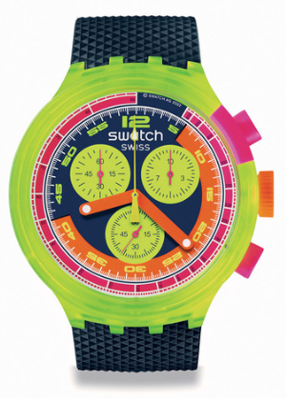
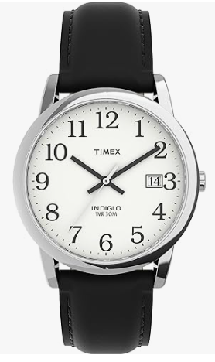

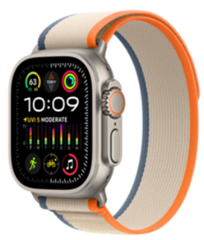
Jobs To Be Done – Market Segmentation
Social, Status Symbol
Emotional, Style, Fashion
Emotional, Gadget Lover
Functional,
Time Keeping

Slide 33

Jobs To Be Done – Impact on the Product
How do you make a Rolex watch into a social Status Symbol?
High price
Limited availability, waiting lists
High bars to be accepted to the club – Need to prove yourself
Side effects:
  Lucrative second-hand market with prices higher than retail
  An investment asset with appreciating value, similar to art
  Collector items, similar to art

Slide 34






Jobs To Be Done – Social Status Symbol
Annual production quantities
    Patek Philippe – 68,000
    Breitling – 170,000
    Omega – 570,000
    Rolex – 1 million
    Longines – 1.8 million
    Swatch – 3.2 million

Slide 35
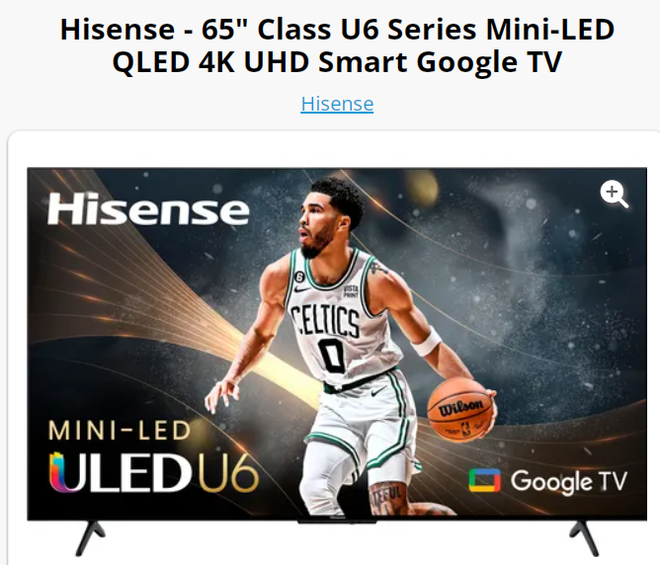
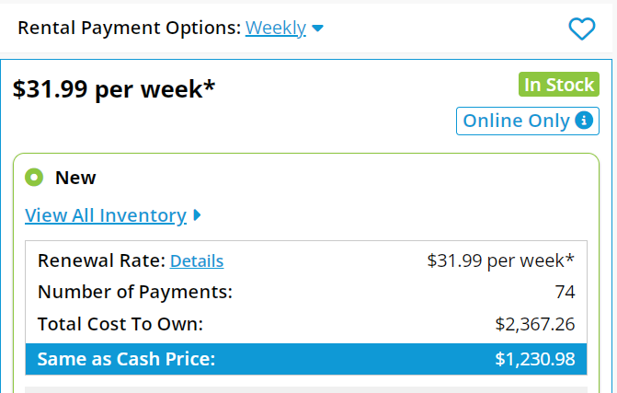
Jobs To Be Done – Market Segment by Context
Furniture rentals – Rent a TV

Slide 36
Jobs To Be Done – Market Segment by Context
In what context renting a TV for a week would make sense?
Exhibitors in exhibitions
Product demo tours

Slide 37
Jobs To Be Done – Market Segmentation
Airline Tickets – Market Segmentation
Business Class tickets – 2-3 times the price
Functional – Same as Coach, fly from A to B
Contextual – Business travel, the company pays for the ticket
Emotional – Better service on the ground, better seats, better
service on the plane
Social – Status symbol

Slide 38

Jobs To Be Done - Kimos
Kimos - The Bottle That Boils Water In 3 Minutes
https://www.youtube.com/watch?v=KqvZ9jlozS0
Sold 1,300 units on KickStarter for $89 a unit

Slide 39
Jobs To Be Done – Kimos
Market Segments, taking the 4 dimensions into account
  Contextual
  Functional
  Emotional
  Social
Mothers to small babies
  Contextual – Mothers, outside of their homes, who need to prepare
  a bottle of formula for their babies
  Functional – Boil the water to 100 degrees, sterilize fast
  Emotional – Worry not to infect the baby with unsterilized water
  Social – Uncomfortable to ask strangers for boiled water

Slide 40
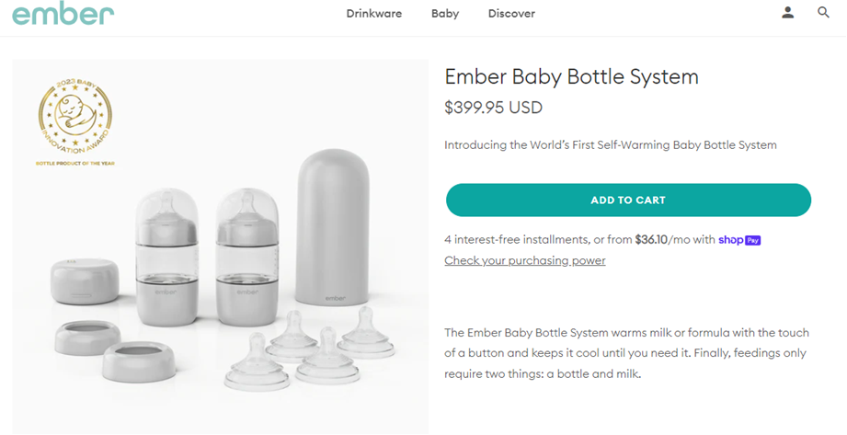
Jobs To Be Done – Impact on the Product & Pricing

Slide 41
Jobs To Be Done – Impact on Branding & Marketing
Create content on the dangers of using unboiled water
SEO Long Tail – specific cases of baby hospitalizations, a page per case
Publish content on Facebook in groups for new mothers
Position the product as the ideal present for the birth of a new baby
Google ads on words like “Materna”, or “Breast feeding”

Slide 42
Jobs To Be Done – Kimos
Market Segments, taking the 4 dimensions into account
  Contextual
  Functional
  Emotional
  Social
Travelers to exotic countries
  Contextual – Travelers to countries like India, Congo, Mozambique,
  who need to boil drinking water for safety
  Functional – Boil water to 100 degrees, sterilize fast
  Emotional – Worry not to get sick in a foreign country
  Not always trust bottled water, and it is not always available
  Social – Uncomfortable to ask strangers, who might not speak
  English, for boiled water

Slide 43
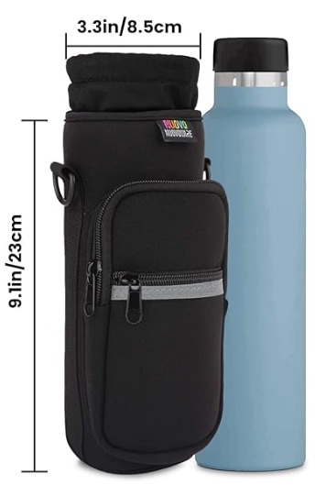

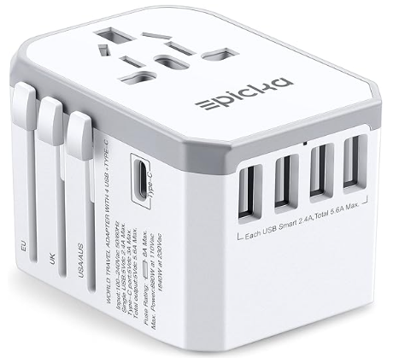
Jobs To Be Done – Impact on the Product
Package with water bottle carrier bag
and Universal Travel Power Adapter.
And potentially an extra battery pack for recharging if no power outlet

Slide 44
Jobs To Be Done – Kimos
Other potential markets for Kimos
Analyze the 4 dimensions, for each of them, and the impact they will have on the product, pricing and marketing
  Truck drivers
  Mountain bike riders
  Skiers
  Soldiers

Slide 45
Jobs To Be Done – and Innovation
Does a company need to develop a new disruptive technology in order to build a fast growing, profitable, successful company?
What made the following companies so successful?
  Microsoft (IBM PC)
  Apple (iPod)
  Meta (Facebook)
  X (Twitter)
  Amazon
  Nvidia (Vector processor)
  Salesforce
  Oracle, LinkedIn, AirBnB, Waze, ….

Slide 46
Jobs To Be Done – Enablers and Innovation
Does a company need to develop a new disruptive technology in order to build a fast growing, profitable, successful company?
Jobs To Be Done, combined with so many new technologies, offer plenty of opportunities to improve existing processes
A partial list of recent enablers
Speech to text
Translation
Face recognition
Picture recognition

Slide 47
Jobs To Be Done – Enablers and Innovation
A partial list of recent enablers – Continued
ChatGPT
  Enables high quality verbal man machine dialog – talk to your TV
  High quality data extraction from free text and forms – for example, extracting information from office rental agreements, medical records
3D printing
Drones – surveillance of building permit compliance in cities

Slide 48
SmartUp Academy
A program to teach the profession of building successful companies (…work in progress)
The Foundations Course
  The three pillars for a successful company:
    Profitable
    Fast growing
    Modest investment
Workshops – Specific Subjects
4-5 years Residency Program

Slide 49
The END – See you next time ☺

Slide 51
Jobs are stable over time. While products change, the underlying job remains consistent.
A job is solution-agnostic. Focus on the job itself, not a specific product or technology.
Make the job the unit of analysis. Understand the job deeply to create better solutions.
Instead of a “Solution looking for a problem”, focus on a “problem looking for a solution” – many times the solution is a fairly simple product, or service, or a combination.

