Slide 1

SmartUp Academy
Foundations Course
Lecture 1

Slide 2


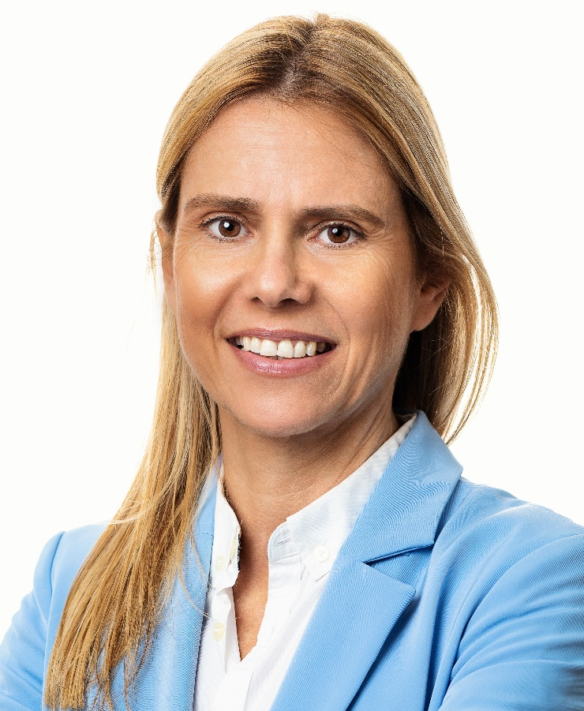

The SmartUp Founding Team
Yonatan Stern
Founder
And CEO
Libby Molad
Co-Founder and COO
Ayala Dinur Turgeman
Co-Founder
and CFO
Libby@smartupacademy.org
Yonatan@smartupacademy.org
Notes:
All right, first of all, let me introduce to you the Founding Team.
I’m Yonatan Stern. I’ll talk about myself at length later on.
Libby is a co-founder and the COO. Basically, everything you see here was organized by her. She took the full responsibility. You see her email address here.
Anybody who wants to get in touch with me, please do it through Libby, because she organizes. We get tons of requests and people interested, and we want to keep track of everything. So please do it through Libby. In that case, we will have tracking, and we understand what we’re doing.
And my email address is there as well.
Ayala is sitting there, and she’s the CFO and co-founder of SmartUp. And, there’s a lot of complexity in running this business and helping all the companies with their legal stuff and finance stuff, and that’s what Ayala does.

Slide 3




Yonatan Stern
ServiceSoft
Notes:
Okay, let’s start with myself.
So, I studied at the Technion in Atuda Academit. I won’t tell you the year, because that might disclose my age. And then I went to 8200 at the time when it was a huge secret, and I couldn’t say where I work or what I’m doing. The only people who knew what I was doing were all the Arabs working in the strawberry fields around the base, but that’s about it.
Then when I left the Army, we started a company called Rosh Intelligence Systems. I left that company in 1992. At the time, we relocated to Boston, which is where my accent, the American accent, is a Bostonian accent, for those of you who recognize.
And I left the company—we started the company in 1985—I left in 1992, and then the company changed its name to ServiceSoft, and later on was sold, and there was an Exit and a public offering and whatever.
I didn’t see a penny out of it, but it was an Exit.

Slide 4
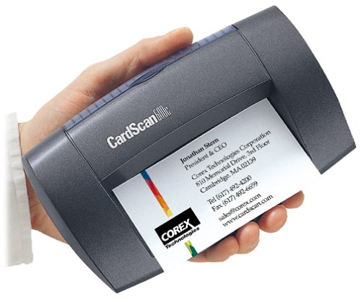
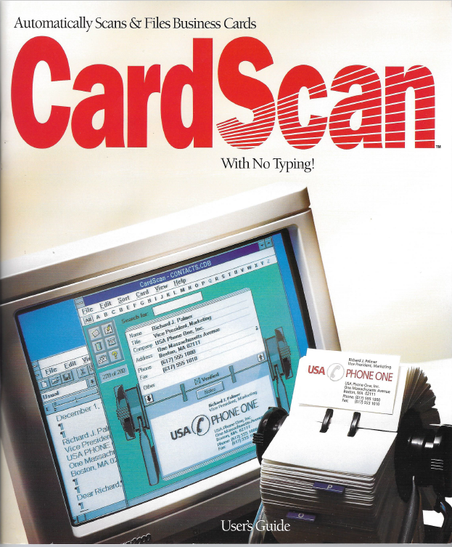
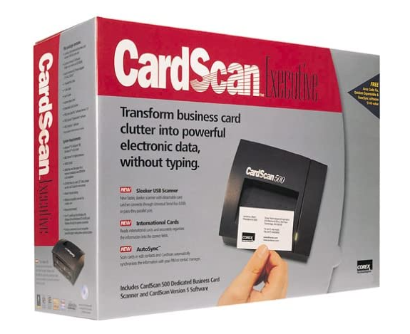
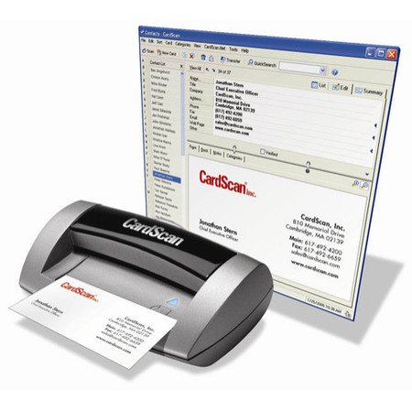
Notes:
Then I started a company called Cardscan, which I’m very proud of, because it’s the only company that I can explain to you exactly what it does.
It’s really simple‚ I can even hold it in my hand, and so it’s good to talk about something like that.
It’s basically a small scanner that scans and read business cards, create a database out of it automatically, and it was very successful, and the company grew, became profitable, and out of it, we started another company called ZoomInfo.
We have a few representatives here from ZoomInfo.

Slide 5



Yonatan Stern
Notes:
So ZoomInfo was started in the year 2000, almost as a spinoff from Cardscan. We didn’t do it as a spinoff, but it was kind of a spinoff to the shareholders, and we financed the company from the profits of CardScan.
I’ll talk about profitability at length throughout this course. So that’s why I stress all of that stuff—that we generated a lot of money at Cardscan, and we used it to build another company called ZoomInfo, started in the year 2000.
Zoom Info became profitable itself in the year 2002. And we built a directory of people. We’ll talk about it in one of the lectures.
And we started having a lot of traffic on our website. And we tried to build a business of advertising on our website on Bizo.
It went okay.
We reached about $750,000 a year in sales, which didn't make a lot of sense for us. So then we changed.
It was again spun off from ZoomInfo and in 2007. And then we switched the business model to use the data from ZoomInfo as a targeting data.
And we sold Bizo to LinkedIn in 2014, I think, for $175 million.
Then I started SmartUp Academy, which we’ll talk about it later. But, out of it, one of the first companies that joined us was a company called Opster. And we sold Opster to Elastic in October/November of last year.
So I had quite a number of Exits that I’m very pleased with.

Slide 6
SmartUp Academy
A program to teach the profession of building successful companies
What is a successful company?
Profitable
Fast growing
Modest investment
Notes:
So then I thought, ‘Okay, I did all of these companies. What did I learn from all of these activities, and what am I going to do with it?’
And gradually, it came to me that the companies—even though they were different from one another and were doing different things—there were principles that were common to all the companies that we were building.
And that these principles led us in a fairly safe way through the lifecycle of a company.
And I thought that we can teach it to other people.
So we started SmartUp about three, four years ago. And the idea is to teach entrepreneurs, people who want to be entrepreneurs, people who are in SmartUp companies, the profession of building successful companies.
And as you see, the word profession is highlighted. And the reason it is highlighted is that it’s a profession very much like any other profession.
So you go to an engineering school, you study civil engineering, you are on the Dean’s List, and you finish the Technion. Nobody, but really nobody, will let you design a high-rise building, right? Because you have no idea what you're doing. A few of you know that.
Why? Because then you left the Technion, you go and you work at an engineering firm for a few years. You learn and you specialize—whether you want to build bridges or high-rise buildings or tunnels or whatever it is—because it's a profession.
For entrepreneurs, there is no place to learn.
You have a great idea, you work at a company, you develop an algorithm or whatever it is, and you say, ‘All right, great, I'm going to go and raise money and start a company.’ And honestly, you have no clue what you’re doing because the software you develop is the easiest part of what you can do. Literally, the easiest part.
In all the lectures I'm going to give, I’ll never talk about product development, because most entrepreneurs come with knowledge about the product they want to build and zero knowledge about everything else, which is what we’re talking about now.
Now, how I define “successful company.” So, first of all, profitable.
Profitable means that the company is a grown-up company. So you have kids—many of you have kids, I guess—and if the kid is 30 years old and still lives at home and gets money from the parents every month, they are not grown-ups.
A grown-up is when you can sustain yourself.
A company that needs investment all the time is like a baby. They can’t survive. The moment you take the investment out, they die. So, a successful company is a profitable company.
It’s fast-growing because, otherwise it’s just not interesting.
So if you have a company selling a half a million dollars a year for ten years, it’s good. It's a nice vacation, I would call it, but it’s not an interesting, successful company.
And the last point is, what we’re going to teach in here is how to do it with a modest investment. And we will talk about that in following lectures many, many times.
So, what is the modest investment? It depends on the company you want to build, but definitely, it’s not in the tens of millions of dollars.
I’m laughing now that they call “pre-seed” with the $5 million round. I started CardScan and ZoomInfo and Bizo for less than $5 million altogether, so I don’t understand what that means.

Slide 7

SmartUp Academy
A program to teach the profession of building successful companies (…work in progress)
The Foundations Course
The three pillars for a successful company:
Profitable
Fast growing
Modest investment
Workshops – specific subjects
4-5 years Residency program
Notes:
You can see the words “work in progress.”
Honestly, we are doing the methodology that I’m going to teach you internally here, which is we try things, we see what works, see what doesn't work, and we keep improving.
So those of you who were with us at WOPA—the other building and small office—so as you can see, we have progressed. This is a much nicer office.
Yeah, stop laughing at us. They were sitting next to us in the office building. Yeah, in the same floor.
So what we originally started back four years ago, is we started helping and building companies. So we built companies. I’ll show you later what we built.
But that’s kind of narrow because it's a lot of work. It takes a long time to build a company. So were looking for ways to teach and train more people on the profession of building a company.
And so what we decided to do is several things:
First one is the Foundation Course. You are on the first lecture of the first round of the Foundations, and I’ll talk about it later.
And then we’re going to do workshops.
So here we’re going to talk about this in general terms, but later on we would like to do workshops. So, if you want to talk about ‘how do I do marketing for my company?’ we will put three or four companies in a room and work with them on their specific needs. So they will learn how to do so, and others will learn, as we do that.
The last element is the Residency Program. As you can see, we’re talking about a very, very long period of time.
It takes years to build a successful company, usually anywhere from three to five to even ten years. Takes a long time to build a successful company.
That doesn’t mean that it’s crazy hard work—you don’t sleep at night—to the contrary. But there is a time it takes to do things.
So, the Residency Program is a big investment on our part—there are a lot of people in here who are in this Residency Program, and they know how many hours we spend with them throughout that period. So we’re very, very selective at the companies we take for the Residency.
So now you see the logic, which is the course—anybody who wants to join is welcome to join. They will learn as much as they can. The workshops is kind of in-between—not a big investment on our time, but much more specific to the specific companies. And the Residency Program—we’re going to be very, very selective at who we work with.

Slide 8







SmartUp Companies
BionData
Notes:
So what are the companies?
The first one is Altnext. Was one of the first, we started working with them, and we failed.
Okay, so, with all due respect to how smart we are, we failed, and we had to shut down the company.
Then Opster, I told you, was in a very arcane technology, Elasticsearch, and they built tools for DevOps in Elasticsearch. And we were very successful there. We sold the company to Elastic, which is the company that produced the technology.
Bioforum is in the clinical data, clinical trials data, and we have two companies with them: Bioforum and BionData joined us three years ago—two years ago? Three years ago. And we’re doing really well, I think. We’re very excited about what’s going on there. I won’t go into the details because I’ll talk about it in one of the following lectures.
Tickchak, I’ve been with you, kama shanim [how many years]? Okay, so I’ve been with them for a year and a half or so, and we're moving really, really nice. Again, I won’t talk about it because there’s a whole lecture where we talk about these companies and show what we do there.
Intellichain is another one. We work with you for a year, right? About a year. Same with Sogomatic, which, right here. And, ClinicalSite is a company that we developed in-house. And actually it’s now on hold because we just don't have enough resources to do all of these things together.

Slide 9
The Foundations Course
13 Lectures – Equivalent to a semester in university
A lecture every 2-3 weeks
Still evolving – Your feedback and input is vital and welcome
Expected audience:
Participating SmartUp companies
Entrepreneurs, Founders, CEO’s and executives
Angel investors
Startup companies
Others –
Curriculum of the Foundations course
Notes:
Okay, so what is the Foundation’s Course?
We aimed, we timed it as if it is a semester, 13 lectures. And the reason is that next year, I’m going to give that as a course in university, so I wanted to try and build the curriculum for a semester. So, there will be 13 lectures every two, three weeks. There are holidays in between and so forth.
And your feedback and input is vital. So really, as we do it the first time around, anything you can tell me—good, bad, ugly and actually what you are missing that I didn’t talk about, please let us know.
Who do we expect to be the audience?
So, obviously, the SmartUp companies, as you can see, they have a representative here.
Entrepreneurs, founders, CEOs, executives of companies are welcome to join us.
Angel investors, because we are—I will not get to it now—but in one of the lectures I will talk about funding. So, you will see that the funding issue is a critical issue in all of these discussions. So, we would like to help angel investors invest in these companies.
Obviously, startup companies. When I differentiate between the entrepreneurs and founders and startup companies, I’m talking here about companies that are already midway—they raise money from VCs, and they get stuck. They feel that they need help.
And others, which means I have no clue who is going to come.

Slide 10
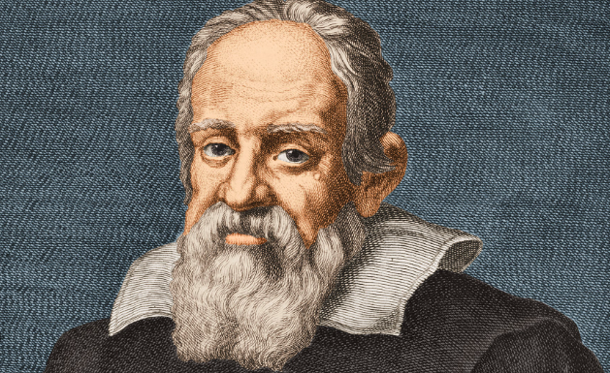
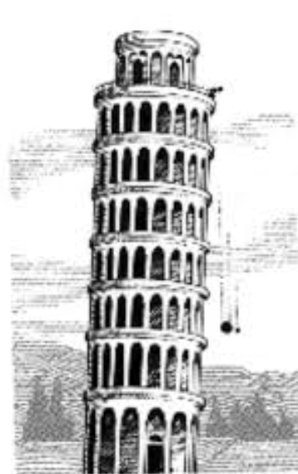
The Language of Business
Moving from Science to Business
“Mathematics is the language in which God has written the universe !” Galileo Galilei 1564 – 1642
Galileo was the first to write an equation in physics, and paved the way to Newton
What is the language of business?
Money !! Models to evaluate options
Notes:
So, what’s the curriculum of the course?
I’m going to take you through two minutes on each subject. I will not dive into it, but so you will understand what’s going to come in the next 13 lectures.
So, the first thing is, what is the language of business?
Remember that what I said is that most entrepreneurs come from an idea, a technology; they think they can change the world and all the good stuff.
But the reality of it is you move to a different domain, which is business. You need to start speaking the language of that business.
I’ll bring an example. Galileo Galilei, he says, “Mathematics is the language in which God has written the universe.” He was the first person who wrote an equation, which means he took measurements of speed and weight and whatever.
And you see the famous experiment of dropping two balls, a big one and a small one. And despite what Aristo said, the two of them reached the ground at the same time. So, he wrote the equation. They changed the world. Newton came after him.
What is the language of business?
Money.
Try to run your company without being able to pay salaries, and you will realize very quickly that it’s not working.
So what we’re going to do a lot during this session is convert everything to models where you can evaluate options.
You want to do something? Convert it to money. Figure out how much it’s going to cost you, how long it’s going to take you, and what are the expected results in money.
If you can’t convert it to money, you’re dreaming.

Slide 11
SmartUp Foundations Course – The VC model
Understanding the VC business model and its impact on VC backed companies
Expectations: Out of 10 startups
5 will shut down
3 will barely return the investment, or just drag along (“walking dead”)
1 will generate a 2-3 return on investment
1 will be a star, a huge exit, by IPO or M&A. Generating above 10x
9 out of 10 companies fail – very bad outcome for entrepreneurs
Notes:
Okay, so the first lecture—which is going to be today—we’re going to talk about the VC, Venture Capital, business model and the impact that this business model has on the venture-backed companies. So, I’ll go into a great detail then.
And let’s start with the kind of top line of what VC tell every company that walks in the door:
We expect that out of ten companies that we invest in, five will shut down.
Three kind of barely return the investment or just drag along. I’ll explain later on what the “walking dead” means.
One will generate a return—about two, three times the amount of money invested.
And one, the jewel in the crown, will be a star. A huge Exit.
Usually, when people talk about “huge Exit,” they talk about an IPO. Yes, there are M&As, mergers and acquisition—basically selling the company to another company. Very rarely, you will see the number attached to it—they sold this company at 300 million or 400 million. In most cases, they just say it was sold and acquired.
When we were at Opster, the VP of Sales came one day, all beaming, and she says, ‘Oh, my previous company was just sold for $50 million.’
I said, ‘Oh, great, congratulations.’
She says, ‘Not really. The investors invested 100 million, got 50.’
So, when I do all the analysis, I only do it on the IPOs, the public offerings. And the reason is because the numbers there are disclosed. You can see the numbers; you can do all the calculations. Remember, the language of business is money. So we can calculate.
However, if one out of ten succeeds, that means nine out of ten companies fail.
All of you are entrepreneurs, not investors. So, you really care about the nine out of ten that fail more than about the one that succeeds.
It’s really suckish to be in a company that fails.

Slide 12
SmartUp Foundations Course – The VC model
The FINITE game, impact of Exit on the founders
Profitability vs. Exit
The INFINITE Game
Why fail if you can succeed
Notes:
Then we’ll talk about what is the Finite Game and its impact on the Exit on founders, profitability versus an Exit—I will not go into details because in about ten minutes, we’re going to get into it in big details.
And the main thing I want you to think about is why fail if you can succeed.
So, the purpose of this Foundations Course is to give you the foundations of why fail if you can succeed.
Do I believe that all of you will finish the course and know exactly what you’re doing?
No.
But I hope at least to broaden your thinking, understand a few more ideas and how to do things, and at least think about them before you start or when you run your business.

Slide 13
SmartUp Foundations Course – Profitability
How to build a profitable company - Almost any decision has direct impact on profitability
Terra Incognita – Life is hard. Spend less than you make
The order of activities have a great impact on profitability
Branding First
The size of the team – the biggest weight on profitability
Measure Sales per employee
Continuous incremental improvements
Intro to business models
Notes:
Profitability. Remember, I said that’s the number one objective that you want to accomplish.
So, how to build a profitable company?
And the most important thing is that virtually everything you do will impact the ability to be profitable. Virtually everything you do.
Second, we’re dealing with terra incognita. Terra incognita, obviously, is Latin; it’s not English. And it means “unknown territory.” Right, “terra,” “territory,” same word.
Which means you start a business, you start a company, and despite the fact that you know everything about the business, you always are surprised that things just don’t go the way you expected them to go.
Life is hard.
So my formula for being profitable—remember, it’s all equations, money.
Spend less than you make. Really simple.
Why?
Because you can have expectations and you have projections and whatever, and life is hard. And so try to spend as little as possible and spend it only after you make the money.
The order of activities have a great impact on profitability.
People don’t think about it, but most companies that you will see come and start with building a product or a prototype of a product.
So, they go and they hire ten engineers or scientists or researchers or whatever you want to call them, okay? Now, they have five or six or ten people on the payroll. They work for a year. Ten people times $150,000 a year. It’s a million and a half dollars. And you haven’t sold a little, one piece of things.
What if you start with marketing first?—or actually, branding first; we’ll talk a lot about that—and start selling before you have the product.
I know, you look at me like I’m crazy. But the reality of it is that’s the right way of doing things.
And then you don’t need so much money because you didn’t spend a lot of money building a product that you have no clue who is going to buy it.
So I just said it. The size of the team—the biggest weight on profitability. At the end of the day, if you look at every company, 60, 70, 80% of their expenses are salaries. That’s the end of the day what you spend.
Very few companies have huge infrastructure costs or things like this. Most of your expenses are salaries.
So the size of your team is the big, heavy weight on your budget.
One thing to do is you measure sales per employee. If your cost per employee is about $150,000, you know exactly how much money you need in order to be profitable.
Okay, take 150,000 multiplied by the number of employees, 20 employees. You need $3 million, as simple as that.
So remember, money is the language of business. Back-of-the-envelope calculations can save you a lot of agony.
Continuous incremental improvement, or what I call later on: i-Square.
You never invent. I mean, look at this course. I said, ‘Okay, we’ll do it. We’ll start with something. We’ll give a course, and we’ll see what happens, and we will improve from one lecture to the other, from one company to the other.’
That’s the way things work.
But it’s important to think about it all the time and say, ‘How can I do it better today than I did yesterday? How can I do it better now than I did last month?’
If you keep thinking about incremental improvements, you’ll be surprised, looking backward at how far you have come.
It’s never done in a disruptive way—‘Wow. I solved all the problems in the world’—you never solve all the problems in the world. It’s all about incremental improvements.
And, I will also give you there, intro to business models, which is a whole big subject.

Slide 14
SmartUp Foundations Course – First movers Advantage
What is innovation?
Do you need to be first?
“The Innovator’s Dilemma” – Clayton Christensen
Sustaining Innovation vs. Disruptive Innovation
Advantages and disadvantages of being first
Disruptive innovations or Incremental innovations
The concept of Enablers
Business model innovations – Ealy Netflix, Pango, Wolt,
Notes:
Market Size
Another thing you’re going to hear from all VCs: you need a huge market in order to be successful.
Is that true?
So, it depends if you need an Exit or profitability, and that will be discussed later on.
Second is, when you talk about a big market, usually markets are not uniform. And I have my usual story. Those of you who heard it, please excuse me.
I call it the Chinese Dilemma. So, we all know China is huge, right? 1.4 billion people. And I can assure you, all of them eat rice. So I have an idea. I would like to sell one kilo of rice once a year to every Chinese. ‘Boy, am I going to be rich, right? What can be simpler than that?’
But I see already people smiling because you understand the problem is not the need and the product. The problem is the distribution channels, how you do all of that stuff.
It’s the details.
With every big market, there are a lot of details, and the market very quickly disintegrates into a lot of little islands.
Pick an island. Okay.
When entrepreneurs come to me, I always ask them, ‘Can you name your customers?’
And they look at me and they say, ‘Anybody who has…’ Right?
‘Anybody who does this will be a customer. Anybody who has that will be a customer.’
And I said, ‘Okay, can you give me a list of anybody who…’
And they look at me like, ‘What?’
I say, ‘You can’t sell to nobody. Give me a name of people you want to sell to.’
And only then they start to understand that if you don’t really—if you can’t really name your potential customers, you don’t really know them. You have no clue who’s going to buy your product.
Because the moment you start looking for their names, you start understanding, ‘Wait a minute, where do I find their names? How do I understand if they are big or small, where they are located?’ and all of that good stuff.
Then you start thinking, ‘Okay, how am I going to connect with them? And how are they going to listen to me?’
Okay, big problems.
So my suggestion, and I’ll talk about it at that course, is finding a beachhead.
Pick one island that fits your needs and focus on that one. And once you are successful, you can start growing from one island to the other.
Basically, same concept as terra incognita.

Slide 15
SmartUp Foundations Course – Market size
Do you need a very big market?
Exit vs. Profitability and its impact on market size selection
Big markets are not uniform – The archipelago concept
Who are your customers?
Can you name them?
Do you know how to contact them?
What do you know about them?
Find your beachhead – Branding First
Terra Incognita
Notes:
market size. Another thing you're going to hear from all VC's, you need a huge market in order to be successful. Is that true? So it depends if you need an exit or profitability, and that will be discussed later on. Second is when you talk about a big market, usually markets are not uniform. And I have my usual story. Those of you who heard it, please excuse me.
I call it the chinese dilemma. So we all know China is huge, right? 1.4 billion people. And I can assure you, all of them eat rice. So I have an idea. I would like to sell one kilo of rice once a year to every chinese. Boy, am I going to be rich, right? What can be simpler than that? But I see already people smiling because you understand the problem is not the need and the product. The problem is the distribution channels, how you do all of that stuff. It's the details. With every big market, there are a lot of details. And the market very quickly disintegrates into a lot of little islands. Pick an island. Okay. When entrepreneurs come to me, I always ask them, can you name your customers? And they look at me and they say, anybody who has.
Right, anybody who does this will be a customer. Anybody who has that will be a customer. And I said, okay, can you give me a list of anybody who. And they look at me like, what? Say, you can't sell to nobody. Give me a name of people you want to sell to. And only then they start to understand that if you don't really, if you can't really name your potential customers, you don't really know them. You have no clue who's going to buy your product. Because the moment you start looking for their names, you start understanding, wait a minute, where do I find their names? How do I understand if they are big or small, where they are located and all of that good stuff? Then you start thinking, okay, how am I going to connect with them?
And how are they going to listen to, okay, big problems. So my suggestion, and I'll talk about it at that course, is finding a beachhead. Pick one island that fits your needs and focus on that one. And once you are successful, you can start growing from one island to the other. Basically, same c

Slide 16
SmartUp Foundations Course – Branding First
Branding vs. Marketing
Examples of branding
What do you do first – build your product or try to sell it?
The cost of building a brand
Is “Viral” a reliable option?
How to create a brand without having a product
Long Tail SEO
Industry analyst
Free tools
A brand has a high value, independent of the product
Notes:
Branding First
So, what do I mean by branding as opposed to marketing?
So, these are two very different activities. Okay?
If I think about the Kardashians—anybody here who doesn’t know who the Kardashians are? You don’t know? Oh, you know. Okay, good. I’m so relieved.
Why do I say that? Because honestly, what do they do? They’re celebrities, right? They created a brand. They don’t do marketing. They created a brand. What are they going to do with the brand? Oh, tons of things.
They use their brand to sell perfumes, to sell cosmetics, to sell clothing. I don’t know what else they sell, okay? But the whole idea is that because they have a brand, they can get your attention, they can reach to you.
That’s a brand.
Now, if you think it’s only beautiful women who have brands, so let me ask you a question: who is the CEO of Mercedes? Do you know? No. CEO of General Motors? No.
CEO of Tesla?
[From Audience]: Elon Musk
How did you know that? Brand, right?
He doesn’t have dealers—you go on a website and you buy the car because he has a brand.
So, the first thing you want to think about is, ‘How do I create a brand?’ Not marketing. Marketing is lead generation. Marketing is all the work we do with press releases and all the other crap.
A brand is something different. A brand is you want your company to be the Elon Musk, the Kardashians.
Now, that’s a big task. You have to be creative. And I don’t have a solution for being creative, but I have a few suggestions when we get to it.
So, I gave you branding, some examples, so you know it.
What do you do first? I answered.
The cost of building a brand; that’s really important.
Because brands are creative, in most cases, the cost of creating a brand is a fraction of the cost of creating your product.
Listen again. Remember, money is the language of business.
The cost of building a brand, in many cases, is a fraction of the cost of building your product.
And a brand has high value.
So when you create a brand, it has a value independent of the product you were planning to build. So this investment that you do in the brand already has a payback without you building the product.
I know it sounds crazy, but the Kardashians are worth a lot of money because they have a brand. Tesla saves a lot of money because they have a brand. So it has tremendous value, okay?
People think about brand being viral. Well, you can also win the lottery, but that’s not a business model. I don’t know how to do anything viral.
Now, how to create a brand without having a product. So I have a few ideas; I’ll talk about them at length later on: long tail SEO, become an industry analyst, free tools, there are many, many things that you can do. Each company needs to find what works for them.

Slide 17
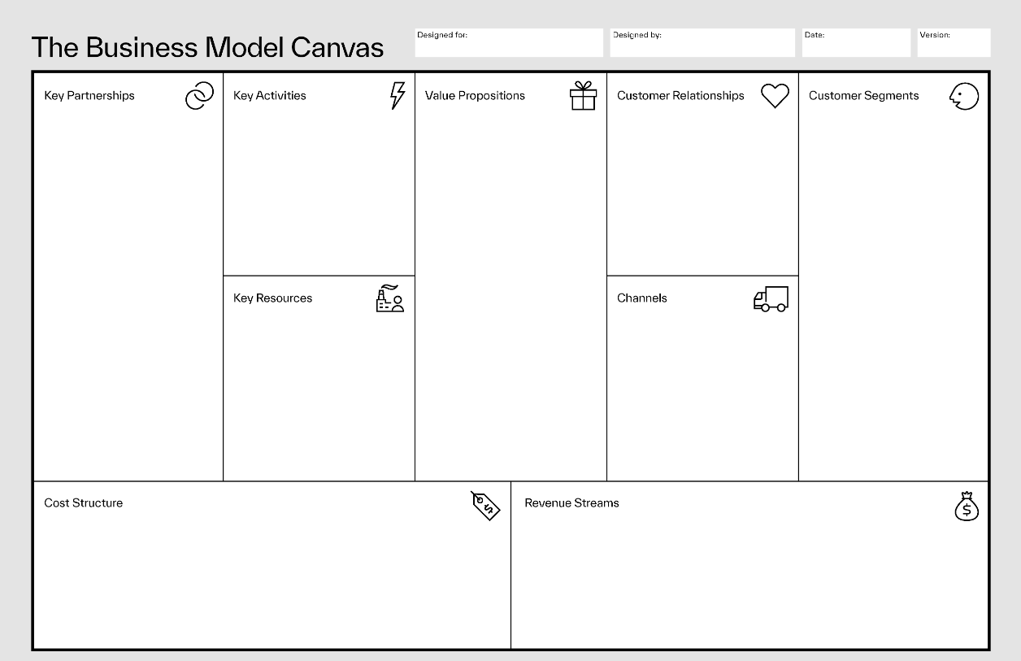
SmartUp Foundations Course – Business Model
What is a business model?
The business model Canvas
Notes:
Business Model
So, for you to build a business, then you need a business model.
There is a Business Model Canvas; that’s what I’m showing in here.
It’s kind of a structure to how you think about a business model.
I put it in here because everybody’s talking about it—I don’t really like it, so I’m not going to teach that one, but I’m going to show you other things.
But it’s just a simple model.

Slide 18
SmartUp Foundations Course – Business Model
Where is the value? technology, patents, products, customers, infrastructure, services, ….
The concept of “The complete product”
Customers First
Customer satisfaction vs. Customer delight
Direct sales model vs. eCommerce
Consultative sales
Owning the customer
Distribution channels, resellers, international sales
How to increase subscription renewals
Notes:
The main questions I’m asking myself is, ‘Where is the value that your business brings? Is it technology, patents, product, customers?’
Whatever it is, where is the value that you bring to the market?
And the other thing is the notion of a complete product.
The complete product is a really simple concept: people don’t want your product; they want a solution to something that bothers them. That’s what they want, not your product.
What’s the difference?
The difference is, for example, my favorite one is watches.
Their purpose, in the books, is to show the time, right? Used to be that because it was mechanical, some of them were accurate, some of them were not accurate. Nowadays, every watch is the same. They all are accurate.
So why do some of them cost $20, some of them cost $200, and some of them cost $20,000? Because they are not built to show the time. They are built to show something else.
If you spend $20,000 on a watch—stop laughing there—then you really want it to go like this all the time so that everybody can see it. Because it’s a statement: ‘I can spend $20,000 or $50,000 on a watch.’
Swatch, for example. They build their business on fashion, right? The watch is a fashion accessory.
So if you want to look pretty, you have a red one. If you want to look sad, you have a blue one. Whatever it is, right? It was a fashion accessory, not a time shower.
So that’s what I mean, the complete product. You really need to think about what the customer wants to solve.
Another thing. You have a technology, you have a product, but they don’t know how to use it. Happens a lot in high tech.
So, you don’t really want to sell them a product—you need to sell them the value of the product. You need to sit with them, work with them, make them successful. God knows what you need to do in order for the customer to say, ‘Yes! I’m delighted I got what I wanted.’
And in most cases, it’s not just the product.
Customer first means never think about what you do; think about what they want. Always.
When I started being in business, one day, a very smart consultant sat with me and I was talking about our measurements of customer satisfaction.
So I was talking about, ‘We measured this, we measured that’ and he looked at me and he said, ‘You already failed.’
I said, ‘What? You know, I’m doing everything that is written in the book. You know, I measure all of this satisfaction.’
He says, ‘Because you measure the wrong thing. You have to ask yourself, are your customers delighted in working with you? Not satisfied, delighted.’
When Apple comes up with a new phone model, people stand from midnight in long lines in front of the store. But they’re not going to get it tomorrow—they can get it tomorrow or next week or next month, but they are delighted.
That’s the difference.
So when you think about your business, think about ‘How do I get customers to swear by what they do with me?’
Another question that a lot of companies ask themselves: ‘Do we want to sell directly through salesforce, do we want to go through distributors, or do we want to sell on our website?’
Each one of these business models have tremendous ramifications about the product, the packaging, the pricing, so we will talk about that.
There’s consultative sales—just giving lots of things we’re going to talk about in this lecture.

Slide 19
SmartUp Foundations Course – Yonatan’s Model
Yonatan’s computational financial model – a tool to evaluate different options
Two dimensions – Time (months) and Money (Sales & Expenses)
Convert every element of the business model to money placed on the timeline – use parameters for stress testing
Compute 3 outcomes
Total investment needed to reach profitability
Number of months to profitability
Investment payback period
Startup financial model compared to real estate financial model
Sales per employee, stress tests,
Notes:
Okay, what is this, Yonatan’s model?
I decided to name something after me, just, you know, something.
So, the idea here, it said, that the language of business is money. So, I’m building a model that will allow you to calculate your business.
And the calculation goes along two dimensions.
One dimension is time. Every activity you do falls in a certain time and it has money involved, either sales, income or expenses.
So, you have a matrix, right? Time: every column is a week, a month, a year, whatever it is, and lines.
And you want to convert any idea and every element in your business model to money on this timeline, okay?
And I want you to use parameters—we grow every month by 5% in sales, by 2% in sales, by 10% in sales—so you have parameters that you can decide to play with. And you want to compute—and that’s the key in here—you want to compute three outcomes.
Number one is the total investment: all the money you lose every single month. So, you want to calculate it every month, and you want to sum it up until you become positive cash flow.
That’s the investment you need because somebody needs to pay all of this.
You can calculate the investment you need, and obviously, as you play with all kinds of options, you will get very different numbers, and I will show that later on.
Second parameters I want you to calculate is, how long it took you to reach profitability. Profitability is when your chart moves from negative numbers—that expenses are higher than income—to sustainable, profitable. Which means, ‘I generate cash month after month after month.’
Okay, how long? Ten months, ten years, 30 months, whatever it is the number.
And the third, which is unheard of, how long it takes you to pay back the investment.
Most startups don’t even think about paying back the investment—‘Why would I pay back the investment? I have an Exit, I’m going to be a billionaire. Everything is great, right?’
Well, no, it’s not right.
So, if you try to become a real estate developer, everybody will ask you, ‘When do I get my investment bank? When do I see my money back?’
And I think it is a really good philosophy to think about startups in the same exact manner—‘When am I going to see my investment bank?’
And if you start thinking like that, you will think about your business very, very differently.
Okay, I said that. And sales per employee.
What is stress test?
Remember, I said that there are parameters in this model.
So, what you want to do is start playing with the parameters and see what happens.
What if we don’t grow 10% month after month? We only grow by 1% month after month. What does that mean?
What if I can’t sell the product for $10,000 a year? I have to sell it for $2,000 a year. What does that mean?
The moment you start playing with these numbers—and they are related to one another, obviously—you will start seeing very different pictures, and you will have three numbers that will be calculated automatically for you: how much money you need, when are you going to be profitable, and when are you going to pay back the investment.
Very, very important.

Slide 20
SmartUp Foundations Course – Pricing & Packaging
Pricing and price elasticity models (competition, expectations, new product, differentiation, etc.)
Consumer pricing vs. Business pricing
Business decision-making process
Sales models and pricing – eCommerce or sales people
Price as a signal of quality and distinction
Pricing elements: subscription, one time, seats, records, data types, packages (by country..), etc. etc.
How to make money on FREE products? (consumer free → business pays, games, advertising, )
Notes:
We mentioned pricing, right? Pricing and packaging.
So, people believe that the market is sensitive to price. Well, price is really something very elusive.
As I said before, what is the cost of a watch?
Well, it depends. There’s no cost for a watch. Many people today don’t even have a watch—they use the iPhone or the phone, and they look at it, right? 15:52, eight minutes to a break.
Okay, so what is the price of the product?
So sometimes there’s competition. They dictate you can’t be ten times more expensive than the competition unless you really do something different.
Expectations of customers.
If it’s a new product, you might be able to set a new price. But again, people compare it to other things.
The differentiation you have with different products, and so forth.
So pricing is a very, very complicated thing.
Second, are you selling to consumers or to businesses?
Well, there is a whole different psychology about pricing for consumers and pricing for businesses.
Why? Because the person on the other side—negotiating with you, making a decision—if it is a consumer, they judge it from their pocket, so they are very emotional about it.
If they represent a business, they buy on behalf of a business, the set of criteria or risks they evaluate is very, very different. They don’t care about the price in business. They care about the risk and the benefits.
Because if they buy a certain product and it brings mayhem to the company, everybody’s going to remember it. If they buy a product and could have got it for $10,000 less, nobody even remembers. Nobody knows. It’s stupid, okay?
So when you price a product for business to business, think very, very different than consumers—and you have to take into account the business decision-making process because nobody in a company buys it on its own. They have committees, they have discussions, they have budgets, they have all kinds of things that you need to be aware of before you even start.
Again, you have to think about if you want to sell in e-commerce—essentially, people buying on the web—you can’t really sell for $100,000. Nobody’s going to put a credit card for $100,000.
If you want to price your product at $100, you can’t really have salespeople because no salesman will be able to get any commission from this kind of price. So this decision of whether you sell with salespeople or e-commerce dictates the kind of price range you can go.
[From audience]: Tesla and Elon
Because it’s a very well-known product and he’s a genius. I know, I wish you to be as smart as him, I’m not. So. With geniuses, it’s different. I don’t know. It’s successful, I agree, but I don’t know how he does it.
Price is also a signal of quality, and don’t underestimate it.
You go, and you buy perfume, and it costs, I don’t know, $50 for a small bottle. Why? This doesn’t cost them $50, but it sends a message: this is a really good one.
When I say price, well, price is even not well-defined. So, how do you create a price?
So, think about CRM. How do you charge for a CRM? By seat? User? By the amount of data? By the number of records they keep? By transactions? By—you name it—you can create a pricing model that will be as complicated or as simple as you wish.
And it’s really an art, and a lot of thinking on how you build the pricing model.
And the last question, of course, is, how do you make money on free products? The example I like a lot is Zoom Communication, the Zoom we all use for meetings.
So, they made a really smart distinction between their free product and the business product. They didn’t want to irritate the users, the consumers, the free product. Yet, they wanted to force businesses to pay. And they do something really stupid and simple: after 40 minutes of the free product, it turns off.
So, if you talk to your wife or to your great uncle—you know, you say, ‘Okay, I’ll call you back in a minute.’ Nothing happened, right?
But if you’re in the middle of a business meeting and you try to negotiate a $10,000 deal and suddenly the 40 minutes are off, people will say, ‘Well, he can’t even afford to buy a Zoom license? What’s wrong with this guy?’
So, even that little irritation caused the distinction and differentiation between the two products. And that’s a great example.

Slide 21
SmartUp Foundations Course – The team
What is a co-founder and how to find co-founders
Team for a VC backed company vs. a team for building a profitable company
When to hire a new person
Parkinson's Law - work will expand to fill the time allotted for its completion
Price’s Law - 50% of the work is done by the square root of the total number of people who participate in the work (like the 20/80 rule)
Who to hire –
No ego, Results oriented, Smart as hell
Peter’s Principle - In an organization, every employee tends to rise to his level of incompetence
Notes:
Tov [good], the team.
And then we will finish this and take a break.
What is a co-founder? People come to me, and they have two co-founders, three co-founders.
Who are they, and how do you find co-founders?
I’ll talk about it when we get there because I don’t want to say anything that might irritate people here, so.
Remember that a team that VCs expect is probably different than the team you are going to build if you want to build a profitable company.
So, the direction you want to take your company dictates what kind of a team you’re going to build, and you need to think about it.
When do you hire a new person? You say, ‘What? When I need!’
So, I’ll bring you a few laws that we will talk about them later. They’re very funny.
Parkinson’s Law: work will expand to fill the time allotted for its completion. Or the opposite: if you want anything done, give it to the busiest person, right? That’s the mirror image of the same rule.
So you bring a person, if they’re not—if you don’t give them enough work, they will be very, very busy disturbing other people, generating work for other people to show that they are really, really busy. They will create all kinds of stuff.
So, before you bring a person, make sure that everybody else in your company is, you know, don’t have a minute to say ‘Hi,’ even.
[Price’s Law] That’s a new law that I’ve learned just a few weeks ago: 50% of the work is done by the square root of the total number of people who participate in the work. It’s like the 20:80 rule.
That’s a very interesting law because it was experimentally tested. The person who wrote it—Mr. Price—he was a historian of science, and one day, he decided to check on every subject, how many articles were written, and how many writers there were.
Okay, so let’s say that there were a thousand articles and 100 writers that wrote these thousand articles. He found that the square root of the writers, ten, wrote 50% of the articles, 500, and 90 wrote the other 500. So, in every company, you will find that there is a small group of people that do most of the work and most of the value. So before you go in to hire a new person, think twice.
Who to hire?
I have three rules when I hire—very hard to figure them out. I mean, when you interview people. But that’s a different story.
- First and foremost, no ego. Which means the person doesn’t sit there and tell you all the time, ‘I did. I did. I’m this, I’m that.’ That’s a disaster. A person that thinks about himself in every meeting shouldn’t be in your company.
- Second, results-oriented. Which means they don’t tell you, ‘Oh, I worked so hard. I worked the whole weekend.’ Honestly, I don’t want you to work the weekend.
I like when you come, and you say, ‘Here’s what I did last week. I checked this. This is working. This is not working. I don’t this, this, this, this. And I was on two days vacation last week. So I’m sorry I didn’t accomplish more.’
This is the kind of person I like. They need to measure themselves. Not you, them. So you only want people who measure themselves. That’s the way they think about themselves. Not something you try to enforce them to do.
And last but not least, smart as hell. Try to find them.
Peter’s Principle. And this is really, really important about who to hire.
In every organization, every employee tends to rise up the ladder, right?
When do they get stuck?
If you think about it for two minutes, you say, ‘They get stuck when they can’t get promoted anymore because they fail. That’s where they get stuck.’ Right?
But think about you as a startup wanting to hire people. ‘Wow. I have this guy, he was VP of Marketing in three different companies. Wow, what a hire I get, you know? Really experienced person.’
So, the first company he got, he was fired because he was at the level of incompetence. Then, he kind of found his way to two more companies, didn’t have any growth within the companies.
Never hire them. Remember this rule. It is really, really dangerous.

Slide 22
SmartUp Foundations Course – The team
Leadership is personal – Founder/CEO sets the company DNA
How to make people productive and happy – title vs. jobs
Compensation pitfalls – annual review, bonus structure, stock options, salary fairness, new employee salary vs. salary increase, ”exposed” pay chart, “Employee of the month” vs “Night on town”
Company morale
Paying attention – feedback
Openness, transparency, listening
Official org chart vs. actual influencers
When to fire and how to fire – time is money squared
Notes:
Leadership is personal.
Which means every company looks like the CEO. At the end of the day, every company looks like the CEO. And that’s not bad—that’s great—because you’re not going to change yourself. You’re also not going to change the people that work for you.
But you have to be aware of what is your personality and hire people that work well with it. Because the company will look like you and you will best if everybody will understand it and behave like this.
How to make people productive and happy.
There’s a whole theory that I have about it which says: because we are all different, nobody is like the other person—I don’t really care about your title. I care about what you like doing.
And then you take the team and you kind of shift the jobs until everybody gets what they really like doing, regardless of their title. No ego, remember? No ego.
And then everybody gets up in the morning, and they’re really excited because today they’re going to do what they like doing. So, they can’t wait to get to work because they like doing what they do.
It’s much better than taking [unintelligible]. ‘In your job. You also have to write press releases and I can’t write two words, you know, so what if I’m in marketing? I don’t like writing.’
Compensation pitfalls, I will not go in because I think we need to take a break. But tons and tons and tons of mistakes about compensation, and people don’t understand why people are angry. So you have to be very careful about it.
The one I really like is the employee of the month. Every company has the employee of the month, right?
Great idea; what can be better? The employee of the month will feel appreciated. Everybody will clap their hands and great. So the first month works really, really well. The second month, you can’t give it to the same person, right? So you go to the next in line.
The third month, you can’t give it to the first two, even though they’re really still the employee of the month, they haven’t become worse. You know, they are the employee of the month—they do 50% of the work, but you can’t really give it to them month after month after month. That’s stupid.
[Unintelligible question from the audience]
Right, you know, so very quickly you get to the point where number ten in the rank is getting the employee of the month because you have to give it every month. So don’t ever try employee of the month. It’s the most stupid plan ever.
So, what do you do instead, right?
It’s like, you know, the Parkinson’s—the Peter’s Principle, you know, it’s so obvious.
So what do you do instead?
What I did, at least, was “night on town.” If somebody did something nice, I would go to him personally, alone, discreetly, and say, ‘Listen, you did a wonderful job on whatever it was. I want you to take your wife to the best restaurant in Boston, in the next two weeks, and have a night on town and tell your wife I paid for it, and bring me the receipt. And if you don’t bring me the receipt in two weeks, don’t go again, you know. Two weeks and you bring me a receipt. Go wherever you want.’
What that caused, first of all, nobody else knew, so no—[video cuts off]

Slide 23
SmartUp Foundations Course – Financing options
Companies that focus on profitability need smaller investments than companies focusing on an Exit
Smaller investments with relatively big equity and a much higher success rate can be attractive to Angel investors
If Exit is not the target, how do investors make money?
Use creative financing options, like a loan plus equity, with the loan gradually paid back out of profits.
Other options exist
Over time, VC firms will support companies using the SmartUp approach as part of their portfolio
Notes:
First and foremost—important thing—if you focus on profitability, then you need smaller investment than companies that don't. And that’s critical because the smaller the amount of money you need to raise, the more options you have of raising the money. Okay?
Smaller investments with relatively big equity and a much higher success rate can be attractive to angel investors. Right?
There are some angel investors here in the room. I won’t tell you who they are because they wanted anonymity.
So, this whole process of focusing on profitability and small investments can be opening up the whole financing market to some other alternatives.
Well, if Exit is not the target, how do investors make money? And I’ll talk about that.
And we also develop creative financing options as part of the SmartUp Academy. That’s one of the subjects we’re still thinking about, debating, talking—because obviously, even if you need small investment, you still need an investment, and we need to find ways to provide it to you.
My hope is that VC firms will also realize at some point that with the amount of money they have, they can build ten times as many companies with a much higher success rate, and it’s not very smart to spend $50 million on a company that fails. Okay?
The way we think about—currently as a potential investment vehicle—is to do the investment as a loan, very much like a real estate project. So you give a loan, and the loan goes back to the investor once the company becomes profitable, taking about 20% of the profit every year to pay back the loan. And still, the investor stays with the equity. But because the amount of money raised was small, then usually the founder stays with a lot more equity than otherwise.
So I did it with Opster, and I don’t think you will hear any complaints by the amount of money that all of them made on a fairly small, decent Exit. And everybody made money there, so.

Slide 24
Venture Capital Model
Venture Capital firms say that 9 out of 10 companies fail
In reality it is much worse
9 out of 10 companies fail – very bad outcome for the founders and employees
Why fail if you can succeed?
SmartUp Academy – Learn how to build a successful company
Notes:
Okay, so we talked about VC, and we’re talking about that in this presentation.
So we’re moving now to the lecture of this week. Previous was, as I said, the syllabus for the entire course.
So, nine out of ten companies fail.
Well, that’s what they say.
But remember—numbers, money. If I can check the facts, I’m going to check the facts. So it’s very about outcomes for the employees and the founders.
And my question is, why fail if you can succeed?

Slide 25
Questions ?

Slide 26
Venture Capital View of a Good Startup
One of the first things most entrepreneurs and startup companies do is seek to raise money from Venture Capital firms. VCs look for
A great team – experienced, rounded – all functions, work well together
Target a significant problem of a big market
Disruptive technology, or at least a disruptive model
First to market – an advantage
Need to be able to grow fast
Profitable model ?? In 2021 – NO, now Yes
Notes:
Tov [good].
So, how does VC work?
Okay, so what do they look for? You go to a VC—I don’t know if any of you went to VCs and had the beautiful experience—so what do they look for?
First and foremost, all of them will tell you, ‘We look for a great team. Okay, what do I mean by a great team? We want people with experience—who doesn’t want people with experience, right? We want them rounded. Rounded means we want to have a VP Marketing, and a VP Sales, and a CEO-Founder that already did three Exits’ and yada, yada, yada, yada.
So they want a big team; they want people who work well together; preferably people who already built one company, had an Exit, and now they’re building a second company—everybody is chasing them.
But the reality of it is 99% of the entrepreneurs don’t have any of that stuff.
So I was visiting a VC firm that gave a lecture and they were telling people that they see a thousand business plans a year and meet with a thousand groups of people. Out of those, they meet second time with 200 companies or groups, and out of the 200, at the end, invest in eight.
So, the chances of even getting through a VC is eight out of 1000. Out of ten starts to look great, right?
Second thing they want is they want a big market. ‘We want you to solve something big.’
The bigger the better, you know. Maybe a machine that can fly and dive and kills and whatever, you know, the bigger the dream.
So, profitable model.
So until 2001, nobody was talking about profitability.
You know the famous story of Mark Twain? That when he was 16, he realized that his father is an idiot—total idiot; doesn’t know anything—and when he reached 21, he was surprised how much his father learned in five years.
So the same in here, you know, come 2022, and everybody’s talking about profitability. Duh. You know?
Obviously, if you have a company that is losing money, you are at risk.

Slide 27
Venture Capital View of the Startup process
Invest seed money or round A money
Raise more money every year or two years, at rising valuations
Push the company to grow as fast as it can grow
Have an Exit – preferably an IPO (Initial Public Offering) in the USA, or sell the company at a profit to another company (M&A)
VC Expectations: Out of 10 startups
5 will shut down
3 will return the investment, or just drag along (“walking dead”)
1 will generate a 2-3 return on investment
1 will be a star, a huge exit, by IPO or M&A. Generating above 10x
Notes:
So how do they work? What is the process? Usually, they start investing in rounds.
So they invest “seed” or “round A,” depending on the terminology. Now they talk about “pre-seed.” Soon, it will be “pre-, pre-, pre-germ”—I don’t know what. It’s like, all kinds of names—doesn’t matter.
But they want you to raise money every two years or so—every year or every two years. We will talk about it later, why they want companies to keep raising money. There is a real reason why, and it’s not for you.
They push the company to grow as fast as possible because valuations, usually when you go to an IPO—IPO means Initial Public Offering, basically going out to the stock market—the faster the company grows, the higher the value it’s going to get.
Why? Because people say, ‘Well, this year they sold 100 million. If they grow 50% year over year, in two years, they will sell $225 million. So the value will grow very, very fast. So, the value is a multiple of revenues and profits. If the company grows really fast, the value of it will grow very fast and we will make a lot of money.’
So that’s why they want companies to grow fast, and they want a company to have an Exit, preferably an IPO.
Sometimes, they will go with an M&A. Usually, the reason they want to go with an IPO is that the valuation you’re going to get in the public market is higher, and there is a liquidity for the investor as well. An M&A is a one-time deal.
And we talked about this: five go under; one hopefully goes to an IPO.

Slide 28
Venture Capital Model
Venture Capital model is that 9 out of 10 companies fail
In reality it is much worse
9 out of 10 companies fail – very bad outcome for entrepreneurs
Why fail if you can succeed?
SmartUp Academy – Learn how to build a successful company

Slide 29
Venture Capital Money Flow
Startup 1
$$$$ Investors
Pension Funds, Insurance companies
Limited partners
Venture Fund
General Partner
Startup 2
EXITS
$$$$
Startup 3
Notes:
So let’s talk about Venture Capital Flow.
So, venture capital company is actually two different parts.
There is the venture fund. These are the people you meet. So the people you meet are actually the managers or what’s called the “general partner.” They raise money from their investors. So it’s not their own money. They raise money from investors.
Who are the investors?
Pension funds, insurance companies, companies with large pools of money that usually invest 95% of the money in safe and low-income investments, but they allocate about 1 or 2% of their funds to high-risk, hopefully high-return options, like venture capital.
So, if you manage a trillion dollars—and 1% of it is a lot of money—you invest it in a VC firm, okay?
So they are called the “limited partners.”
What do they do? They give the venture fund—let’s say, you know, the venture fund raised $200 million, and then they take this money, and they start investing in Startup One, Two, Three, whatever. And then, hopefully, there are Exits, IPO, or M&A. And then they put the money back into their investors. Okay, so it’s a round trip.
The reason that they need an IPO is very simple: these groups, you know, pension funds and insurance companies, put money in, and they won’t get money out. They have nothing to do with 2% of a successful company that they cannot liquidate the investment. So an IPO or an M&A is a must. It’s not an option, it’s not “nice to have,” it’s a must for a venture capital firm.
Bear that in mind.
So, some of the behaviors I’m going to describe to you really don’t come because they’re stupid, because they don’t know what they are doing, or anything else. It comes because their financial structure dictates it.

Slide 30
Venture Capital Timeline
Money from investors comes in
Invest in new startups.
Seed money, Series A round
Repeat investments in same companies
Hope for an Exit
Possible time extensions
Official end of the fund
Inception
Year 1
Year 2
Year 3
Year 4
Year 5
Year 6
Year 7
Year 8
Year 9
Year 10
Notes:
So, let’s look at the timeline of it.
So, inception, they raise money from the investors. In Year 1 to Year 3, they make the investment—the seed money, the Series A. Essentially, they select the companies they are going to invest money in.
Their entire lifetime is seven years. That’s it.
So, in the agreement that they do with their investors, usually, it’s a seven-year deal: ‘I give you $5 million, and you better return it to me as $10 million, or preferably $15 million.’
It’s money coming in, money coming out.
So, for money to come out, you need time to generate it; you need time for the company to reach an Exit. So that’s why they invest in new companies very early on. Then, later on, they do subsequent investments in the same companies.
That’s kind of the structure that they work.
The official end of the fund is at the end of Year 7. But because life is hard—and most companies you can’t liquidate them at the end of seven years—usually, they get extensions. Seven years come, nine years come, ten years come, even more.
When I did CardScan, some of the investors put the money in 1993, and our last Exit was in 2017. So they couldn’t complain because they kept getting money from CardScan, from Bizo, from all of that stuff. But the last monies came out 20 years later, and they were complaining that they had to wait so long.
So these are the time extensions. Usually, people talk about 8, 9, 10, 11 years of this, okay?
So that’s the timeline, and we need to remember the timeline.
Second, which is not in this chart, they raise funds. “They,” I mean, the venture capital firms raise money themselves every two years or so. So they raise $200 million. Two years later, they need to get fresh money. They go out, they raise another 200 million, and so forth and so on.
And usually they call it Number 1, 2, 3, 4. So, if you have, I don’t know, Yonatan Ventures. So it will be Yonatan Ventures 1, Yonatan Ventures 2, Yonatan Ventures 3, right? It’s basically layers of money that they raise. Each one of those is packaged differently.
Now, they raised $100 million from an insurance company. They come two years later, and they say, ‘Hey, we want to raise another round.’
And they say, ‘Okay, great. What did you do with my money?’
They said, ‘Oh, we invested it in Company A, Company B, Company C.’
And he says, ‘And how well is it doing?’
He says, ‘Okay, I don't know. We'll have to wait seven years.’
He says, ‘Okay, I'll wait seven years. When you know, show me in seven years, I'll put my next money.’
Obviously, VCs don’t like it, so what do they do? They push you—if you’re doing reasonably well—they push you to go and raise additional round. Hopefully, if the first round was at the valuation of $20 million, now they want you to get $30 million. Now, they can put in the books: ‘We made 50% on the money because it was worth 20, now it’s worth 30—50% growth. Great, we’re doing wonderfully.’
So the only way that they have to show growth before there is an Exit or an IPO or anything is by [video cuts off]

Slide 31
If 9 out of 10 Fail, How do VCs Make Money?
Very big Exits are usually when companies go public (IPO, Initial Public Offering) in the USA on Nasdaq or NYSE
A reality check:
Every year about 1,000 companies are founded
Since the year 2000 more than 20,000 companies were created
In that period less than 100 companies went public and only 38 companies were valued at more than $100m, of which 24 went public during the hype of 2020-2022
Less than 1 in 500 or less than 0.2%
Notes:
How do you make the big Exit—the one big Exit?
So the big Exit comes, as I said, usually from an IPO. We looked only at IPOs in the US market, which is the main market where people go out when they feel they are successful.
So, we did a reality check. Every year, about 1000 companies are founded.
I think, last quarter, they were at a rate of 500 and everybody was totally shocked that the rate of creation went down.
[Unintelligible comment from the audience]
Just in Israel—I’m talking now just Israeli companies—even though I speak English, talking about the Israeli companies.
So since the year 2000, we looked at all the companies—startup companies—that started from year 2000 and onward, and there were about 20,000 companies, a little more, that were created in that period.
And now look at the numbers. Less than 100 companies went public. 20,000 companies—north of 20,000 companies—and we counted, okay? Ruthie sat down and counted how many of them. Less than 100.
But if we lower it, we said, ‘Okay, we only want companies that went public at a valuation above 100 million.’
Why we did that? Because there were a lot of companies, like pharma companies, that basically, instead of raising money from investors, raised money from the IPO market—and they usually went for very low valuations, 50 million, 40 million, things like that.
So, only 38 companies raised more than 100 million—worth more than 100 million in their IPO—out of 20,000.
Even worse, the bubble years, 2020 and 2022, two-thirds of those companies—two-thirds came out in these two and a half years. Because it was a bubble year, everybody could go public, basically. But the previous year—the previous 20 years—from The entire financial industry is not my darling, okay? They make money. They take 2% per year, don’t worry about them.
Guys, listen, you don’t want me to say bad words. I think you got the numbers—these are the numbers that we verified two or three times.
I can give you the list; you can do the work. I’m just giving you the facts the way we saw them, okay?
Your interpretation is as good as my interpretation. Unless there’s a huge black hole that generates a lot of money for the VC, I don’t know where it is.
I can make the picture even darker because, at the end, you don’t really care about the IPO of the company; you, as the founder

Slide 32
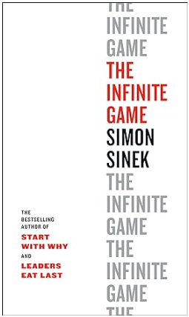
The Infinite Game
What is an Infinite Game?
An Infinite Game is a journey towards a purpose, just like LIFE
What is a Finite Game? - Basketball, football, baseball, chess, tennis, ….
Clear rules, designated players, a beginning and an end, winners and losers
….. and what happens the day after the win?
An Exit is a Finite Game !
Notes:
Okay, The Infinite Game.
It’s a book by Simon Sinek. And I read it, and it really struck me as something. The book could have been an article—the main messages are pretty short—but it’s a book, and he’s talking about the difference between an infinite and a finite game.
And what is an infinite game?
It’s a journey towards a purpose, and the example that he gives is life. Hopefully, there’s no quick exit of the game. You really want to stay and play the game. So that is an infinite game.
What is a finite game?
A lot of games that you know: basketball, football, baseball, chess, tennis, you name it.
And what are the rules?
So you have clear rules, right? If you play baseball, there are rules for the playboard. There is designated players—you know who plays, who plays against you—there’s a beginning and an end, and there are winners and losers. That’s how a finite game is played.
Now, what happens the day after you win?
You start all over, right? Because you are the last year winner, that’s nothing this year. So you either try to win a game, or you’re a loser. You’re always a winner or a loser. That’s it.
So, I’ll share with you what happened with me. So I was a winner. I got an Exit; I sold the company. And because I founded ZoomInfo, my personal email address was yonatan@zoominfo. What else would it be? And suddenly I stopped getting all the mails from the banks, from everywhere, you know. All my subscriptions were canceled because I sold the company—my email address was closed. That was a shock to the system. Even though it’s obvious, it was kind of, ‘Wow, they have taken my identity. That’s horrible. I sold it for a few dollars in the bank.’
An Exit is a finite game—regardless of whether you sell your company or you do an IPO. ZoomInfo today doesn’t look, at all, like it used to look when it was a private company, because there are quarterly meetings and you need to hit certain targets, and it drives the whole company nuts.

Slide 33
The Infinite Game
Principles of the Infinite Game:
A clear, long term, worthy purpose, well communicated, “The flag on the mountain”
Flexibility – Independence, Courage to make decisions, evolve and change on the road to the worthy purpose
A trusting team – a group of people who work together and support each other. Respect, openness, transparency, listening
The journey is the game – not a one-time winning
Notes:
So, what are the principles of the Infinite Game?
First and foremost, you need a clear, long term, worthy purpose, well communicated. I call it the flag on the mountain or the flag on the hill.
So you have to know and communicate to everybody what you want to be when you grow up—and you never grow up, by the way.
So Smartup Academy is this:
We want to show the world that there is a better way of building companies where you can be very successful and do a good job, and you don’t need an Exit, and you can enjoy life while you do it.
And that’s my mission, and everybody at SmartUp Academy, when you ask them, they say, ‘no, we’re not trying to make money. We’re not trying to—’ We do, but we don’t try—that’s not the target.
The target is to really build a school that will deliver that message and show people how to do it. Educate people how to do it. It’s a profession. It can be taught, and we’re going to help them succeed.
And the reason we have the Residency Program is because it takes a long time and we want to show that it’s doable. And to me, Opster is a checkbox. Yes. We started the company, and four years later, we had an Exit. So, there’s a checkbox. And, the founders and the employees made tons of money, and they were very happy.
So that’s the flag on the hill for me, and everybody that works with me knows it. It’s well communicated.
However, how do you get there?
That’s flexibility. That means we’re not sure, really. I hinted at that at the beginning. So we now have a course, and hopefully, it will give you something to think about, open your mind to different ideas and different ways of doing things, okay?
Will it change your life? I hope so, but I doubt it. I think we will need to do more, maybe more residency, maybe bring more people to help us. We’re not sure yet, okay?
So when you build a company, you do it this way. You know where you want to be when you grow up. I always tell people, ‘I know where I want to be when I grow up. I know what I’m going to do next week. Everything beyond it depends on what I did next week.’ So, if it works, I’ll keep doing it. If it doesn’t, I’ll go somewhere else.
And that’s where you come in. All of you are really our guides. You’re going to tell us:
Are we going in the right direction?
Do we help you?
Do we give you value?
Do we do the best we can to help you?
So please, feel free to tell us whatever works/doesn’t work because that’s the only way of getting close to that flag on the hill.
You also need a trusting team. You never do things all on your own. Remember, egoless? Anybody who thinks that, ‘Wow, he did all of that stuff,’—either a fool or an idiot.
So you need a group of people that work with you, and you need to work with them on a trusting platform. They need to know what you do, why you do it. You need to know why they do what they do. You don’t have to agree with them. To the contrary, actually. You want them to give you other options and other opinions and tell you when you are wrong, okay?
But you want to have respect, openness, transparency, no secrets. In SmartUp, there are no secrets. In my companies, there were never secrets.
Why?
Because secrets breed distrust, distrust reduces morale. And what do I have to hide, right? There’s nothing to hide, right? If your target is very clearly articulated, what are you going to hide? That you failed? Okay, you failed. Of course, you learned something from it. There’s nothing wrong with it.
And you want to listen to everybody in the room. Many, many, many times, I sat in a room in meetings with VPs and Directors and whatever, and there was this person who just joined the company two weeks before, and she’s sitting at the corner, and she’s very quiet and timid. And then she says a comment, and many times, many times, this comment was like, ‘What?!’ Yeah, you’re absolutely right.
God didn’t distribute brains by title. I verified that many, many times.
Remember the Peter’s Principle?
So everybody is smart if you listen. If they’re not, don’t keep them. You build a team that is going to help you get to where you need to go. But once you build a team, you work with them really, really closely. They are your best friends.
So this is the infinite game—and SmartUp is the infinite game—and I urge you, when you build a company, think about that.

Slide 34
Why Did So Few Companies Go Public?
For a company to go public it needs to have:
Revenues of $100m and up.
Year over year growth rate of 20% or more.
Preferably profitable.
Notes:
For a company to go public, it needs to have revenues of 100 million and up—otherwise, it’s not very interesting—year-over-year growth of 20%, and preferably profitable, okay?
So let me show you—remember, the language of business is money—so we’re going to build a model, very simple model. I’ll take you through the model and show you the reality of building a company that looks as simple as that.

Slide 35
What’s Needed to Get to $100m in Sales?
Let’s build a model - Assumptions:
SaaS product, $10,000 per year license
Years 1 & 2 product development – No sales
Year 3, first 100 customers
Year over year growth rate of 40% in number of new customers
Perfect renewal rate of 100%
Notes:
Okay, so it’s a SaaS product. I took the simplest thing. Okay, you have a software product—Software as a Service—$10,000 a year license, pretty simple.
Years 1 and 2, product development. Remember we said you start with the product like everybody else, no sales.
Year 3, boom, 100 customers like that, out of the box. Because in Year 2 you were working on lead generation and what have you, okay?
Year-over-year growth of 40%. Like clockwork. 40% new customers and perfect renewals.
Anybody who bought from you on Year 3 will buy from you in Year 13. You don’t lose a single customer.
The best company ever.

Slide 36
Customer Growth
Notes:
Okay, here are the number of customers you have.
Year 1 and 2, zero.
100 [Year 3].
Year 2—Year 4, actually—it’s 100 plus 40% growth in new customers, right? So it’s 140.
100 + 140 is 240.
Trust me, this is the same formula.
So you get to 1000 to 9-10,000 customers in Year 13.
[Unintelligible question from the audience]
I assume 40% year-over-year growth. What is linear about it? You want it to be exponential? You want to grow—that the growth will be exponential? No, it usually doesn’t happen.
Most companies, if they grow 40% year-over-year for ten years, they have a book written about them.

Slide 37
The Path to $100m
Notes:
Okay, we multiply that by $10,000 per license and you get to 100 million on Year 13.
That's with perfect assumptions, okay? Everything goes for you really good.

Slide 38
What is the Amount of Investment Needed?
In a typical software company, 70% of expenses are salaries
To foster this rapid growth, the company will grow its team at about the same pace of 40% YoY
The company will start generating cash profits only in year 12
And will lose $100 million in aggregate in its first 11 years
As a result, company management raises money continuously
Notes:
Okay, what is the amount of investment you need?
So, in a typical software company, 70% of expenses are salaries.
So as I said to you, the biggest expense you’re going to have is always people.
What are the other 30%?
Rent, travel, lawyers, you name it. It changes from—
[Unintelligible question from the audience]
Yeah. But even not, you know, if you’re a medical company, right, pharma company, what do you spend the money on? Doctors, professors, and do the work. Labs.
So, do you have fixed investments? But they’re small compared to the salaries that come out month after month after month.
To foster this rapid growth—40% year-over-year—the company will grow its team at about the same rate: 40% year-over-year.
And the company will start generating cash profits only in Year 12 and will lose 100 million aggregate in the first 11 years.
So you need to raise the 100 million in order to get to $100 million in sales.
As a result, the company raises money continuously. So management is in a constant pace, you know, of raising money, raising money, raising money all the time, which is a big disruption of attention.

Slide 39
But… What if Life is a Bit Harder?
Model Assumptions:
SaaS product, $10,000 per year license
Years 1 & 2 product development – No sales
Year 3, first 100 customers
Year over year growth rate of 30% in number of new customers
Realistic renewal rate of 80%
Notes:
But often, what if life is a bit harder?
So, same ideas, right?
Except it grows only 30% year-over-year, and renewal rate is only 80%, which is fairly realistic.
What happens then?

Slide 40
Customer Growth
Notes:
So, I don't need to show you the other one, right? ‘3567’ means $35 million.

Slide 41
Sales Per Year
Notes:
You see how sensitive it is to minute changes.
Remember, I talked about the model with parameters that you can play with? You start seeing what I’m talking about.
So, building business models like that, really simple models, playing with the parameters, opens your eyes to say, ‘Oh my God, this is not what I expected, because on paper it looks great, you know, 30% growth year-over-year, 80% renewal rate. Wonderful.’

Slide 42
Why do 9 out of 10 Venture Backed Companies Fail?
The drive for growth and an EXIT-by-IPO leads management to hire many people early on, to support a hypothetical growth
In many cases, these newly hired people are not effective because the company is still charting its path
Hiring many people increases cash burn rate early in the company life, before it has significant revenues
Continuous drive for Growth, Growth, Growth
Pressure, Pressure, Pressure !!!
Notes:
Okay, so the drive for growth.
Keep the management go crazy to support a hypothetical growth. So, what a lot of companies go through is they hire the entire team right away so they will have the marketing ready and the salespeople ready and the product management and the this and the that—and the newly hired people are not effective.
I remember one day I was still in Boston and the company next door in the same office building just raised, I don’t know, $20 million on some widget. I don’t remember what it was.
There were hordes of new people coming, like, just hordes. So, out of curiosity, I asked them, ‘Hey, do you know what your company is doing?’
He says, ‘I’m not really sure.’
‘And what’s your job?’
He says, ‘I don’t know yet. They didn’t have time to initiate me.’
That was like a few weeks after they hired the person. It was a joke. But you will see that time and again. There’s a lot of pressure for growth; people confuse growth in revenues with growth of people.
I talked to people here in Israel and they said, ‘Oh, we grew last year phenomenally.’
And I said, ‘Oh, tell me about it.’
He says, ‘Yeah, we hired 50 more people.’
And I’m like, ‘Oh my God, you know, you just spent $5 million a year now.’
That’s not how you measure growth. But people do measure growth by how many people they hired, which is basically just putting a bigger and bigger weight on the company.
So, as I said, now. An continuous drive for growth, growth, growth puts tremendous pressure.
Why?
Because after a while, people look at the budget, and they say, ‘Oh my God, yeah, I have $5 million in the bank, but I spend a million dollars a month. So that means I have five months to live.’
That’s scary. That’s very scary.

Slide 43
Why do 9 out of 10 Venture Backed Companies Fail?
Because of the high cash burn rate, companies need to raise money all the time
And what happens if sales don’t grow fast enough?
They don’t have enough time and resources to succeed
They have difficulties in raising additional money
They need to reduce expenses and lay people off
Need to continue to reduce expenses and lay more people off
Morale and confidence decline, and the company spirals downward
They shut down, or get stuck in “death valley” and become a “walking dead” company
Notes:
So, what happens?
So, you have difficulties raising additional money. The problem with raising money is it is very dependent on things that are beyond your control.
There is a war October 7. Everything stops. Salaries don’t stop. Your expenses don’t stop because salaries are fixed expense. But your ability to raise money suddenly stops.
You know, crashes, interest rates go up, whatever it is. So it’s a very, very unstable market for raising money. So it’s very dangerous.
So, you need to continue to reduce expenses.
What happens for many companies—let’s say they have 100 employees, and the CEO is smart, he looks at it, and he says, ‘100 employees, that’s a big number every month; market is not good; I need to start laying off people.’
So they start laying off people. The moment you start laying off people, that sends a signal. People are not idiots. ‘So wait a minute. That means this is not stable in here. Maybe I should look for another job.’
Now, I give you a guess. So, do you think that the people who are the best will look for a new job or the people who don’t think they can get another job?
So, chances are it’s not enough that you reduce expenses; you will lose your best people. So, the company starts spiraling down, and then what happens? Two things.
They either shut down or they get stuck in death valley, which is the “walking dead” that I promised to tell you what it is.
The walking dead is a term by VCs. They’re not dead, and they’re walking really well. It’s not a problem. But it’s a company that got to an equilibrium. They have 20 employees, they sell $2 million a year or $3 million a year, they grow 2% a year, 5% a year, kind of break even. They’re going nowhere, but they have enough money to sustain themselves, and they keep going. No IPO, no M&A—just a headache for the VC because they still have them on their books; they still need to worry about them, but they’re going nowhere. That’s what they call the walking dead. Nice company, doing fine, getting a salary every month, but just not interesting.
So when you hear the walking dead, that’s what it means. And “death valley” is where the walking dead walk to.
Okay, so the problem is they don’t have enough time and enough resources to succeed. As I showed you, it takes many, many years to succeed for an IPO.

Slide 44
9 Out of 10 Companies Fail ….
OK, got it !!! So tell me HOW not to fail?
Change the goal of the company from an EXIT To PROFITABILITY
Profitability = Positive cash flow
Generating cash. Month after month, year over year
Notes:
Okay, I think I convinced you that life is not easy.
So, how not to fail?
So you have to change the goal of the company. And that’s a really fundamental change from Exit to profitability. Sounds trivial, right?
Yeah. What’s the difference?
Well, there’s a huge difference in the way you think and what you do.
First of all, I want to define what profitability is. Those of you who are familiar with the financial nomenclature, well, I’m not talking about profitability by what lawyers and accountants say profitability. I’m talking about positive cash flow.
Positive cash flow means how much money you have in the bank month after month after month. Do you see your bank account going up, or do you see your bank account going down? The language of business is money—very easy to track. It’s linear; it either goes up, goes down.
So you really want to be in a position where every month you look at your bank account, money goes up, month after month, year after year.

Slide 45
Why Profitability?
What is the difference between a company that
generates a profit of a million dollars a year,
and a company that loses a million dollars a year?
Notes:
So I'll ask you a question.
What is the difference between a company that generates a profit of $1 million a year and a company that loses a million dollars a year? What's the difference?
[Unintelligible response from the audience]
Yeah, I was waiting for the 2 million. Thank you so much.
He knows the answer. So he was just a shatul [plant].

Slide 46
Why Profitability?
A company that loses a million dollars a year
→ Lives on borrowed time until it runs out of money and dies
A company that generates a million dollars a year
→ Lives an Infinite Game, thrives and grows
A company that generates a million dollars a year has:
Figured out a successful business model
Time and resources to pursue their worthy purpose
Independence to do whatever they need to do
Notes:
All right. A company that loses a million dollars a year lives on borrowed time so you can calculate how long they can live. If they have $3 million in the bank, they will live for three years. When the money runs out, dead.
A company that generates a million dollars a year lives an infinite game. It thrives and grows.
Now, you understand how I connect the infinite game with money.
If you make money every day—I used to joke at Zoom and say, ‘If you make money every day, you are profitable by the end of the year.’ So obviously, you want to make money all the time.
[Unintelligible comment from the audience]
It is. It is. But unfortunately, it gets there after it exhausted all of its resources, and everybody is tired, and they kind of lack of morale. But, yes, you are right. And I’ve seen walking deads that got out of it—usually when a new person comes in and revitalized the company. But yes, yes.
Remember, I say from a VC perspective, it’s a walking dead. From the company perspective, they’re not walking dead. You know, they get a salary, they do well, they have parties. Nothing happening.
A company that generates a million dollars a year, first of all, has figured out a successful business model. You don’t generate cash month after month and year after year unless you figure out something that works consistently. And that’s not simple.
So, the sign that you figured out something is that you start generating cash consistently and continuously. You figured out a business model that works. And as I described before, business models are fairly complex.
You have time and resources to pursue the worthy purpose. You remember I talked about the infinite game, right? If you have more money, you can rent offices like that; they look nice, and you can start investing in new ideas and new things you want to do—and you have independence to do whatever they need to do.
I don’t know how many of you were in a company that needs to raise money all the time, but people who give you money have requirements and they feel they can dictate what you can do or not do. And many, many times, new investors try to push you in directions that you don’t believe are the right directions. But you have no choice. You need the money.
So, being profitable on your own makes you independent. When people ask me, ‘Why are you so keen on making money?’
My answer was not, ‘I want to be rich.’ It was, ‘Freedom. I am the boss. I can do whatever I want.’
So, I was making money at CardScan, and I wanted to create ZoomInfo, and the investors said, ‘Why do you want to do that?’
I said, ‘Because it’s cool.’
And he said, ‘You’re nuts. We are against it.’
I said, ‘Okay,’ and I did it.
Why?
Because investors have money over you only at the time when you need to raise money, if you don’t need to raise money, they have zero ability—regardless of what’s written in the bylaws and everything and the board and all of that stuff. The real power people have on you is when you need to beg.
You know, some people know—these are the people who’ve been there—some people still don’t know what I’m talking about. They will, right?

Slide 47
Impact of pursuing the Infinite Game of profitability
This change in company objective from Exit to Profitability will change EVERYTHING you do
The team you build
The markets you target – a beach head
The sequence of activities – Branding first
The product you develop – incremental vs. disruptive innovation, enablers
Better not to be first
The business model, pricing, packaging, the complete product
The pace you grow – organic growth
Focusing on profitability does not prevent an EXIT – actually, it makes a lucrative exit more likely
Notes:
Okay. So this changing company objective will change everything you do. And that is basically what I’m teaching in the entire course—is how to look at all of the decisions you have to make through the lens and the perspective of becoming profitable.
So the team you build:
Remember all the Parkinson Law and the Peters Law and all of that stuff? This is the most important thing you’re going to do. And you don’t need to show to investors that, you know, ‘Okay, I have the full team,’ blah, blah, blah, blah. You really need to think very carefully—who do you need to hire, and what is it worth for you?
The markets you target:
Do you really want to go after a huge market, or you want to have a much smaller—still, big enough to make you profitable—but a much smaller slice of a big market that is easier for you to penetrate? And I will explain when we come to branding—how do you choose that.
The sequence of activities:
When you put the expenses on the timeline, a person that you hire is a fixed expense forever. I will repeat it again and again. A person you hire is a fixed expense forever.
Why?
You cannot fire them without having some real issues, and you cannot fire and hire, fire and hire. So you hire a person, that person stay there. So you have to be really, really careful about what roles and what people you want to add to your team, and when.
There are ways of getting really good people not on your payroll. Or, really good people at a much lower salary than otherwise because you give them something else. Like, it used to be freedom to work at any hour they want, freedom to work from home.
This, after the Corona, became much standard, but before that, I used it a lot to get very, very talented people—usually women with little children that, you know, if you get a call from the kindergarten, ‘Hey, your kid is sick,’ she drops everything and she goes. For me, it was okay, you know, ‘Fine, go home.’
But it was a huge benefit for the people to do that. So, at the time, that was a good thing.
[Unintelligible question from the audience]
Oh, yeah, it doesn’t matter. Yeah. I don’t—you know, I’m really gender blind. I don’t really look at that. But I do look at—people want to balance salary with interest at work and with their life. Okay?
And sometimes you get really, really good people because you give them something very interesting to work; some other times you give them the flexibility to do things that they want. As I said, people who measure their performance; I want people who are results-oriented. So these kind of people—men or women, doesn’t matter—will work at home because they want to accomplish something today. So I don’t have to go and check hours.
So we talked about the sequence of activities:
Basically, what I say: focus first, not just on branding, but on anything that will tell you’re going in the right direction. If you heard many times, ‘Oh, the company had to do—’ how do you call it when they shift direction? Pivot. Pivot, right, sorry.
And you think to yourself, ‘Wow, they have 50 people, they have huge expense month after month, and now they do a pivot? Only now they realize that people are not willing to pay for it?’
Can they do the pivot early on? You know how many times I pivoted SmartUp Academy? This is one of the pivots. Because you, all the time, have to figure out what works and what doesn’t before you have 20 people or 50.
So the product you develop—again, very, very seldom people think ‘What’s simple but brings value?’ They usually think about, ‘What can I do that is totally disruptive? It’s going to change the whole market. It’s going to be great.’
Disruptive is difficult to sell. Most people have simple problems. Give you my—the example I like to give. Look at every industry: hotels, manufacturing, retail, you name it, they all have a back office with paper. Somehow, at the end of the day, there is a piece of paper, or lots of pieces of paper, that somebody needs to put into a computer, look at them, verify them, whatever it is. Paper.
Nowadays, some companies have a lot of paper, other companies, less paper. But with the new technologies of ChatGPT and others, you can do miracles on the most mundane activities in a company. But most people look for, you know, ‘Oh, I’m putting AI and Machine Learning and you name it,’ and I’m like, ‘Just take the piece of paper, get into the computer, and that’s about it.’
My recommendation is better not to be first.
I have a whole lecture on being first and the difficulty. If you need to explain to somebody your new product, that they never heard about it—when Apple came out with the Newton, you know, that was their handheld device, people didn’t get what they want.
And you can see, you know, when I show it later on in the lecture, I show even scientific discoveries—the same thing. The discovery was done before people were ready to accept it. It was forgotten. Nobody understood what it does.
So timing with an idea is very, very important, and the best timing is after a few people tried it, opened the market, educated the market, and failed. And now you come in. And they failed, not because they’re idiots; they did the pivots. Now you know where to pivot.
You need to think about the business model, pricing, packaging, the complete product.
If you sell a product for $100, if you sell a product for $10,000, $10,000 is 100 times higher. So you ask yourself, ‘Can I sell it for $10,000?’ Before you say, ‘If I sell it for 100, everybody’s gonna buy!’ No, not everybody’s going to buy. So, think very carefully about your pricing model.
The pace you grow:
You can force growth, or you can have an organic growth. Organic growth, many times, is just word of mouth. Happy customers tell other customers. Yeah, it might be slow, but it’s really inexpensive. If you try to force growth, it’s very expensive—many times, not worth it. And there are ways of growing.
Right, Ashi?
He says, ‘Yes.’
So, focusing on profitability does not prevent Exit.

Slide 48
Why Fail if you can Succeed?
Founders focusing on profitability are much more likely to make more money, than with a traditional IPO exit
Let’s build a simple model:
On year 5 the company has $5m in revenues with 20% profits
The company grows at 20% year over year, and maintains its 20% profitability margin
The founders still hold 50% of the equity because they did not need to raise a lot of money
Company value is 20 P/E, Price to Earning per share. In other words, the value of the company is 20 times its profits
Notes:
Founders focusing on profitability are more likely to make more money.
So I’ll do another model very quickly because we are running out of time—unless you really want to stay here till 7:30 and then you have all the time in the world.
So let’s take a small company. On Year 5, they did $5 million in revenues with 20% profits.
The company grows at 20% year over year but remains profitable at 20%.
And the Founders, because they raised, you know, just a little bit of money from angel investors, still hold 50% of the equity,
And the company value is 20 x P/E. P says price-to-earning per share. Because you buy shares in the market, so they have a price. Usually, they calculate the price-to-earning per share.
So, if your company earns a million dollars, your value is $20,000,000. 20 x P/E is like giving 5% interest in a bank. I put $100; I want to get $5 every year—1 to 20.

Slide 49
Why Fail if you can Succeed? Model
Growth of 20% YoY. Profits of 20% per year. Founders still hold 50%.
In 10 years the company generated $10m in profits
The founders can distribute dividends, and are worth $30m
Notes:
So, these are the things, and here’s what happens.
So the revenues: 5 million, 6,000,000, 7-2, and so forth to 12 million. That’s the profit: a million, a million-two, a million-four, and so forth.
And this is the cumulative here.
So in five years—or six years, sorry—the company will generate $10 million in profits. It will also be valued at $60 million.
Why? Because you generated two and a half million.
Right, this year, and you multiply it by 20 and you have another 10 million in the bank, so it’s $60 million.
Okay?
So the founders—or founder—is worth $30 million after ten years. And let’s say we made a mistake, so he will be worth 20 million, 10 million.
But you can calculate it; you can work for it. It’s much more predictable than IPO—that is out of your hands.
Second, because you generate cash, if you took money from angel investors, you have a way to pay it back —because you generate cash.

Slide 50
And what about an Exit?
It is much easier to sell a profitable company, than a company with a potential
A profitable company attracts many types of buyers
A company with a potential attracts a handful of specific buyers
A company that is profitable and growing can fetch a very good multiple (P/E = Price per share to Earning per share)
CardScan (+ the brand)
Bizo
ZoomInfo – 3 exits in a row
Opster (+ the brand)
Notes:
So, a profitable company attracts many types of buyers. You have to remember that.
If you create a profitable company, then there are a lot of people who like to buy machines that generate cash. It’s really simple.
It’s like why people buy apartments: I can rent it and I can make money. It’s that simple. I don’t have to be a developer. I don’t have to be smart. It generates cash.
So, companies that generate cash are like buying real estate. They grow, they generate cash. They are attractive to many, many buyers.
A company that have a potential—so, many of the M&As are potential—wow, they have a technology that this other company really needs at this moment.
That happens. But there are very few buyers like that.
For Opster, we had two buyers, Elastic and Amazon AWS, and Elastic won. But it’s just we had two potential big buyers. That’s it, you know.
So it’s very, very different.
And a company that is profitable and growing can fetch a really good P/E—really good price.
So I’m running out of time, but I will just give you CardScan. I sold it in 2006. I was already not running it; there was—they brought in another CEO.
A lot of it was for the brand. We built a really strong brand in that market. We controlled the market.
Bizo sold for $175 million—exactly like I described in here.
ZoomInfo, I started selling it because I was in Boston; I moved to Israel in 2004—my family moved to Israel; I kept flying every three weeks to Boston, back and forth, back and forth.
After a while, it became a little bit too much and I said, ‘Enough is enough. My flag on the hill is to do something else. So it’s about time to sell the company.’
So I sold the company to private equity and we had a deal with two Exits in it. One Exit and then an Earn Out, it’s called. So I made money once, then twice—and I stayed with enough shares, and six months later, we sold it to DiscoverOrg.
And I did three Exit in two years, which made me very happy.
Why did we sell ZoomInfo and all of the story we talk about brand?
I will bring the story of ZoomInfo and the brand because you will see what happened there—and Opster, the same. It was a small company, wasn’t even really profitable. It was close but not really profitable.
But it had a huge brand in the Elasticsearch business, and because of that, it was very attractive to these two big players—and Elastic won the deal at the end.
So the brand, as I mentioned at the beginning, branding first has value. It generates value independent of the product and the revenues.
Bear that in mind.

Slide 51
Main Take Aways
The business model of VC firms requires an Exit
A focus on a quick Exit is likely to kill your company
There is an alternative way – the Infinite Game, focus on Profitability
Building a successful company is a profession that can be learned
Questions?
Notes:
So, as I said, the takeaway is: there are more options than going the VC ways.
You can make good amount of money, a happy company, and infinite game by taking a different direction; and building a successful company is a profession; and we are keen on proving that we can teach how to build a good company.
I can’t promise success but I can promise to try.
Questions?

Slide 52
Questions ?
Notes:
Questions:
Question: Talking about the model. In the end, to be profitable—in order to be profitable somehow, you need to get money. It takes time. Usually, the one who gives you this money are demanding of you to go, based on different strategies that you show. So how do you do that? You find only small angel investors on the way?
Answer: I don’t have a good answer for you. If I had, I would say it right away. I don’t have a good answer for you. But what I would like to do—and it’s part of the flag on the hill—is get enough investors to understand what we’re doing so that they will be able to support the companies.
The amounts of money are not big, and if you focus first on branding, with a few hundred thousand dollars, you can start creating a brand that will convince people you know what you’re doing.
And we will talk at length about how do you build a brand, okay? But I think that with a fairly small amount of money—remember I asked you to give names of customers? I did the trick on you, too—you need to build a brand. There’s just no other way to be able to raise money and show results with relatively small investment.
If you try to develop your product, yeah, you need big money.
[Question unknown]
Answer: Yes, he says, well, wherever you go, they talk about “the lean startup.” You have to be out in the market and, you know, come up with some MVP and go to the market and learn and evolve and learn and evolve, and everything is great.’
They forgot to explain, how do you go to the market? It’s kind of, ‘You go to the market.’
No. Who is the market?
Usually, it’s people you know or people who know people, right? Which is not something repeatable. This is not a market. This is a group of friends.
When I say branding, you try to figure out how do you reach total strangers and what makes them respond to you. Because what people tell you when you ask them, especially Americans—they are tremendously polite. We joke at home about this, that Americans will say, ‘Oh, this is interesting.’
You are laughing, right? Right. ‘This is interesting’ means ‘When are you getting out of here?’ You know?
It’s like, ‘We must get together sometime.’ You know? You’re American, right? I see you know all the jargon, right?
‘We might get together sometime’ means ‘That’s the last time I really want to see you.’ Okay. That’s what ‘We must get together sometime.’
So, people are polite. They tell you what you want to hear because they’re polite.
[Unintelligible comment from the audience]
Americans understand it. You immediately understood it. So, it’s not really polite in American.
[Unintelligible comment from the audience]
In American, it’s very clear that you are not interesting, but that’s the way it is.
So, the only way you find when people are really interested is when you ask them to sign a check. That’s when you hear the real answer is when you ask them to sign a check.
Why?
Because then you realize suddenly they don’t have the authority to sign the check. It has to go through this and that and a committee and what have you.
I don’t have a really clear solution to tell you, but I say if you at least create a brand and you see people respond, you, at least, get a definition of your picture. These people are not just going to sell them, but I know how to get out to them, how to get them to listen to me.
It’s so difficult to get people to listen to you. It’s unbelievably difficult. Unbelievably difficult. That’s the number one problem of every company—not to develop a product. Products are easy.
Now, of course, you know, medicine for cancer is difficult, but most of what we do is relatively straightforward. But getting people to listen to you is really, really hard.
Any other questions?
[From the audience:] Maybe they can ask you privately after?
But then I will have to answer.
Thank you.
One last thing, I was very, very serious about saying that, we need your feedback, we need your input—feel free to give it to us. Whether we like it or not, that’s a different story. But, we need you to help us develop a program that can help a lot of people.
Thanks.

