Slide 1

Entrepreneurial Thinking
Yonatan Stern – SmartUp Academy

Slide 2




Yonatan Stern
ServiceSoft
Libby@smartupacademy.org
Yonatan@smartupacademy.org

Slide 3
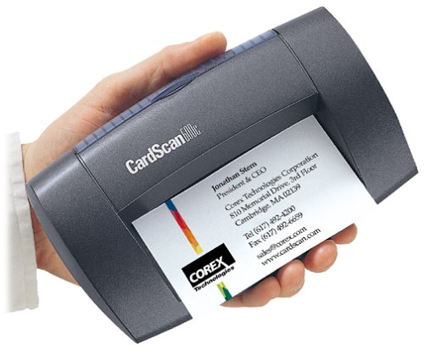
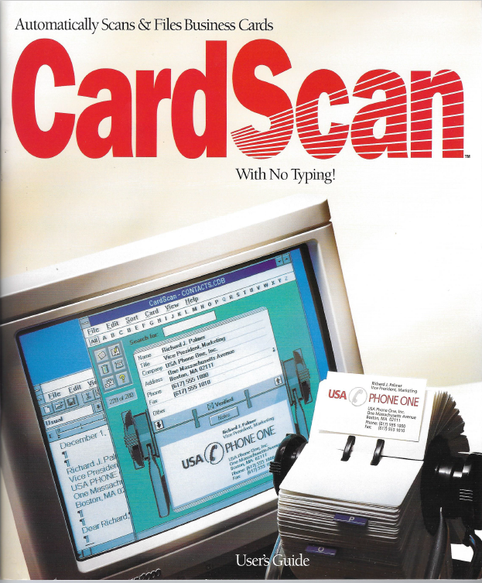
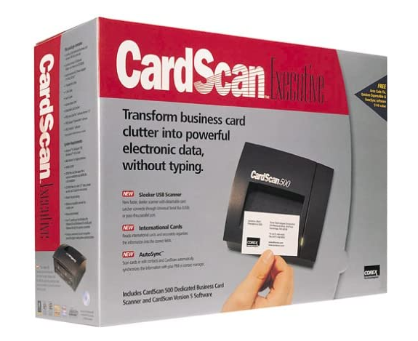
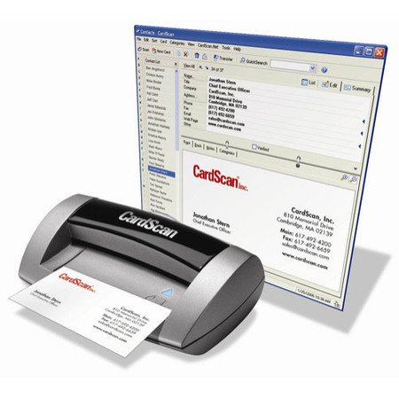

Slide 4



Yonatan Stern
Libby@smartupacademy.org
Yonatan@smartupacademy.org

Slide 5
Entrepreneurial Thinking
Venture Capital funds say that 9 out of 10 companies fail
To make a return on fund’s investments they need a huge EXIT, usually an IPO on NASDAQ – Any guess?
A reality check:
      Every year about 1,000 companies are founded
      Since the year 2000 more than 20,000 companies were created
      In that period less than 100 companies went public and only 38 companies were valued at more than $100m
      Less than 1 in 500 or less than 0.2%

Slide 6
Entrepreneurial Thinking
9 out of 10 companies fail – But why?
    Mistakes made for lack of experience
    Pressure from investors to achieve an EXIT,
    instead of reaching profitability
    Here is what you hear from investors
          You need a big disruptive idea
          You need to move fast and be first to market
          You need to address a huge market
          You need to grow as fast as possible

Slide 7

SmartUp Academy
A program to teach the profession of building successful companies.
The Foundations Course
  The three pillars for a successful company:
    Profitable
    Fast growing
    Modest investment
Workshops
4-5 years Residency program

Slide 8







SmartUp Companies
BionData

Slide 9
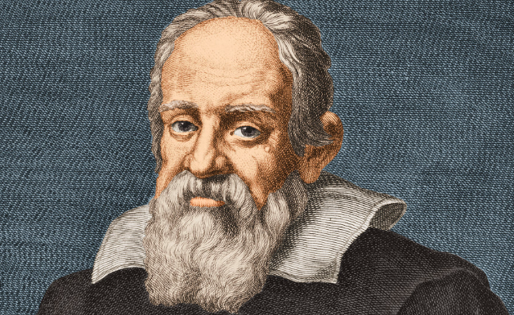
Entrepreneurial Thinking
Moving from Science to Business
“Mathematics is the language in which God has written the universe !”
Galileo Galilei 1564 – 1642
What is the language of business?
Money !!

Slide 10
Venture Capital Money Flow
Startup 1
$$$$ Investors
Pension Funds, Insurance companies
Limited partners
Venture Fund
General Partner
Startup 2
EXITS
$$$$
Startup 3

Slide 11
Venture Capital Timeline
Money from investors comes in
Invest in new startups.
Seed money, Series A round
Repeat investments in same companies
Hope for an Exit
Possible time extensions
Official end of the fund
Inception
Year 1
Year 2
Year 3
Year 4
Year 5
Year 6
Year 7
Year 8
Year 9
Year 10

Slide 12
If 9 out of 10 Fail, How do VCs Make Money?
An Exit on the 1 out of 10 companies must be very BIG
Very big Exits are usually when companies go public (IPO) in the USA on Nasdaq or NYSE
Since the year 2000, more than 20,000 startup companies were founded in Israel (*)
At the same time less than 100 companies, went public on Nasdaq or NYSE, and only 38 companies had a valuation bigger than $100m, less than 1 in 500
(*) IVC Data

Slide 13
Why So Few Companies Go Public?
For a company to go public it needs to have:
Revenues of $100m and up
Year over year growth rate of 20% or more.
Preferably profitable.

Slide 14
What’s Needed to Get to $100m in Sales?
Let’s build a business model
Assumptions:
SaaS (software) product, $10,000 per year license
Years 1 & 2 product development – No sales
Year 3, first 100 customers
Year over year growth rate of 40% in number
of new customers
Perfect renewal rate of 100% year over year

Slide 15
Customer Growth

Slide 16
The Path to $100m
$99m
$70m
$49m
$34m
$24m
$16m
$7m
$11m
$1m
$2m
$4m

Slide 17
What is the Amount of Investment Needed?
In a typical software company, 70% of expenses are salaries
To foster this rapid growth, the company will grow its team at about the same pace of 40% YoY
The company will start generating cash profits only in year 12
And will lose $100 million in aggregate in its first 11 years
As a result, company management raises money continuously
…. And gets heavily diluted

Slide 18
But… What if Life is a Bit Harder?
Business Model Assumptions:
SaaS product, $10,000 per year license
Years 1 & 2 product development – No sales
Year 3, first 100 customers
Year over year growth rate of 30% in number
of new customers
Realistic renewal rate of 80%

Slide 19
Customer Growth

Slide 20
Sales Per Year

Slide 21
Why do 9 out of 10 Venture Backed Startups fail?
The drive for rapid growth and an EXIT-by-IPO leads management to hire many people early on, to support a hypothetical growth
In many cases, these newly hired people are not effective because the company is still charting its path (aka “pivot”)
Hiring many people increases cash burn rate early in the company life, before it has significant revenues
Push, Push, Push for Growth, Growth, Growth
Pressure, Pressure, Pressure !!!

Slide 22
Why do 9 out of 10 Venture Backed Startups fail?
Because of the high cash burn rate, companies need to raise money all the time
And what happens if sales don’t grow fast enough?
They don’t have enough time and resources to succeed
The company has difficulty raising additional money
They need to reduce expenses and lay people off
Need to continue to reduce expenses and lay more people off
Morale and confidence decline, and the company spirals downward
The company shuts down, or gets stuck in “death valley” and becomes a “walking dead” company

Slide 23
9 Out of 10 Companies Fail ….
OK, got it !!! So tell me HOW not to fail?
                Change the goal of the company from an EXIT
      To PROFITABILITY
      Profitability = Positive cash flow. Generating cash.
      Year over year

Slide 24
Why Profitability?
What is the difference between a company that
generates a profit of a million dollars a year,
and a company that loses a million dollars a year?

Slide 25
Why Profitability?
A company that loses a million dollars a year
→ You know when it will run out of money
A company that generates a million dollars a year
→ Can live forever. They don’t run out of time !!!
A company that generates a million dollars a year has:
      Time to make mistakes, learn and pivot if needed
      Less pressure
      Freedom

Slide 26
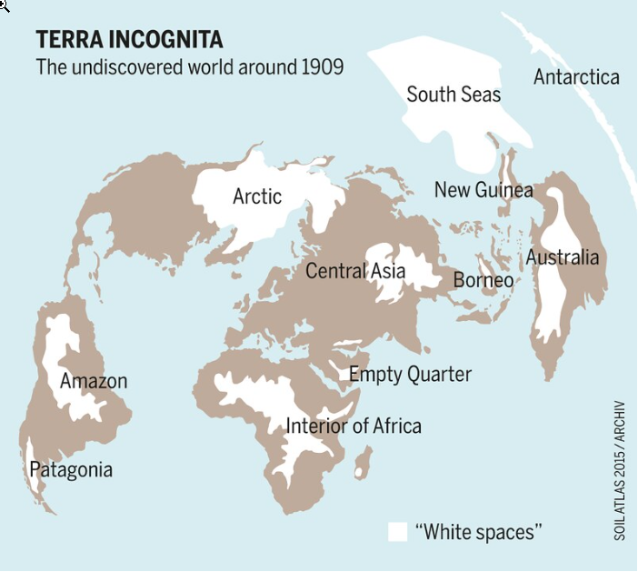
Terra Incognita
Building a new company is like exploring a new territory
It is unknown, exciting, rewarding, scary and dangerous
You need training, preparation and resources
Exploring takes time
AND you need to learn how to survive off the territory or you could die of hunger

Slide 27
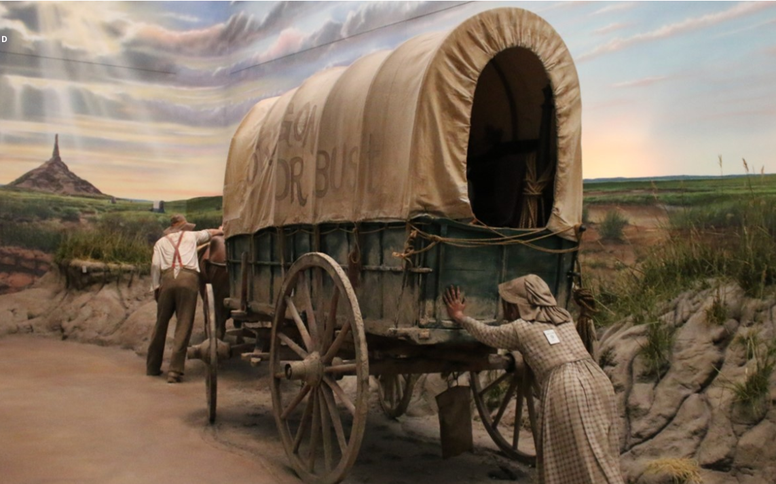
The Oregon Trail
From Missouri to Oregon,
3,000 km, 20 km/day
My daughter’s assignment:
  A family of 4
  Food for 6 months
  Clothing
  Tools
  Guns
  Seeds
  All in one wagon

Slide 28
The Startup Terra Incognita
You need time to figure out:
Who your customers are
How to reach them
What to tell them
How to make them pay attention
How to make them buy and pay
At what price
How to build your team
What product to build
How to build it
….. And on and on

Slide 29
Why Fail if you can Succeed?
Founders focusing on profitability are much more likely to make more money, than with an exit
Let’s build a simple model:
      On year 5 the company has $5m in revenues with 20% profits
      The company grows at 20% year over year, and maintains its 20% profitability margin
      The founders still hold 50% of the equity because they did not need to raise a lot of money
      Company value is 20 P/E, Price to Earning per share. In other words, the value of the company is 20 times its profits

Slide 30
Why Fail if you can Succeed? Model
Growth of 20% YoY. Profits of 20% per year. Founders still hold 50%.
In 10 years the company generated $10m in profits
The founders can distribute dividends, and are worth $30m

Slide 31
The SmartUp principles
Strive for profitability, as early as possible.
An Exit is a Finite Game, nice to have but not THE target
Branding first – product second
Don’t be the first – let others educate the market
No need for a disruptive technology or idea – The concept of Enablers and Incremental improvements
No need for a huge market – pick a beachhead, customers who respond to the branding
Grow profitably at the pace the market dictates

Slide 32
Strive for profitability – Branding First
Your biggest challenge is not to build your product - It is to bring paying customers
If nobody ever heard about your company, you will not have customers !!!
The first thing you need to do is think about your customers
    Who are they?
    How do you reach them?
    What do you tell them?
    How do you get them to buy from you?

Slide 33

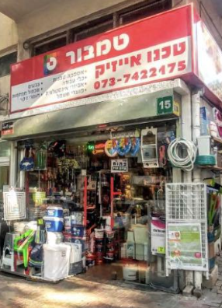



Branding First – The smart old fashioned way
And then what happened?

Slide 34



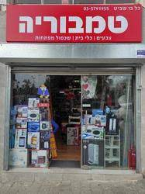

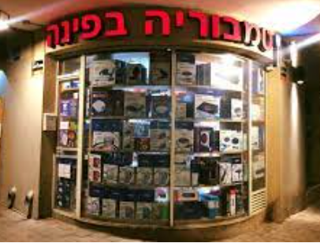
Branding First – A success story

Slide 35
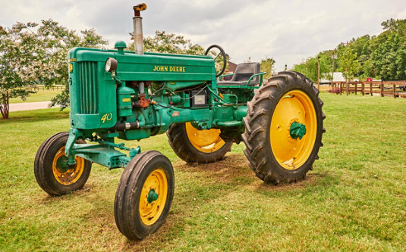

Branding first – Another concept
John Deere & Company
Founded in 1834
The Furrow Magazine – Launched in 1895
The magazine was so successful that it reached 4 million readers by 1912
Still in circulation today, with a global audience of over 1.5 million

Slide 36
Opster
Opster- Tools for DevOps engineers to manage and optimize mission critical ElasticSearch clusters
      Did anybody here understand what that means?
Who are Opster’s prospects?
      ElasticSearch DevOps engineers
How on earth can we target these elusive people?
      They are busy and they don’t respond to emails

Slide 37
Opster
Focus on the problem - not on your solution
  When Opster started, we had nothing to sell. Product vision was murky
  We asked ourselves – What do DevOps engineers do when encountering a problem with their ElasticSearch installation?
  In many cases the ElasticSearch system produces an error log that is written to their log file
  Here are random examples of real error logs

Slide 38
Opster
Error Log examples
  Could not lock IndexWriter isLocked
  Delaying allocation for unassigned shards; next check in
  Suspect illegal state: trying to move shard from primary mode to replica mode
  Failed to start monitoring service
  Using discovery type and seed hosts providers
  All shards failed
  Term query does not support array of values
  No mapping found for ” + fieldName + ” in order to sort on
  high disk watermark [90%] exceeded on
  Mapping update rejected by primary

Slide 39
Opster
Long Tail Creation Process
  How to automatically create thousands of content pages?
  Wrote a script to extract all error logs from ElasticSearch open-source code. Initially extracted about 700 different error logs. Today there are some 3,000 error log pages published on Opster
  Created an Opster web site, mainly these 700 pages produced automatically. Plus a detailed glossary on the basic terminology of ElasticSearch, a page per term
  60 or so pages generated 80% of traffic – manually enriched their content. High quality content creates a strong brand

Slide 40
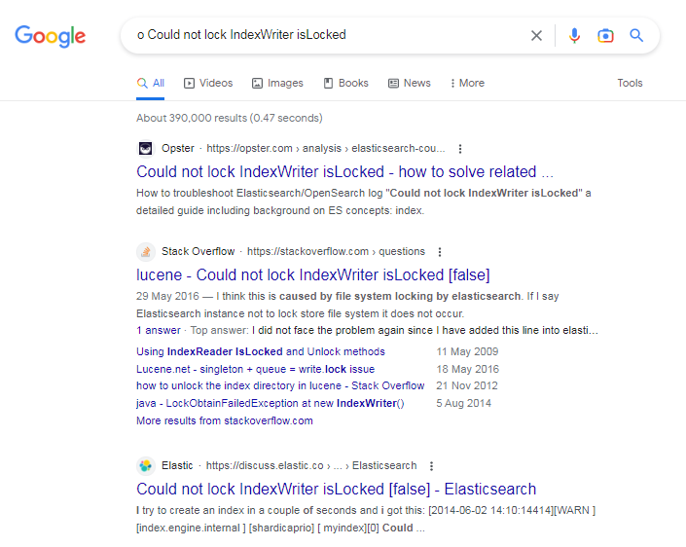
Opster - the Power of Long Tail
Ahead of StackOverflow and Elastic itself
Opster
StackOverflow
Elastic.com –
The originators of ElasticSearch

Slide 41
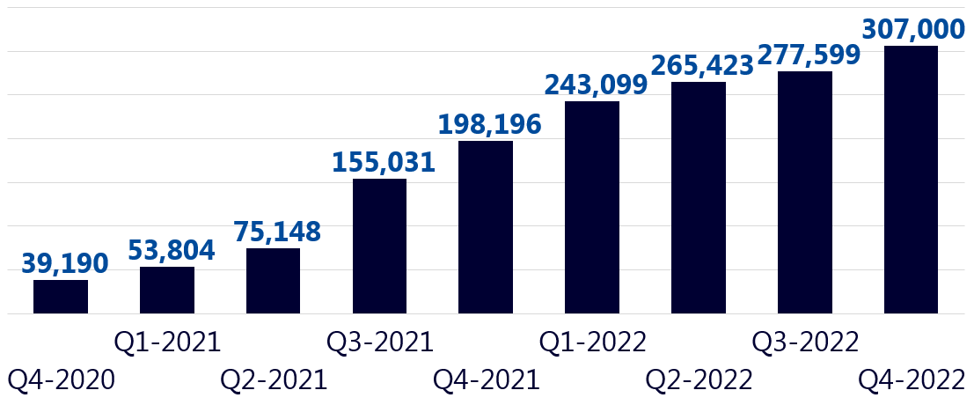
Opster
Website traffic results per quarter

Slide 42
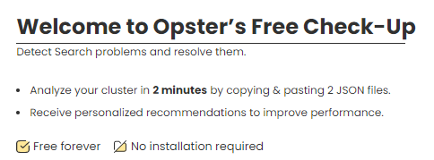

Opster – Marketing Funnel
BUT – Traffic is not yet leads
  Developed CheckUp – a simple tool to identify problems based on 2-3 files taken from the Elastic cluster
  Users need to create an account to run CheckUp
  Our main source of leads – Very low Customer Acquisition Cost (CAC)

Slide 43
Opster
Number of New Registered Users
Total Number of Registered Users

Slide 44
Opster
Company was founded in September of 2019, with SmartUp as a co-founder
Modest investment
Less than 20 employees
It was acquired by Elastic in November of 2023. The founder still held close to 50% of the shares
A very happy deal that made the founder and the executives very happy ☺
The power of Branding First and Long Tail

Slide 45

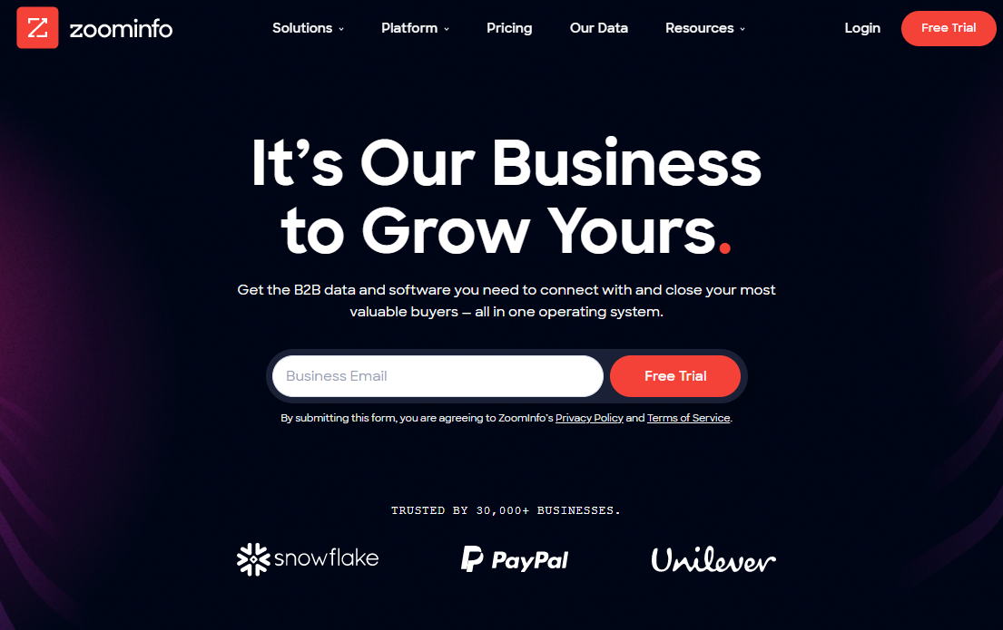
ZoomInfo – Tools for sales

Slide 46
ZoomInfo - History
Founded in 2000 by Yonatan Stern
Nice little company, selling mainly to recruiters – Executive Search Firms
By 2004 revenues were about $6m, profitable, growing
But we wanted to grow much faster by going after sales people
How do we go from one customer set – recruiters,
to another – sales people?

Slide 47
ZoomInfo - History
Made a bold decision – Let’s publish all of our data, one page per person
Long Tail - Sales people and recruiters search for people by name, or company name and title all day long
Search by name is one of the most common searches in Google
There was no other people directory on the web at the time - LinkedIn just started 2 years before and did not publish its data

Slide 48
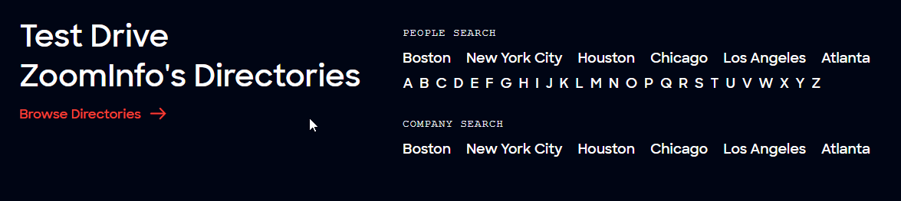
ZoomInfo Directory

Slide 49
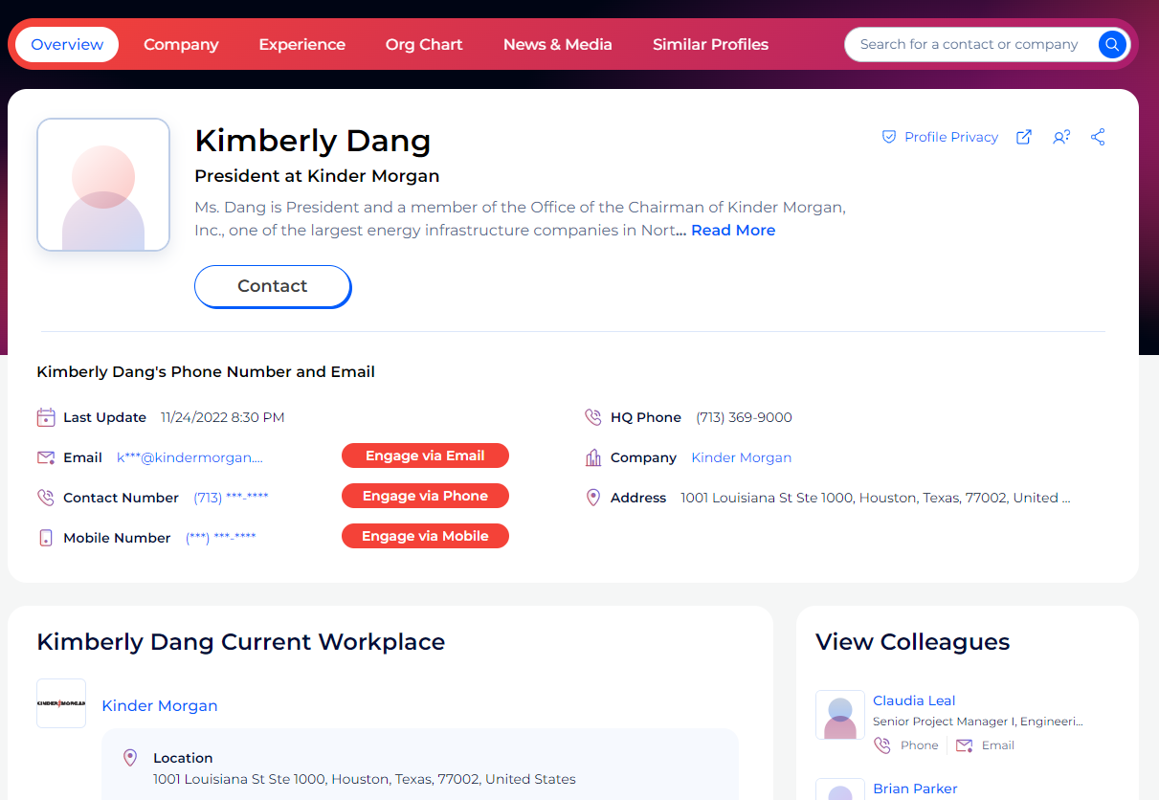
ZoomInfo Directory

Slide 50
ZoomInfo - Results
By the time I left in 2018 there were
  50 million directory pages indexed by Google
  About 10 million visitors to the site every month – aggregation of many small searches each for a different name
  Some 20,000 inbound leads every month
  Company grew revenues consistently by 50% year over year
  CAC – Cost of Customer Acquisition very low
  Sale cycle of 2-4 weeks, customers were familiar with what ZoomInfo provides

Slide 51
ZoomInfo – The Brand
In early 2019 ZoomInfo was acquired by DiscoverOrg for $800m
The CEO of DiscoverOrg ran a study to decide on the name of the combined company
ZoomInfo brand was 9 times more recognized than DiscoverOrg
The combined company is called ZoomInfo
The power of long tail branding

Slide 52
The SmartUp principles
Strive for profitability, as early as possible.
An Exit is a Finite Game, nice to have but not THE target
Branding first – product second
Don’t be the first – let others educate the market
No need for a disruptive technology or idea – The concept of Enablers and Incremental improvements
No need for a huge market – pick a beachhead, customers who respond to the branding
Grow profitably at the pace the market dictates

Slide 53

SmartUp Principles – First Mover Advantages
Market domination - No competitors
You set the standards
You set the pricing and packaging
You can get patent protection
Product category will forever be associated with your brand:
Kleenex, Xerox, Hoover, iPhone
You have a learning curve head-start
Pioneers are the ones with arrows in their back

Slide 54
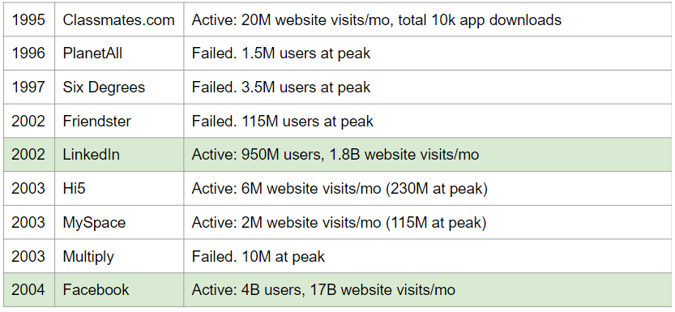
Social Networks – First Movers

Slide 55
Social Networks First Movers – Big Names Fail
1996 | Amazon (PlanetAll) | Acquired PlanetAll for 100M, at 1.5M users. Failed to use as social media - integrated the tech in e-commerce features
2004 | Google (Orkut) | Developed internally, 100M users at peak. 2014 - closed due to declined user base
2004 | Microsoft (Windows Live Spaces) | 30M at peak 2011 all users transferred to wordpress blogging
2005 | Yahoo!360 | Failed to get traction beyond few millions
2010 | Google Buzz | Integrated with Gmail. Failed immediately for privacy backlash
2011 | Google+ | 500M users, 2019 - closed, very low engagement time (in seconds)

Slide 56
Search Engines – First Movers
Search Engine | Year | Comments
Vlib, Jughead, Aliweb wwwwanderer, w3catalog | 1990 -1993 | Pre-search and Early search engines: Manual or archive indexing, some are directories, partial crawling. Remained as research, never commercialized
Jumpstation / World Wide Web Worm | 1993 | The first real search engine - crawling, indexing searching, started as university projects, failed to get funded and discontinued
WebCrawler | 1994 | Fully supported by ads 2nd most visited site in 1996, slow decline and failed
Lycos | 1994 | 1996 - fastest inception to IPO in NASDAQ history 300M. slow decline and failed
Infoseek | 1994 | 1996- 5th most visited site. IPO 42M slow decline and failed

Slide 57
Search Engines First Movers – Continued
Search Engine | Year | Market Share | Comments
Yahoo | 1994 | 1.21% | Focus on media and entertainment
Yandex | 1997 | 1.83% | Dominates the Russian market
Baidu (RankDexengine) | 1996 | 1.02% | Dominates the Chinese market
Microsoft Search Microsoft Bing | 1998 | 3.11% | Standard text-image-video search, AI integration, integrated into Windows
Google | 1998 | 91.55% | Standard text-image-video search
DuckDuckGo | 2008 | 0.54% | Privacy focused, anonymous search

Slide 58
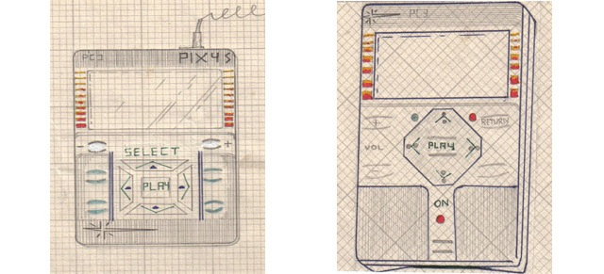
Music MP3 Players - First Movers
Kramer’s vision - 1979
Solid-state cigarette box size device to store and play music, 4-way navigation
Music will be saved on a central server and accessed via a phone line
Distributed via vending machines at locations such as bars and supermarkets (no internet yet!)
Filed a patent was
Was unable to get funding, never put into production

Slide 59
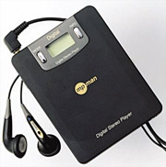
Music MP3 Players - First Movers
South Korea - Saehan’s “MP Man” – 1998
An MP3 player with 6-10 songs on a flash drive
Despite questionable reception at the CeBIT trade show in Hannover, 50k units were sold in the first year for ~$200
"No matter how the Korean staff tried to explain what an MP3 player was, people didn’t understand why they needed such a device because they could listen to music with CDs or cassettes"
JR Bum, President of German Tech company MPIXAR

Slide 60
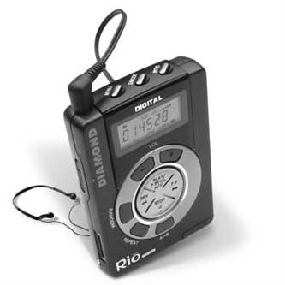
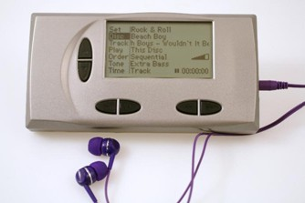
Music MP3 Players - First Movers
1998 - Diamond’s Rio - 200k units sold
30 minutes of music. Price $200
1999 - Compaq Personal Jukebox - 80 hours of music for $750
1999 - RioPort - First Internet online music download service
1998-2001 - Market is flooded.
50 different MP3 player devices available in the US alone

Slide 61
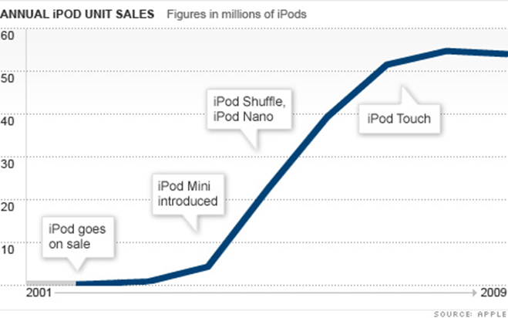
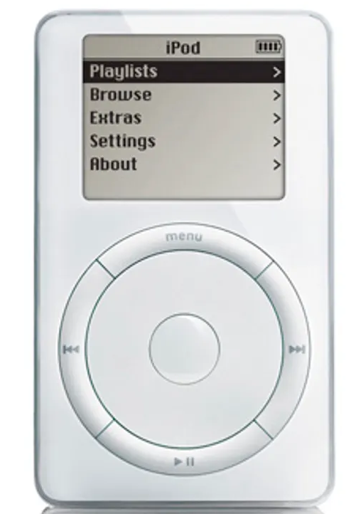
Music MP3 Players – the iPod

Slide 62
Innovator’s First Mover Dis-advantage
So, why do so many fail?
What are the dis-advantages of being first?
No competitors – the market is all yours - There is NO market
  You need to create the market
  You need to explain what your product does
  You need to convince people why they should care and take action

Slide 63
First Mover – Needs to Explain
Need to explain your product – Describe the following product in your own words?
Touch fastener product is used for a closure consisting of a piece of fabric of small hooks that sticks to a corresponding fabric of small loops
Swiss electrical engineer George de Mestral who studied at EPFL invented his first touch fastener in 1941, when he went for a walk in the Alps, and wondered why burdock seeds clung to his woolen socks and coat. The fastener consisted of two components: a lineal fabric strip with tiny hooks that could 'mate' with another fabric strip with smaller loops, attaching temporarily, until pulled apart.

Slide 64
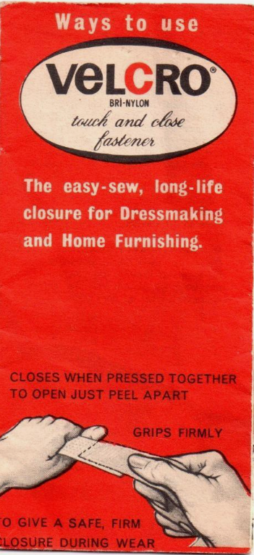

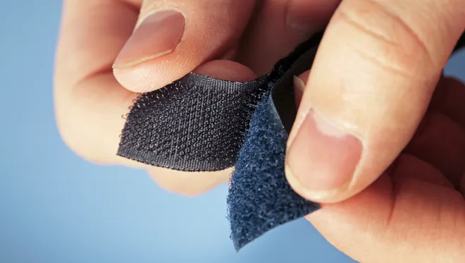
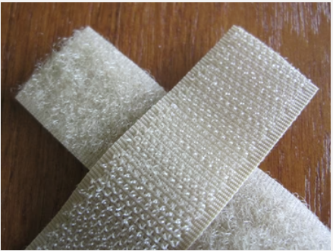
Velcro

Slide 65

First Mover – Needs to Explain
Need to explain your product – Describe the following product in your own words?
Portable document format
is a file format developed in 1992. It captures formatting information from a variety of desktop publishing applications, making it possible to send formatted documents and have them appear on the recipient's monitor or printer as they were intended. This is because the file will maintain the original fonts, images, graphics as well as the exact layout of the file.

Slide 66

Digital Innovation – First Movers
What do they do?
Who are their customers?
How can they reach them?
Infinipoint is a pioneer in the Device-Identity-as-as-Service security category to extend a true zero-trust security posture to devices. Infinipoint is the only solution that provides Single Sign-On (SSO) authorization integrated with risk-based policies and one-click remediation for non-compliant and vulnerable devices. This reduces risk by protecting access to an organization's data and services while transforming devices to support a world-class security posture. Infinipoint can do all this in a productive way that maintains business continuity with no disruption to the workforce.
- PR Newswire 17 Mar, 2022

Slide 67

Digital Innovation – First Movers
What do they do?
Who are their customers?
How can they reach them?
Novidea is the leading Insurtech provider of a cloud-native, data-driven insurance management system. Using an open API architecture, Novidea's software platform enables brokers, agents, MGAs, and carriers to modernize and manage the customer insurance journey, end-to-end, and drive growth across the entire insurance distribution lifecycle. The Novidea platform, built to leverage the power of Salesforce's Big Technology, provides a complete ecosystem spanning every aspect of an insurance business, including a 360-degree view of the customer and all stakeholders, an integrated customer-facing policy transactions, and the middle and back office. Brokers, agencies, and MGAs extract more value from their customer and policy data with actionable intelligence from any device, anywhere. Novidea supports more than 100 customers across 22 countries.

Slide 68
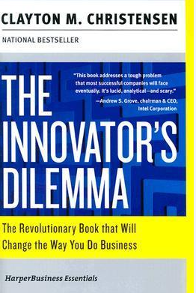
The Innovator Dilemma
The Innovator's Dilemma: When New Technologies Cause Great Firms to Fail, first published in 1997, is the best-known work of the Harvard professor Clayton Christensen. It expands on the concept of disruptive technologies, a term he coined in a 1995 article. It describes how large incumbent companies lose market share by listening to their customers and providing what appears to be the highest-value products, but new companies that serve low-value customers with poorly developed technology can improve that technology incrementally until it is good enough to quickly take market share from established business.

Slide 69
The SmartUp principles
Strive for profitability, as early as possible.
An Exit is a Finite Game, nice to have but not THE target
Branding first – product second
Don’t be the first – let others educate the market
No need for a disruptive technology or idea – The concept of Enablers and Incremental improvements
No need for a huge market – pick a beachhead, customers who respond to the branding
Grow profitably at the pace the market dictates

Slide 70



Disruptive Innovation
Is innovation evolutionary or revolutionary?
Who invented the light bulb?
And when?

Slide 71
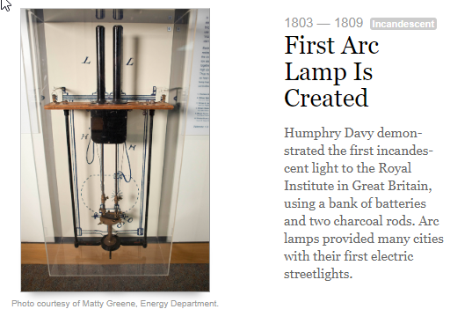
Light Bulb History 1803 – 1809

Slide 72
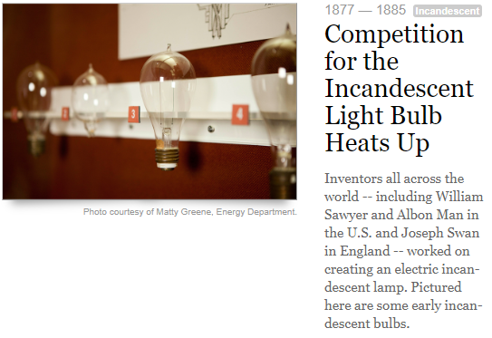
Light Bulb History 1877 – 1885

Slide 73

Who invented the light bulb?
1809 - British inventor Humphry Davy invented an incandescent light bulb in 1801 and created the “arc lamp”
1835 - Scottish inventor James Bowman Lindsay demonstrated a constant electric light in Dundee
1841 - British inventor Frederick DeMoleyns patented a light bulb
1872 - Russian engineer Alexander Lodygin invented an incandescent light bulb
1877 - William E. Sawyer developed a incandescent light in partnership with Albon Man
1870s - Hiram Stevens developed a light bulb and in 1880 installed the first electric lights in a New York City building
1878 - British inventor Joseph Wilson Swan demonstrated a light bulb at a lecture in Newcastle that soon had the attention of the world, including Edison. Swan was awarded a light bulb patent (patent No. 4933) only in 1880, the year in which his house in Gateshead, England became the first house in the world lit by a light bulb.
1879 - Thomas Edison filed for a patent on a light bulb that burned up to 600 hours and eventually up to 1,200 hours

Slide 74
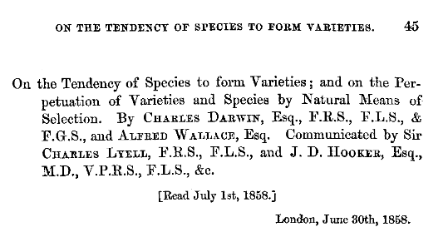
Innovation Evolution
What triggers the evolution of Innovation?
Surprisingly, many inventions were independently developed by different people, at the same time

Slide 75
Innovation Influencers
Earlier Thinkers Who Influenced Darwin and Wallace
Jean Baptiste Lamarck (1744–1829) was an important French naturalist and one of the first scientists to propose that species change over time. However, Lamarck was wrong about how species change. His idea of the inheritance of acquired characteristics is incorrect and traits an organism develops during its own life-time cannot be passed on to offspring (…. Epigenetics)
Charles Lyell (1797–1875) was a well-known English geologist. Darwin took Lyell's book, Principles of Geology, with him on the Beagle. Lyell argued that gradual geological processes have gradually shaped Earth’s surface and inferred that Earth must be far older than most people believed.
Thomas Malthus (1766–1834) was an English economist. He wrote an essay titled On Population arguing that human populations grow faster than the resources they depend on. When populations become too large, famine and disease break out. In the end, this keeps populations in check by killing off the weakest members.

Slide 76
Concurrent Innovation
1600s: Isaac Newton and Gottfried Leibniz both develop calculus
1770s: Carl Wilhelm Scheele and Joseph Priestley discover oxygen
1800s: Charles Darwin and Alfred Russel Wallace both describe natural selection (Evolution)
1839: Louis Daguerre and Henry Fox Talbot invent the first photographic methods
1869: Louis Ducos du Hauron and Charles Cros present the earliest workable methods of color photography on the same day
Late 19th early 20th century Guglielmo Marconi, Nikola Tesla, and Jagadish Chandra Bose invented radio transmission
1950s: Jonas Salk and Albert Bruce Sabin invent the polio vaccine

Slide 77
Innovation Enablers
Innovation is evolutionary – it evolves one step at a time
Innovation always relies on enabling ideas, theories, technologies and resources
Product innovation succeeds when it reaches acceptable levels of price, performance, and ease of use

Slide 78
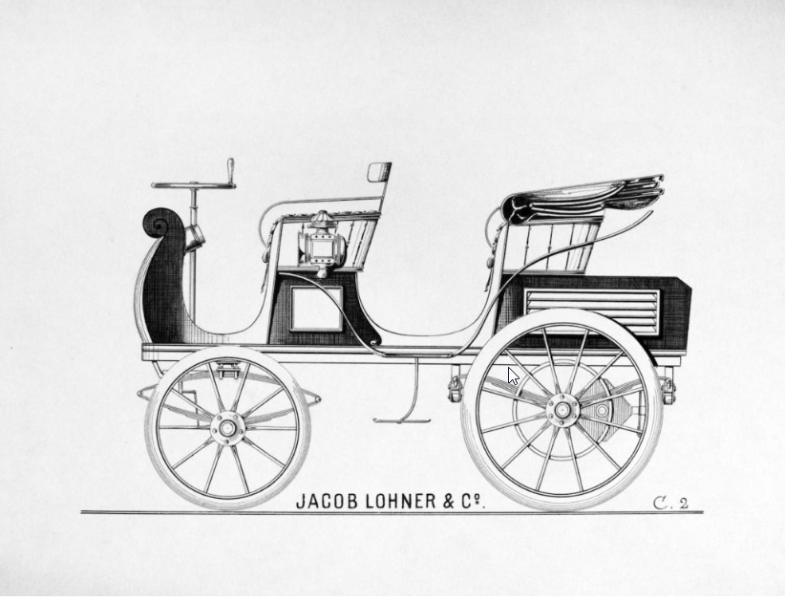
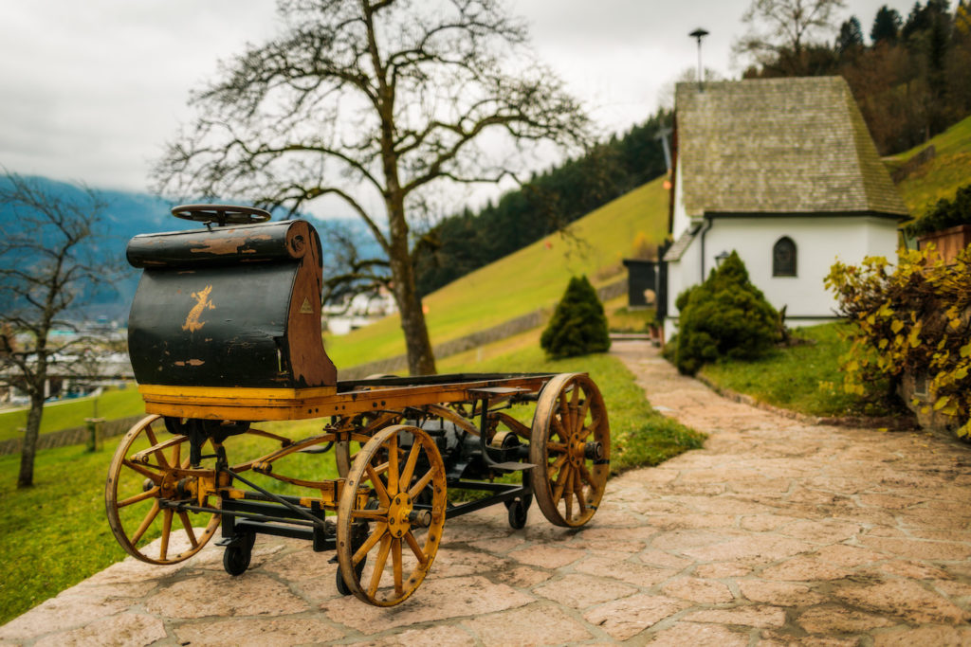
Innovation Enablers – Electric car
Very popular in the early days, circa 1900-1910
Easier to drive than a gasoline car that needed a hand crank
Quieter, no pollution
Perfect for short drives, range of 80 km, cost about $1,750

Slide 79
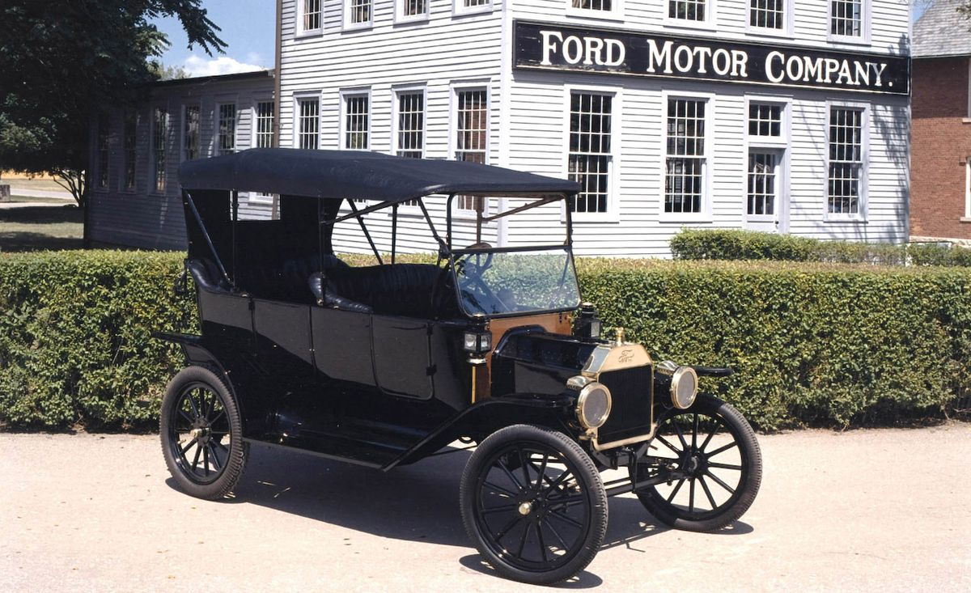
Innovation Enablers – Electric car
Ford Model T, introduced in 1908
Costs $650
Gas allowed longer range trips
Better road system encourages longer rides
Electric engine starter – no need for a hand crank
Crude oil discovered in Texas, cheap gas
More than 15 million Model-Ts were built over its
19-year life span
Electric cars disappear by 1935

Slide 80
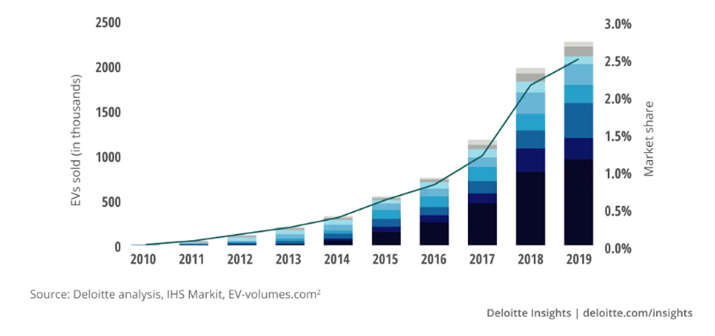
Innovation Enablers – Electric car
Electric car sales growth since 2010 – But why?

Slide 81
Innovation Enablers – Electric car
Reasons for the revival of electric cars
Combat global warming – CO₂ emissions
Government subsidies
Tesla - Computer on wheels -- instead of a car with computers
Much better batteries – longer range, 400 km But why?

Slide 82
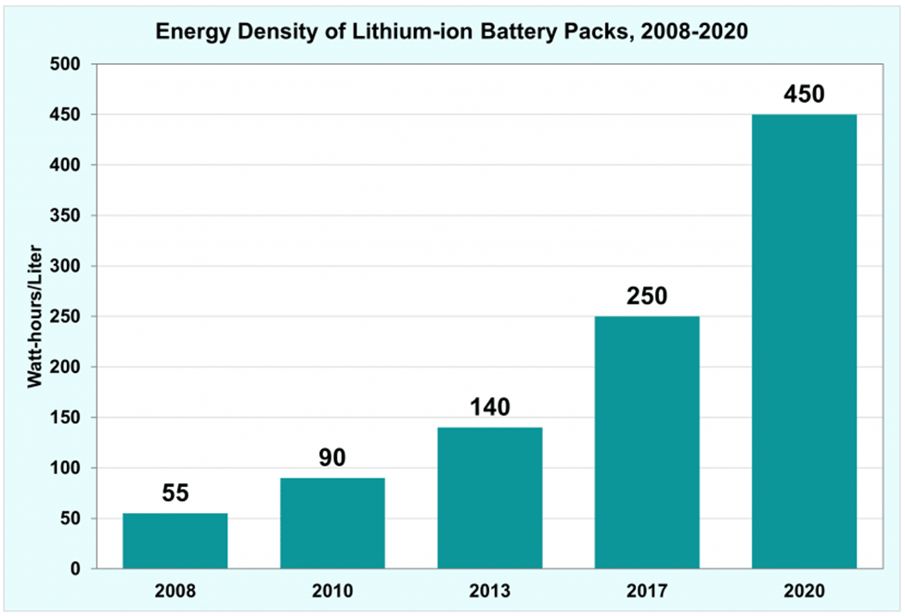
Innovation Enablers – Batteries
Batteries improve almost 10-fold in twelve years Why?

Slide 83
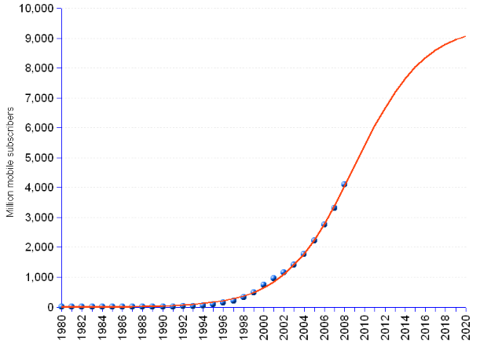
Innovation Enablers – Batteries
Growth in cell phone use
From about 1B in 2000
To about 9B in 2015
Similar growth in laptops and other mobile gadgets

Slide 84
Innovation Enablers –iPhone Enablers circa 2007
Cellular Data – 3G
      Widely deployed in 2007, Compared to 2G, 3G had four times the data transferring capabilities reaching up to 2 Mbps on average.
      Video streaming, video conferences, and live video chat became real.
      Emails also became another standard form of communication over mobile devices.
      What made 3G revolutionary, was the ability to surf the internet and stream music on mobile.
GPS
      1999: GPS-enabled cell phones become commercially available for the first time.
      2000: The U.S. Government revokes a plan from 1990 that purposely made GPS less accurate as a defensive mechanism. As accuracy skyrocketed, many industries, including forestry, fishing, and freight management, started using GPS.
      2001: Personal GPS products surge, including in-car navigation systems.

Slide 85
Digital Innovation – Recent Enablers
We ALL walk with a powerful Smart-Phone computer in our hand
  It is always connected to the Internet – Cellular data + WiFi (Spotify, Netflix, Zoom, )
  Powerful enough to run sophisticated applications
  It is very easy to develop new applications (iOS, Android)
  If has a camera, a microphone and high-fidelity speakers
  Hi quality color screen (photo album, no one prints photos)
  It has enormous memory (512 GB, endless photos)
  It has a GPS – (Waze, Pango, Uber, Gett, Wolt, more?)
There are many more useful apps
Think about business applications (Insurance, agriculture, traffic, …)

Slide 86
Digital Innovation – Recent Enablers
Powerful technologies
    Deep learning algorithms
    Translation
    Speech to text
        Embedded (YouTube, Zoom, ….)
        Business – Sales (Gong, Chorus), Customer service,
        Legal
        Police, Intelligence services,
    Picture recognition
        Embedded (Google pictures, Google navigation)
        Security – police, ClearView AI,

Slide 87
Picture Recognition – ClearView.AI
Clearview AI, based in NYC, founder Hoan Ton-That
A database of over 3 billion images scraped from various websites, including LinkedIn and Facebook
Facial recognition software that claims to have the best accuracy
Clearview AI sells its technology to police agencies around the world
However, the use of Clearview AI has raised serious privacy and ethical concerns, as it allows anyone to identify a person by uploading their photo and finding their online profiles
The Australian privacy commissioner has launched an inquiry into Clearview AI, and some police forces have distanced themselves from the company
Clearview AI has also faced legal challenges and cease-and-desist letters from the websites it has scraped data from

Slide 88
Digital Innovation – Recent Enablers
ChatGPT and other Large Language Models (LLM)
Enables high quality verbal man machine dialog – talk to your TV
High quality data extraction from free text and forms – for example, large scale medical information from hospitals and health organizations
This is so new, we just started scratching the surface…

Slide 89
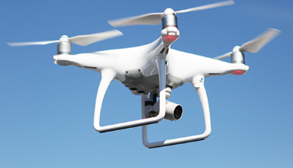
Additional Technology Enablers
Drones (filming, agriculture, policing, military, archeology, ….. What else?)
3D Printing
DNA manipulation using CRISPR
  Treatment for genetic defects
  New treatments and medications (cancer treatments?, ….. )
  It is the beginning of a whole new Digital Innovation revolution
Soon to be here
  Self driving cars – huge impact on urban life
What Else?

Slide 90
Digital Innovation – Impact of Enablers
  The innovation is not in the technology but in the use.
  The where and how to use the technology and the data
  Examples:
    Taxi service – Uber, Lyft, Gett, …..
    Hotels, Travel – Expedia, Bookings.com, Kayak, TripAdviser, AirBnB,
    Movie theaters – BlockBuster, Netflix
    Postal Service – email, WhatsApp, Zoom, SMS,
    Dating – OKCupid, Bumble, eHarmony, Tinder, Jdate ….
  Virtually every domain in our life is going to be impacted

Slide 91
The SmartUp principles
Strive for profitability, as early as possible.
An Exit is a Finite Game, nice to have but not THE target
Branding first – product second
Don’t be the first – let others educate the market
No need for a disruptive technology or idea – The concept of Enablers and Incremental improvements
No need for a huge market – pick a beachhead, customers who respond to the branding
Grow profitably at the pace the market dictates

Slide 92
SmartUp Guiding Principles
You don’t need a huge market to succeed
Before you succeed you need to be alive
Alive = Profitable = Positive cashflow
Big markets are made of many small islands and thus are expensive to penetrate and hard to dominate
To be profitable (the SmartUp way) all you need is $3m to $5m in sales
To be profitable all you need is to penetrate one focused market island - and then expand from island to island

Slide 93

Establishing a Beach Head
World War II – D Day, June 5, 1944
The invasion of the allies to Nazi controlled Europe
The Nazi Atlantic Wall – 5,100 km
of fortified barrier
The beach head of Normandy
was 80 km long and was further divided to 5 sections
The entire US and British armies
landed on that small beachhead

Slide 94
The SmartUp principles
Strive for profitability, as early as possible.
An Exit is a Finite Game, nice to have but not THE target
Branding first – product second
Don’t be the first – let others educate the market
No need for a disruptive technology or idea – The concept of Enablers and Incremental improvements
No need for a huge market – pick a beachhead, customers who respond to the branding
Grow profitably at the pace the market dictates

Slide 95
The End
Yonatan Stern
SmartUp Academy
Libby@smartupacademy.org
Yonatan@smartupacademy.org

