Slide 1

Digital Innovation
Lesson 5
Business Models

Slide 2
Product Innovation
You want to start a startup, and you are looking for an idea
What should you do?
Disruptive innovation - Invent something totally new that will disrupt the world, or maybe just an industry… (ChatGPT….)
Incremental innovation – use existing technologies in a new way to improve a product or a process, or to solve a problem (Gett, Uber, Pango, ICQ…)
Enter an existing market by improving on existing offerings – No need to be first (Facebook, Google, Bookings.com, WhatsApp…)
Enter an existing market with a new business model (eCommerce, Netflix, Android, )

Slide 3
What is a Business Model
In simple terms – How does your company make money?
The most important focus for building a successful company
A complex combination of many parameters, from the product or service, to customer profiles, to pricing and packaging, to costs and infrastructure, and much more
Usually an iterative process of trial and error, to select, adjust and refine all parameters
An evolutionary process as markets change, technology disrupts, conditions vary, and competition arise

Slide 4
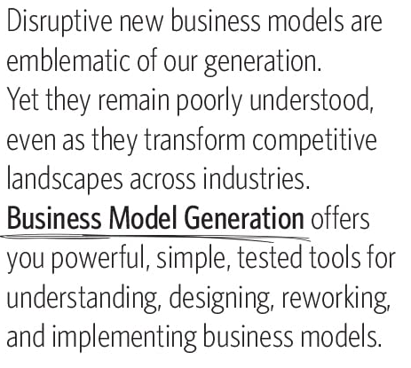
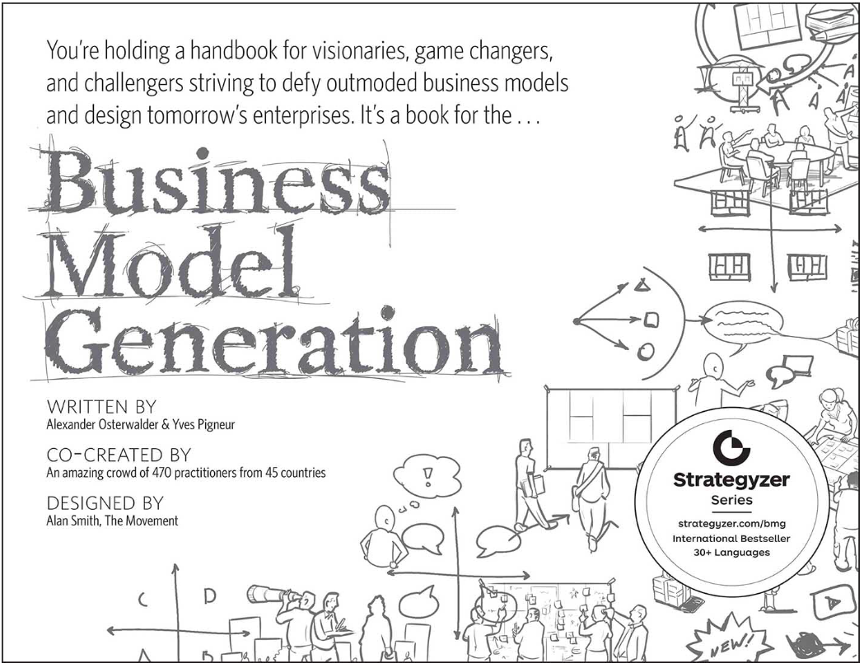

Business Model Generation

Slide 5
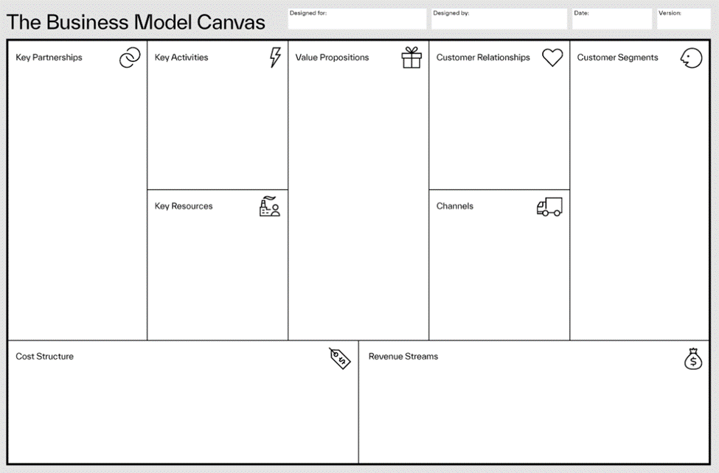
Business Model Canvas

Slide 6
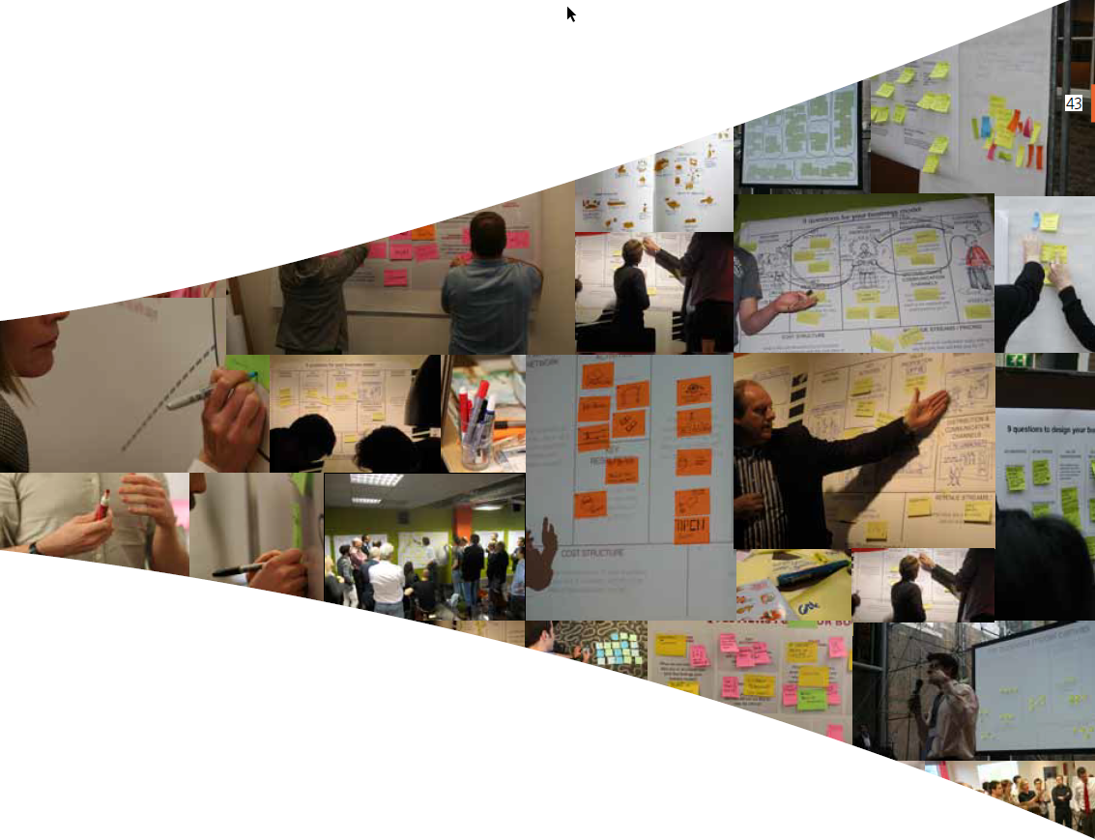
Business Model Canvas

Slide 7
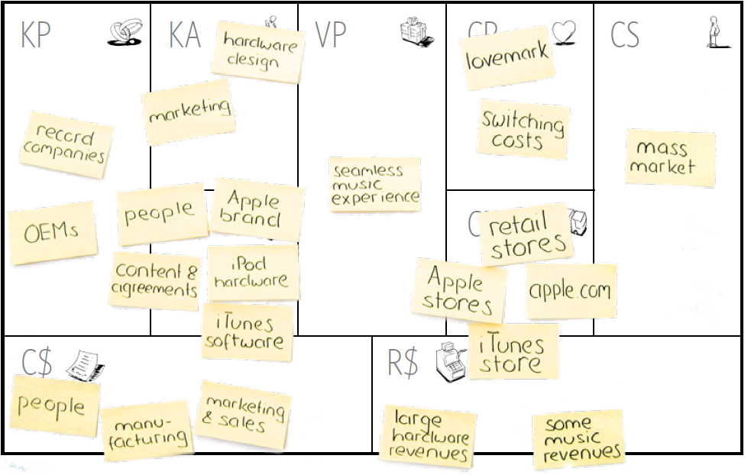
Business Model Canvas

Slide 8
Business Model Canvas
The Business Model Canvas consists of nine essential parts:
Value Proposition
Customer Segments
Revenue Streams
Cost Structure
Key Resources
Channels
Customer Relationships
Key Activities
Key Partners

Slide 9
Business Model Innovation
The nine building blocks are all interconnected and can be put together in innovative ways to create many opportunities.
Value Proposition
Customer Segments
Revenue Streams
Cost Structure
Key Resources
Channels
Customer Relationships
Key Activities
Key Partners
For example:
Value Proposition ←→ Pricing
Pricing ←→ Customer Segments
Cost Structure ←→ Pricing

Slide 10
Value Proposition
The Value Proposition solves a customer problem or satisfies
a customer need. It is also the reason why customers turn to one company over another:
Performance
Price
Customization
Getting the job done
Design
Brand / Status
Convenience
…. and many more

Slide 11
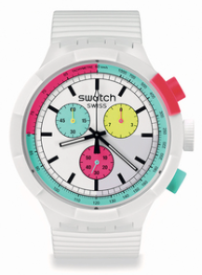
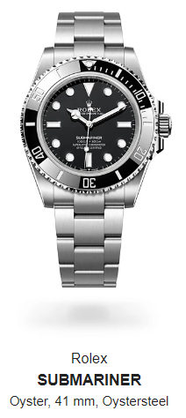
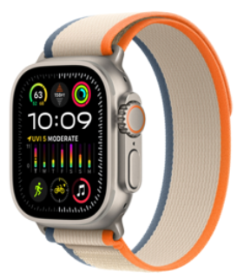
Value Proposition – Watches
The purpose of a watch is to show the time – they all do it ….
Performance – They are all accurate
Getting the job done – what is the job ?
Price – Timex, Casio,
Customization – Apple Watch
Design - Swatch
Brand / Status – BREITLING₪ 39,600 , Rolex ₪ 66,000, Patek Philippe
Convenience – No watch, use the phone

Slide 12
Customer Segments
The Customer Segments define the different groups of people or organizations the company aims to acquire and serve as customers
Customer groups represent separate segments if:
• Their needs require and justify a distinct offer
• They are reached through different Distribution Channels
• They require different types of relationships
• They have substantially different profitabilities
• They are willing to pay for different aspects of the offer

Slide 13
Customer Segments – Cars
New cars or Used cars
Cash or leasing
Gas engine, Diesel engine, Hybrid cars, Plug-in cars, Electric cars
Luxury cars – Lexus, Infinity, Acura, Mercedes
Sports cars – Corvette, Porsche 911, Mustang
Mini cars – Fiat 500, Mini Cooper, Smart
Off road, 4x4 cars – Land-rover, Jeep, Toyota Frontier
Family sedan cars – Toyota Corolla, Mazda 3,
Family minivans – Chrysler Voyager, Kia Carnival
Pickup vans – RAM, Ford Ranger, Chevrolet Silverado

Slide 14

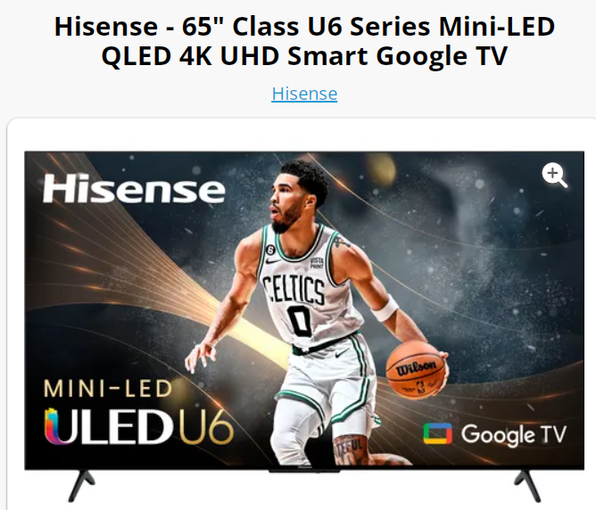
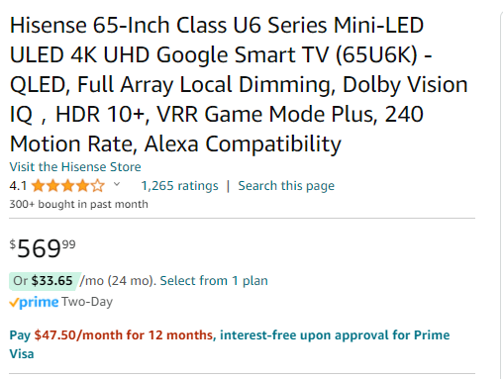
Customer Segment – Very poor neighborhoods
Furniture rentals – Rent a TV
24 months - $807.60

Slide 15
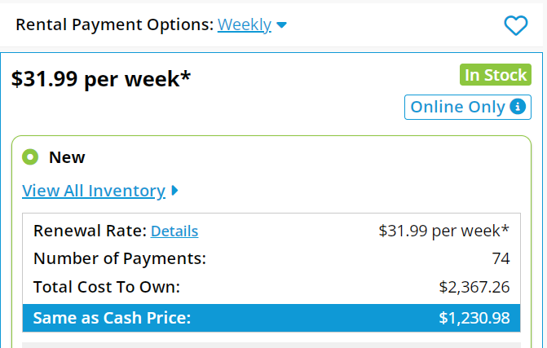
Customer Segment – Poor neighborhoods
Furniture rentals – Rent a TV

Slide 16
Customer Segments – Individual or Business?
Same product – Very big difference in price.
How to differentiate?
Airline tickets – Business travel willing to pay more than tourists ??
The trick – Round trips with no weekend stay are much more expensive
Internet access – Businesses are willing to pay more ??
The trick – A guarantee for uninterrupted service – Not offering residential plans to business addresses

Slide 17
Customer Segments – Individual or Business?
Same product – Very big difference in price. How to differentiate?
Zoom Communications
Individual FREE
Business – Starts at $12.49/month per host
The trick – calls time-out after 40 minutes
Monday.com
Individual – FREE
Business – starts at $9/month per seat
The trick – Free is up to 2 users
Slack
Individual – FREE
Business – starts at $7.25/month per seat
The trick – 90 days message history

Slide 18
Revenue Streams
Revenue Streams represent the cash a company generates from each Customer Segment (cash is calculated as revenues minus costs)
If customers comprise the heart of a business model, Revenue Streams are its blood and arteries
For what value is each Customer Segment truly willing to pay?
Answering that question allows the firm to generate one or more Revenue Streams from each Customer Segment.
Each Revenue Stream may have different pricing mechanisms

Slide 19
Revenue Streams – Pricing
How do companies or service providers set their prices?
Competitive pressures
Industry standards
As much as customers are willing to pay
Enough to pay the bills and make some money
Two to five times the cost to produce the product
Price is regulated (taxi cabs, milk, eggs, ….) Why aren’t all prices regulated? Rent control?
Sophisticated companies set a different price for each market segment

Slide 20
Revenue Streams – Pricing
How do lawyers charge?
By the hour, actually by the 10 minutes – for commercial clients, for family feuds, or consultations
Retainer – customary in long term business services
By project – for standard, well-defined tasks
Percent of the deal – buying real estate, M&A transaction, going public
Success fee – Entrepreneurial attitude. Part of the compensation. Ambulance chaser. Class actions

Slide 21
Revenue Streams – Pricing
How do dentists charge?
By procedure – annual checkup, filling, root canal, etc.
How do hairdressers charge?
By procedure – hair cut, hair styling, hair coloring, ….
Special price - if it is for a bride on her special day ☺
Why don’t dentists charge more when the pain is high?

Slide 22
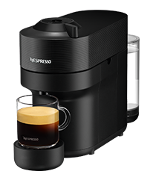
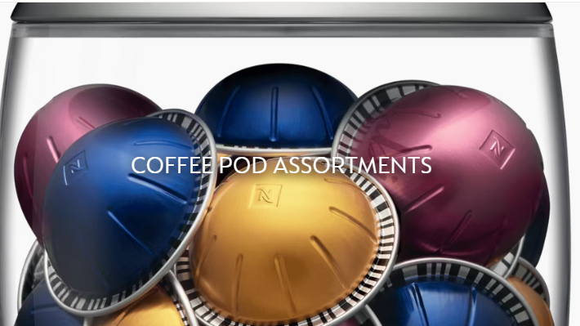
Revenue Streams – Pricing Components
What do we pay for?
A coffee machine or the coffee capsules (Razor & Blades)
International phone calls pricing evolution
Per minute + Distance + Time of the day + Connection fee
Then, flat fee per minute
Then, flat fee, unlimited calls
Then, Free international calls – WhatsApp, Facetime, etc.

Slide 23
Revenue Streams – Pricing for Perishables
What would your pricing philosophy be?
The flight is about to leave in 2 hours, would you offer half price tickets to lure customers?
The day before the flight, would you raise or lower ticket prices?
It is 9:00 p.m. and you have available rooms in your hotel, would you offer last minute rates?
It is 10:00 p.m. and your supermarket will close in 2 hours, would you offer big discounts on perishable produce?

Slide 24
Revenue Streams – FREE
Why do companies offer products and services for FREE?
To gain a large number of non-paying users, in order to sell advertising to their customers: Google, Facebook, X, (If it is free, you are the product)
To create a brand and get users – then upsell
Free basic use with a paid upgrade to same individual : Many games, many smartphone apps, etc.
The right way, and the irritating way
30 days free, then locks
Free bare bones, almost unusable

Slide 25


Revenue Streams – FREE
Why do companies offer products and services for FREE?
To create a brand and get users – continued
Product samples – cosmetics, food,
Grass root individual use – upgrade to business use : Zoom communications, Slack, Monday.com
Newspapers (ynet, NYT) – an interesting case study
ynet – news free, articles paid
New York Times – 10 articles a month

Slide 26
Revenue Streams – Free
Evolutionary decisions
Internet access –
Early players (AOL, CompuServe) – modem connection, charge by the hour and Mb traffic
Today - 24/7, flat monthly fee, regardless of use, Why ?
Net Neutrality – Netflix, YouTube, Instagram, WhatsApp, Zoom, Google, Microsoft, …..
Email – Free from inception. Why?
Part of ISP (Internet Service Provider) wars
Google won the identity wars – What is your Gmail account?
What to do about spam? What if each email cost $0.01?

Slide 27
Revenue Streams – who pays the bills?
Who pays the bill when using Gett? The Driver or the Passenger?
Let’s do an analysis taking into account the following criteria:
How would passengers react?
What would the impact be on number of passengers using Gett
What would be the financial impact on the driver?
How much money would Gett make

Slide 28
Revenue Streams – who pays the bills?
Who pays the bill when using Gett?
Impact on: Passenger, Driver, Gett
The taxi driver on a monthly subscription basis
The taxi driver per trip
The taxi driver on a monthly PLUS a “medallion” one time fee
The passenger per trip – visible
The passenger per trip – hike in the per km fee, hidden from passenger
The passenger per trip Plus a VIP subscriptions of benefits like discounts, priority, faster service, etc.
The driver PLUS a passenger VIP subscription

Slide 29
Revenue Streams – Payment terms
Is there a difference between $1,000/Month or $12,000/Year?

Slide 30
Revenue Streams – Payment terms
Is there a difference between $1,000/Month or $12,000/Year?
Let’s build a model
The company sells a SaaS subscription at $1,000 a month.
We will check the impact of charging $12,000 upfront instead of $1,000 per month on cumulative loss and how much money the company needs to raise
Assume the following:
Company operational expenses start at $50,000 a month and grows to $70,000 a month by year-end
Company grows nicely, starts with 1 new customer a month, then 2, then, 3, and by year-end it gets 9 new customers a month

Slide 31
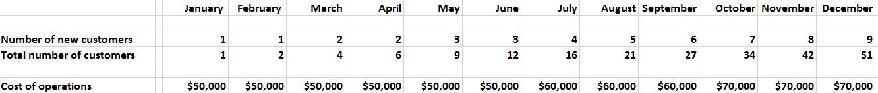
Revenue Streams – Payment terms
Company needs to raise $465,000 and more to survive
Company needs to raise $168,000 and is in positive cash flow since August

Slide 32



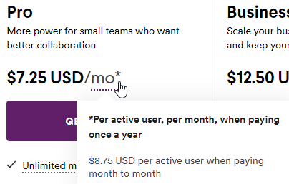

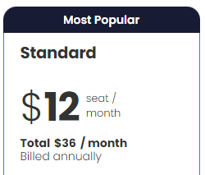
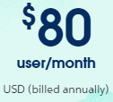
Revenue Streams – Monthly billed Annually
$8.75 per month, if paid monthly.
17% discount, to $7.25 / month, if paid once a year.

Slide 33
Business Model – Small Decisions Big Impact
Why was the US behind Europe in cell phone usage?
There is a call connection cost between a landline number to a cell phone number (same between carriers and countries)
In Israel (05x-) and Europe – special area codes for cell phone numbers. In the US same area codes for both landlines and cells
Therefore, in the USA charged connection cost and airtime also for incoming calls
Therefore, people gave their cell phone number only to a close circle of friends and family
Therefore, it was of a lower value, and people did not use it

Slide 34
Business Model – Small Decision, Big Impact
Who owns your phone number? Your service provider, or You ?
For technical reasons, for 100 years, it was the service provider (AT&T, Bezeq, Pelephone, Cellcom, …)
New regulations – phone number mobility
The purpose was to create price competition- BIG success
The unintended consequence
Your phone number is your personal ID
Your physical phone, in your hands, is YOU !!!

Slide 35
Cost Structure
Describes all costs incurred to operate a business model
Fixed costs – rigid expenses
Salaries – in high tech and software companies salaries are about 70% of the cost
Other costs include – rent, utilities, compute power (Cloud)
Variables costs
Activities that can be scaled up or down easily, like advertising
Cost of Goods Sold
The cost to produce and support the products, per unit

Slide 36
Cost Structure – Restaurants
Restaurants are a tough business
Initial investment
Planning and permits – ₪ 125,000 to 250,000
Construction – ₪ 5,000 – 15,000 per sqm
Equipment – ₪ 100,000 to 500,000
Supplies, marketing – ₪ 100,000 to 200,000
Total – ₪ 500,000 to 3,000,000
Monthly expenses
Rent – ₪ 12,000 to 60,000
Operations – ₪ 6,000 to 20,000
Salaries – ₪ 70,000 – 150,000
Supplies – ₪ 90,000 to 180,000
Total – ₪ 170,000 to 400,000
Well run restaurants spend
40% on supplies
25%-30% on salaries
10% on rent
Every year 3,000 restaurants close down
Only 30% of restaurants survive 5 years

Slide 37
Cost Structure – Restaurant Enabler
Wolt created a new business model for restaurants
Just a kitchen and a nice web site
No place to sit
No serving and servers
Only deliveries
Huge cost reduction
Same meal price – More gross margin
Restaurant owners complain
Is it the same market segment?

Slide 38
Key Resources
Key Resources are the most important assets required to make a
business model work
Key resources may include:
Financial – money, ability to get credit,
Equipment – trucks, airplanes, chip manufacturing equipment
Intellectual – patents, algorithms, recipes, Intellectual Property
Human – engineers, sales people, creative talents,
Distribution – stores, retail clients, partners,

Slide 39

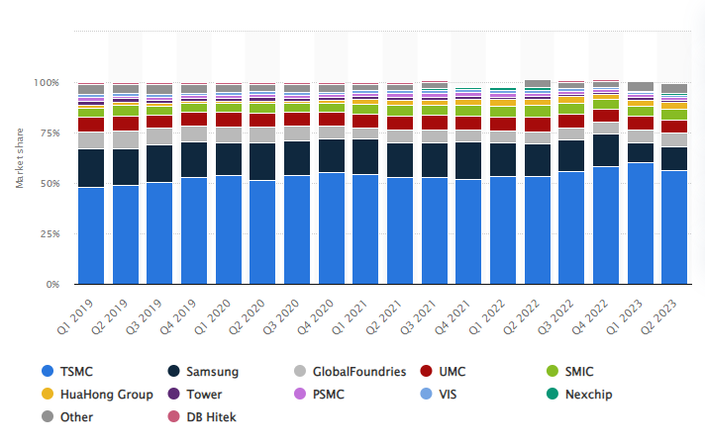
Key Resources – Semiconductor Manufacturing
TSMC Taiwan Semiconductor Manufacturing Company

Slide 40
The End

