Slide 1
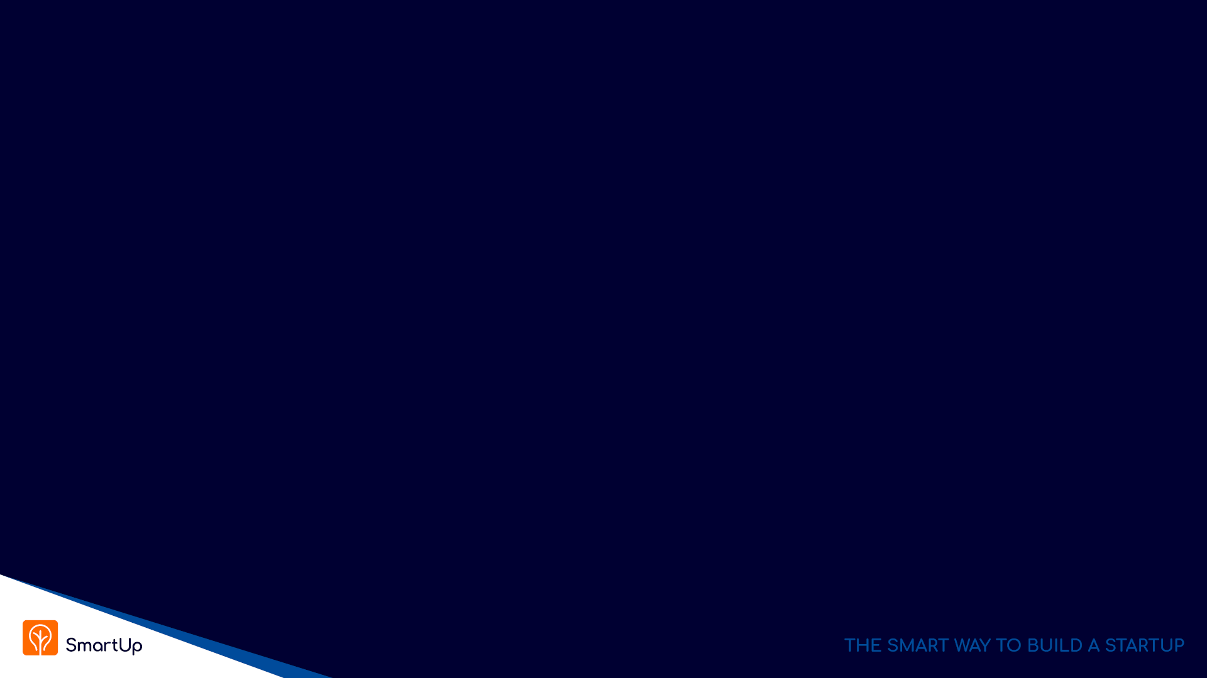
Digital Innovation
Lesson 4

Slide 2
Digital Innovation - Today’s class
Summary and review of what we learned last week
Marketing Funnel
“Branding First” deeper dive with several examples
“Branding First” – additional benefits
Questions ?
yonatan@yonatanlabs.com
Yonatan@smartupacademy.org

Slide 3
Main Points From Last Week
Innovation is evolutionary
The concept of Enablers - Innovation always relies on enabling ideas, theories, technologies and resources that already exist
Innovation happens concurrently independently by several people when the Enablers are in place
For product innovation - NO need to be first, actually it is better not to be first
Product innovation succeeds when the product reaches acceptable levels of price, performance, and ease of use

Slide 4
Product Innovation
Product innovation is mostly not in new technology but in its use. The where and how to use the technology and the data
Examples:
Taxi service – Uber, Lyft, Gett, …..
Hotels, Travel – Expedia, Bookings.com, Kayak, TripAdviser, AirBnB,
Movie theaters – BlockBuster, Netflix
Postal Service – Email, WhatsApp, Zoom, SMS,
Dating – OKCupid, Bumble, eHarmony, Tinder, Jdate ….
Virtually every domain in our life is going to be impacted

Slide 5
Sustaining Innovation vs. Disruptive Innovation
Sustaining innovation is when a company creates better-performing products to sell for higher profits to its best customers.
Examples: iPhone, Flat TV, Wissotzky Herbal Tea, 1% Milk, Soy milk, car reverse camera,
Typically, sustaining innovation is a strategy used by entrenched companies already successful in their industries
The motivating factor in sustaining innovation is higher profits; by creating better products for its best customers, a company can pursue ever-higher profit margins
https://online.hbs.edu/blog/post/sustaining-vs-disruptive-innovation

Slide 6
Sustaining Innovation vs. Disruptive Innovation
Disruptive innovation— occurs when a new company with fewer resources moves into a market and later challenges an incumbent business. There are two types of disruptive innovation:
Low-end disruption, in which a company uses a low-cost business model to enter at the bottom of an existing market and claims a segment
New-market disruption, in which a company creates a new segment in an existing market by catering to a usually small unrecognized or unappreciated need
New innovations are usually inferior to existing products measured by industry standard parameters

Slide 7
The Innovator’s Dilemma – 5 Principles
Principle #1 - Companies depend on existing customers for sustained and growing revenues – Sustaining Innovation
Principle #2 - Small markets don’t solve the growth needs of large companies
Principle #3 - Markets that don’t exist can’t be analyzed
Principle #4 - An organization’s capabilities define its disabilities
Principle #5 - Innovation’s performance may initially not fulfill main market demands, as measured by the market’s traditional properties

Slide 8
Digital Innovation – The Startup Dilemma
You want to start a startup, and you are looking for an idea
What should you do?
Disruptive innovation - Invent something totally new that will disrupt the world, or maybe just an industry… (ChatGPT….)
Incremental innovation – use existing technologies in a new way to improve a product or a process, or to solve a problem (Gett, Uber, Pango, ICQ…)
Enter an existing market by improving on existing offerings – No need to be first (Facebook, Google, Bookings.com, WhatsApp…)
Enter an existing market with a new business model (eCommerce, Netflix, Android, )

Slide 9
The SmartUp Way – Branding First
Your biggest challenge is NOT to build your product - It is to bring paying customers
Paying customers are hard to get - They just don’t report to you
The first thing you need to focus on is your prospects and customers
Who are they?
How do you reach them?
How do you get their attention?
How do you get them to buy from you?

Slide 10
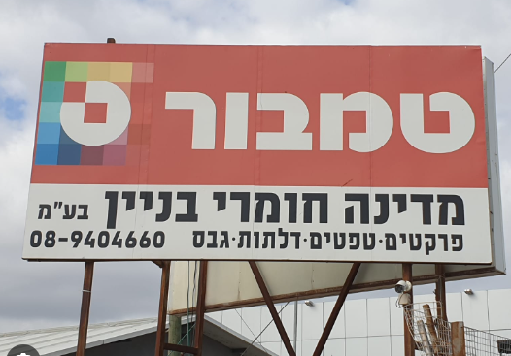
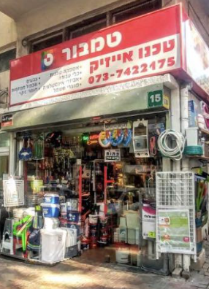
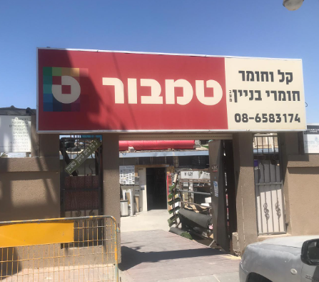
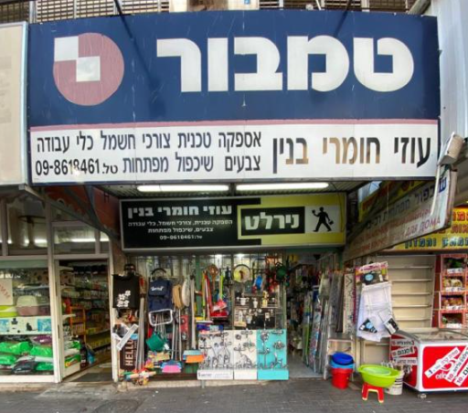
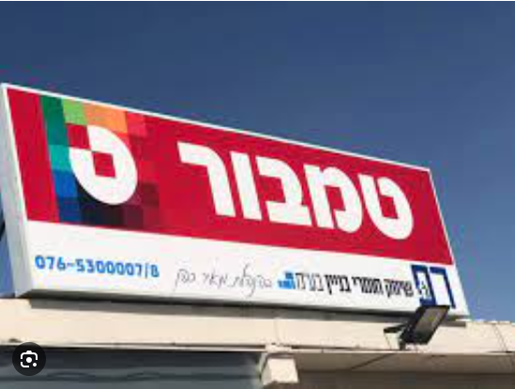
Branding First – The smart old fashioned way
And then what happened?

Slide 11

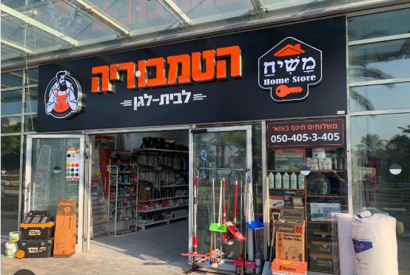
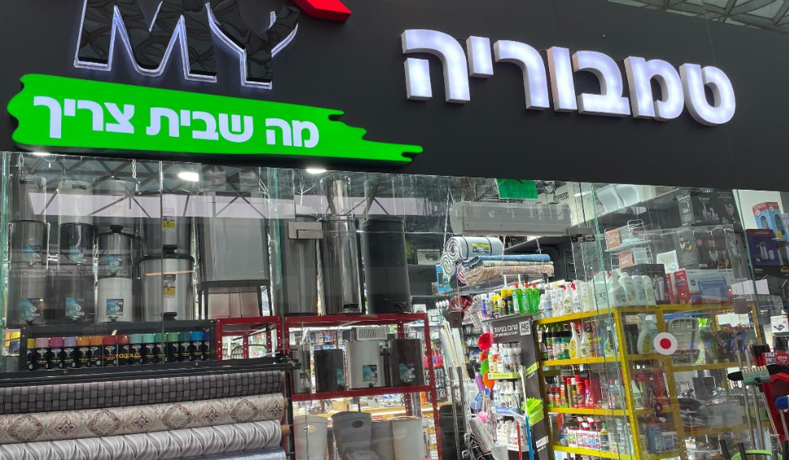
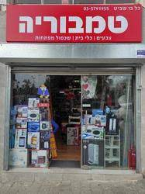
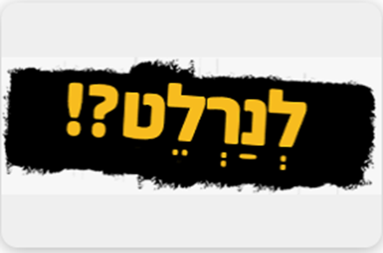
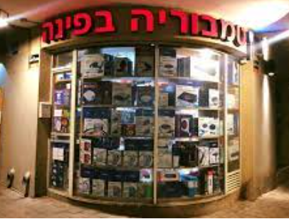
Branding First – A success story

Slide 12
The SmartUp Way – Branding First
Instead of building the company around a product idea
Build the company around a branding and marketing strategy
What is the BRAND you want to build?
A name your prospects will recognize
and have positive feelings towards it
No need to be specific about the product or the solution
Building a brand takes a long time – so better start early

Slide 13
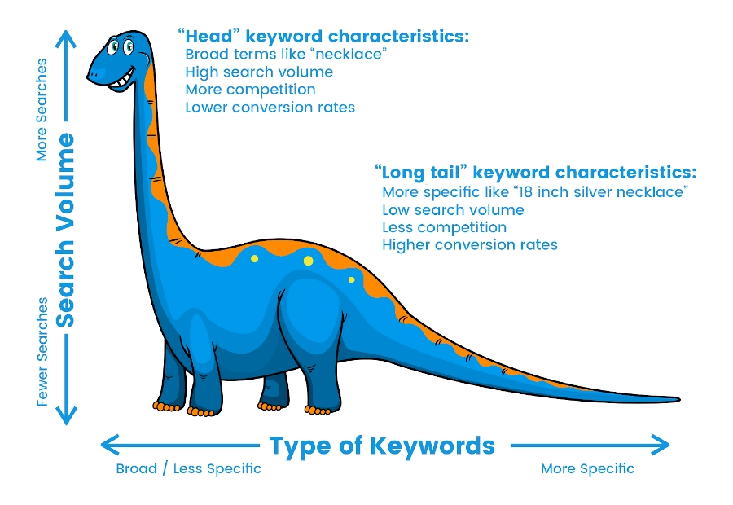
SEO (Search Engine Optimization) - Long Tail
Google is your best friend,
if you know how to bring value to Google’s users

Slide 14
SEO - Long Tail
“Head” keyword characteristics
Common terms like “necklace”, “laptop”, “Car Insurance”
High search volume
Intense competition for a first page placement in Google
Lower conversion rate
“Long tail” keyword characteristics, usually longer phrases, 4-6 words
More specific terms, like “18 inch silver necklace with a pendant”
Low search volume
Less competition for Google first page placement
Higher conversion rates

Slide 15
SEO - Long Tail
Why a database?
Each row in the table is about an entity – Person, Address, Company, and will be translated to one page on the website with information about that entity
The content of the page is the data included in the fields or columns of the database
How to choose a set of “long tail keywords”?
The most important element is to find a set of keywords that your prospects are likely to search for when having the problem you try to solve, or the product you try to sell – will discuss later, Opster

Slide 16

Opster – A SmartUp Company
Focus on the problem - not on your solution
When Opster was founded, we had nothing to sell. Product vision was murky
We asked ourselves – What do DevOps engineers do when encountering a problem with their ElasticSearch installation?
In many cases the ElasticSearch system produces an error log that is written to their log file
Here are random examples of real error logs

Slide 17
Opster
Error Log examples
Could not lock IndexWriter isLocked
Delaying allocation for unassigned shards; next check in
Suspect illegal state: trying to move shard from primary mode to replica mode
Failed to start monitoring service
Using discovery type and seed hosts providers
All shards failed
Term query does not support array of values
No mapping found for ” + fieldName + ” in order to sort on
People who search for such error logs are likely to be Elastic DevOps engineers – exactly Opster’s prospect base

Slide 18
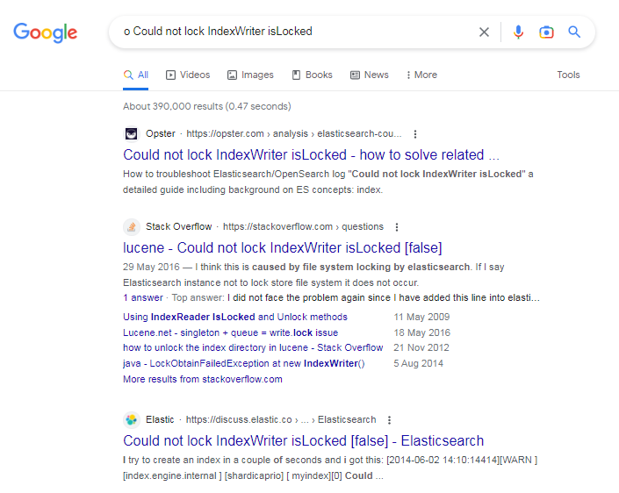
Opster - the Power of Long Tail
Ahead of StackOverflow and Elastic itself
Opster
StackOverflow
Elastic.com – The originators of ElasticSearch

Slide 19
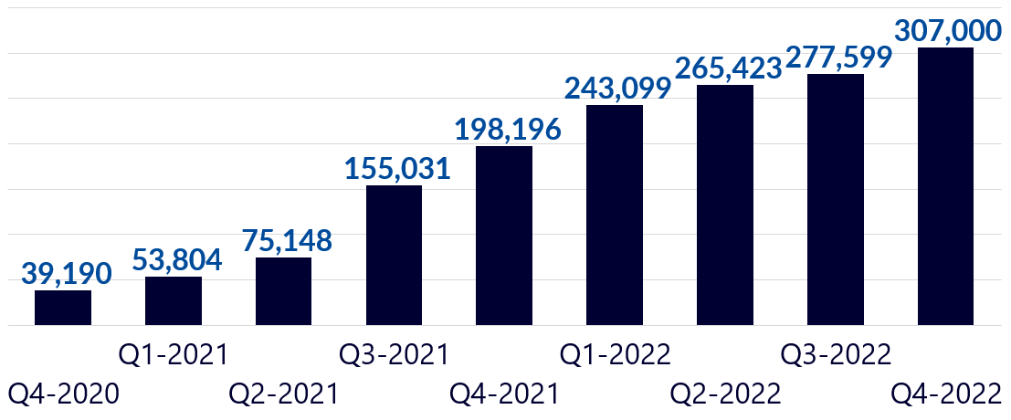
Opster - Awareness
Traffic results per quarter

Slide 20
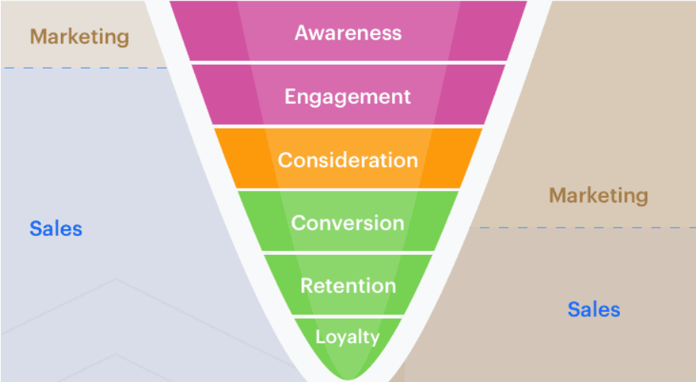
Branding First – Marketing Funnel
Traditional
Sales & Marketing
Internet Based
Sales & Marketing

Slide 21
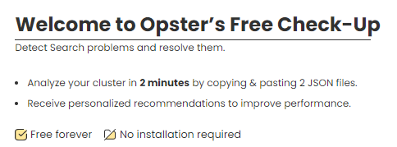

Opster – Marketing Funnel – Engagement
How to move from Awareness to Engagement
Developed CheckUp – a simple tool to identify problems based on 2-3 files taken from the Elastic cluster
Users need to create an account to run CheckUp
Our main source of leads – Very low Customer Acquisition Cost (CAC)

Slide 22
Opster - Engagement
Number of New Registered Users
Total Number of Registered Users

Slide 23
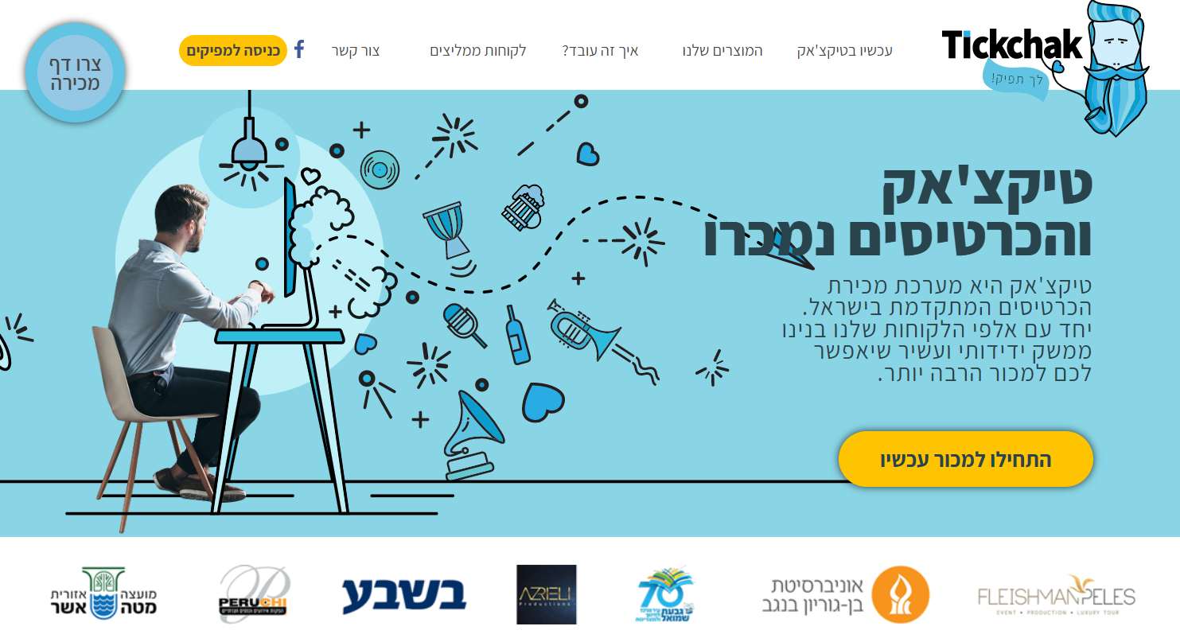
TickChak – A SmartUp company

Slide 24
TickChak – A SmartUp company
A small company with about 30 employees, located in Jerusalem. Joined SmartUp in October of 2022
A web platform for building “Event Page” or “Event Brochure” and selling tickets online for the event
Entire process is digital
TickChak handles the credit card processing for a small fee – which is their main source of income
Profitable from inception, generates cash every quarter

Slide 25
TickChak – A SmartUp company
Survived the Corona lockdowns by offering their platform as a tool to raise money for good causes. GiveChak was born
The core of their customer base is ציונות דתית, Orthodox Zionist, and they grow nicely, 20% year over year, by word of mouth
But…. They feel stuck in שער הגיא , on the way to Jerusalem
They wanted to penetrate the entire culture and entertainment scene in Israel, and also go international
Any ideas how to get there?

Slide 26
Live.TickChak Branding Idea
Long Tail Strategy
Long tail of what?
A database of every event, current and past, of every singer, artist, actor, stand-up artist, and anybody else who sells tickets for shows or events
But how do you create such a database?
There are 25-30 online ticketing websites that sell all tickets for all events in Israel
Built a bot visiting these websites every day, scraping the information about any new event

Slide 27
Live.TickChak - Long Tail Branding Idea
For each event collect and extract the following information:
The name of the concert, show or event
Type of the event, like: Jazz, Rock, Hasidic, lecture, stand-up, etc.
Names of artist, or artists
Date and time of event
Venue
Location – city
Price range
Etc.

Slide 28
Live.TickChak - Long Tail Branding Idea
With the information collected, TickChak builds a summary page for each:
Artist
Genre
Venue
City
Producer

Slide 29
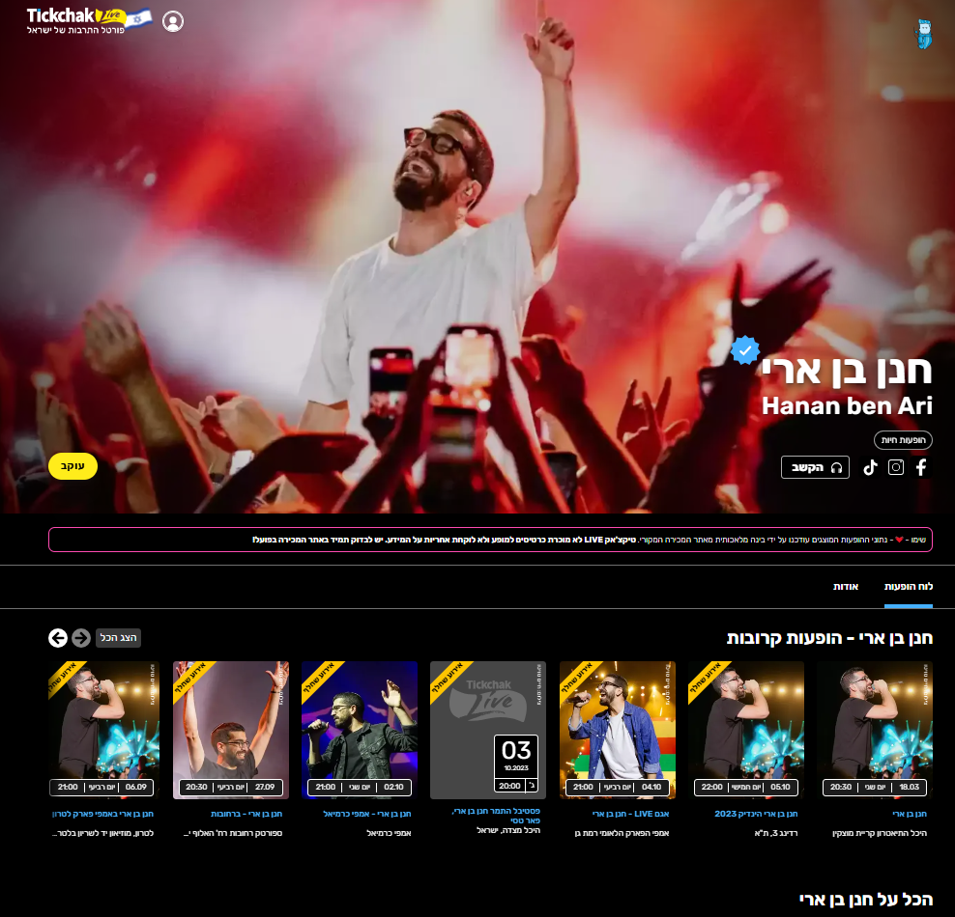
Live.TickChak
Artist Page
חנן בן ארי

Slide 30
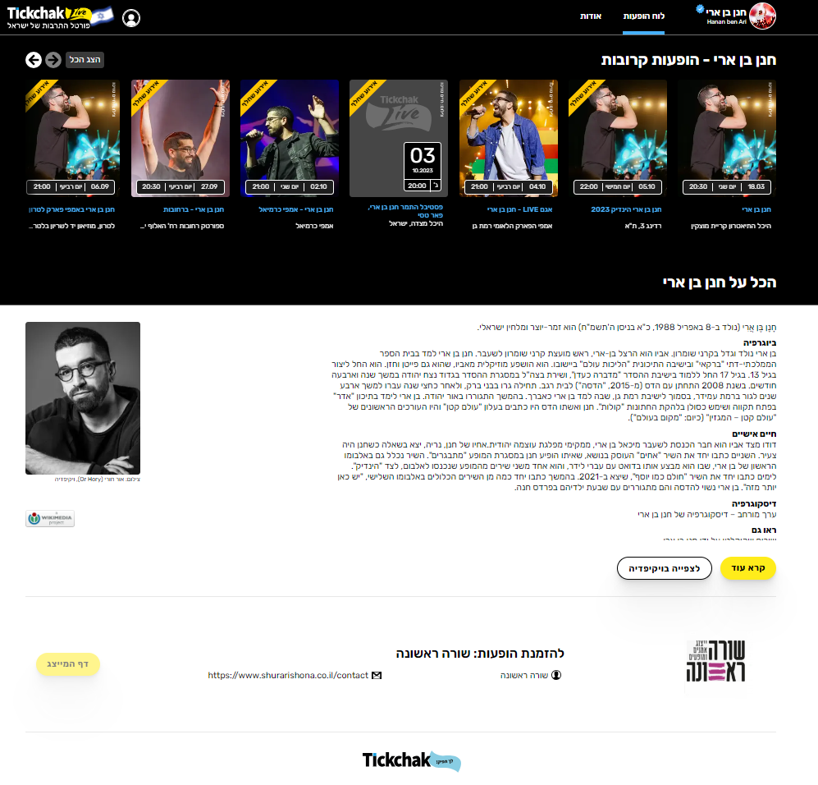

Live.TickChak
Artist Page –
חנן בן ארי
Continued

Slide 31
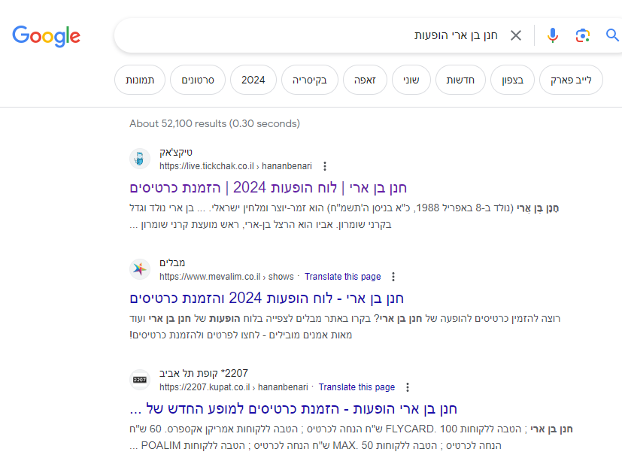
Live.TickChak – Google search result position
TickChak Live
מבלים
קופת תל אביב

Slide 32
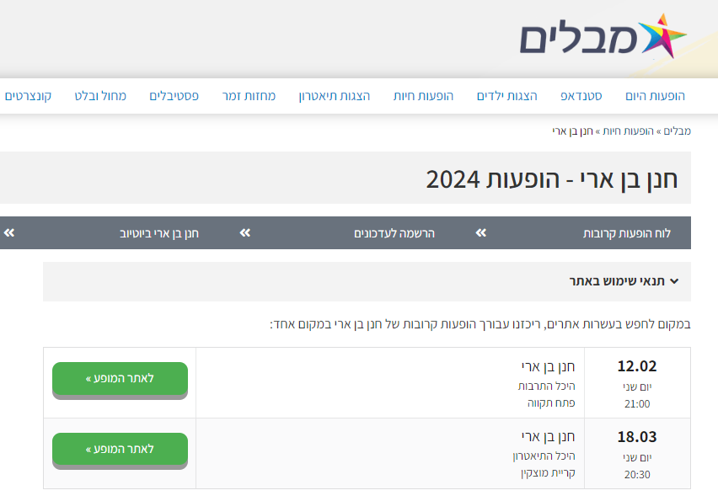
Live.TickChak – Competitor
No need to be first
Who knows מבלים ?

Slide 33
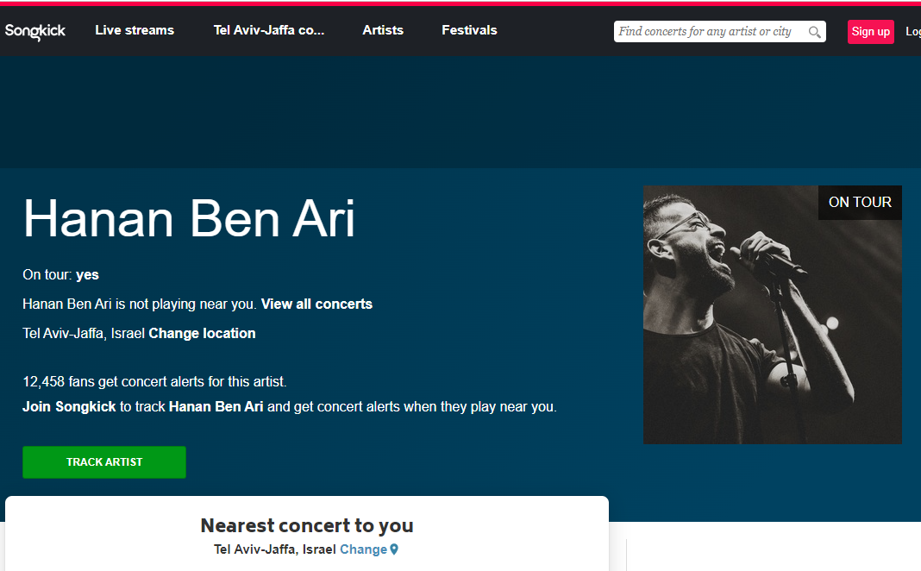
Competitor –SongKick.com
Who knows SongKick?

Slide 34
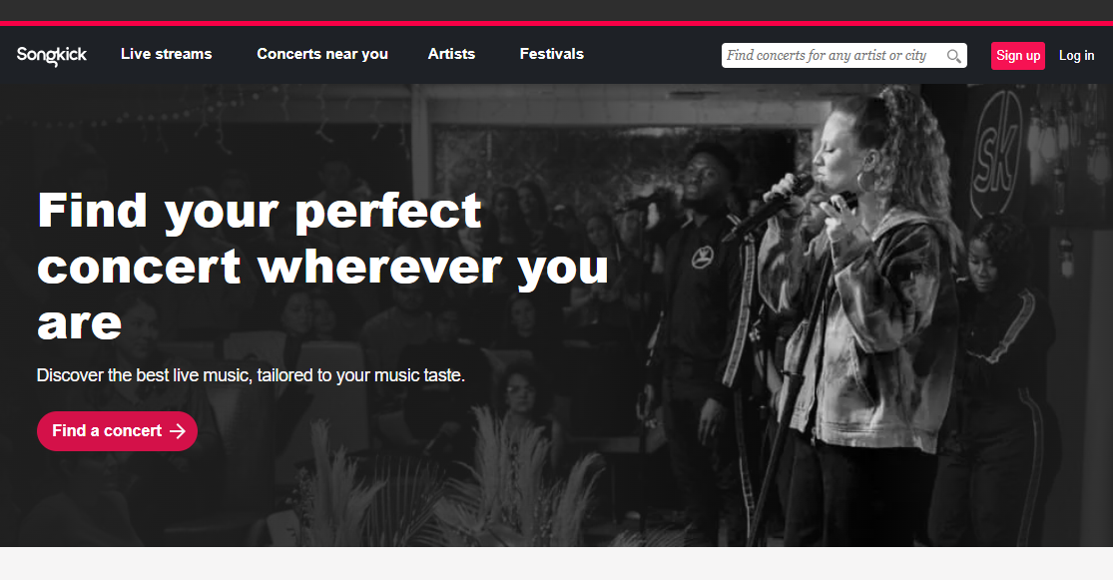
Competitor –SongKick.com
Songkick is a concert discovery service
Founded in 2007 at Y-Combinator
Raised $61 million in 10 financing rounds
Acquired by Warner Music Group in 2017
About 30 employees

Slide 35
Live.TickChak - Long Tail Branding Idea
With the information collected, TickChak builds a summary page for each:
Artist
Genre
Venue
City
Producer

Slide 36
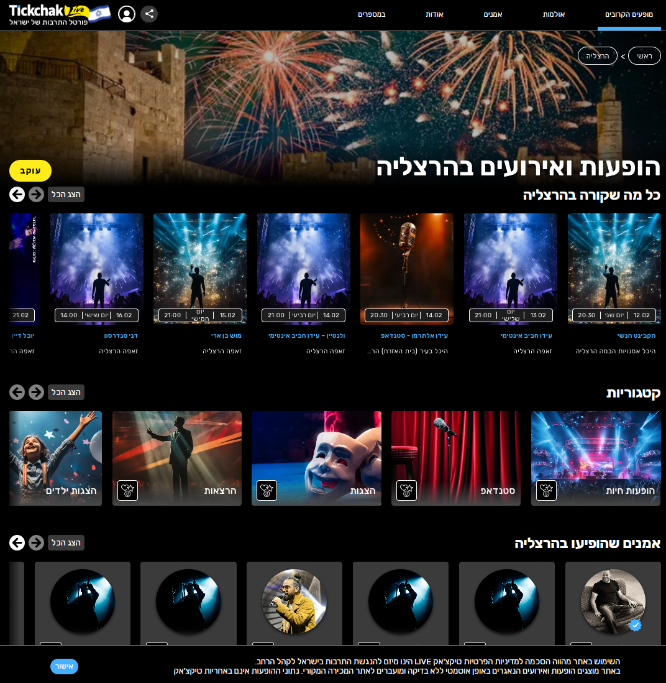
Live.TickChak
City dynamic page

Slide 37
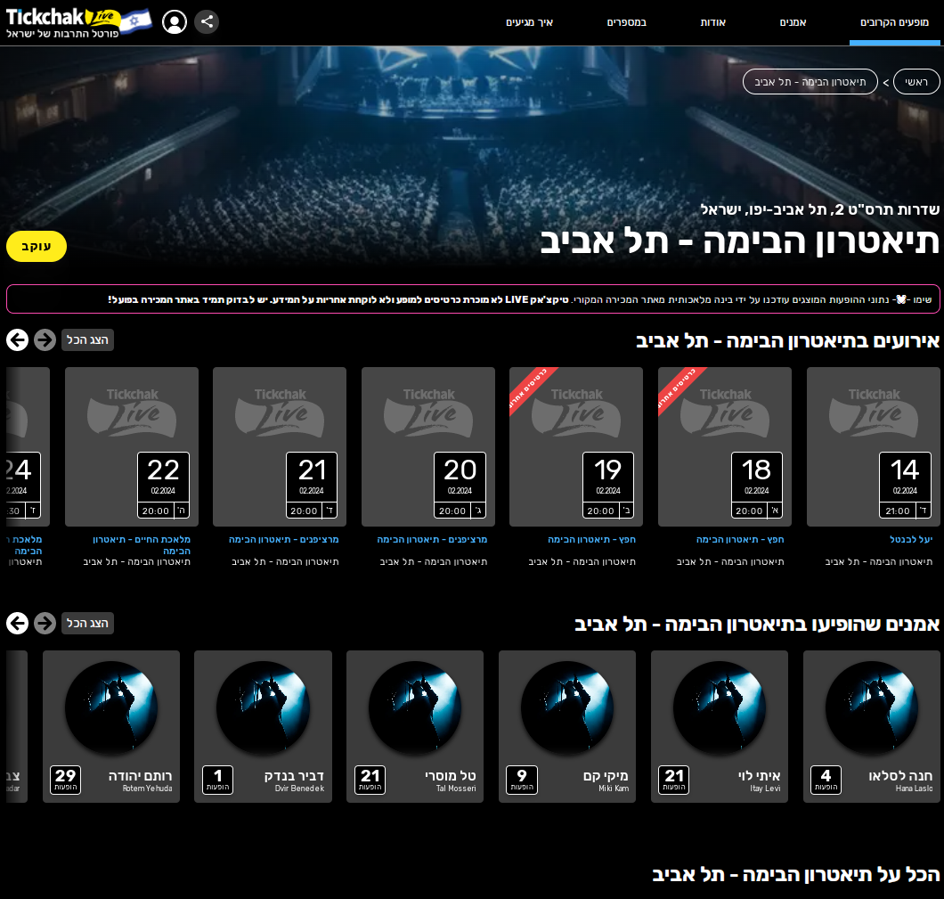
Live.TickChak
Venue dynamic
page

Slide 38
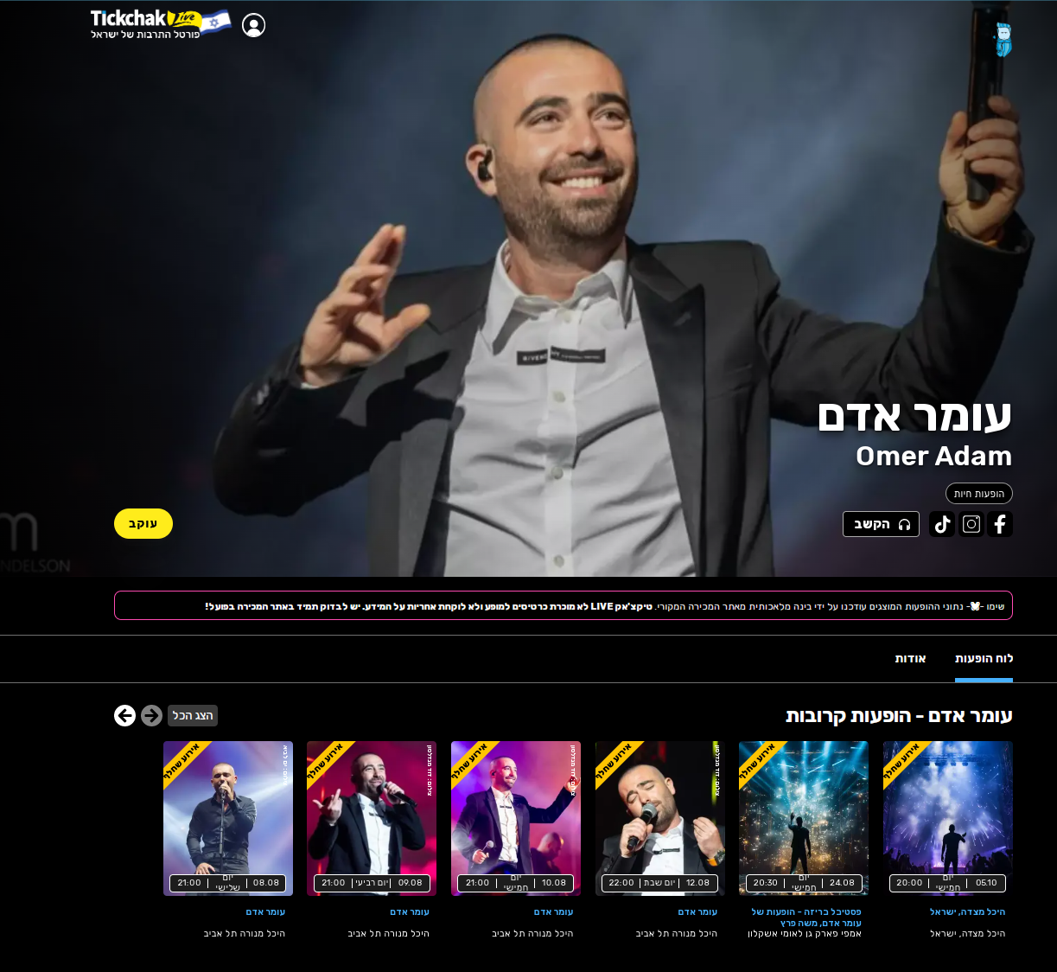
Live.Tickchak Branding
Artist Page
עומר אדם

Slide 39
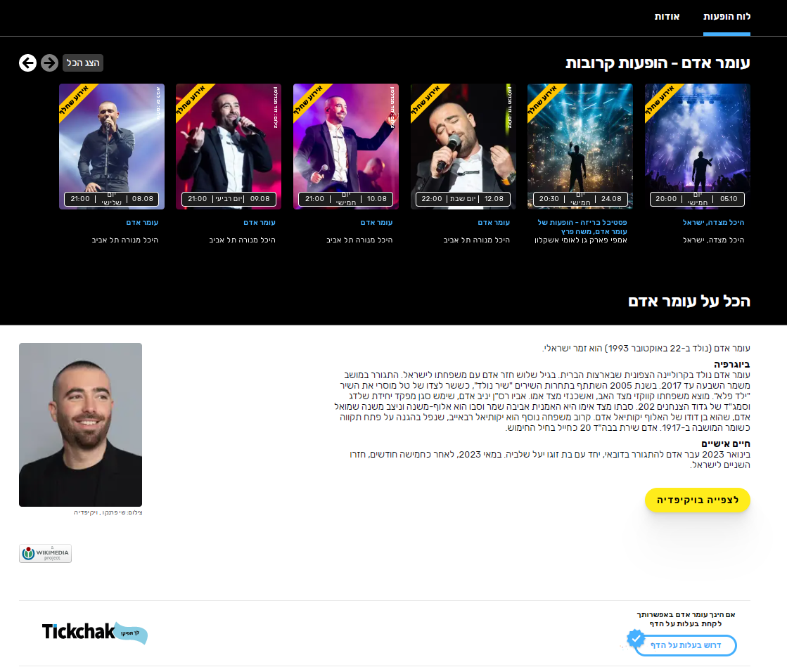
Live.Tickchak Branding
Artist Page
עומר אדם
The rest of the page with more information

Slide 40
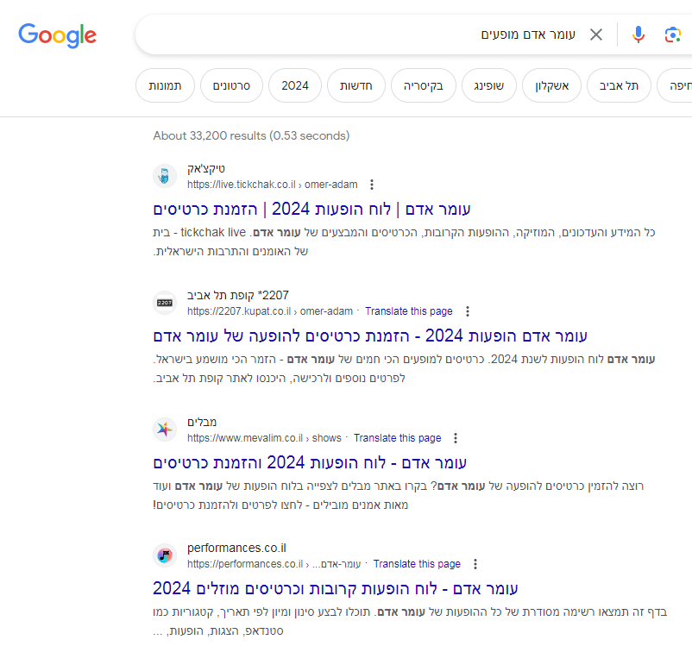
Live.Tickchak Branding - Long Tail
TickChak Live
קופות תל אביב
מבלים

Slide 41
Live.TickChak Branding First
Who is the target for the branding?
People who want to go to a show?
The artists?
Managers, producers?
Three different audiences, with different branding intentions
The people who want to go to a show
Artists, managers, producers
Venues, cities, locations
Any idea what we might want to accomplish with each audience?

Slide 42
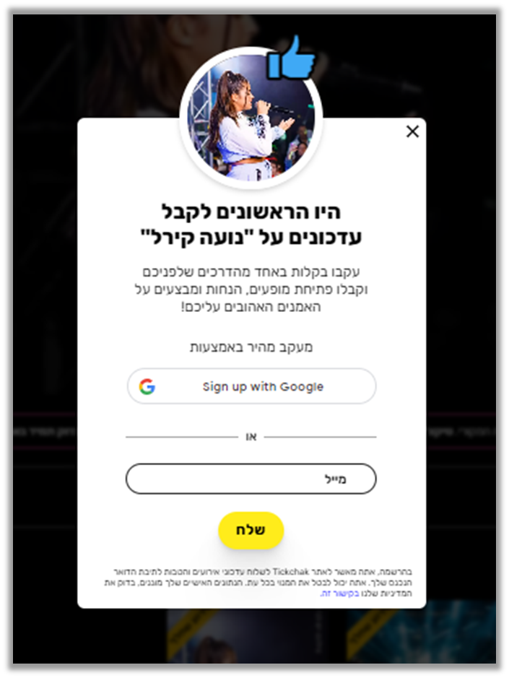
Live.TickChak - Branding First
people who want to go to a show
Built a process to collect contact information of fans and followers of the artist
Using this growing list, offer the artist tools to interact with his or her fans
Ability to sell early tickets to fans, and also fill in a venue in the last minute

Slide 43
Live.TickChak - Branding First
Offerings for artists, managers and producers
Free basic offering - Artist’s always-updated home page, with lots of information about the artist, and tools to add and tailor the page
Access to the growing list of fans and followers, with tools to communicate with them – Paid upgrade
Ability to promote their concerts and shows on the Live site
Ability to sell tickets using the TickChak platform, while accessing their fan list

Slide 44

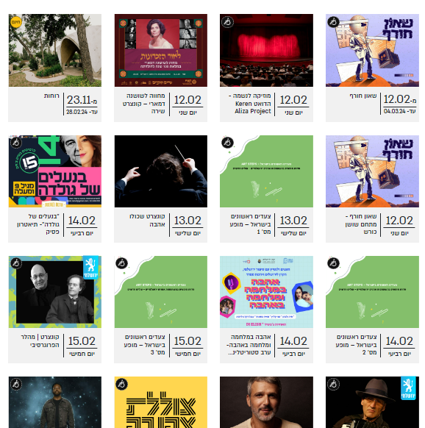
Live.TickChak - Branding First
Offerings to venues and cities
Always updated page for venues and cities – Paid offering
https://www.jerusalem.muni.il/he/experience/lobbyevents/?cat=music

Slide 45
Branding First – Benefits
Focusing on Branding before spending time, money and effort on developing your great Digital Innovation has several benefits:
A company has to become profitable, generating cash from operations, as early as possible
For that it needs to have sales, and for that it needs to have paying customers
Customers will not come and pay for a product or service unless they know about it, understand it, and have positive feelings towards the company
There is no way to address the entire market, effective branding efforts help the company identify a beach-head

Slide 46

Establishing a Beach Head
World War II – D Day, June 5, 1944
The invasion of the allies to Nazi controlled Europe
The Nazi Atlantic Wall – 5,100 km of fortified barrier
The beach head of Normandy was 80 km long and was further divided to 5 sections
The entire US and British armies landed on that small beachhead

Slide 47
Branding First – Benefits
Focusing on Branding before spending time, money and effort on developing your great Digital Innovation has several benefits:
People and companies who are interested raise their hands – giving the company an indication of the market beach-head it needs
Effective branding creates familiarity and positive attitude towards the company, as early as possible, and at a fraction of the cost
It solves two problems at once – what is the beach-head, AND people on the company site, ready for the next step - engagement
Many times, the method to create the brand creates various business opportunities that are simpler to sell than your original Digital Innovation

Slide 48

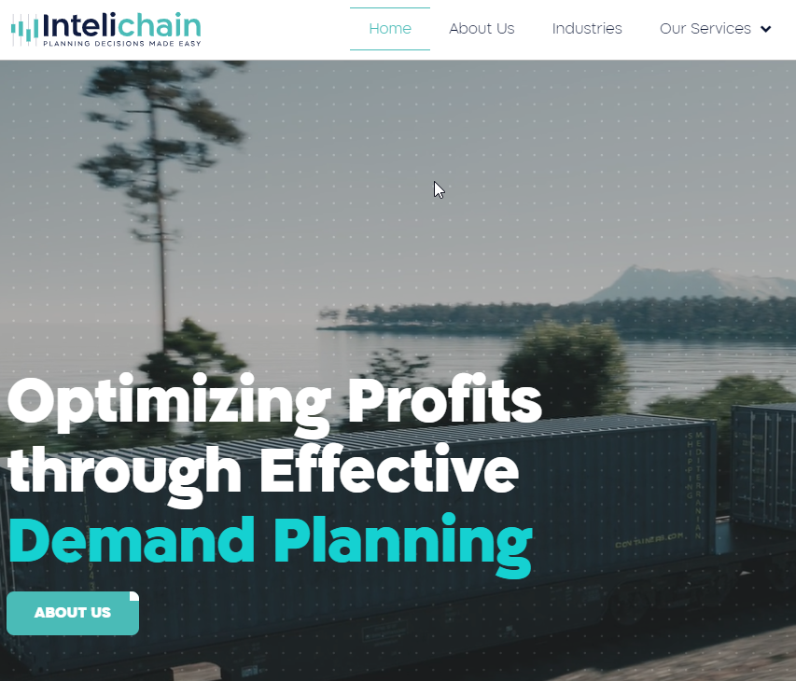
Intelichain, a SmartUp Company
Demand planning Software, aimed at the low end of the market
A piece of the S&OP methodology process
A small company with about 10 employees, located in Raanana. Joined SmartUp in April of 2023

Slide 49
Intelichain, a SmartUp Company
Product is a sophisticated Demand Planning module that was aimed at the low end of the market – companies around $100m
A hard sale, with a long sale cycle, including a Proof of Concept step that took several days to prepare per customer
The Proof of Concept usually involved an analysis of inventory levels of all products and how well they match needs
This Birds Eye view was usually an eye opener and an Aha moment …. But did not lead to sale…

Slide 50
Branding First – Intelichain
Long Tail marketing – we couldn’t find any good idea
Instead, took a very different marketing and branding path
Founder spent many years at E&Y in their S&OP practice, working with dozens of companies
During his years at E&Y he developed several training courses and was very good at delivering them
Evolved the marketing plan to selling courses, instead of the Demand Planning product
Much easier to sell courses – everybody knows what a course is, and S&OP is a “sexy” subject

Slide 51
Branding First – Intelichain
After a person registers for the course, he or she gets a call to discuss what specifically she wants to gain from the course….
Needless to say, this call was a paid sales call
At the course, the company explained the process of analyzing inventory levels of all products given historical sales of same products. It is packaged as “Strategic Consulting” because it provides very interesting and useful insights into “buried” costs of inventory
Started selling Strategic Consulting as a follow up to the course

Slide 52
Branding First – Marketing Funnel
Traditional
Sales & Marketing
Internet Based
Sales & Marketing

Slide 53
Branding First – Intelichain
Interacting with the executives who attended the course, it emerged that most companies were curious but cautious about S&OP
S&OP has a reputation of a complicated, expensive and painful to implement process
The notion of Agile S&OP was invented
Branding First – completely changed the direction of the company, while generating revenues from very large customers

Slide 54
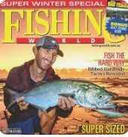
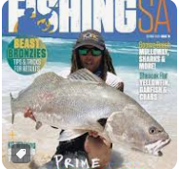


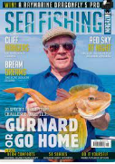

Branding First – Other ideas
Branding First is critical to the success of a company – BUT it is a challenging creative task
Position the company as experts – evolving research through questionnaires and newsletters
Sometimes it creates income opportunities – 40+ fishing magazines

Slide 55

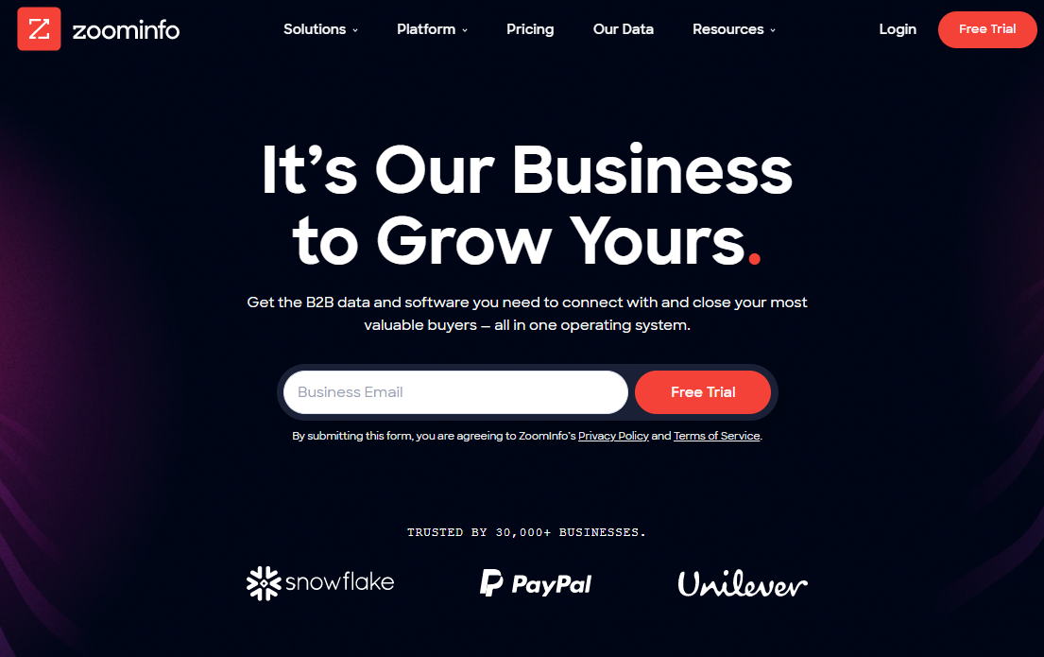
ZoomInfo – Tools for sales

Slide 56
ZoomInfo - History
Founded in 2000 by Yonatan Stern
Nice little company, selling mainly to recruiters – Executive Search Firms
By 2004 revenues were about $6m, profitable, growing
But we wanted to grow much faster by going after sales people
How do we go from one customer set – recruiters, to another – sales people?

Slide 57
ZoomInfo - History
Made a bold decision – Let’s publish all of our data, one page per person
Long Tail - Sales people and recruiters search for people by name, or company name and title all day long
Search by name is one of the most common searches in Google
There was no other people directory on the web at the time - LinkedIn just started 2 years before and did not publish its data

Slide 58
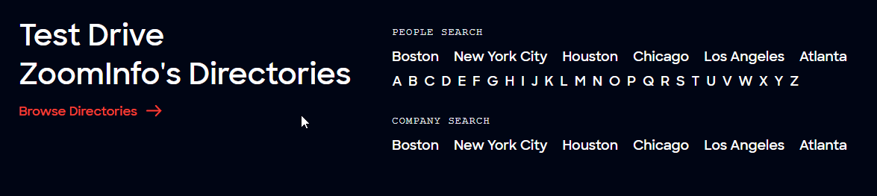
ZoomInfo Directory

Slide 59
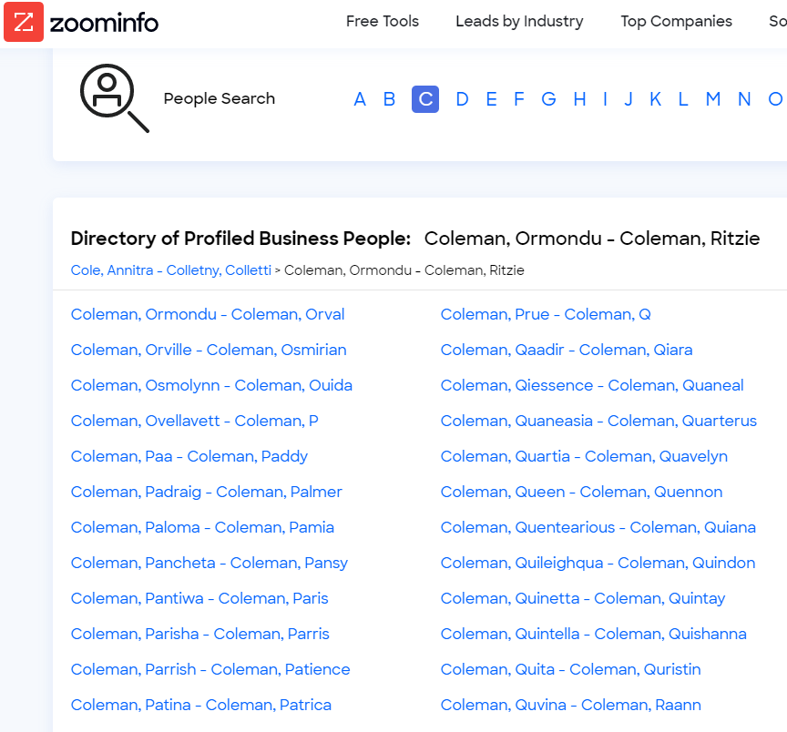
ZoomInfo Directory

Slide 60
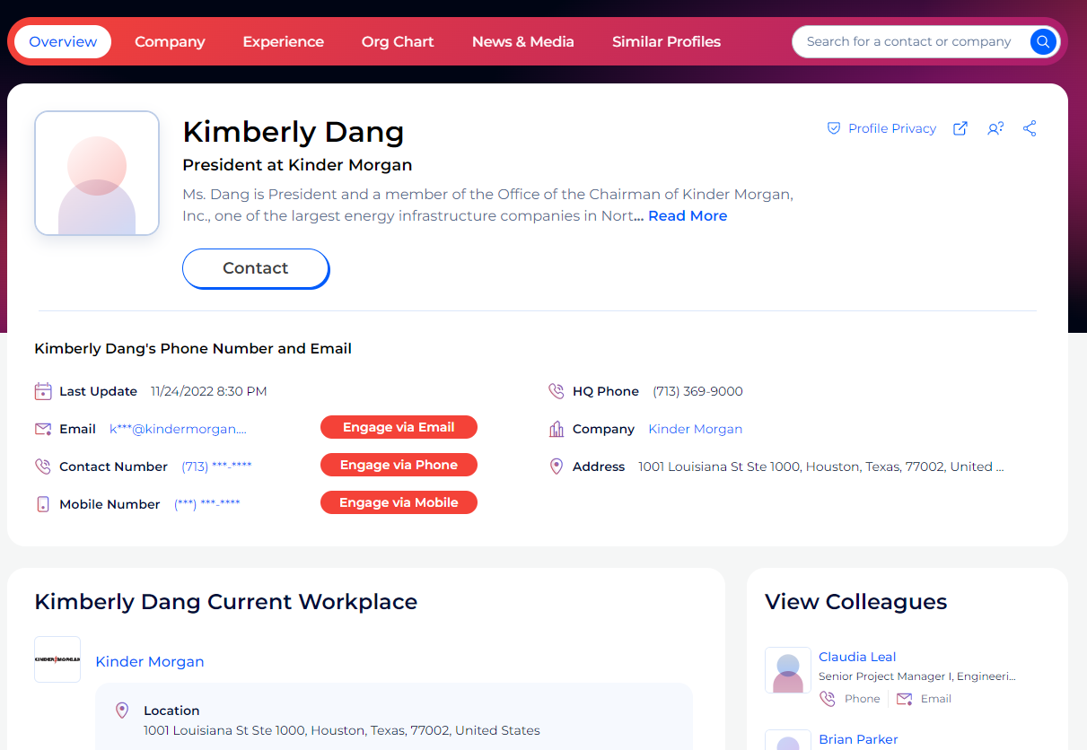
ZoomInfo Directory

Slide 61
ZoomInfo - Results
By the time I left in 2018 there were
50 million directory pages indexed by Google
About 10 million visitors to the site every month – aggregation of many small searches each for a different name
Some 20,000 inbound leads every month
Company grew revenues consistently by 50% year over year
CAC – Cost of Customer Acquisition very low
Sale cycle of 2-4 weeks, customers were familiar with what ZoomInfo provides

Slide 62
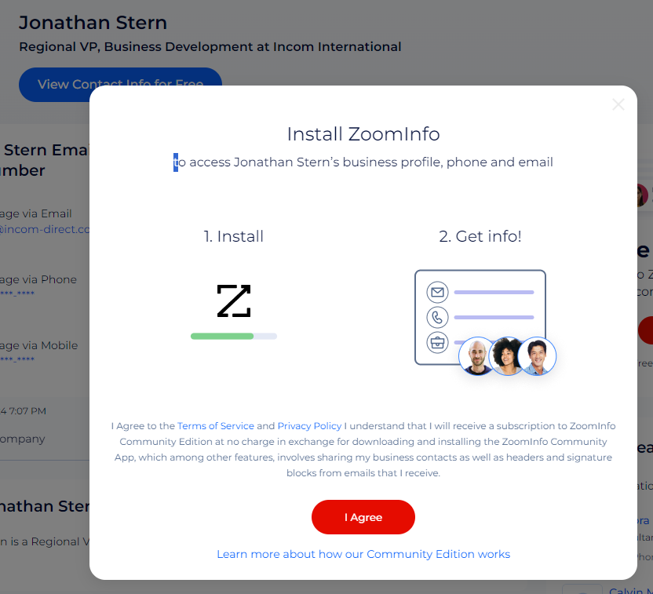
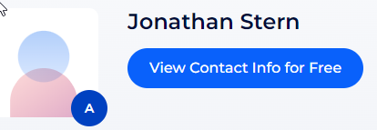
ZoomInfo Long Tail – Additional Benefits
The 10 million monthly visitors contributed in another way – Data Contributors
ZoomInfo’s main source of contact data

Slide 63
ZoomInfo – The Brand
In early 2019 ZoomInfo was acquired by DiscoverOrg
The CEO of DiscoverOrg ran a study to decide on the name of the combined company
ZoomInfo brand was 9 times more recognized than DiscoverOrg
The combined company is called ZoomInfo
ZoomInfo went public in NY in June of 2020, the first IPO during the Corona lock-down, and is worth today $12 billion
The power of long tail branding

Slide 64



Companies that are built on Long Tail
Some companies were built from scratch on a Long Tail strategy
Indeed.com – job posting and recruitment
Zillow – A national real estate player
Yelp – business directory with customers’ reviews

Slide 65

Indeed.com
Indeed, Inc. is an American worldwide employment website for job listings launched in November 2004
It started by crawling and extracting job postings from company career pages, job boards, staffing firms, and associations
Indeed.com published all these job postings in a directory for Google to crawl, and show up when job seekers typed a query like: “Product manager in Waltham, MA”, or “Dental hygienist in Little Rock, AK”
Grew to about 15,000 employees in 60 countries

Slide 66

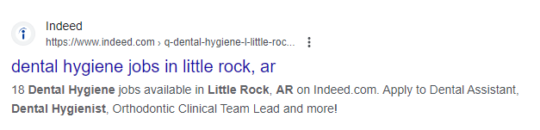
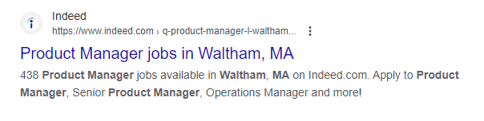
Indeed.com

Slide 67
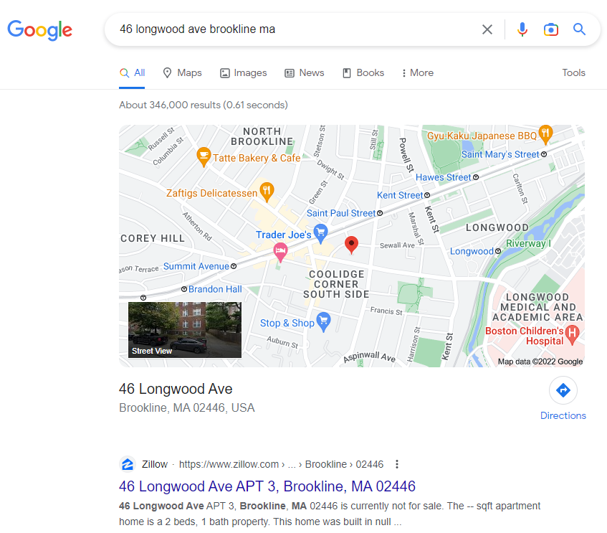
Zillow – A Realtor’s Long Tail Strategy
My first address in the USA: 46 Longwood Avenue, Brookline, MA
Zillow is the first Google answer

Slide 68
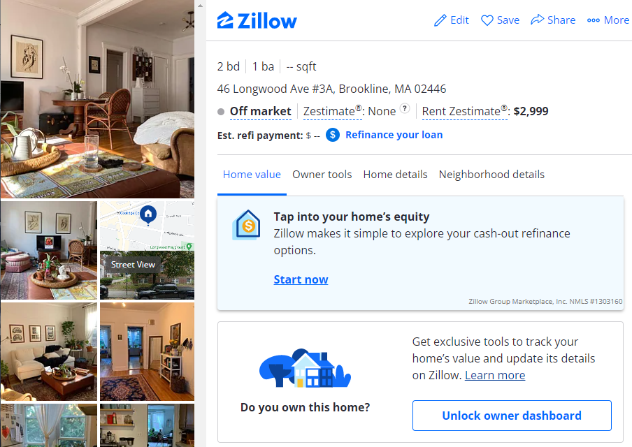
Zillow
Notice the “Rent Zestimate” of $2,999
The “Off market” for sales estimate
And the funnel to engage customers

Slide 69
Yelp
Yelp was founded in 2004 and has since become one of the leading sources of user-generated reviews and ratings for businesses – Hair dressers, Coffee shops, Lawyers, ….
It started by publishing a page per company, based on information it took from the Yellow Pages, creating a long tail of pages about companies, and asking visitors to write reviews
Yelp went public in 2012 and is worth $3.1 billion in Feb. 2024
By end of 2021, Yelp had approximately 244.4 million company reviews
In 2021 Yelp had about 105 million unique visitors

Slide 70
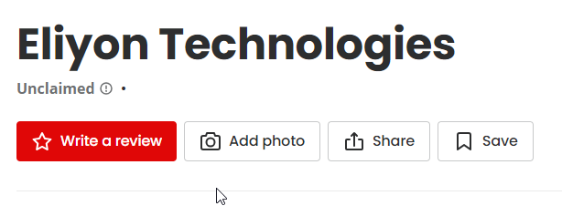
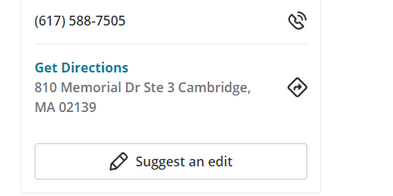
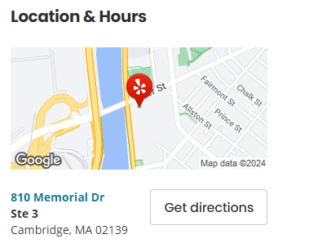
Yelp

Slide 71
Yelp
The company has been accused of using unfair practices to raise revenue by presenting more negative review information for companies that do not purchase its advertising
Or by prominently featuring advertisements of competitors on their page
For companies that advertise, Yelp was accused of excluding negative reviews from their overall rating on the basis that the reviews "are not currently recommended“
Food for thought….

Slide 72
Digital Innovation - Today’s Lesson
Summary and review of what we learned last week
“Branding First” deeper dive with several examples
Opster
TickChak
Intelichain
ZoomInfo
Indeed
Zillow
Yelp

Slide 73
Digital Innovation - Today’s Lesson
Branding First” – additional benefits
Must have first step to a profitable cash generating company
It creates familiarity and positive attitude
It leads to a market beach-head
It solves two problems at once – what is the beach-head, AND how to reach out to it
Many times, the method to create the brand creates various business opportunities that are simpler to sell than your original Digital Innovation

Slide 74
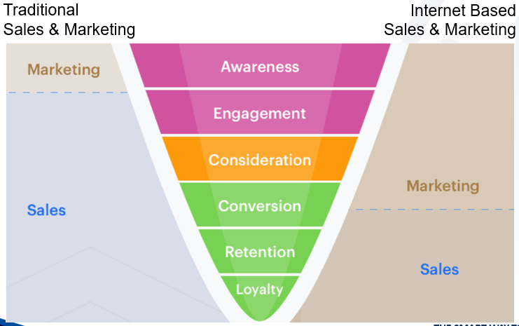
Digital Innovation - Today’s Lesson
Marketing Funnel

Slide 75
The End

