Slide 1
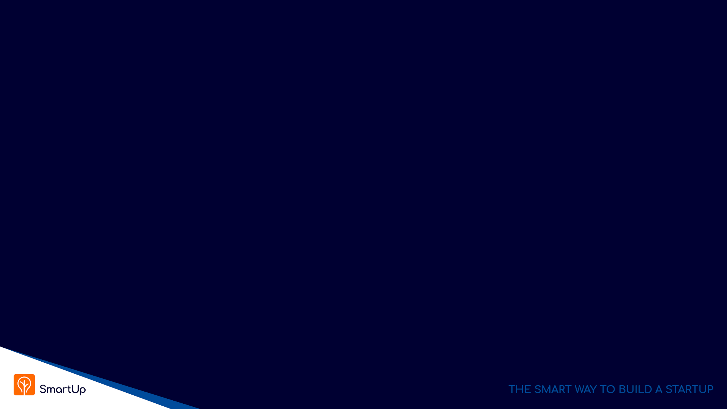
Digital Innovation
Lesson 3

Slide 2
Main Points From Last Week
Innovation is evolutionary
The concept of Enablers - Innovation always relies on enabling ideas, theories, technologies and resources that already exist
Innovation happens concurrently independently by several people when the Enablers are in place
For product innovation - no need to be first, actually it is not the best idea
Product innovation succeeds when the product reaches acceptable levels of price, performance, and ease of use

Slide 3
Digital Innovation – Recent Enablers
We ALL walk with a powerful Smart-Phone computer in our hand
It is always connected to the Internet – Cellular data + WiFi (Spotify, Netflix, Zoom, )
Powerful enough to run sophisticated applications
It is very easy to develop new applications (iOS, Android)
If has a camera, a microphone and high-fidelity speakers
Hi quality color screen (photo album, no one prints photos)
It has enormous memory (512 GB, endless photos)
It has a GPS – (Waze, Pango, Uber, Gett, Wolt, more?)
There are many more useful apps
Think about business applications (Insurance, agriculture, traffic, …)

Slide 4
Digital Innovation – Recent Enablers
Inexpensive, easily accessible, platforms and infrastructure
Standards – Windows, iOS, Unix, Mozilla browser (Chrome, Firefox, Edge)
Enormous computing power at your fingertips
Cloud computing - Amazon AWS, Google Cloud, Microsoft Azure, ….
With built-in technologies
Scalable architecture – as many servers as you need
Databases
Search engines
Artificial Intelligence

Slide 5
Digital Innovation – Recent Enablers
Powerful technologies
Deep learning algorithms
Translation
Speech to text
Embedded (YouTube, Zoom, ….)
Business – Sales (Gong, Chorus), Customer service,
Legal
Police, Intelligence services,
Picture recognition
Embedded (Google pictures, Google navigation)
Security – police, ClearView AI,

Slide 6
Digital Innovation – Recent Enablers
ChatGPT and other Large Language Models (LLM)
Enables high quality verbal man machine dialog – talk to your TV
High quality data extraction from free text and forms – for example, large scale medical information from hospitals and health organizations
This is so new, we just started scratching the surface…

Slide 7
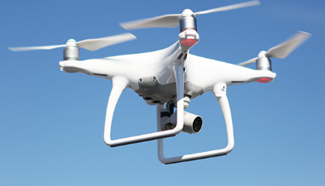
Additional Technology Enablers
Drones (filming, agriculture, policing, military, archeology, ….. What else?)
3D Printing
DNA manipulation using CRISPR
Treatment for genetic defects
New treatments and medications (cancer treatments?, ….. )
It is the beginning of a whole new Digital Innovation revolution
Soon to be here
Self driving cars – huge impact on urban life
What Else?

Slide 8
Product Innovation
Product innovation is mostly not in new technology but in its use. The where and how to use the technology and the data
Examples:
Taxi service – Uber, Lyft, Gett, …..
Hotels, Travel – Expedia, Bookings.com, Kayak, TripAdviser, AirBnB,
Movie theaters – BlockBuster, Netflix
Postal Service – Email, WhatsApp, Zoom, SMS,
Dating – OKCupid, Bumble, eHarmony, Tinder, Jdate ….
Virtually every domain in our life is going to be impacted

Slide 9
Product Innovation – Introducing new products
Today’s lecture - exploring the business side of innovation
The Innovator’s Dilemma – why successful entrenched companies many times fail against new entrants
The challenges for new entrants
New entrants within an established market and well understood products, or
New entrants with new unfamiliar products
Possible solution – Branding and Marketing first

Slide 10
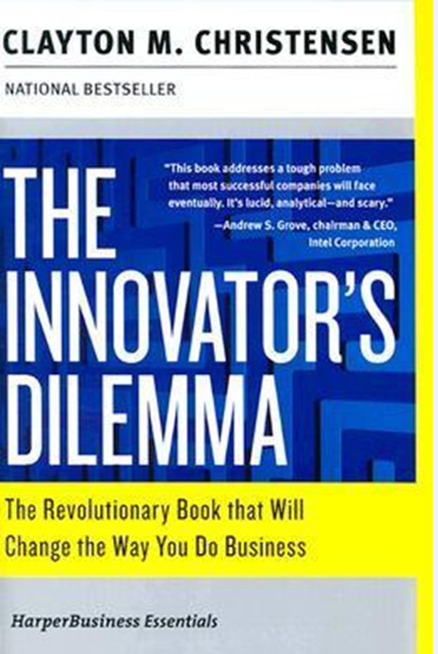
Product Innovation - Challenges
What happens when a company wants to introduce a new product
“The Innovator’s Dilemma”
A deep and revealing analysis of why highly successful entrenched companies miss new emerging technologies and trends and lose market share to new upstarts

Slide 11
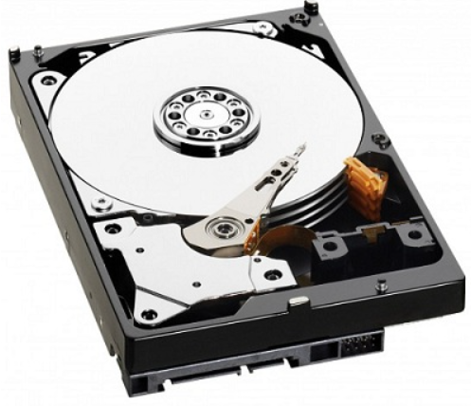
The Innovator’s Dilemma
Clayton Christensen initial research was done on the hard disk drive industry, the business research model equivalent to “fruit flies” in genetic research
Any ideas why entrenched companies fail?
Would Tesla beat the rest of the car industry?
Is Intel out of the game, losing its lead?
Would Nvidia take over the processor industry?

Slide 12
Hard Disk format evolution 1970’s - 1994
1st generation – 14 inch Mainframes
2nd generation – 8 inch Minicomputers
3rd generation – 5.25 inch Personal computers
4th generation – 3.5 inch Laptop computers
5th generation – 2.5 inch Laptop computers
6th generation – 1.8 inch Portable heart monitoring
Business models - Who benefited from buying disk drive defunct companies?

Slide 13
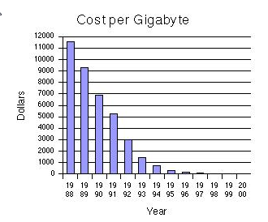
Hard Disk format evolution 1970’s - 1994
The main driving parameter in the industry was Cost per Megabyte and later Cost per Gigabyte
The disruptive parameter was physical size and weight

Slide 14
Sustaining Innovation vs. Disruptive Innovation
Sustaining innovation is when a company creates better-performing products to sell for higher profits to its best customers. Examples?
Examples: iPhone, Flat TV, Wissotzky Herbal Tea, 1% Milk, Soy milk
Typically, sustaining innovation is a strategy used by entrenched companies already successful in their industries
The motivating factor in sustaining innovation is higher profits; by creating better products for its best customers, a company can pursue ever-higher profit margins
https://online.hbs.edu/blog/post/sustaining-vs-disruptive-innovation

Slide 15
Sustaining Innovation vs. Disruptive Innovation
Disruptive innovation— occurs when a new company with fewer resources moves into a market and later challenges an incumbent business. There are two types of disruptive innovation:
Low-end disruption, in which a company uses a low-cost business model to enter at the bottom of an existing market and claims a segment
New-market disruption, in which a company creates a new segment in an existing market by catering to a usually small unrecognized or unappreciated need
New innovations are usually inferior to existing products measured by industry standard parameters

Slide 16
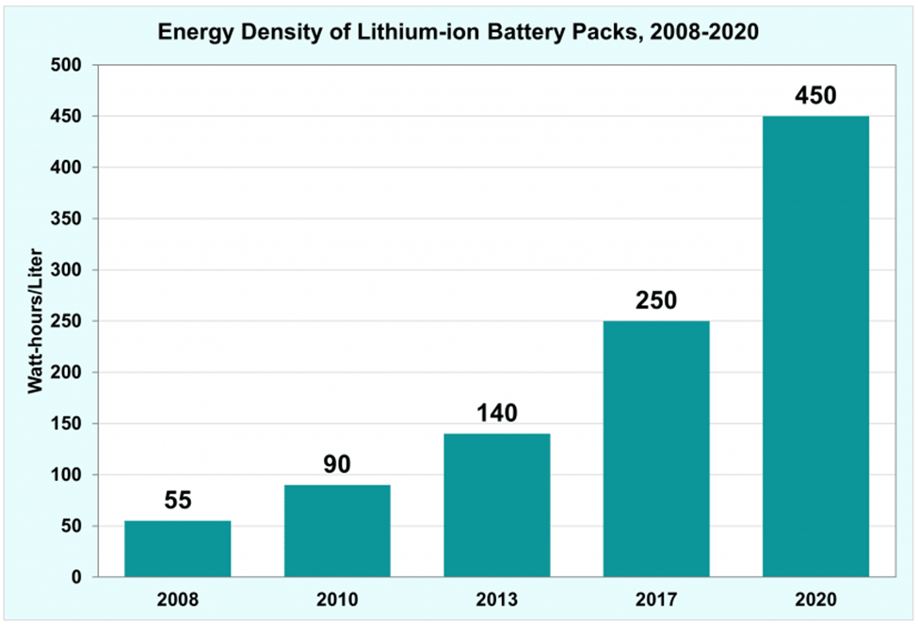
Sustaining Innovation - Batteries
Sustaining Innovation - Batteries are measured and valued by their Energy Density
Current industries:
Electric cars
Smartphones
Laptops,tablets
What technologies and parameters might disrupt the market ?

Slide 17
Disruptive Innovation - Batteries
Charging time:
What uses and industries might open up if there were batteries
With very high energy density but with very long charging time
With relatively low energy density but with very fast charging time
Structure:
What would happen if a battery with relatively low energy density can be molded and used as part of the product structure

Slide 18
Disruptive Innovation – Examples
The IBM Personal Computer - 1981 (Microsoft deal)
Xerox PARC (Palo Alto Research Center) - 1970’s
The standard modern user interface – Windows, Menus, Icons,
The Mouse
Graphical User Interface (GUI), WYSIWYG (What You See Is What You Get)
Laser printers
Local Area Network (Ethernet)
Apple co-founder Steve Jobs said that "Xerox could have owned the entire computer industry, could have been the IBM of the nineties, could have been the Microsoft of the nineties
Bitcoin – BlockChain, How disruptive is it going to be?
Intel vs. the SmartPhone + Intel vs. Nvidia in AI revolution

Slide 19
The Innovator’s Dilemma – 5 Principles
Principle #1
Companies depend on existing customers for sustained and growing revenues, therefore:
Successful companies listen and cater to their customer needs, which usually are new features, cost reduction, and performance improvements
Internal Focus – Successful companies focus on increasing revenues and profits by incremental improvements to all aspects of their operations

Slide 20
The Innovator’s Dilemma – 5 Principles
Principle #2
Small markets don’t solve the growth needs of large companies
This is exactly where small startups can penetrate
They don’t need and can’t conquer big established markets
They can thrive on relatively small market niches, or beach heads
They can innovate to cater to unmet needs
(IBM licensing Microsoft’s DOS for its Personal Computer)
But how do you identify these beach heads?

Slide 21
The Innovator’s Dilemma – 5 Principles
Principle #3
Markets that don’t exist can’t be analyzed
It is hard to predict a success or a market size of a new product that doesn’t exist, therefore company executives assume it is small
Big companies need big markets and will ignore what they assume is a small niche market

Slide 22
The Innovator’s Dilemma – 5 Principles
Principle #4
An organization’s capabilities define its disabilities
Companies succeed by being very good at what they do
They invest heavily in what makes them good
Therefore, it is hard for them to change what they do. Their success DNA is embedded in every activity of the company from sales to manufacturing, from finance to HR, from engineering to marketing.
(The ZoomInfo story, Kodak, BlockBuster)

Slide 23
The Innovator’s Dilemma – 5 Principles
Principle #5
Innovation’s performance may initially not fulfill main market demands, as measured by the market’s traditional properties
Which forces the innovator company to search for a new breed of customers who would value the product not just by traditional properties (like disk drive physical size, Bitcoin, …. )

Slide 24
Digital Innovation – The Startup Dilemma
You want to start a startup, and you are looking for an idea
What should you do?
Disruptive innovation - Invent something totally new that will disrupt the world, or maybe just an industry… (ChatGPT….)
Incremental innovation – use existing technologies in a new way to improve a product or a process, or to solve a problem (Gett, Uber, Pango, ICQ…)

Slide 25
Digital Innovation – The Startup Dilemma
You want to start a startup, and you are looking for an idea
What should you do? - Continued
Enter an existing market by improving on existing offerings – No need to be first (Facebook, Google, Bookings.com, WhatsApp…)
Enter an existing market with a new business model (eCommerce, Netflix, Android, )
Other options ….?

Slide 26
Startup Dilemmas – Questions
Can your product be explained in less than five words?
It’s an App to order taxis
It’s car navigation with traffic data
It’s like the iPhone
It’s better than WhatsApp
It’s an app to pay for metered parking
And what about these?

Slide 27

Digital Innovation – First Movers
What do they do?
Who are their customers?
How can they reach them?
Infinipoint is a pioneer in the Device-Identity-as-as-Service security category to extend a true zero-trust security posture to devices. Infinipoint is the only solution that provides Single Sign-On (SSO) authorization integrated with risk-based policies and one-click remediation for non-compliant and vulnerable devices. This reduces risk by protecting access to an organization's data and services while transforming devices to support a world-class security posture. Infinipoint can do all this in a productive way that maintains business continuity with no disruption to the workforce.
- PR Newswire 17 Mar, 2022

Slide 28

Digital Innovation – First Movers
What do they do?
Who are their customers?
How can they reach them?
Novidea is the leading Insurtech provider of a cloud-native, data-driven insurance management system. Using an open API architecture, Novidea's software platform enables brokers, agents, MGAs, and carriers to modernize and manage the customer insurance journey, end-to-end, and drive growth across the entire insurance distribution lifecycle. The Novidea platform, built to leverage the power of Salesforce's Big Technology, provides a complete ecosystem spanning every aspect of an insurance business, including a 360-degree view of the customer and all stakeholders, an integrated customer-facing policy transactions, and the middle and back office. Brokers, agencies, and MGAs extract more value from their customer and policy data with actionable intelligence from any device, anywhere. Novidea supports more than 100 customers across 22 countries.

Slide 29
Startup Dilemma – Questions
Do you have an intimate knowledge of the problem you try to solve and of the market you go after?
Can you list the names of at least 100 potential customers? Companies and people
Do you know how to reach them?
Does anybody actively look for a product, a solution or a service like yours? Where do they look for the solution?

Slide 30
The SmartUp Way – Branding First
Your biggest challenge is NOT to build your product - It is to bring paying customers
Paying customers are hard to get They just don’t report to you
The first thing you want to do is think about your prospects and customers
Who are they?
How do you reach them?
What do you tell them?
How do you get them to buy from you?

Slide 31
The SmartUp Way – Branding First
Instead of building the company around a product idea
Build the company around a branding and marketing strategy
What is a BRAND?
Building a brand takes a long time – so better start early
But how? And what do you mean by “build your company around a branding strategy” ?

Slide 32
The SmartUp Way – Branding First
How to build a branding engine that brings prospects to you, and it
Works 24/7
Generates leads
At a low Customer Acquisition Cost (CAC)
With minimal investment

Slide 33
The SmartUp Way – Branding First
How can you start branding and marketing before having a product?
Focus on the problem that you try to solve, not on your solution
Google is your best friend – Regardless of what you do !!!!
Everyone, including your prospects, is searching for answers on Google
When your customers have the problem you try to solve - what information do they search for on the web?

Slide 34
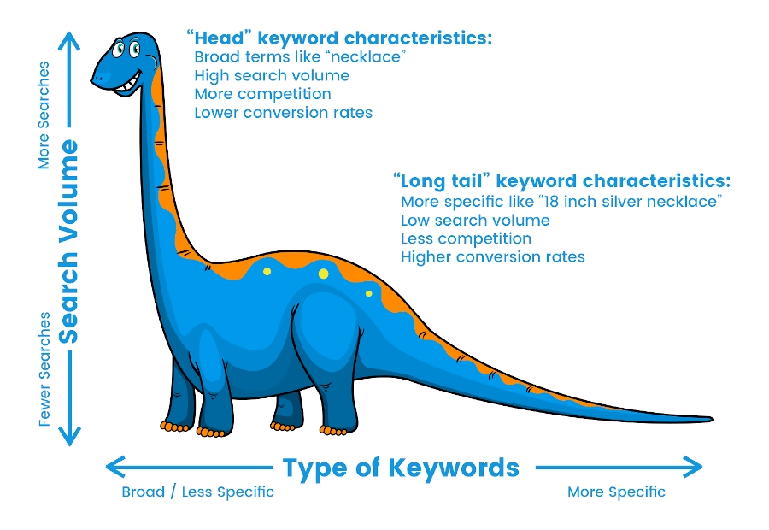
SEO (Search Engine Optimization) - Long Tail

Slide 35
SEO - Long Tail
“Head” keyword characteristics
Common terms like “necklace”, “laptop”, “Car Insurance”
High search volume
Intense competition for a first page placement in Google
Lower conversion rate
“Long tail” keyword characteristics, usually longer phrases, 4-6 words
More specific terms, like “18 inch silver necklace with a pendant”
Low search volume
Less competition for Google first page placement
Higher conversion rates

Slide 36
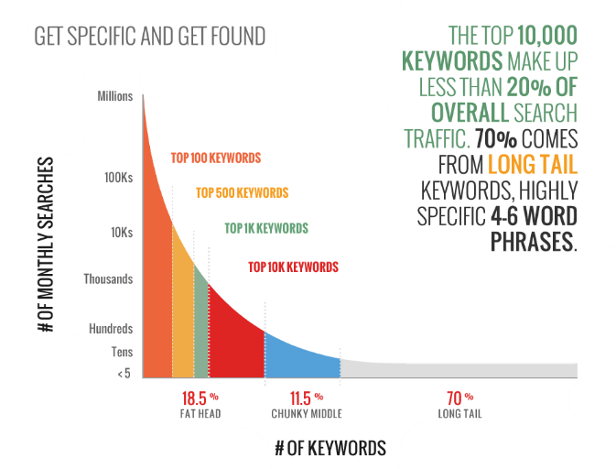
SEO - Long Tail

Slide 37
SEO - Long Tail
Chris Anderson, editor-in-chief of Wired Magazine, noted that
"The best way to dominate the web in the face of stiff competition is to optimize for long-tail search."

Slide 38
SEO - Long Tail
The Problem
Each keyword in the long tail has very few searches every month
To reach high traffic you need to publish thousands if not millions of pages
How do you cost effectively create thousands or millions of pages?
The Solution
A database of information about something relevant to the problem your prospects try to solve

Slide 39
SEO - Long Tail
Why a database?
Each row in the table is about an entity – Person, Address, Company, and will be translated to one page on the website with information about that entity
The content of the page is the data included in the fields or columns of the database
Any query can generate additional interesting content, like:
20 largest companies in New Haven CT
10 most expensive houses in Birmingham AL
CEO’s of Cyber Security firms

Slide 40
Companies that use Long Tail Effectively
Many well-known companies use Long Tail for their branding and for generating sales
Amazon – A page for every possible product
LinkedIn – A page for every person, a page for every company
CrunchBase – A page for every company
Facebook – A page per person, or group, or entity, ….
TripAdvisor – A page per hotel, attraction, location
Zillow – A page per street address

Slide 41
Digital Innovation – First Movers
What do they do?
Who are their customers?
How can they reach them?
Infinipoint is a pioneer in the Device-Identity-as-as-Service security category to extend a true zero-trust security posture to devices. Infinipoint is the only solution that provides Single Sign-On (SSO) authorization integrated with risk-based policies and one-click remediation for non-compliant and vulnerable devices. This reduces risk by protecting access to an organization's data and services while transforming devices to support a world-class security posture. Infinipoint can do all this in a productive way that maintains business continuity with no disruption to the workforce.
- PR Newswire 17 Mar, 2022

Slide 42

Opster – A SmartUp Company
Founded in Sept. 2019 by Ziv Segal and Yonatan Stern
Opster- Tools for DevOps engineers to manage and optimize mission critical ElasticSearch clusters
Did anybody here understand what that means?
Who are Opster’s prospects?
ElasticSearch DevOps engineers
How on earth can we target these elusive people?
They are busy and they don’t respond to emails

Slide 43
Opster – A SmartUp Company
Focus on the problem - not on your solution
When Opster was founded, we had nothing to sell. Product vision was murky
We asked ourselves – What do DevOps engineers do when encountering a problem with their ElasticSearch installation?
In many cases the ElasticSearch system produces an error log that is written to their log file
Here are random examples of real error logs

Slide 44
Opster
Error Log examples
Could not lock IndexWriter isLocked
Delaying allocation for unassigned shards; next check in
Suspect illegal state: trying to move shard from primary mode to replica mode
Failed to start monitoring service
Using discovery type and seed hosts providers
All shards failed
Term query does not support array of values
No mapping found for ” + fieldName + ” in order to sort on
high disk watermark [90%] exceeded on
Mapping update rejected by primary

Slide 45
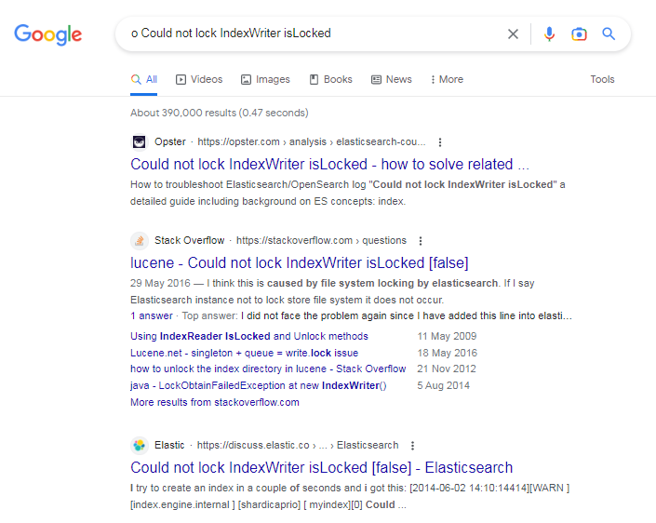
Opster - the Power of Long Tail
Ahead of StackOverflow and Elastic itself
Opster
StackOverflow
Elastic.com – The originators of ElasticSearch

Slide 46
Opster
Long Tail Creation Process
How to automatically create thousands of content pages?
Wrote a script to extract all error logs from ElasticSearch open-source code. Initially extracted about 700 different error logs. Today there are some 3,000 error log pages published on Opster
Created an Opster web site, mostly these 700 pages that were produced automatically
Plus a detailed glossary on the basic terminology of ElasticSearch, a page per term, and later on many “How to”s
60 or so pages generated 80% of traffic – we manually later enriched their content. High quality content creates a strong brand

Slide 47
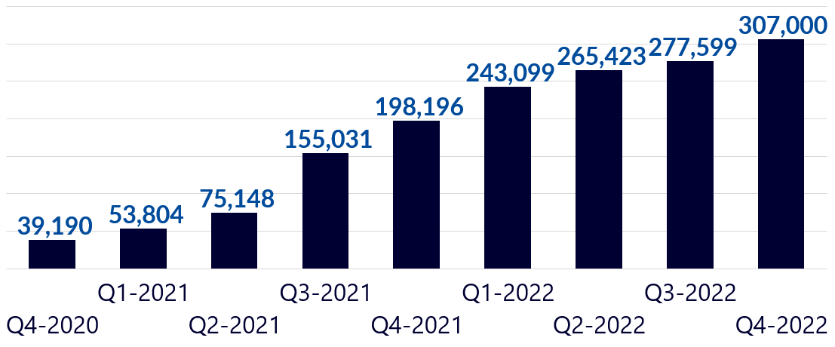
Opster
Traffic results per quarter

Slide 48
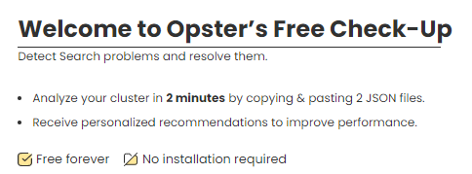

Opster – Marketing Funnel
BUT – Traffic is not yet leads
Developed CheckUp – a simple tool to identify problems based on 2-3 files taken from the Elastic cluster
Users need to create an account to run CheckUp
Our main source of leads – Very low Customer Acquisition Cost (CAC)

Slide 49
Opster
Number of New Registered Users
Total Number of Registered Users

Slide 50
Opster
In November of 2023 Opster was acquired by Elastic, the creators of ElasticSearch
One of the main reasons for the acquisition was the content Opster created and its widespread use by Elastic customers and even by Elastic technical support team
The power of:
Branding and Marketing first
Long Tail SEO

Slide 51

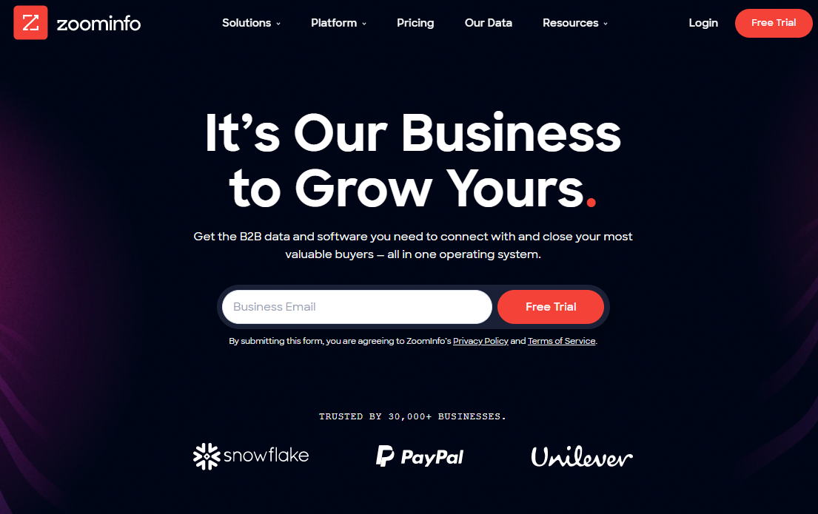
ZoomInfo – Tools for sales

Slide 52
ZoomInfo - History
Founded in 2000 by Yonatan Stern
Nice little company, selling mainly to recruiters – Executive Search Firms
By 2004 revenues were about $6m, profitable, growing
But we wanted to grow much faster by going after sales people
How do we go from one customer set – recruiters, to another – sales people?

Slide 53
ZoomInfo - History
Made a bold decision – Let’s publish all of our data, one page per person
Long Tail - Sales people and recruiters search for people by name, or company name and title all day long
Search by name is one of the most common searches in Google
There was no other people directory on the web at the time - LinkedIn just started 2 years before and did not yet publish its data

Slide 54
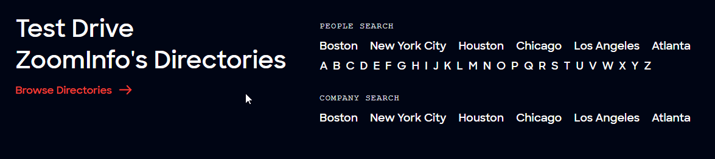
ZoomInfo Directory

Slide 55
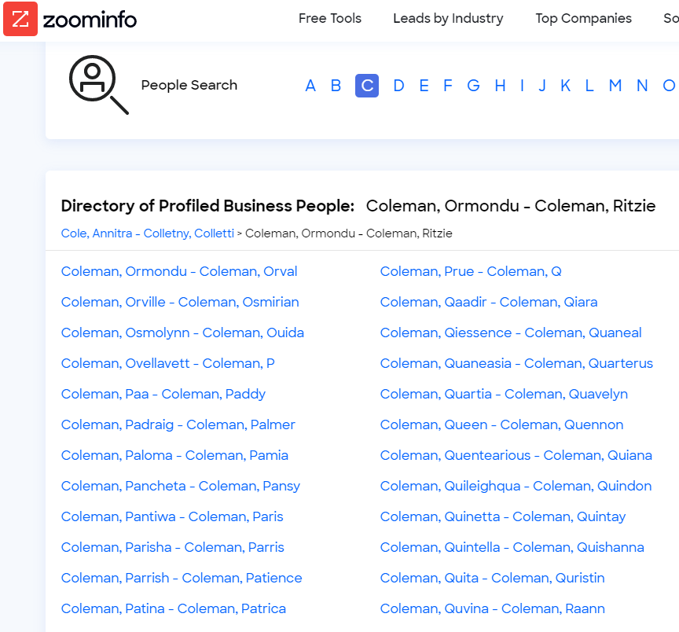
ZoomInfo Directory

Slide 56
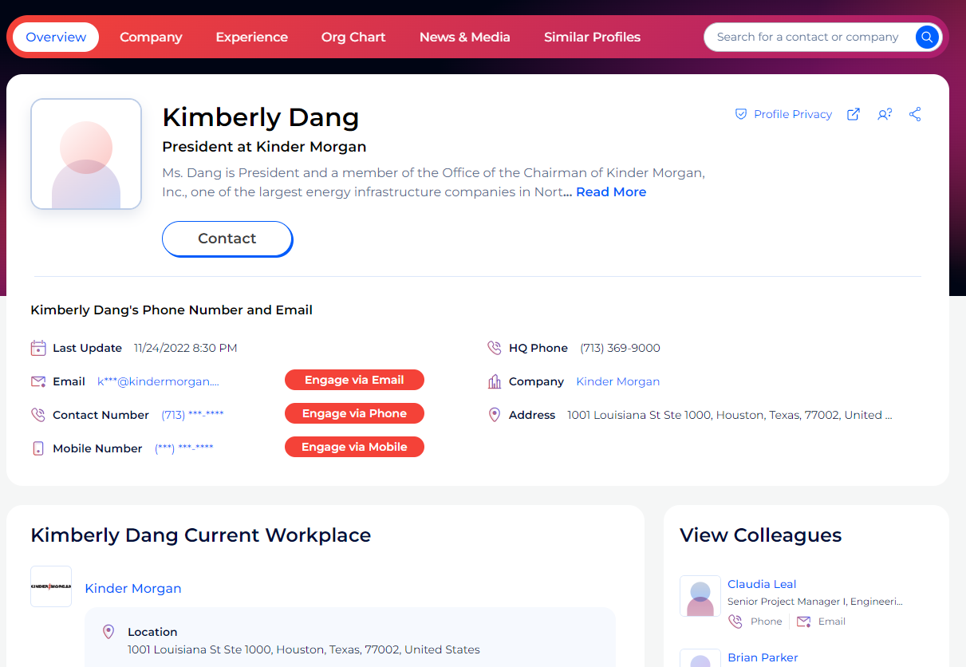
ZoomInfo Directory

Slide 57
ZoomInfo - Results
By the time I left in 2018 there were
50 million directory pages indexed by Google
About 10 million visitors to the site every month – aggregation of many small searches each for a different name
Some 20,000 inbound leads every month
Company grew revenues consistently by 50% year over year
CAC – Cost of Customer Acquisition very low
Sale cycle of 2-4 weeks, customers were familiar with what ZoomInfo provides

Slide 58
ZoomInfo – The Brand
In early 2019 ZoomInfo was acquired by DiscoverOrg
The CEO of DiscoverOrg ran a study to decide on the name of the combined company
ZoomInfo brand was 9 times more recognized than DiscoverOrg
The combined company is called ZoomInfo
The company went public in June of 2020 on NASDAQ
With revenues of $1.2B in the last 12 months it is worth $11B
The power of long tail branding

Slide 59

Product Innovation – Summary
The business of introducing new products
The Innovator’s Dilemma – why successful entrenched companies many times fail against new entrants
Sustaining Innovation vs. Disruptive Innovation
Sustaining innovation is when a company creates better-performing products to sell for higher profits to its best customers

Slide 60
Product Innovation – Summary
Disruptive innovation— occurs when a new company with fewer resources moves into a market and later challenges an incumbent business. There are two types of disruptive innovation:
Low-end disruption, in which a company uses a low-cost business model to enter at the bottom of an existing market and claims a segment
New-market disruption, in which a company creates a new segment in an existing market by catering to a usually small unrecognized or unappreciated need

Slide 61
The Innovator’s Dilemma – 5 Principles
Principle #1 - Companies depend on existing customers for sustained and growing revenues
Principle #2 - Small markets don’t solve the growth needs of large companies
Principle #3 - Markets that don’t exist can’t be analyzed
Principle #4 - An organization’s capabilities define its disabilities
Principle #5 - Innovation’s performance may initially not fulfill main market demands, as measured by the market’s traditional properties

Slide 62
Digital Innovation – The Startup Dilemma
Disruptive innovation - Invent something totally new that will disrupt the world, or maybe just an industry… (ChatGPT….)
Incremental innovation – use existing technologies in a new way to improve a product or a process, or to solve a problem (Gett, Uber, Pango, ICQ…)
Enter an existing market by improving on existing offerings – No need to be first (Facebook, Google, Bookings.com, WhatsApp…)
Enter an existing market with a new business model (eCommerce, Netflix, Android, )

Slide 63
The SmartUp Way – Branding First
Your biggest challenge is NOT to build your product - It is to bring paying customers
Paying customers are hard to get They just don’t report to you
The first thing you want to do is think about your prospects and customers
Who are they?
How do you reach them?
What do you tell them?
How do you get them to buy from you?

Slide 64
SEO (Search Engine Optimization) - Long Tail

Slide 65
SEO - Long Tail
The Problem
Each keyword in the long tail has very few searches every month
To reach high traffic you need to publish thousands if not millions of pages
How do you cost effectively create thousands or millions of pages?
The Solution
A database of information about something relevant to the problem your prospects try to solve

Slide 66
The END

