Slide 1

Digital Innovation
Lesson 2

Slide 2



Digital Innovation
What is Innovation ?
Is innovation evolutionary or revolutionary?
Who invented the light bulb? And when?

Slide 3
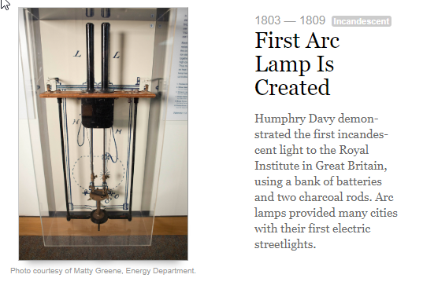
Light Bulb History 1803 – 1809

Slide 4
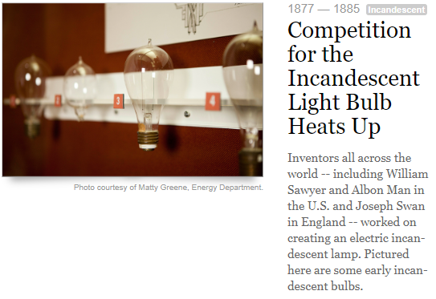
Light Bulb History 1877 – 1885

Slide 5

Who invented the light bulb?
1809 - British inventor Humphry Davy invented an incandescent light bulb in 1801 and created the “arc lamp”
1835 - Scottish inventor James Bowman Lindsay demonstrated a constant electric light in Dundee
1841 - British inventor Frederick DeMoleyns patented a light bulb
1872 - Russian engineer Alexander Lodygin invented an incandescent light bulb
1877 - William E. Sawyer developed a incandescent light in partnership with Albon Man
1870s - Hiram Stevens developed a light bulb and in 1880 installed the first electric lights in a New York City building
1878 - British inventor Joseph Wilson Swan demonstrated a light bulb at a lecture in Newcastle that soon had the attention of the world, including Edison. Swan was awarded a light bulb patent (patent No. 4933) only in 1880, the year in which his house in Gateshead, England became the first house in the world lit by a light bulb.
1879 - Thomas Edison filed for a patent on a light bulb that burned up to 600 hours and eventually up to 1,200 hours

Slide 6
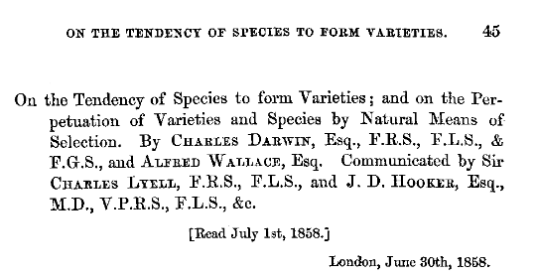
Innovation Evolution
What triggers the evolution of Innovation?
Surprisingly, many inventions were independently developed by different people, at the same time

Slide 7
Innovation Influencers
Earlier Thinkers Who Influenced Darwin and Wallace
Jean Baptiste Lamarck (1744–1829) was an important French naturalist and one of the first scientists to propose that species change over time. However, Lamarck was wrong about how species change. His idea of the inheritance of acquired characteristics is incorrect and traits an organism develops during its own life-time cannot be passed on to offspring (…. Epigenetics)
Charles Lyell (1797–1875) was a well-known English geologist. Darwin took Lyell's book, Principles of Geology, with him on the Beagle. Lyell argued that gradual geological processes have gradually shaped Earth’s surface and inferred that Earth must be far older than most people believed.
Thomas Malthus (1766–1834) was an English economist. He wrote an essay titled On Population arguing that human populations grow faster than the resources they depend on. When populations become too large, famine and disease break out. In the end, this keeps populations in check by killing off the weakest members.

Slide 8
Concurrent Innovation
1600s: Isaac Newton and Gottfried Leibniz both develop calculus
1770s: Carl Wilhelm Scheele and Joseph Priestley discover oxygen
1800s: Charles Darwin and Alfred Russel Wallace both describe natural selection (Evolution)
1839: Louis Daguerre and Henry Fox Talbot invent the first photographic methods
1869: Louis Ducos du Hauron and Charles Cros present the earliest workable methods of color photography on the same day
Late 19th early 20th century Guglielmo Marconi, Nikola Tesla, and Jagadish Chandra Bose invented radio transmission
1950s: Jonas Salk and Albert Bruce Sabin invent the polio vaccine

Slide 9
Innovation Enablers
Innovation is evolutionary – it evolves one step at a time
Innovation always relies on enabling ideas, theories, technologies and resources
Product innovation succeeds when it reaches acceptable levels of price, performance, and ease of use

Slide 10

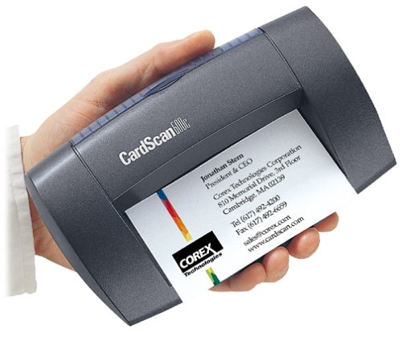
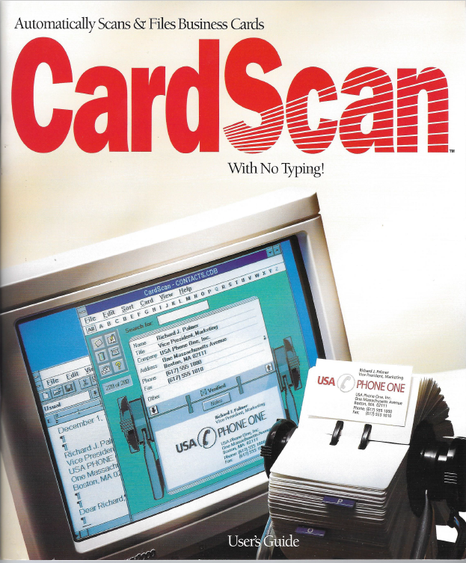
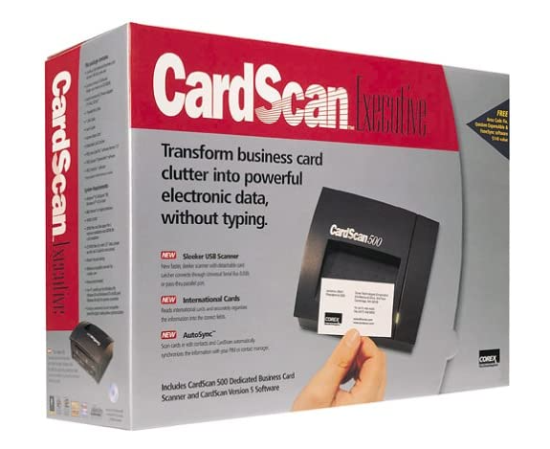
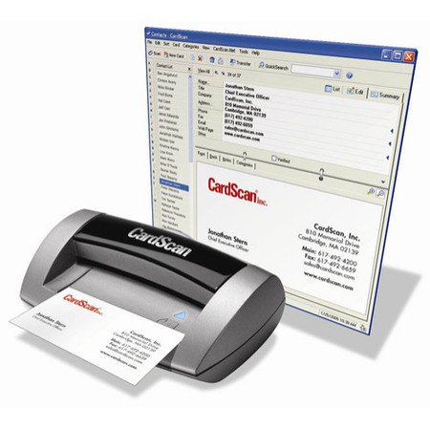

Slide 11
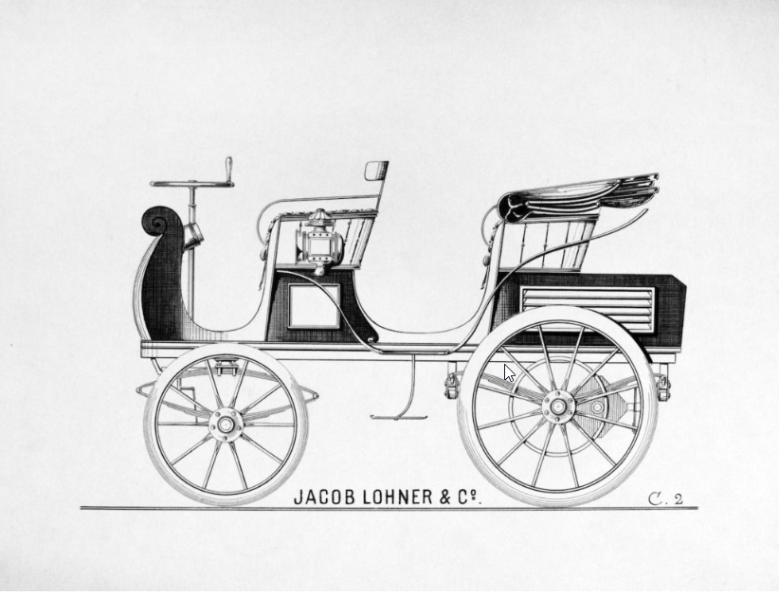

Innovation Enablers – Electric car
Very popular in the early days, circa 1900-1910
Easier to drive than a gasoline car that needed a hand crank
Quieter, no pollution
Perfect for short drives, range of 80 km, cost about $1,750

Slide 12
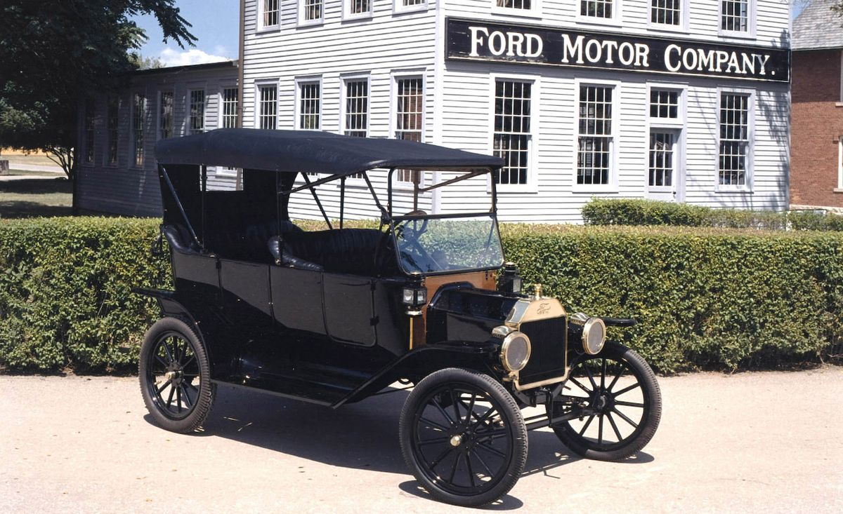
Innovation Enablers – Electric car
Ford Model T, introduced in 1908
Costs $650
Gas allowed longer range trips
Better road system encourages longer rides
Electric engine starter – no need for a hand crank
Crude oil discovered in Texas, cheap gas
More than 15 million Model-Ts were built over its 19-year life span
Electric cars disappear by 1935

Slide 13
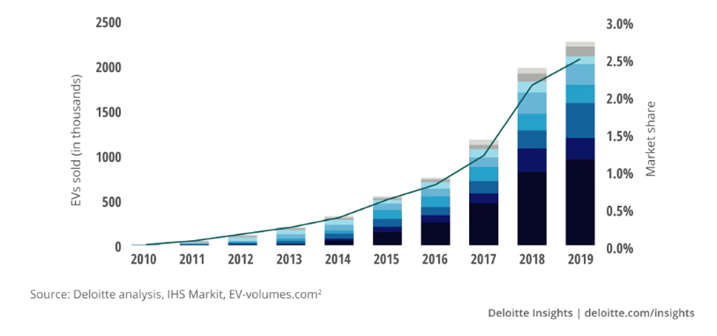
Innovation Enablers – Electric car
Electric car sales growth since 2010 – But why?

Slide 14
Innovation Enablers – Electric car
Reasons for the revival of electric cars – Why?
Combat global warming – CO₂ emissions
Government subsidies
Tesla - Computer on wheels -- instead of a car with computers
Much better batteries – longer range, 400 km But why?

Slide 15
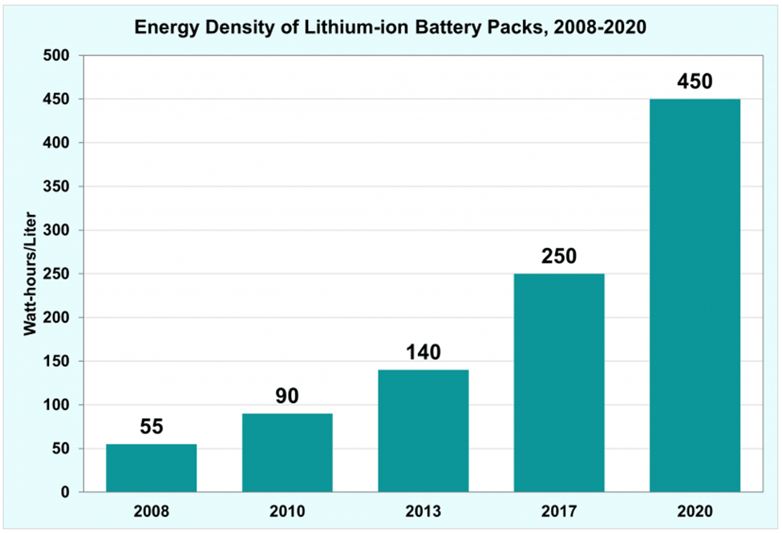
Innovation Enablers – Batteries
Batteries improve almost 10-fold in twelve years Why?

Slide 16
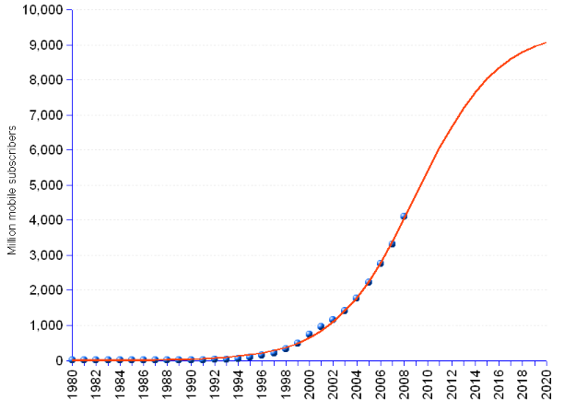
Innovation Enablers – Batteries
Growth in cell phone use
From about 1B in 2000
To about 9B in 2015
Similar growth in laptops and other mobile gadgets

Slide 17
Innovation Enablers – What made the iPhone?
What do you use the iPhone for?
80% of the time on phone calls
50% of the time on phone calls
25% of the time on phone calls
10% of the time on phone calls
OK, let’s vote

Slide 18
Innovation Enablers – What made the iPhone?
What do you use the iPhone for? let’s vote
Social media – Facebook, TikTok, Instagram, WhatsApp, LinkedIn, etc
Web browsing
Communication – Email, WhatsApp, SMS,
Gaming
Navigation – Waze, Google maps, Apple Maps
Other
The iPhone is a hand-held personal computer with GPS
All apps require Internet connection – Cellular or WiFi

Slide 19
Innovation Enablers –iPhone Enablers circa 2007
Cellular Data – 3G
Deployed in 2001, Compared to 2G, 3G had four times the data transferring capabilities reaching up to 2 Mbps on average.
Video streaming, video conferences, and live video chat became real.
Emails also became another standard form of communication over mobile devices.
What made 3G revolutionary, was the ability to surf the internet and stream music on mobile.
GPS
1999: GPS-enabled cell phones become commercially available for the first time.
2000: The U.S. Government revokes a plan from 1990 that purposely made GPS less accurate as a defensive mechanism. As accuracy skyrocketed, many industries, including forestry, fishing, and freight management, started using GPS.
2001: Personal GPS products surge, including in-car navigation systems.

Slide 20
Digital Innovation – Recent Enablers
We ALL walk with a powerful Smart-Phone computer in our hand
It is always connected to the Internet – Cellular data + WiFi (Spotify, Netflix, Zoom, )
Powerful enough to run sophisticated applications
It is very easy to develop new applications (iOS, Android)
If has a camera, a microphone and high-fidelity speakers
Hi quality color screen (photo album, no one prints photos)
It has enormous memory (512 GB, endless photos)
It has a GPS – (Waze, Pango, Uber, Gett, Wolt, more?)
There are many more useful apps
Think about business applications (Insurance, agriculture, traffic, …)

Slide 21
Digital Innovation – Recent Enablers
Inexpensive, easily accessible, platforms and infrastructure
Standards – Windows, iOS, Unix, Mozilla browser (Chrome, Firefox, Edge)
Enormous computing power at your fingertips
Cloud computing - Amazon AWS, Google Cloud, Microsoft Azure, ….
With built-in technologies
Scalable architecture – as many servers as you need
Databases
Search engines
Artificial Intelligence

Slide 22
Digital Innovation – Recent Enablers
Powerful technologies
Deep learning algorithms
Translation
Speech to text
Embedded (YouTube, Zoom, ….)
Business – Sales (Gong, Chorus), Customer service,
Legal
Police, Intelligence services,
Picture recognition
Embedded (Google pictures, Google navigation)
Security – police, ClearView AI,

Slide 23
Picture Recognition – ClearView.AI
Clearview AI, based in NYC, founder Hoan Ton-That
A database of over 3 billion images scraped from various websites, including LinkedIn and Facebook
Facial recognition software that claims to have the best accuracy
Clearview AI sells its technology to police agencies around the world
However, the use of Clearview AI has raised serious privacy and ethical concerns, as it allows anyone to identify a person by uploading their photo and finding their online profiles
The Australian privacy commissioner has launched an inquiry into Clearview AI, and some police forces have distanced themselves from the company
Clearview AI has also faced legal challenges and cease-and-desist letters from the websites it has scraped data from

Slide 24
Digital Innovation – Recent Enablers
ChatGPT and other Large Language Models (LLM)
Enables high quality verbal man machine dialog – talk to your TV
High quality data extraction from free text and forms – for example, large scale medical information from hospitals and health organizations
This is so new, we just started scratching the surface…

Slide 25
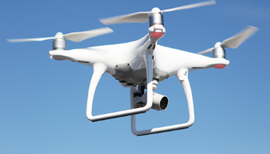
Additional Technology Enablers
Drones (filming, agriculture, policing, military, archeology, ….. What else?)
3D Printing
DNA manipulation using CRISPR
Treatment for genetic defects
New treatments and medications (cancer treatments?, ….. )
It is the beginning of a whole new Digital Innovation revolution
Soon to be here
Self driving cars – huge impact on urban life
What Else?

Slide 26
Digital Innovation – Impact of Enablers
The innovation is not in the technology but in the use. The where and how to use the technology and the data
Examples:
Taxi service – Uber, Lyft, Gett, …..
Hotels, Travel – Expedia, Bookings.com, Kayak, TripAdviser, AirBnB,
Movie theaters – BlockBuster, Netflix
Postal Service – email, WhatsApp, Zoom, SMS,
Dating – OKCupid, Bumble, eHarmony, Tinder, Jdate ….
Virtually every domain in our life is going to be impacted

Slide 27
The BUSINESS of Digital Innovation
Innovator’s First Mover Advantage
You are the innovator - What are the advantages of being first?
No competitors – the market is all yours
You set the standards
You set the pricing and packaging
You can get patent protection
Product category will forever be associated with your brand: Kleenex, Xerox, Hoover, iPhone
You have a learning curve head-start

Slide 28
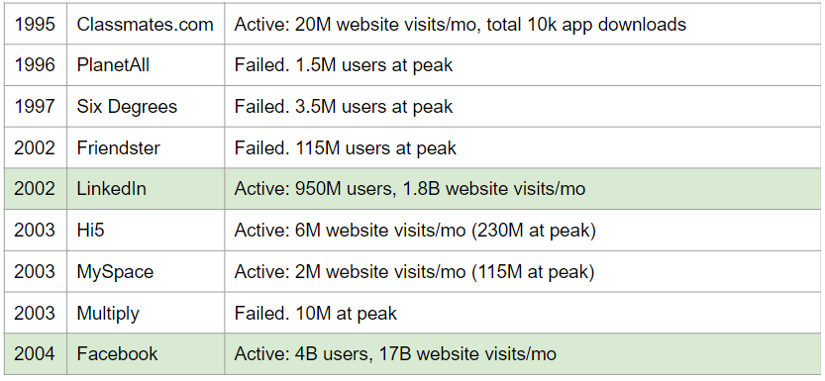
Social Networks First Movers

Slide 29
Social Networks First Movers – Big Names Fail
1996 | Amazon (PlanetAll) | Acquired PlanetAll for 100M, at 1.5M users. Failed to use as social media - integrated the tech in e-commerce features
2004 | Google (Orkut) | Developed internally, 100M users at peak. 2014 - closed due to declined user base
2004 | Microsoft (Windows Live Spaces) | 30M at peak 2011 all users transferred to wordpress blogging
2005 | Yahoo!360 | Failed to get traction beyond few millions
2010 | Google Buzz | Integrated with Gmail. Failed immediately for privacy backlash
2011 | Google+ | 500M users, 2019 - closed, very low engagement time (in seconds)

Slide 30
Search Engines - First Movers
Search Engine | Year | Comments
Vlib, Jughead, wwwwanderer, w3catalog, Aliweb | 1990-1993 | Pre-search and Early search engines: Manual or archive indexing, some are directories, partial crawling. Remained as research, never commercialized
Jumpstation / World Wide Web Worm | 1993 | The first real search engine - crawling, indexing searching, started as university projects, failed to get funded and discontinued
WebCrawler | 1994 | Fully supported by ads 2nd most visited site in ‘96, slow decline and failed
Lycos | 1994 | 1996 - fastest inception to IPO in NASDAQ history 300M. slow decline and failed
Infoseek | 1994 | 1996- 5th most visited site. IPO 42M slow decline and failed

Slide 31
Search Engines First Movers – Continued
Search Engine | Year | Market Share | Comments
Yahoo | 1994 | 1.21% | Focus on media and entertainment
Google | 1998 | 91.55% | Standard text-image-video search
Microsoft MSN Search Microsoft Bing | 1998 | 3.11% | Standard text-image-video search, AI integration, integrated into Windows
Yandex | 1997 | 1.83% | Dominates the Russian market
Baidu (RankDex engine) | 1996 | 1.02% | Dominates the Chinese market
DuckDuckGo | 2008 | 0.54% | Privacy focused, anonymous search

Slide 32
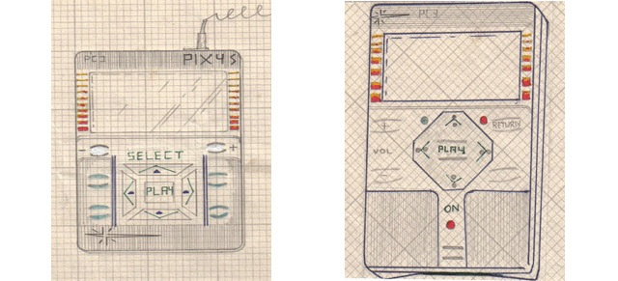
Music MP3 Players - First Movers
Kramer’s vision - 1979
Solid-state cigarette box size device to store and play music, 4-way navigation
Music will be saved on a central server and accessed via a phone line
Distributed via vending machines at locations such as bars and supermarkets (no internet yet!)
Filed a patent was
Was unable to get funding, never put into production

Slide 33

Music MP3 Players - First Movers
South Korea - Saehan’s “MP Man” – 1998
An MP3 player with 6-10 songs on a flash drive
Despite questionable reception at the CeBIT trade show in Hannover, 50k units were sold in the first year for ~$200
"No matter how the Korean staff tried to explain what an MP3 player was, people didn’t understand why they needed such a device because they could listen to music with CDs or cassettes"
JR Bum, President of German Tech company MPIXAR

Slide 34

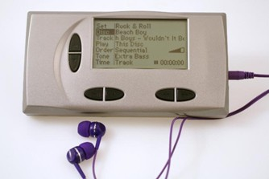
Music MP3 Players - First Movers
1998 - Diamond’s Rio - 200k units sold 30 minutes of music. Price $200
1999 - Compaq Personal Jukebox - 80 hours of music for $750
1999 - RioPort - First Internet online music download service
1998-2001 - Market is flooded. 50 different MP3 player devices available in the US alone

Slide 35
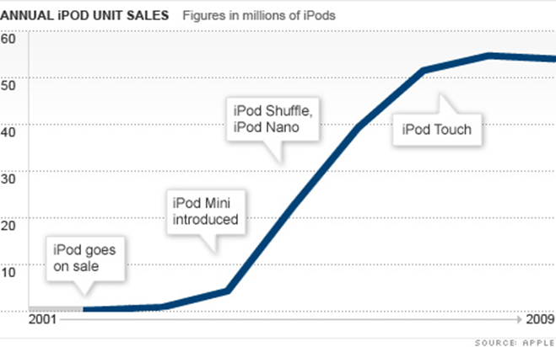
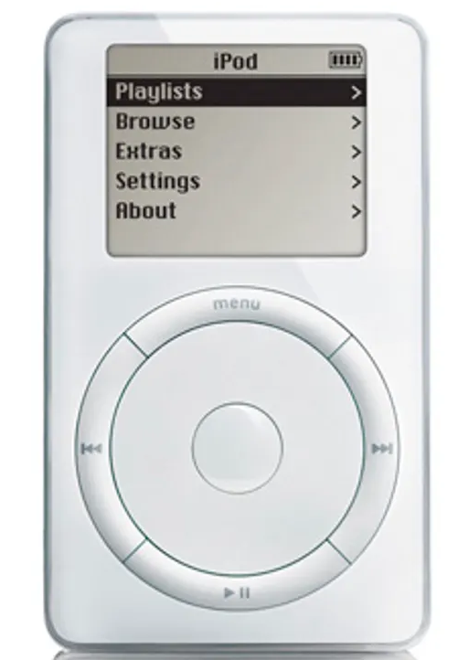
Music MP3 Players – the iPod

Slide 36
Innovator’s First Mover Advantage ?
What are the advantages of being first?
No competitors – the market is all yours
You set the standards
You set the pricing and packaging
You can get patent protection
Product category will forever be associated with your brand: Kleenex, Xerox, Hoover, iPhone
You have a learning curve head-start

Slide 37
Innovator’s First Mover Dis-advantage
So, why do so many fail?
What are the dis-advantages of being first?
No competitors – the market is all yours - There is NO market
You need to create the market
You need to explain what your product does
You need to convince people why they should care and take action

Slide 38
First Mover – Needs to Explain
Need to explain your product – Describe the following product in your own words?
Touch fastener product is used for a closure consisting of a piece of fabric of small hooks that sticks to a corresponding fabric of small loops
Swiss electrical engineer George de Mestral who studied at EPFL invented his first touch fastener in 1941, when he went for a walk in the Alps, and wondered why burdock seeds clung to his woolen socks and coat. The fastener consisted of two components: a lineal fabric strip with tiny hooks that could 'mate' with another fabric strip with smaller loops, attaching temporarily, until pulled apart.

Slide 39
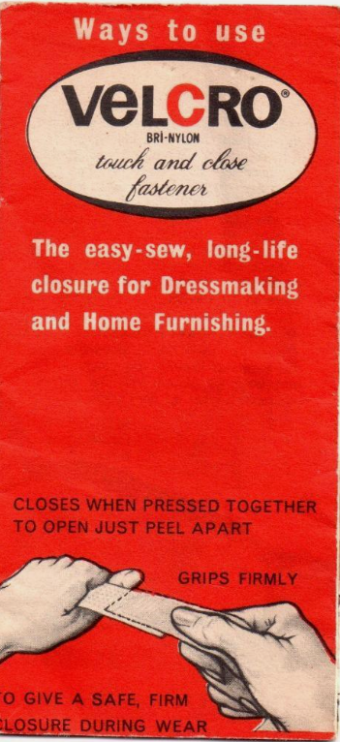



Velcro

Slide 40

First Mover – Needs to Explain
Need to explain your product – Describe the following product in your own words?
Portable document format is a file format developed in 1992. It captures formatting information from a variety of desktop publishing applications, making it possible to send formatted documents and have them appear on the recipient's monitor or printer as they were intended. This is because the file will maintain the original fonts, images, graphics as well as the exact layout of the file.

Slide 41
Digital Innovation – First Movers
How do you explain a new complex product?

Slide 42

Digital Innovation – First Movers
What do they do?
Who are their customers?
How can they reach them?
Infinipoint is a pioneer in the Device-Identity-as-as-Service security category to extend a true zero-trust security posture to devices. Infinipoint is the only solution that provides Single Sign-On (SSO) authorization integrated with risk-based policies and one-click remediation for non-compliant and vulnerable devices. This reduces risk by protecting access to an organization's data and services while transforming devices to support a world-class security posture. Infinipoint can do all this in a productive way that maintains business continuity with no disruption to the workforce.
- PR Newswire 17 Mar, 2022

Slide 43

Digital Innovation – First Movers
What do they do?
Who are their customers?
How can they reach them?
Novidea is the leading Insurtech provider of a cloud-native, data-driven insurance management system. Using an open API architecture, Novidea's software platform enables brokers, agents, MGAs, and carriers to modernize and manage the customer insurance journey, end-to-end, and drive growth across the entire insurance distribution lifecycle. The Novidea platform, built to leverage the power of Salesforce's Big Technology, provides a complete ecosystem spanning every aspect of an insurance business, including a 360-degree view of the customer and all stakeholders, an integrated customer-facing policy transactions, and the middle and back office. Brokers, agencies, and MGAs extract more value from their customer and policy data with actionable intelligence from any device, anywhere. Novidea supports more than 100 customers across 22 countries.

Slide 44
The BUSINESS of Digital Innovation
Innovator’s First Mover Advantage
You are the innovator - What are the advantages of being first?
No competitors – the market is all yours - There is NO market
You need to create the market
You need to explain what your product does
You need to convince people why they should care
The solution - No need to be first, just be better than the other competitors

Slide 45
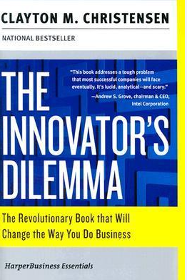
The Innovator Dilemma
The Innovator's Dilemma: When New Technologies Cause Great Firms to Fail, first published in 1997, is the best-known work of the Harvard professor Clayton Christensen. It expands on the concept of disruptive technologies, a term he coined in a 1995 article. It describes how large incumbent companies lose market share by listening to their customers and providing what appears to be the highest-value products, but new companies that serve low-value customers with poorly developed technology can improve that technology incrementally until it is good enough to quickly take market share from established business.

Slide 46
SmartUp Principles
SmartUp Principle for building a successful company
Focus on being profitable as the first and most important objective
For profitability you need to have sales
Selling is much more difficult than building the product

