Slide 1

Digital Innovation
Lesson 1

Slide 2




Yonatan Stern

Slide 3
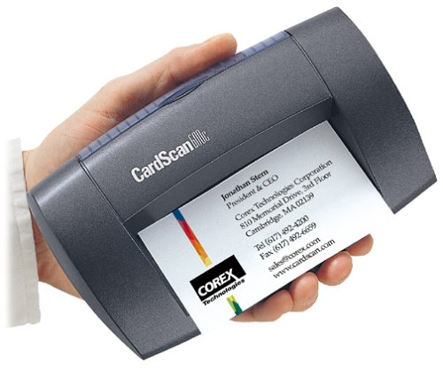
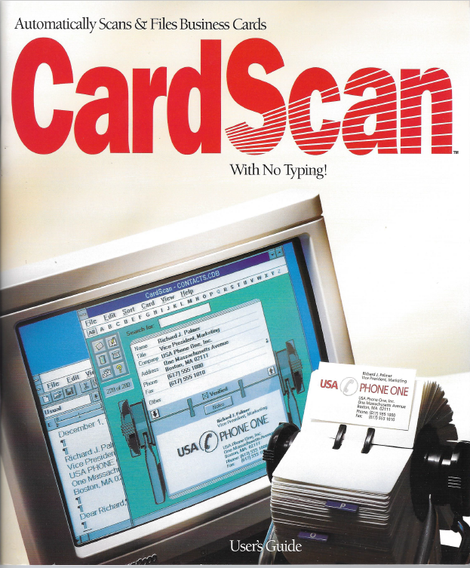
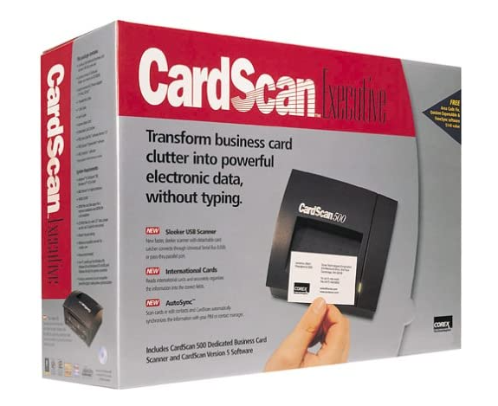
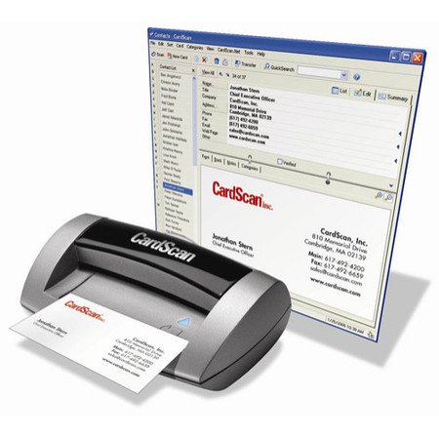

Slide 4

Yonatan Stern

Slide 5

SmartUp Academy
A residency program to teach the profession of building successful companies.
The Foundation Course
The three pillars for a successful company:
Profitable
Fast growing
Modest investment
Workshops
Residency

Slide 6
What is Digital Innovation?
What do we mean by “Digital” ?
Abstraction
Quantification
Conversion
Operation

Slide 7





Digital means an abstraction of something
1
א
I
2
ב
I I
3
ג
I I I
4
ד
I V
10
י
X

Slide 8
Digital means an abstraction of something ??
Why do we have an abstraction of something that does not exist?
0
ZERO
Invented in the 7th century
-1
Minus 1
Invented in the 2nd century BC

Slide 9
Other forms of abstraction – Language
Apple
תפוח
Children
ילדים
Monkeys
קופים
Flowers
פרחים
Hands
ידיים
Invented when?

Slide 10



Other forms of abstraction – Language
Blue
כחול
Democracy
דמוקרטיה
Running
רצים
Laughing
צוחקים

Slide 11
Pre-History
When did history begin?
What changed from Pre-History to History?

Slide 12
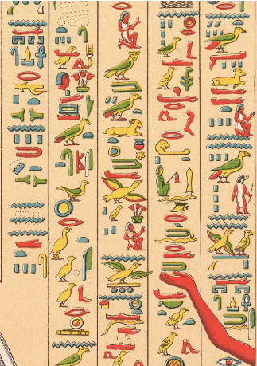
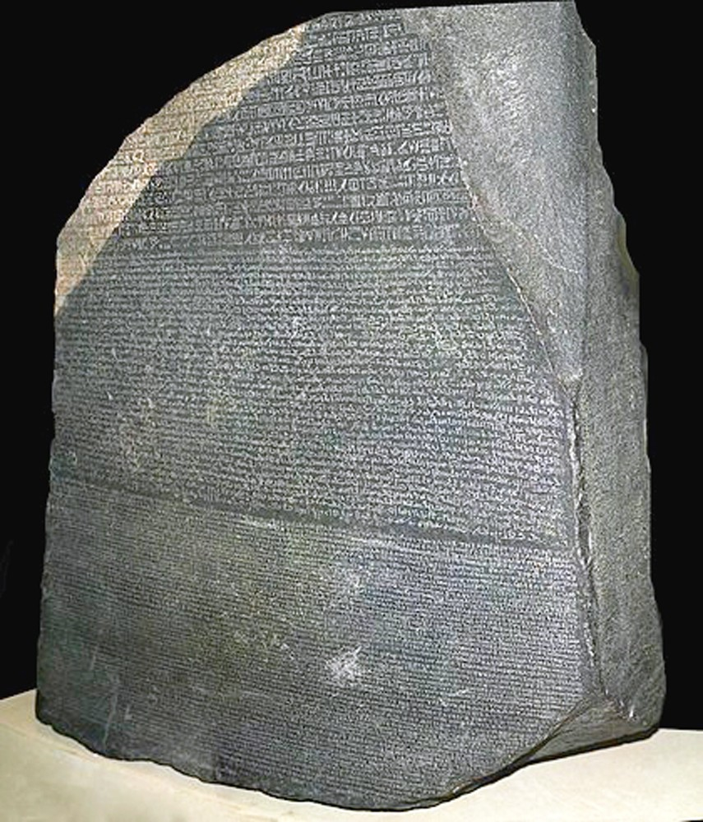
The innovation of writing – First generation
Egyptian Hieroglyphs – pictorial
Invented around 3,100 BC
Used for about 3,500 years
Several thousand symbols
The Rosetta Stone – Found 1799

Slide 13
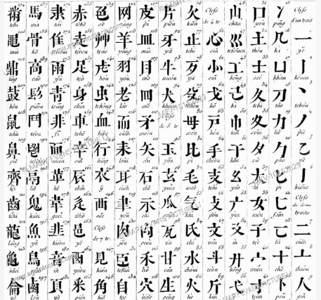
The innovation of writing – First generation
Chinese characters – pictorial
Invented around 1,400 BC
Used until today
A modern dictionary has up to 20,000 characters

Slide 14
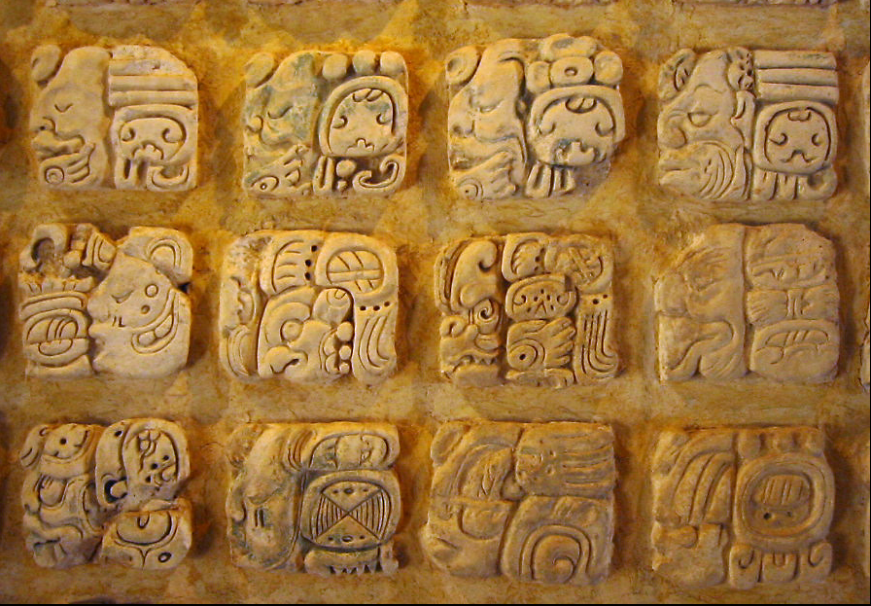
The innovation of writing – First generation
Mesoamerican writing systems– pictorial
Fifteen distinct writing systems have been identified in pre-Columbian Mesoamerica

Slide 15
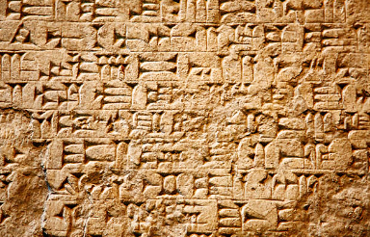
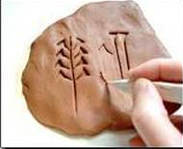
The innovation of writing – Second generation
Cuneiform characters – Abstract
Invented around 3,500 BC
by the Sumerian people in Mesopotamia
About 400 syllable symbols
Early texts are inventory lists

Slide 16

The innovation of writing – Third Generation
ה ד ג ב א
A B C D E
α β γ δ ε
The modern Alphabet was invented by Semitic-speaking people in the Middle East around 1700 B.C.
It contains 22 symbols

Slide 17
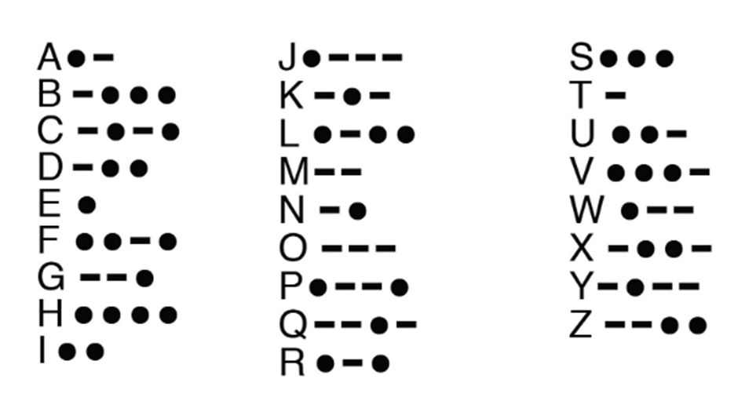
The innovation of writing – Machine alphabet
Morse Code, invented in 1830, is a means to communicate through telegraph, radio, or even with light. The language is a series of short and long bursts that are heard or seen. The short bursts of sound or light are called “dit”, and the long bursts are called “dah”.

Slide 18
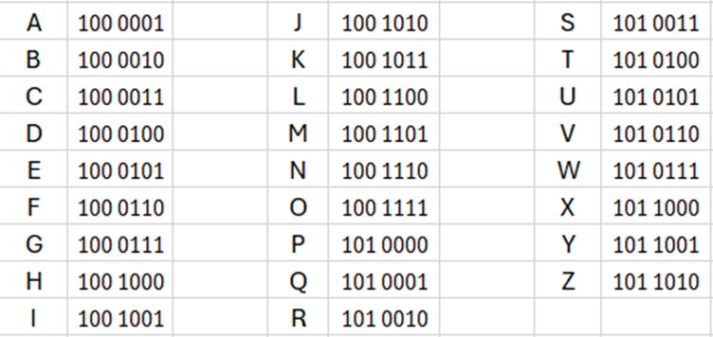
The innovation of writing – Machine alphabet
ASCII code
Only two symbols 0 and 1
Higher abstraction – fewer symbols

Slide 19
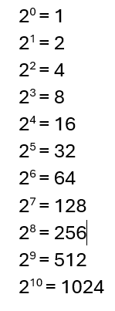
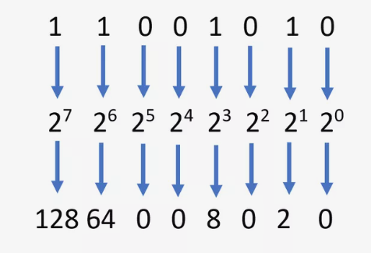
The innovation of writing – The Binary Code
Why is X⁰ = 1?
X^{n} / X^{n} = 1
X^{n} / X^{n} = X^{n-n} = X⁰ = 1
1 x 2⁷ + 1 x 2⁶ + 0 x 2⁵ + 0 x 2⁴ + 1 x 2³ + 0 x 2² + 1 x 2¹ + 0 x 2⁰ = 202
128 + 64 + 0 + 0 + 8 + 0 + 2 + 0 = 202

Slide 20

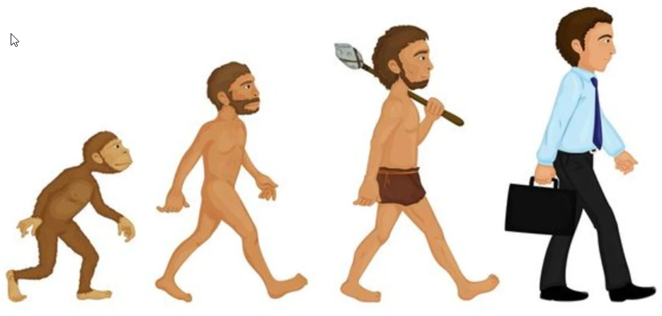
Digital Innovation – Why Abstraction ?
Language made the difference
Homo Sapiens Canis lupus familiaris

Slide 21
Digital Innovation – Why Abstraction ?
Writing Systems - Pre-history compared to explosion of transmitted knowledge
The way we think – sequences of known symbols are much easier to remember than totally new symbols
Think about learning a new language – some 5,000 words and so hard to learn

Slide 22
Digital Innovation – Why Abstraction ?
Ease of use
Mathematics
Try calculating XIII times XXI = ?? Compared to: 13 x 21 =
What is תשפד + תריג = ?? Compared to: 613 + 784 =
What is 7 minus 7 ?
What is 7 minus 9 ?
Writing
Learning to write Chinese – 20,000 symbols by end of high school
Compared to 26 symbols in English, 3-6 months in first grade
Abstraction can generate endless variations

Slide 23
Digital Innovation – Are WE digital?

Slide 24
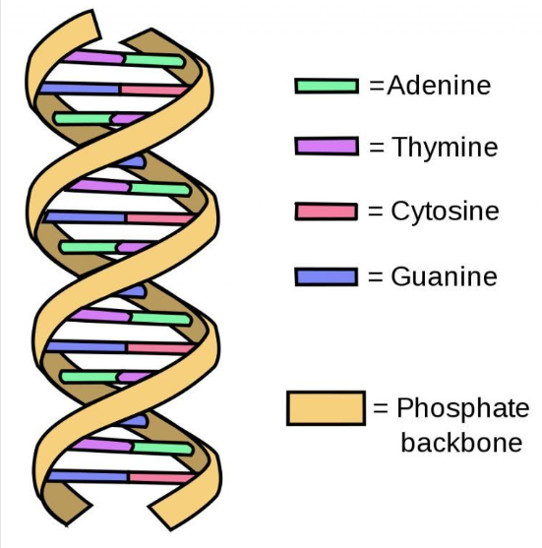
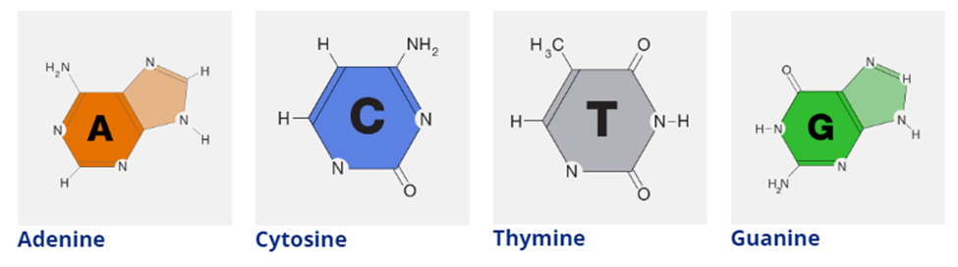
Digital Innovation – Are WE digital? Yes, DNA
Hydrogen, Carbon, Oxygen, Nitrogen

Slide 25
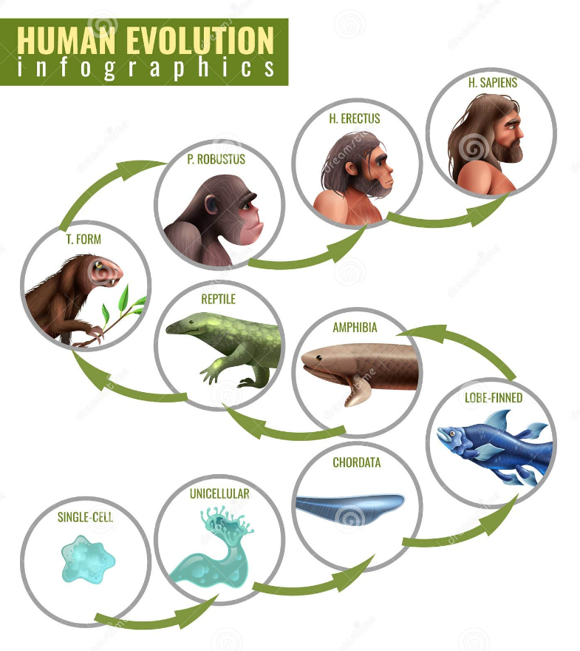
Digital Innovation – Incremental Improvements

Slide 26
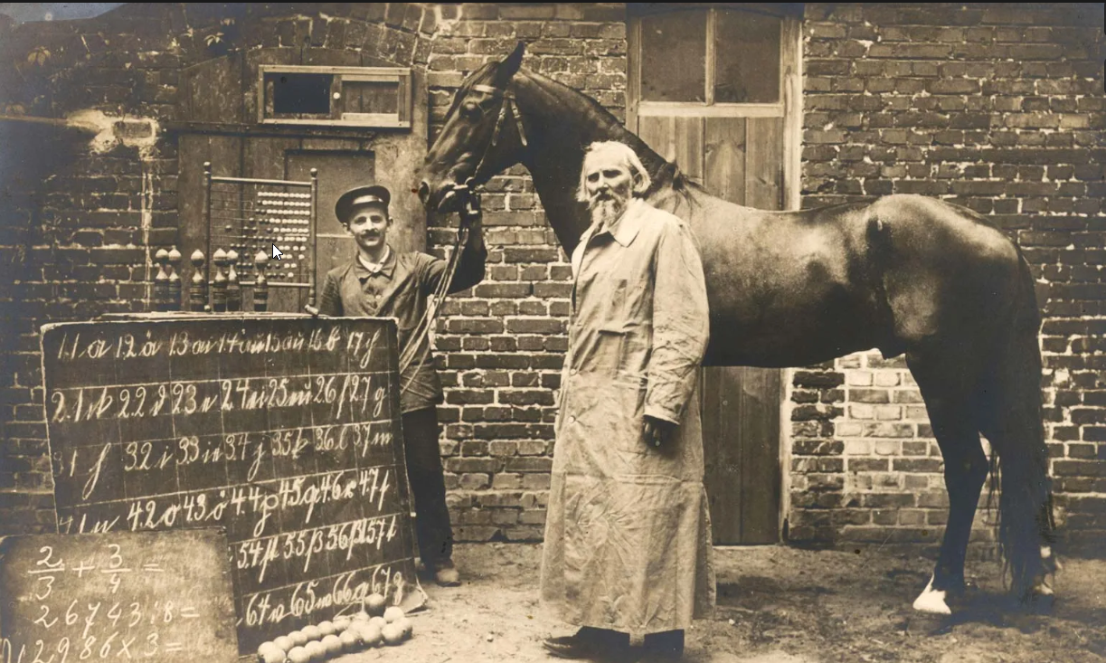
Digital Innovation – Quantification
We can count and measure – can animals do that?
Clever Hans - The horse that counted 1904

Slide 27
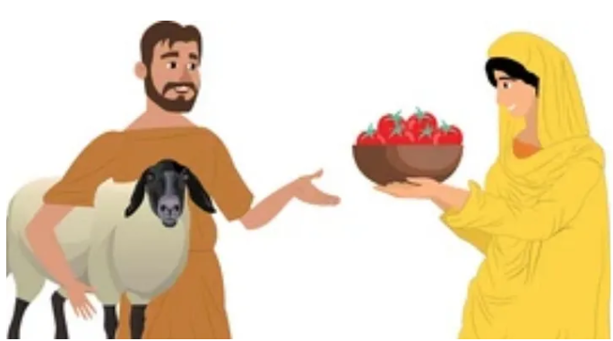
Digital Innovation – Quantification
Barter trading

Slide 28
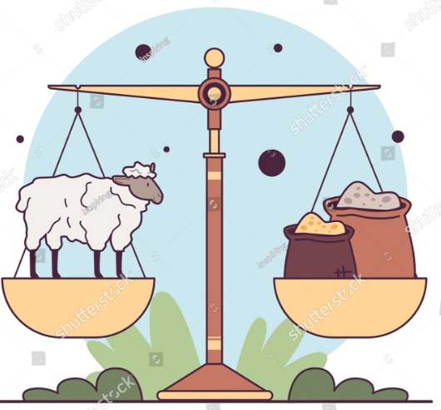
Digital Innovation – Quantification
Is a lamb worth two sacks of wheat?

Slide 29
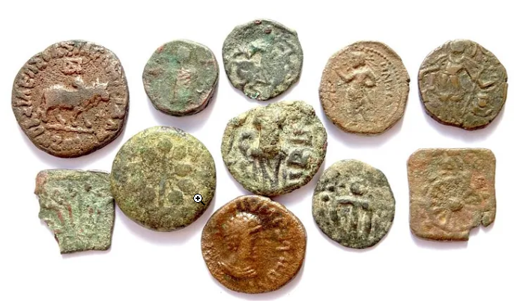
Digital Innovation – Quantification Abstraction
The invention of money – a digital abstraction of value

Slide 30
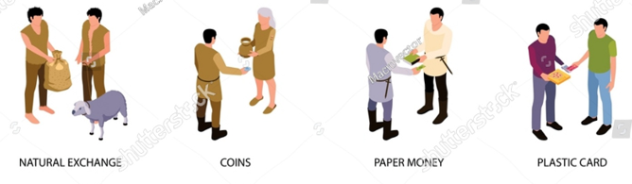
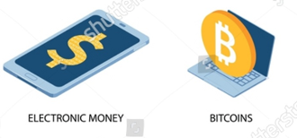
Digital Innovation – The Evolution of Money

Slide 31
Digital Innovation – Conversion
The five senses:
Sound
Sight
Touch
Smell
Taste

Slide 32
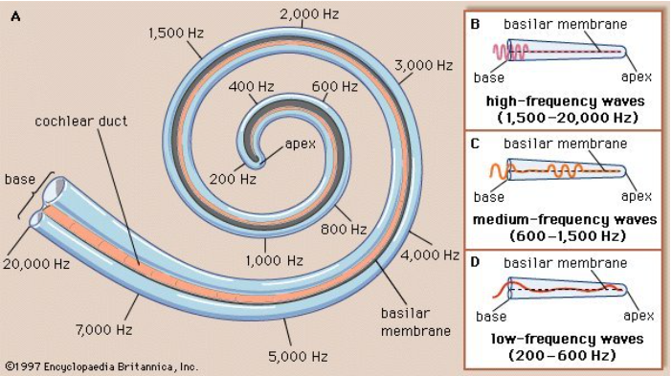
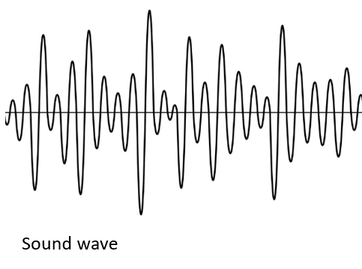
Digital Innovation – Conversion - Sound
The inner part of the ear – the cochlea

Slide 33
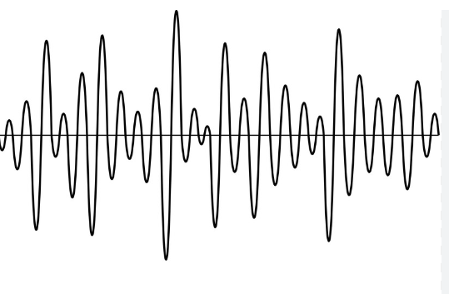
Digital Innovation – Conversion - Sound
Sampling – convert the analog wave into a stream of measurements
Sampling at 5,000 – 20,000 times a second
Sound wave

Slide 34
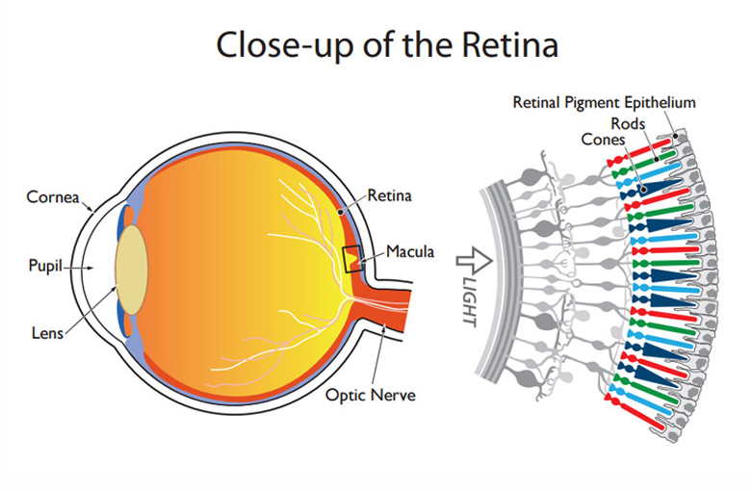
Digital Innovation – Conversion - Sight
Cones are sensitive to color
red, green and blue
Rods are sensitive to any light
There are about 4.5 million cones
(2,000 x 2,000 pixels)
And some 90 million rods

Slide 35
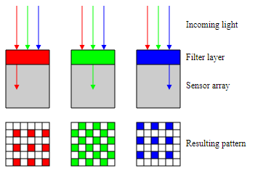
Digital Innovation – Conversion - Sight
Camera sensors contain 10-20 mega (million) pixels – better than our retina
Each pixel has three filters – RGB Red, Green, Blue
RGB was discovered by James Clerk Maxwell in 1861

Slide 36
Digital Innovation – Operation
What do we mean by “Digital” ?
Abstraction
Quantification
Conversion
Operation – What is Operation?

Slide 37
Digital Innovation – Operation
“Operation” is the process or machinery to make the digital abstraction into something tangible
Examples:
DNA is a 4-letter code – the cell has the chemical machinery (Ribosomes) to “read” the DNA thread and build proteins based on the code
Positional number system makes it easy to perform calculations
Money, of any type, is essential for any economy to develop
12,576
37,292
---------
49,868

Slide 38
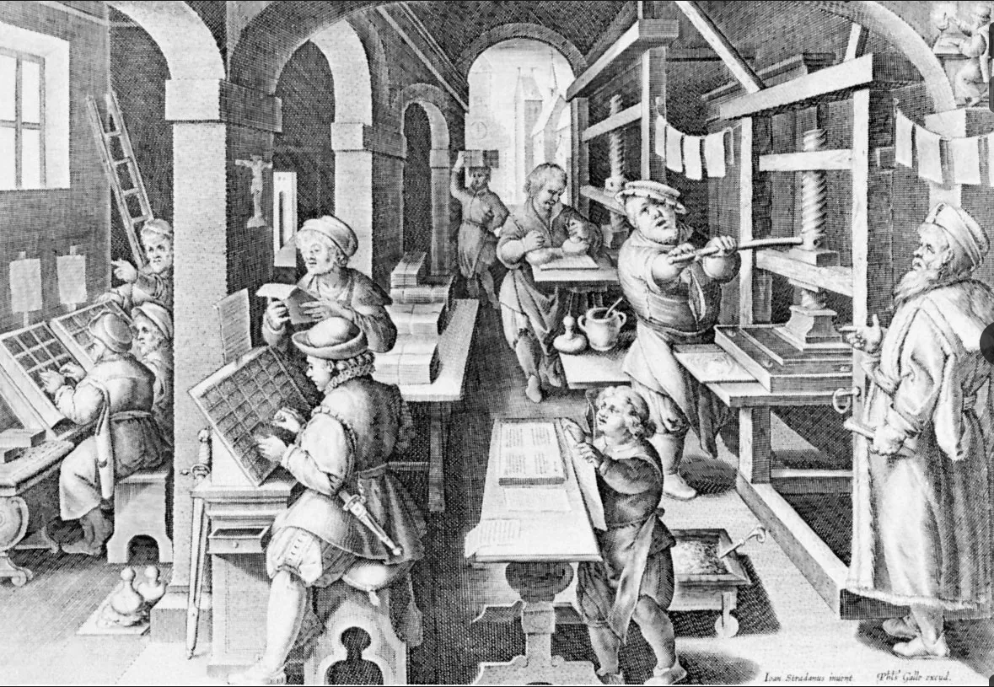
Digital Innovation – Operation
The invention of the printing press by Johannes Gutenberg in1436, in Italy, changed the world

Slide 39
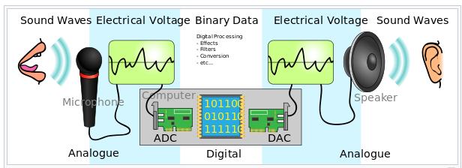
Digital Innovation – Operation
Sound abstracted, quantified and converted to digital and then back to sound

Slide 40
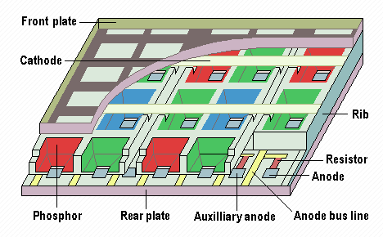
Digital Innovation – Operation
Flat panel display is the “Operation” for an image that was abstracted, quantified and converted to digital and then back to picture

Slide 41
Digital Innovation – Operation
What about the other three senses?
Sound
Sight
Touch
Smell
Taste
Smell and taste sensations are formed by chemicals not by waves
Harder to build a machine to produce these sensations

Slide 42
Digital Innovation
Nowadays EVERYTHING is digital !!!
Innovation is like walking in a toy store or a candy store
We ALL carry with us a powerful computer in our hand
It is connected to the Internet – can access the world on the go
It can run sophisticated applications
It is very easy to develop new applications
If has a camera and a microphone – sound and sight
It has a GPS – location, location,
It has enormous memory

Slide 43
Digital Innovation
Nowadays EVERYTHING is digital !!!
Innovation is like walking in a toy store or a candy store
Powerful technologies
Speech to text
Picture recognition
Deep learning algorithms
Language technologies - ChatGPT

Slide 44
Digital Innovation
Nowadays EVERYTHING is digital !!!
Innovation is like walking in a toy store or a candy store
Inexpensive, easy to use, platforms and infrastructure
Cloud computing - Amazon AWS, Google Cloud, Microsoft Azure, ….
Built-in technologies
Scalable architecture
Databases
Search engines
Artificial Intelligence

Slide 45

Digital Innovation
The innovation is in the Operation – where and how to use digital tools and data
Examples:
Postal Service (stamps) – email
International Telephone service – WhatsApp calls
Taxi service – Uber, Lyft, Gett, …..
Hotels – AirBnB
Movie theaters – Netflix
Match making – OKCupid, Tinder, ….
Business travel – Zoom meetings
Virtually every domain in our life is going to be impacted

Slide 46
Digital Innovation – Revolution or Evolution?
Disruptive technology or incremental improvements?
The Electric car story
Commercially available electric vehicles appeared during the 1890s. An electric vehicle held the vehicular land speed record until around 1900.
High cost, low top speed, and short-range of battery led to a worldwide decline in their use as private motor vehicles.
Then came cellular phones and laptop computers

Slide 47
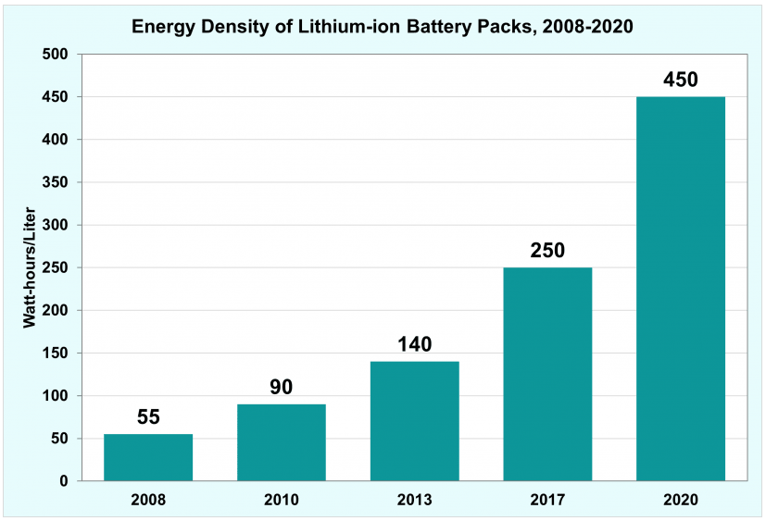
Digital Innovation – Revolution or Evolution?
Disruptive technology or incremental improvements?
The Electric car story
Then came cellular phones and laptop computers – and here is what happened to batteries
Cell phone and laptop computers impact on battery cost and performance made electric cars feasible

