Slide 1

How to Start
a StartUp?

Slide 2




Yonatan Stern

Slide 3
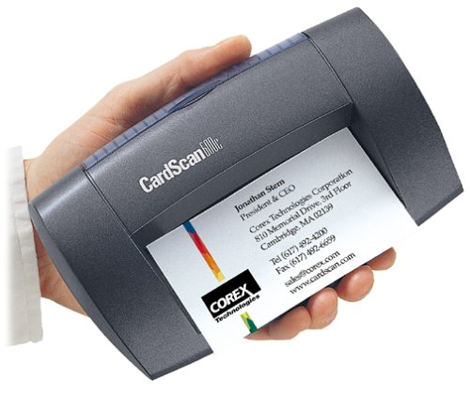
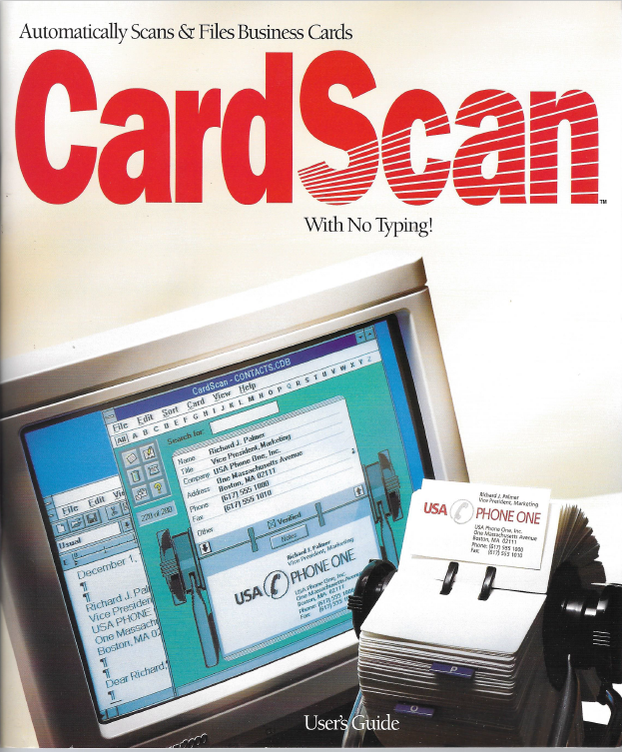
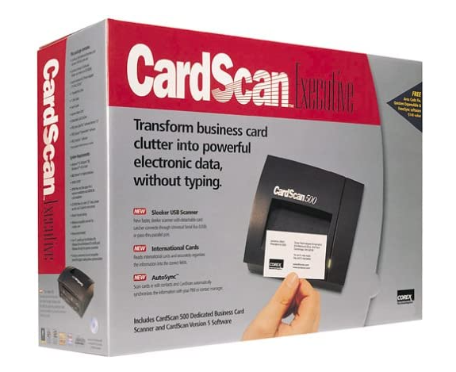
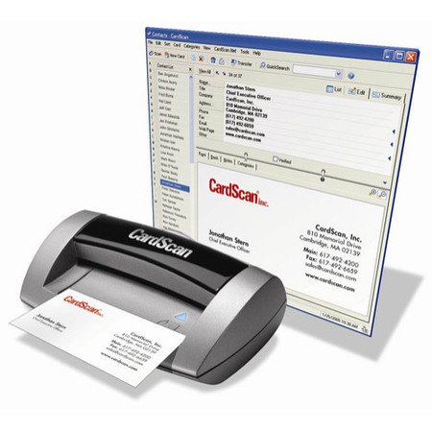

Slide 4


Yonatan Stern

Slide 5


SmartUp Academy
A residency program to teach the profession of building successful companies.

Slide 6




Yonatan Stern

Slide 7
A Quick Recap of Last Presentation
9 out of 10 startup companies fail. Why fail if you can succeed?
VC funds need an exit within 7 - 10 years
A good exit means going public in the US, NYSE or Nasdaq
To go public the company needs to reach $100m in sales and be profitable – very hard to accomplish
In the last 10 years, 12,000 companies were founded in Israel
Only 68 went public – 1 out of 200 !!!

Slide 8
Why Did So Few Companies Go Public?
For a company to go public it needs to have:
Revenues of $100m and up
Year over year growth rate of 20% or more
Preferably profitable

Slide 9
What’s Needed to Get to $100m in Sales?
Let’s build a model - Assumptions:
SAAS product, $10,000 per year license
Years 1 & 2 product development – No sales
Year 3, first 100 customers
Year over year growth rate of 40% in number of new customers
Perfect renewal rate of 100%

Slide 10
Customer Growth

Slide 11
The Path to $100m

Slide 12
What Amount of Investment is needed?
In a typical software company, 70% of expenses are salaries
To foster rapid growth, the company will grow its team at about the same pace of 40% YoY
The company will start generating cash profits only in year 12
And will lose $100 million in aggregate in its first 11 years
As a result, company management raises money continuously, and gets diluted along the way

Slide 13
Why Fail if you can Succeed?
Change the startup objective from EXIT to Profitability
Profitability means cash generation month after month
This change in company objective will change EVERYTHING you do, from strategy, to the markets you focus on, to business model, to product, to marketing
Focusing on profitability does not prevent an EXIT – actually, it makes a lucrative exit more likely

Slide 14
Why Fail if you can Succeed?
In a typical startup, the only way founders get money out of the company, beyond their salary, is when there is a big enough exit
Founders focusing on profitability are much more likely to make more money, than with an exit
Let’s build a simple model
On year 5 the company has $5m in revenues with 20% profits
The company grows at 20% year over year, and maintains its 20% profitability margin
The founders still hold 50% of the equity because they did not need to raise a lot of money

Slide 15
Why Fail if you can Succeed?
Growth of 20% YoY. Profits of 20% per year. Founders hold 50%.
 | Year 5 | Year 6 | Year 7 | Year 8 | Year 9 | Year 10 | Total
Revenues | $5,000,000 | $6,000,000 | $7,200,000 | $8,640,000 | $10,368,000 | $12,441,600 | $49,649,600
Profits | $1,000,000 | $1,200,000 | $1,440,000 | $1,728,000 | $2,073,600 | $2,488,320 | $9,929,920
Founders can take | $500,000 | $600,000 | $720,000 | $864,000 | $1,036,800 | $1,244,160 | $4,964,960
In 10 years the company generated $10,000,000 in profits
The founders can take home $5,000,000 in dividends !!

Slide 16
Why Fail if you can Succeed?
This presentation will discuss the first steps you should take to build a successful, profitable company

Slide 17
The “Standard” Way of Building a Startup
You have a great idea that you think is worth millions…
The accepted model for a successful startup
You need to think big and move very fast
You need to have a grandiose product vision – disruptive, comprehensive, complex, cutting-edge technology, AI, ……
You need to be first to market
You need to be much better than the competition
You need to dominate the market

Slide 18
The “Standard” Way of Building a Startup
To raise money from VC’s you need:
An experienced team – (most don’t have it)
The grandiose product vision
Preferably a demo or a mockup of the product
A compelling pitchbook
Addressing a very large market opportunity – supported by analysts’ research showing phenomenal market growth
Competitive analysis – your product is heads and shoulders above competitors
And the pitchbook should contain something like….

Slide 19
The Famous Hockey Stick Chart
M
480$
M
M
M
M
M
240$
M
M
120$
M
60$
M
15$
30$
0$
1$
5$

Slide 20
The “Standard” Way of Building a Startup
To raise money from VC’s you also need:
A lot of patience knocking on many doors
A thick skin to handle many NO’s
Good timing and a bullish capital market
And most of all – lots and lots of luck ……
Good Luck to you

Slide 21
But, is it Really the Best Way?
There is an alternative way to start your startup
The SmartUp way

Slide 22
An alternative way to start your startup
The SmartUp Way
With a much higher success rate

Slide 23
SmartUp Guiding Principles
Is the “Standard Way of Building a Startup” really true?
Do you really want or need an EXIT? (CardScan, ZoomInfo)
Do you really need to be first?
Do you really need a big market?
Do you really need a grandiose disruptive product vision?

Slide 24

SmartUp Guiding Principles
You don’t need to be the first to dominate a market
Many examples:
Facebook (MySpace, Friendsters, Ryze..)
Google (Yahoo, Lycos, Infoseek, …)
Zoom (WebEx, Skype, FaceTime, ….
iPhone (Newton, PalmPilot, Blackberry..)
Pioneers are the ones with arrows in their back

Slide 25
SmartUp Guiding Principles
You don’t need a huge market to succeed
To be profitable (the SmartUp way) all you need is $3m to $5m in sales
Penetrating one focused market segment is more than enough
Expand from segment to segment to segment until you dominate a large market
Large markets are made of many small segments. The process of penetrating many of them at once is much harder and more expensive than going one by one

Slide 26

Establishing a Beach Head
World War II – D Day, June 5, 1944
The invasion of the allies to Nazi controlled Europe
The Nazi Atlantic Wall – 5,100 km of fortified barrier
The beach head of Normandy was 80 km long and was further divided to 5 sections
The entire US and British armies landed on that small beachhead

Slide 27
SmartUp Guiding Principles
You don’t need a grandiose disruptive product vision
MVP – Minimum Viable Product is a version of the product with just enough features to be usable by and bring value to early customers
Add functionality based on feedback from paying customers
Examples of successful simple products:
WhatsApp
Zoom Communication
Gett
Pango

Slide 28

SmartUp Guiding Principles
The Chinese philosopher Lao Tzu said:
“The journey of a thousand miles
begins with one step”
Think in small achievable steps
But what is the right, first, “one step”?

Slide 29
The SmartUp Way – Marketing First
Your biggest challenge is not to build your product - It is to bring paying customers
It is very hard to bring paying customers - They just don’t report to you
The first thing you want to do is think about your customers
Who are they?
How do you reach them?
What do you tell them?
How do you get them to buy from you?

Slide 30
The SmartUp Way – Marketing First
Instead of building the company around your product idea
Build your company around a marketing and branding strategy
Building a brand takes a long time – so you better start early
But how can you start marketing and branding before you have a product?
Focus on the problem that you try to solve, not on your solution
Google is your best friend – Regardless of what you do !!!!

Slide 31
The SmartUp Way – Marketing First
The first One Step in the long journey of building a successful company is to build a company website that is based on a Long Tail strategy

Slide 32




The SmartUp Way
Confused? Real life examples will make it clear

Slide 33
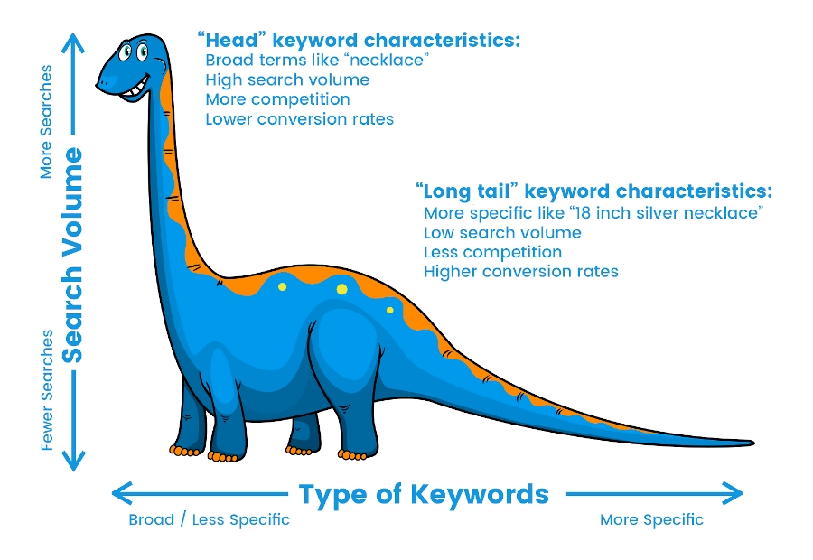
SEO (Search Engine Optimization) - Long Tail

Slide 34
SEO - Long Tail
“Head” keyword characteristics
Common terms like “necklace”, “laptop”
High search volume
Intense competition for a first page placement in Google
Lower conversion rate
“Long tail” keyword characteristics, usually longer phrases, 4-6 words
More specific terms, like “18 inch silver necklace with a pendant”
Low search volume
Less competition for Google’s first page placement
Higher conversion rates

Slide 35
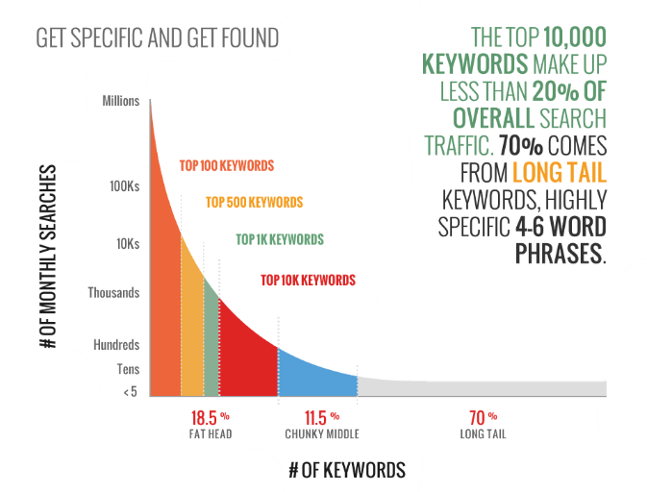
SEO - Long Tail

Slide 36
SEO - Long Tail
Chris Anderson, editor-in-chief of Wired Magazine, noted that
"The best way to dominate the web in the face of stiff competition is to optimize for long-tail search."

Slide 37
SEO - Long Tail
The Problem
Each keyword in the long tail has very few searches every month
To reach high traffic you need to publish thousands if not millions of pages
How do you cost-effectively create thousands or millions of pages?

Slide 38
Companies that use Long Tail Effectively
Many well-known companies use Long Tail for their branding and for generating sales
Amazon – A page per every possible product
LinkedIn – A page per person, a page per company
CrunchBase – A page per company
Facebook – A page per person, or group, or entity, ….
TripAdvisor – A page per hotel, attraction, location
Zillow – A page per street address

Slide 39
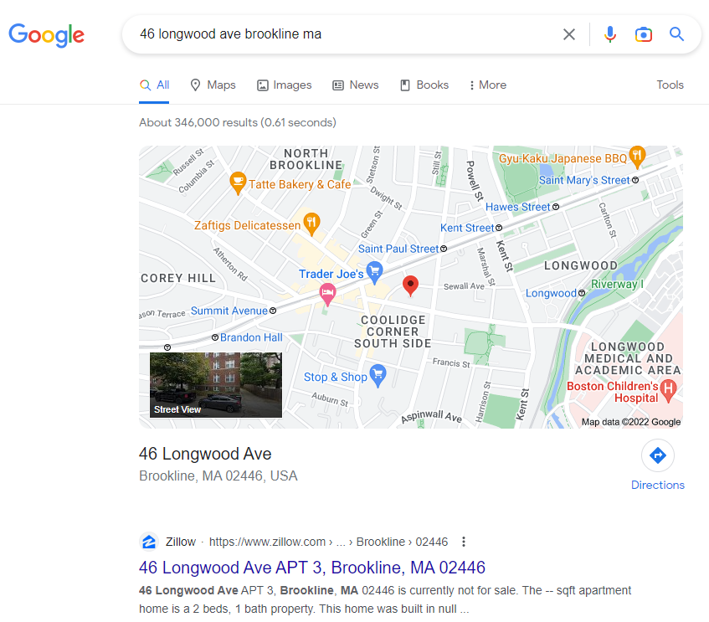
Zillow – A Realtor’s Long Tail Strategy
My first address in the USA: 46 Longwood Avenue, Brookline, MA
Zillow is the first Google answer

Slide 40
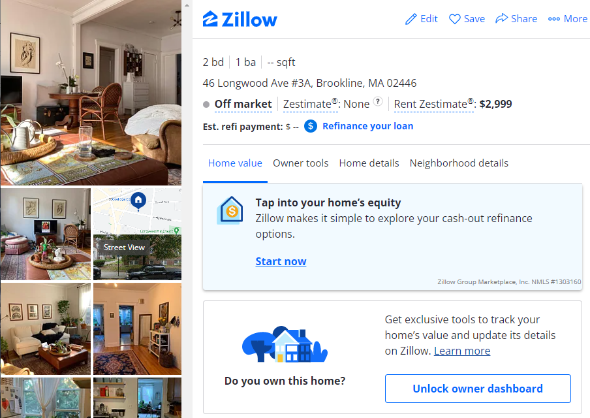
Zillow
Notice the “Rent Zestimate” of $2,999
The “Off market” for sales estimate
And the funnel to attract customers

Slide 41
The SmartUp Way – Marketing First
This presentation focuses on one guiding principle –
How to build a marketing engine that brings your prospects to you
Works 24/7
Generates leads
At a low Customer Acquisition Cost (CAC)
With minimal investment

Slide 42
SEO - Long Tail
The Long Tail Creation Solution
A database of information about something relevant to the problem your prospects try to solve
Each row in the table is about an entity – Person, Address, Company, and will be translated to one page on the website with information about that entity
The content of the page is the data included in the fields or columns of the database
Any query can generate additional interesting content, like:
20 largest companies in New Haven CT
10 most expensive houses in Birmingham AL

Slide 43
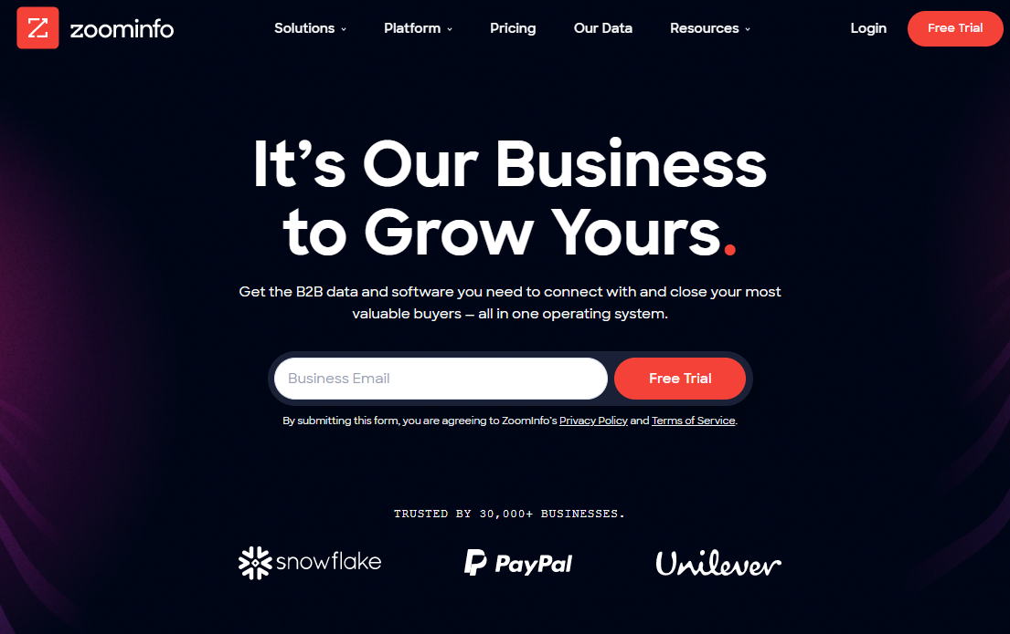
ZoomInfo – Tools for sales

Slide 44
ZoomInfo - History
Founded in 2000 by Yonatan Stern
Nice little company, selling mainly to recruiters – Executive Search Firms
By 2004 revenues were about $6m, profitable, growing
But we wanted to grow much faster by going after sales people
How do we go from one customer set – recruiters, to another – sales people?

Slide 45
ZoomInfo - History
Made a bold decision – Let’s publish all of our data, one page per person
Long Tail - Sales people and recruiters all day long search for people by name, or a title and company name
Search by name is one of the most common searches in Google

Slide 46
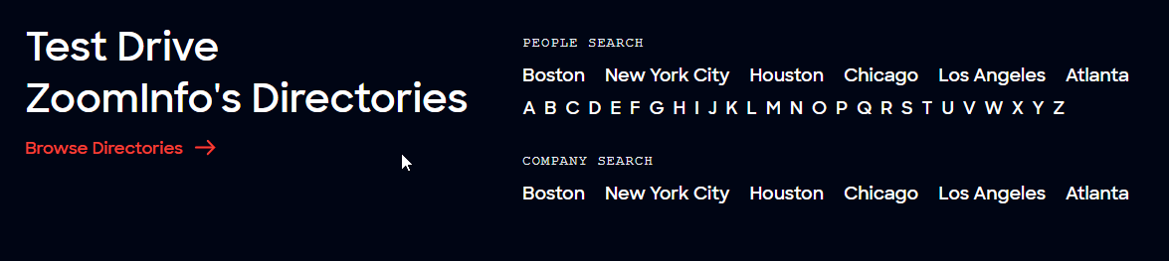
ZoomInfo Directory

Slide 47
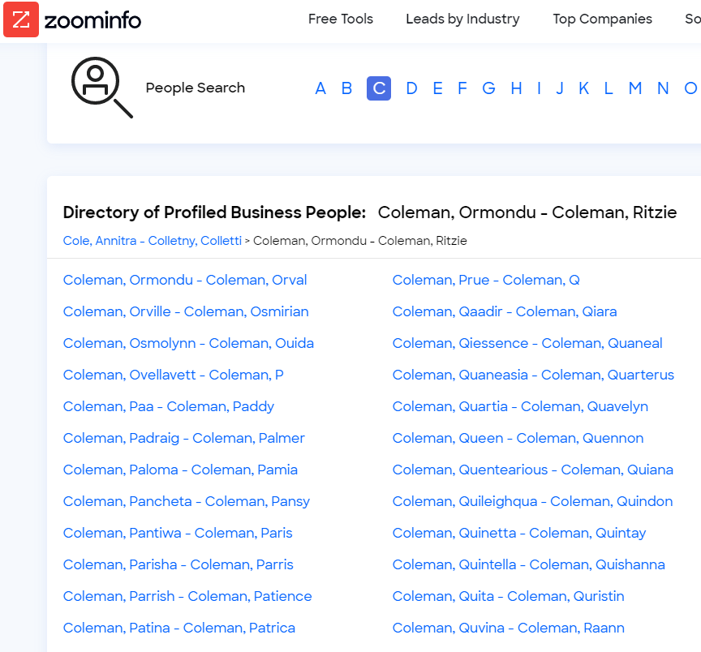
ZoomInfo Directory

Slide 48
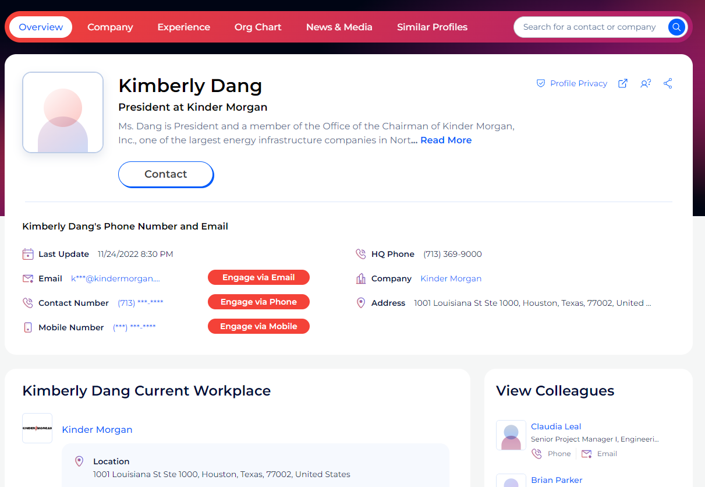
ZoomInfo Directory

Slide 49
ZoomInfo - Results
By the time I left in 2018 there were
50 million directory pages indexed by Google
About 10 million visitors to the site every month – aggregation of many small searches, each for a different name
Some 20,000 inbound leads every month
Company grew revenues consistently by 50% year over year
CAC – Cost of Customer Acquisition very low
Sale cycle of 2-4 weeks, customers were familiar with what ZoomInfo provides

Slide 50
ZoomInfo – The Brand
In early 2019 ZoomInfo was acquired by DiscoverOrg
The CEO of DiscoverOrg ran a study to decide on the name of the combined company
ZoomInfo brand was 9 times more recognized than DiscoverOrg
The combined company is called ZoomInfo
The power of long tail branding

Slide 51
Opster
Opster- Tools for DevOps engineers to manage and optimize mission critical ElasticSearch clusters
Does anyone here understand what that means?
Who are Opster’s prospects?
ElasticSearch DevOps engineers
How on earth can we target these elusive people?
They are busy and they don’t respond to emails

Slide 52
Opster
Focus on the problem - not on your solution
When Opster started, we had nothing to sell. Product vision was murky
We asked ourselves – What do DevOps engineers do when encountering a problem with their ElasticSearch installation?
In many cases the ElasticSearch system produces an error log that is written to their log file
Here are random examples of real error logs

Slide 53
Opster
Error Log examples
Could not lock IndexWriter isLocked
Delaying allocation for unassigned shards; next check in
Suspect illegal state: trying to move shard from primary mode to replica mode
Failed to start monitoring service
Using discovery type and seed hosts providers
All shards failed
Term query does not support array of values
No mapping found for ” + fieldName + ” in order to sort on
high disk watermark [90%] exceeded on
Mapping update rejected by primary

Slide 54
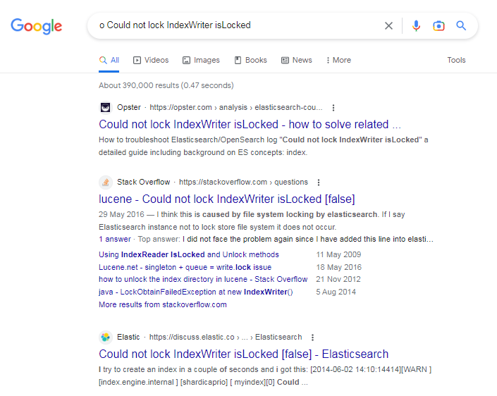
Opster - the Power of Long Tail
Ahead of StackOverflow and Elastic itself
Opster
StackOverflow
Elastic.com – The originators of ElasticSearch

Slide 55
Opster
Long Tail Creation Process – Error Logs Database
How to automatically create thousands of content pages?
Wrote a script to extract all error logs from ElasticSearch open-source code. Initially extracted about 700 different error logs. Today there are some 3,000 error log pages published on Opster
Created an Opster web site, mainly the 700 pages produced automatically.
60 or so pages generated 80% of traffic – manually enriched their content. High quality content creates a strong brand

Slide 56
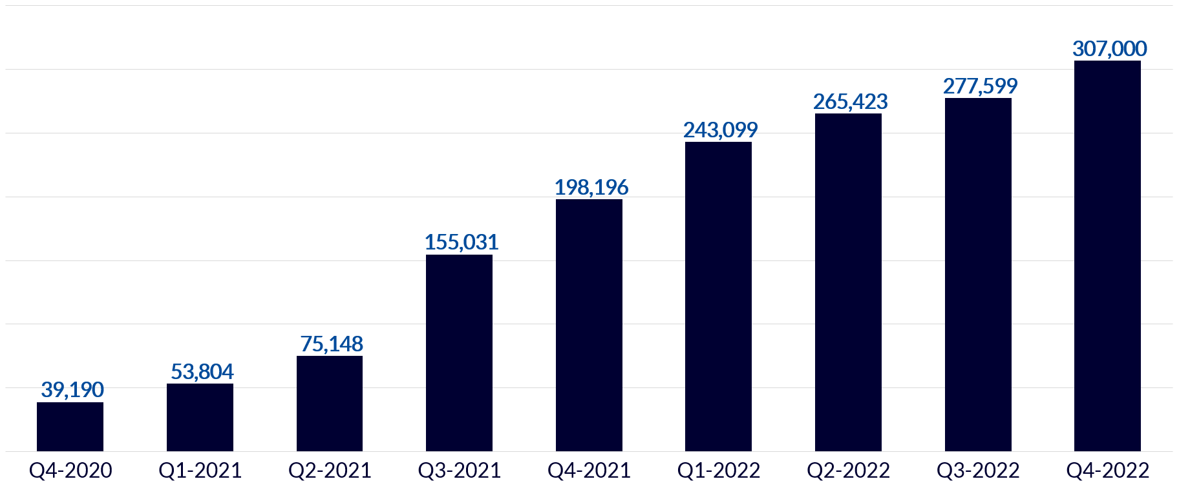
Opster
Traffic results per quarter

Slide 57
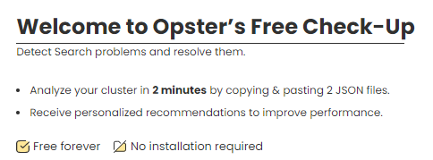

Opster – Marketing Funnel
BUT – Traffic is not yet leads
Developed CheckUp – a simple tool to identify problems based on 2-3 files taken from the Elastic cluster
Users need to create an account to run CheckUp
Our main source of leads – Very low Customer Acquisition Cost (CAC)

Slide 58
Opster
Number of New Registered Users
Total Number of Registered Users

Slide 59

TickChak

Slide 60
TickChak
A platform for selling event tickets
Offers a simple and easy way for artists and producers to create an event web presence and to start selling tickets for it
Fast growing profitable company
No marketing, all growth from word of mouth
However, they continue to grow mainly in their relatively small community and wanted to break out to the entire events market

Slide 61
TickChak – Long Tail Idea
Focus on the problem your customer is trying to solve
Who are the customers? Who is the audience?
Artists, singers, performers, producers, venues (performance halls)
Anybody who wants to buy tickets for a performance or an event

Slide 62
TickChak – Long Tail Idea
Built a robot to extract information about events from all ticket selling websites
The results comprise a database about events, from which we also created a database about singers, performers, producers and venues.
A site listing ALL coming events and concerts in Israel, aggregated from all ticket agencies
When people search for an event by an artist or venue, Google will often present TickChak’s results

Slide 63
TickChak – Long Tail Idea
Over time, create an information page on each and every artist, singer or musician, detailing their current and past shows
Every concert or performance with its promotional material
Historical data
When they performed
Where they performed
How many people attended, based on venue size
And their aggregated audience – interesting, competitive gossip. People, and especially artists, care about their web presence

Slide 64
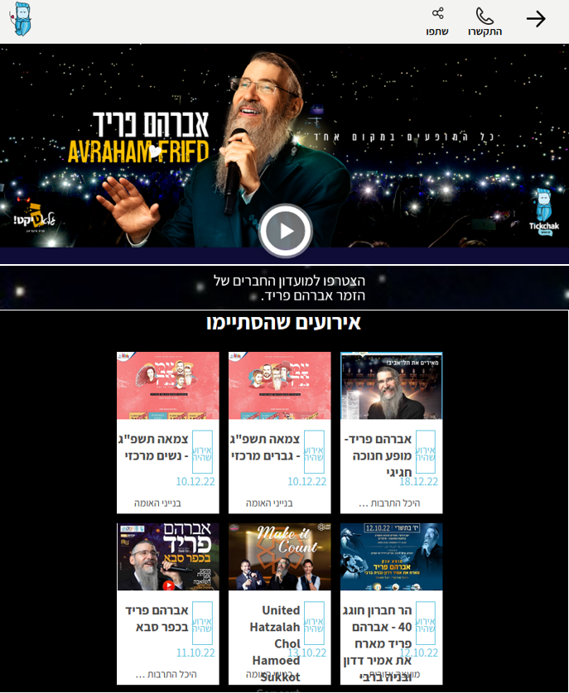
TickChak – Small Proof of Concept

Slide 65
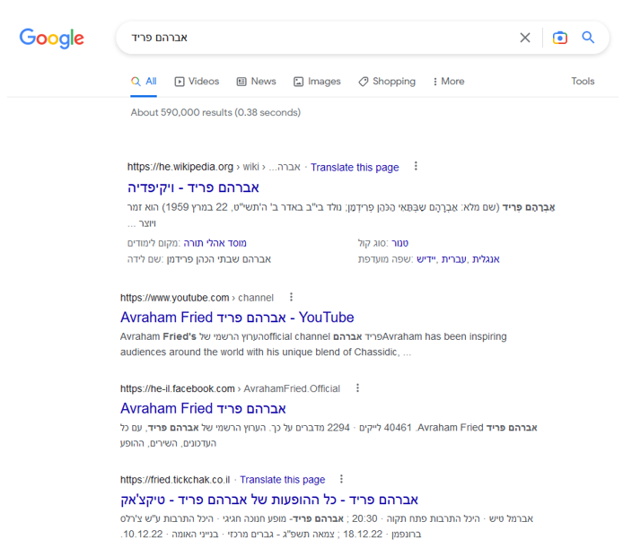
TickChak – Small Proof of Concept
1. Wikipedia
2. YouTube
3. Facebook
4. TickChak

Slide 66
TickChak – Long Tail Idea
Long Tail User Engagement
People who search on Google for an upcoming event, will often get to the TickChak’s page of the artist
When clicking on “Purchase a ticket”, they will be directed to the original site selling tickets for that show
They will also be offered to sign up for an alert if that artist, or similar artists, conduct a show in their area

Slide 67
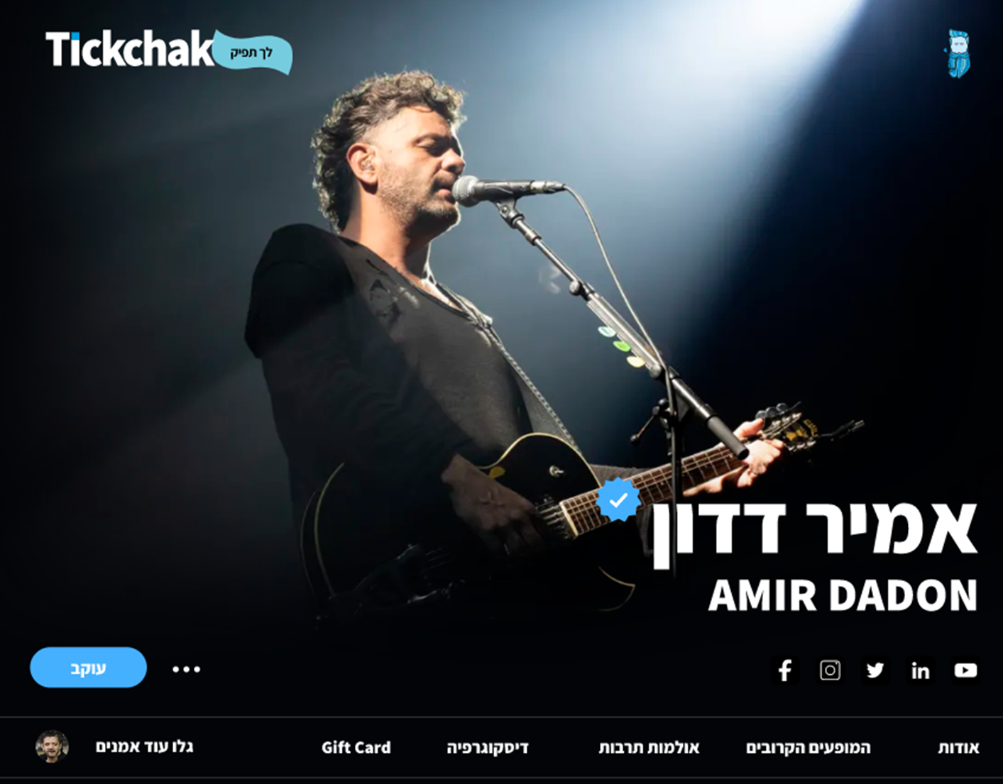
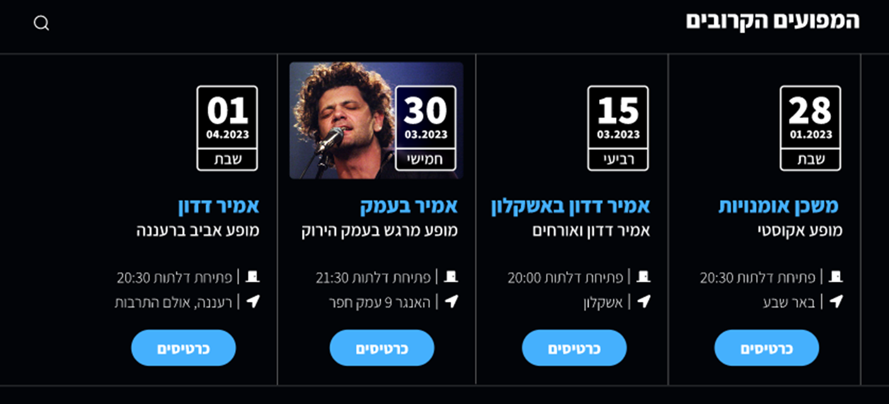
TickChak
And, what’s in it for the artists?

Slide 68
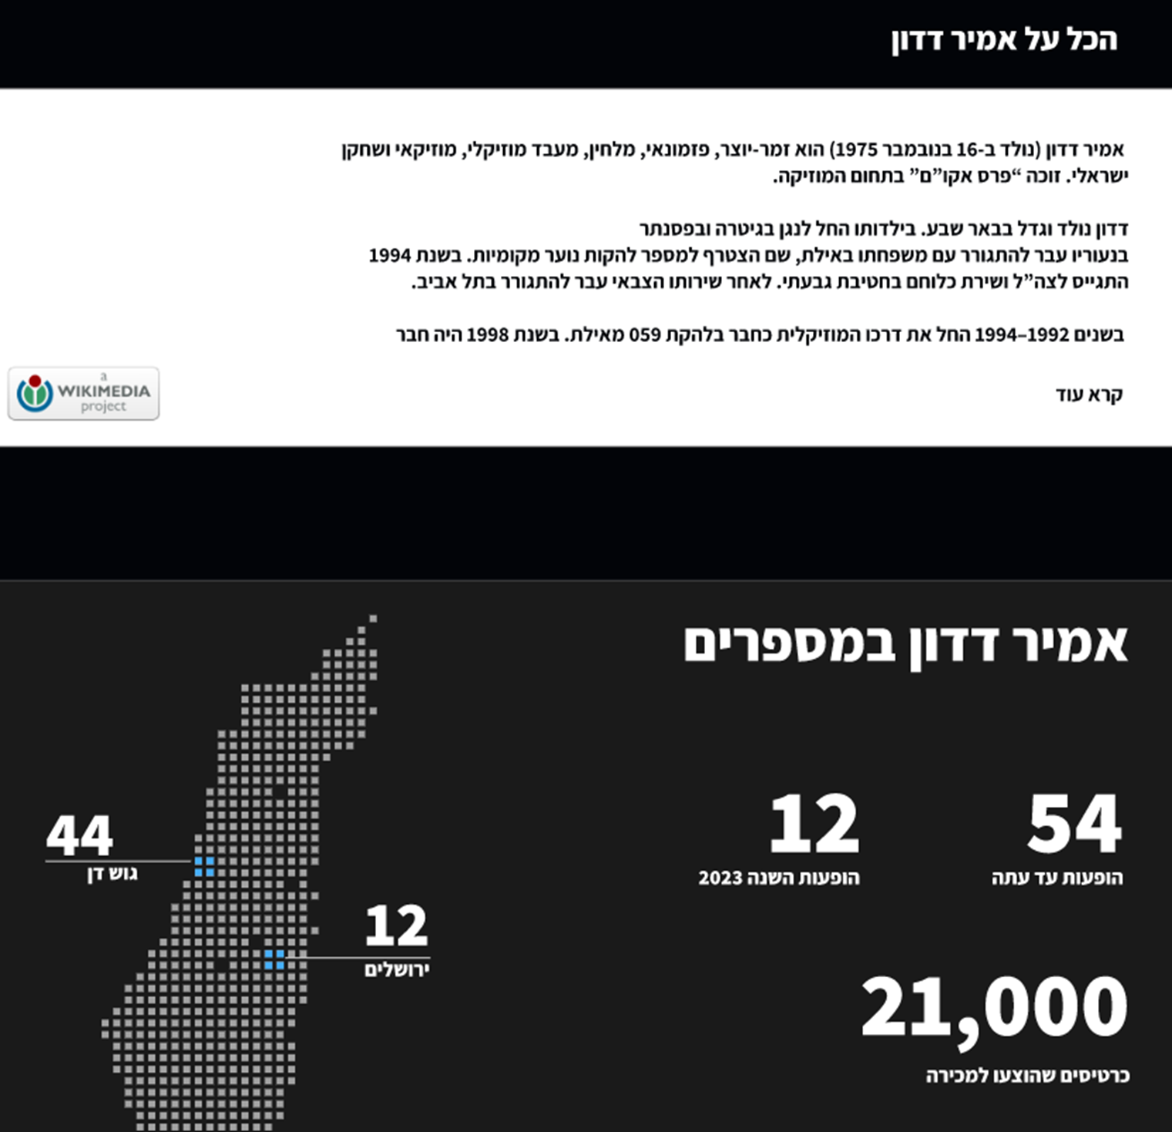
TickChak
And, what’s in it for the artists?

Slide 69
TickChak – Long Tail Idea
And what’s in it for the artists?
People care about their web presence
Most artists don’t have a website or a well-maintained web presence
TickChak will offer artist to own and use the page as their main web presence by adding information, pictures and videos to the page
TickChak will take care of updating and maintaining the list of their events along with any content related to the shows
Obviously, they can use TickChak to sell tickets for their events

Slide 70
TickChak – Long Tail Status
Launching soon
Data collection is ongoing
Building the site
Fairly small investment

Slide 71

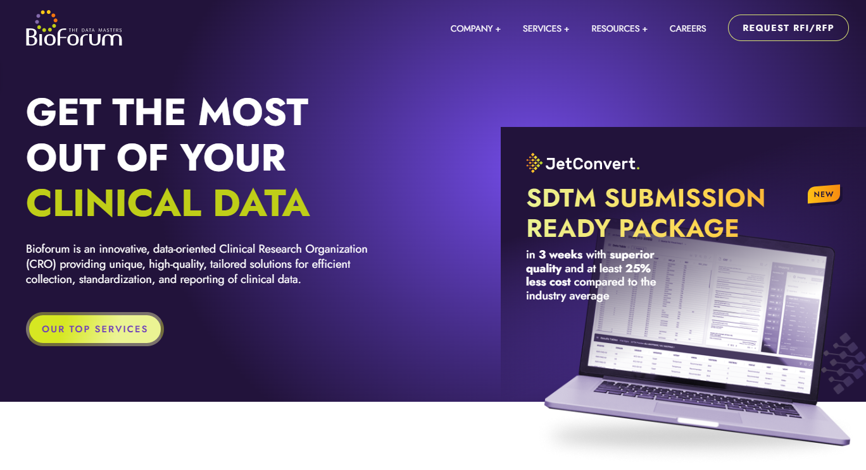
BioForum - The Data Masters

Slide 72

BioForum - The Data Masters
A profitable, growing company, selling data services for clinical trials
Services include:
Medical Writing
Data Management
Biostatistics & Statistical Programing

Slide 73
BioForum - The Data Masters
About 150 employees, strong presence in Israel, low brand recognition outside of Israel
Marketing was based on word of mouth and LinkedIn campaigns
We were looking for a similar inbound marketing machine of long tail that our prospects will explore
Needed a database….

Slide 74
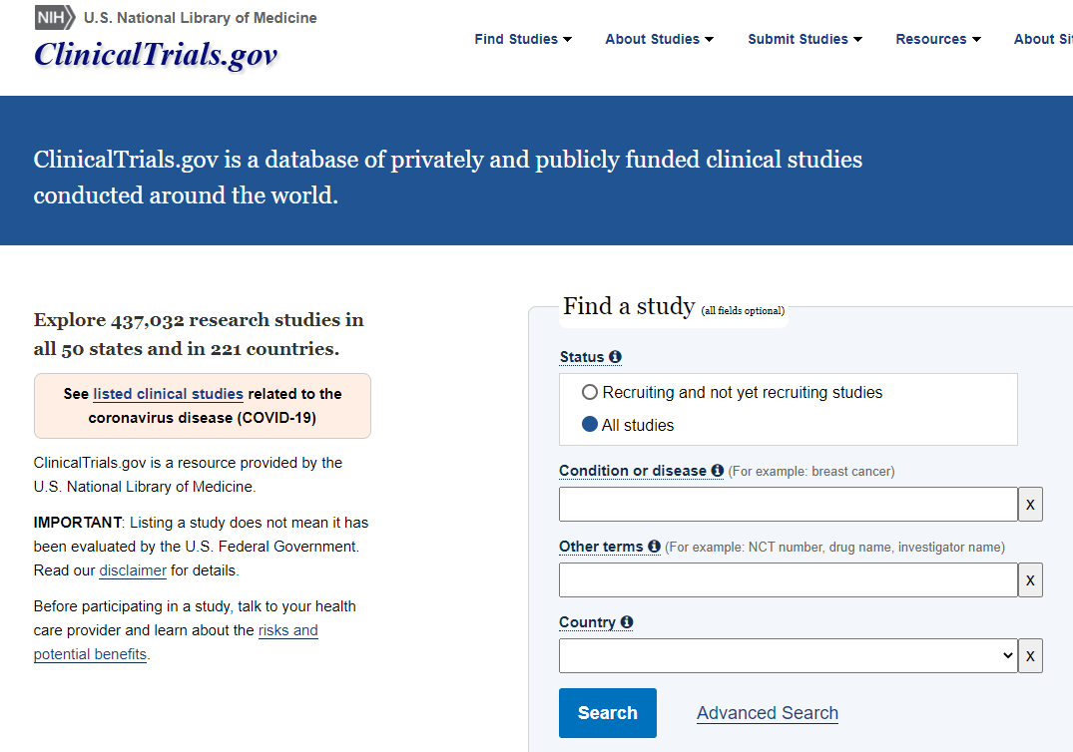
ClinicalTrials.gov
This website is organized by trials. One page per trial listing, among other data, all hospitals where the trial is conducted

Slide 75
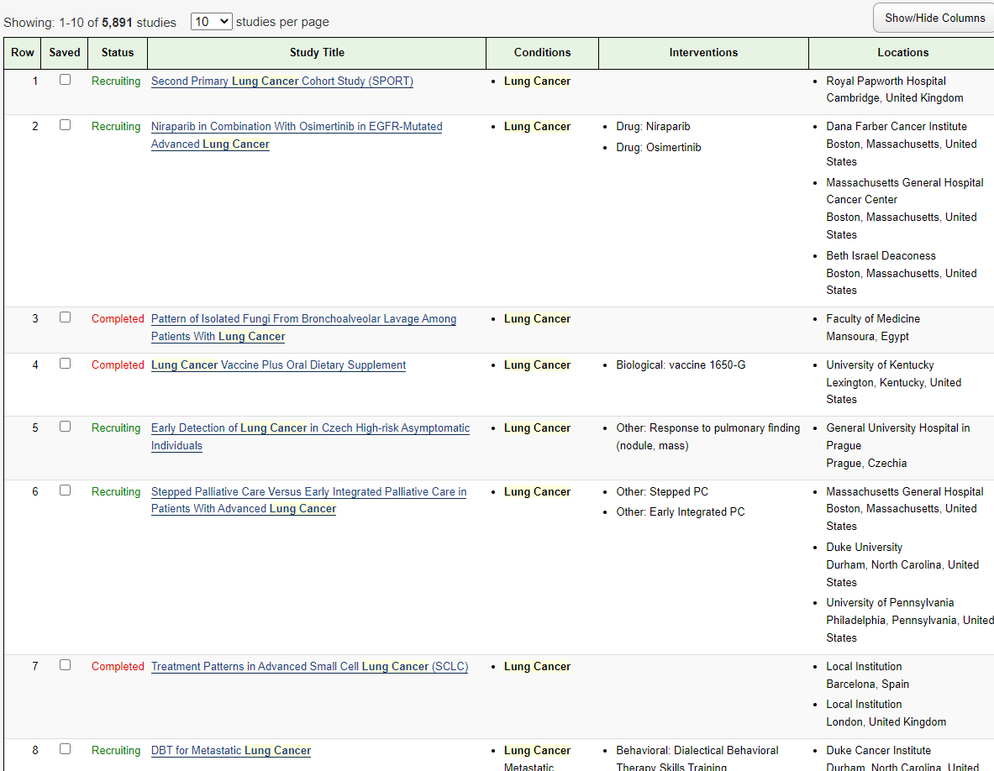
ClinicalTrials.gov

Slide 76
Clinical Trial Hospital Selection
The idea was to invert the data and organize it by hospitals, rather than by the trials themselves
Such a database is a tool to help pharma sponsors – BioForum prospects – identify best hospitals for their specific trial, based on historical trial data
Searched on Google to find such tools
Did not find anything on Google !!!
With the help of experts in the field found several companies offering sophisticated databases and research tools

Slide 77






Clinical Trial Hospital Selection Offerings

Slide 78
Clinical Trial Hospital Selection Offerings
No such data is freely available on the web
Tool providers charge $30,000 - $50,000 per year to access the data
They even refused to give us trial access for a single day
Aha moment – What if we publish the information in a long tail fashion, one page per hospital – about 20,000 locations worldwide

Slide 79
Clinical.Site: Business Model
The birth of a new experiment and potentially a new company
Publish the data, organized by clinical trial hospitals / locations
For each site show:
How many clinical trials were done each year
How many trials were done with each sponsor
How many trials were phase I, phase II, or phase III
How many trials were conducted per condition / disease
Etc.
Free product – how do you make money?

Slide 80
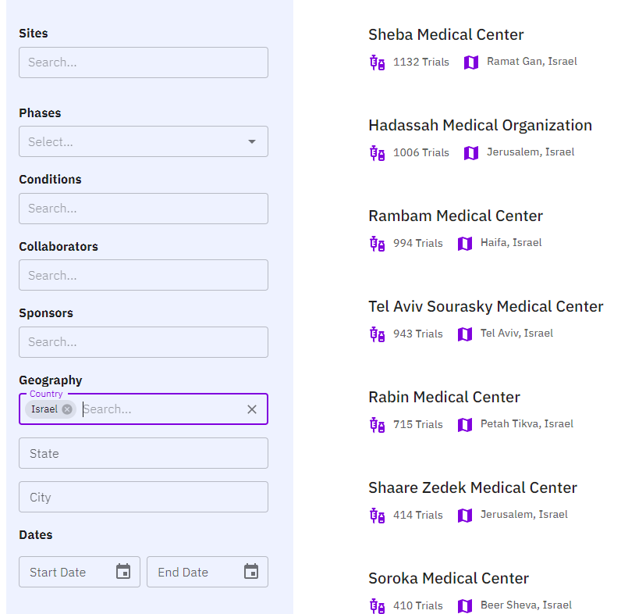
Clinical.Site: Business Model
Created mockups (with real data) on:
Hadassah, Ichilov, Rambam, Sheba, Rabin

Slide 81
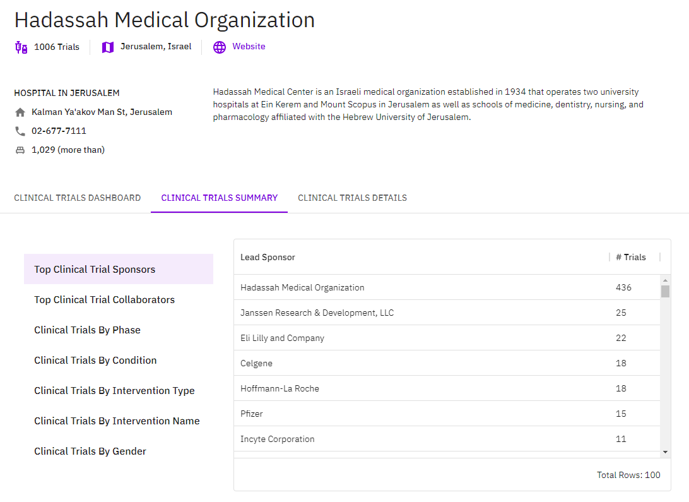
Clinical.Site: Business Model

Slide 82
Clinical.Site: Business Model
Sent them a teaser - five out of five responded to a meeting request
They thought our data was lacking – wanted access to the database to correct it
More importantly they wanted to add reasons why pharma sponsors should choos their hospital for clinical trials
Turns out, clinical trials are an important source of income
People care about their web presence !!!
Then…. They asked how much it will cost to manage their profile

Slide 83
Clinical.Site: Business Model
Guiding Principle: Marketing First
Instead of building the company around your product idea, build your company around a marketing and branding strategy
Long Tail Marketing can lead to interesting ideas and business opportunities
We plan on using it for two purposes - marketing for BioForum, and a stand-alone product

Slide 84
Clinical.Site: Business Model
Plan on launching an MVP in Q1/2023
Investment so far of one man-year of an engineer
After MVP, plan on enriching the data with Principal Investigator data, Open Payments data, and more
Terra Incognita – we don’t know how it will evolve business wise – but given the minimal investment we are open for playing
Marketing First is your best FIRST STEP – it can start generating money before you build your main product

Slide 85
SmartUp Academy
A residency program to teach the profession of building successful companies.

Slide 86
How Does it Work?
It is a residency program – you learn by building your own company
SmartUp becomes a co-founder in the company staying with it for years
SmartUp works with you in designing the strategy and executing it - the devil is in the details
Weekly or bi-weekly management meetings with SmartUp staff
Seminars with other participants and SmartUp staff

Slide 87
The SmartUp Way – Guiding Principles
Building a startup is complex, has many steps, and it takes a long time
Follow up presentations
How to raise seed money
MVP ideation
Business Models
Pricing, packaging, and cashflow
How to reach profitability and maintain it
How to build your team
…….. And more

Slide 88
Who is SmartUp Academy For?
The SmartUp Academy is intended for 5 different audiences:
Founders - at any stage of their company creation journey
Companies that want to do better
People who want to be entrepreneurs
Investors who want to participate
People who just want to learn

Slide 89
Founders
Founders - at any stage of their journey
You are an entrepreneur, with or without experience
You have a project you believe in
You work full-time on your project
You have or don’t have co-founders or a team
You have or don’t have a demo of your product
You need help taking it forward in a professional way

Slide 90
Companies That Want to Do Better
Your company is already established
You have a team working
You raised or didn’t raise money
Preferably:
You have a product
You already have paying customers
You are profitable ☺

Slide 91
People Who Want to be Entrepreneurs
You have a dream of some day starting your own startup
You have, or you don’t have, ideas for a product
You are currently working full time in engineering, marketing, product or any other high-tech position
You want to learn how to build a company, while working at one of the SmartUp companies

Slide 92
Interested Investors
You are a professional VC fund, or an angel investor
You are interested in having early access to SmartUp companies
You want to explore innovative return on investment strategies for companies that aim to be profitable, and need more time

Slide 93
People Who Just Want to Learn
You want to come to our presentations
You want to receive materials that we publish
You want to participate in some meetings
You want to join our mailing list

Slide 94
How to Apply?
Go to our website www.smartupacademy.org click on “Join” and fill out a form

Slide 95
Summary of the Presentation
Change the company objective from an Exit to Profitability (cash)
Profitable companies have a higher likelihood for a lucrative exit
Profitable companies can and do pay dividends to the founders without an Exit
You don’t need to be the first to market
You don’t need to dominate a huge market
You don’t need a grandiose, sophisticated, disruptive product vision

Slide 96
Summary of the Presentation
“The journey of a thousand miles begins with one step”
The first step is a website with a “long tail” strategy
Start building your brand and have your prospects come to you, before you build your product.
Building a startup company is a profession and it can be taught and practiced

Slide 97
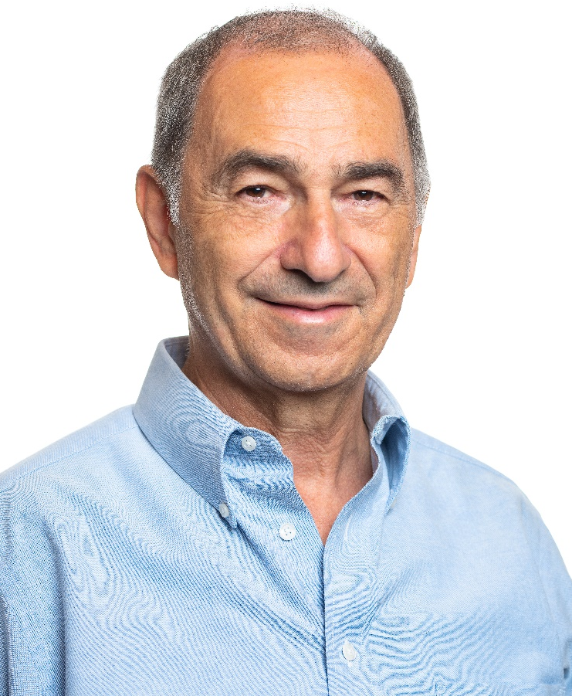
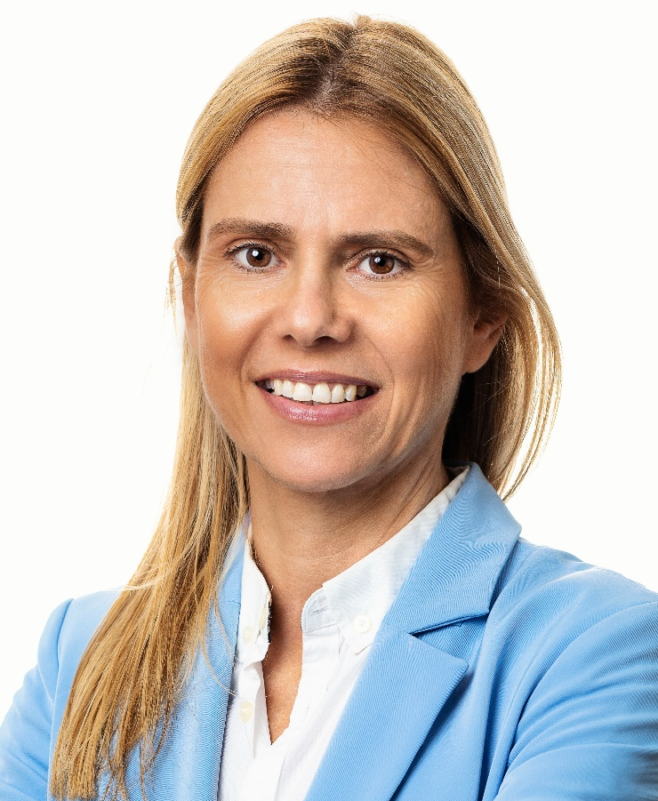
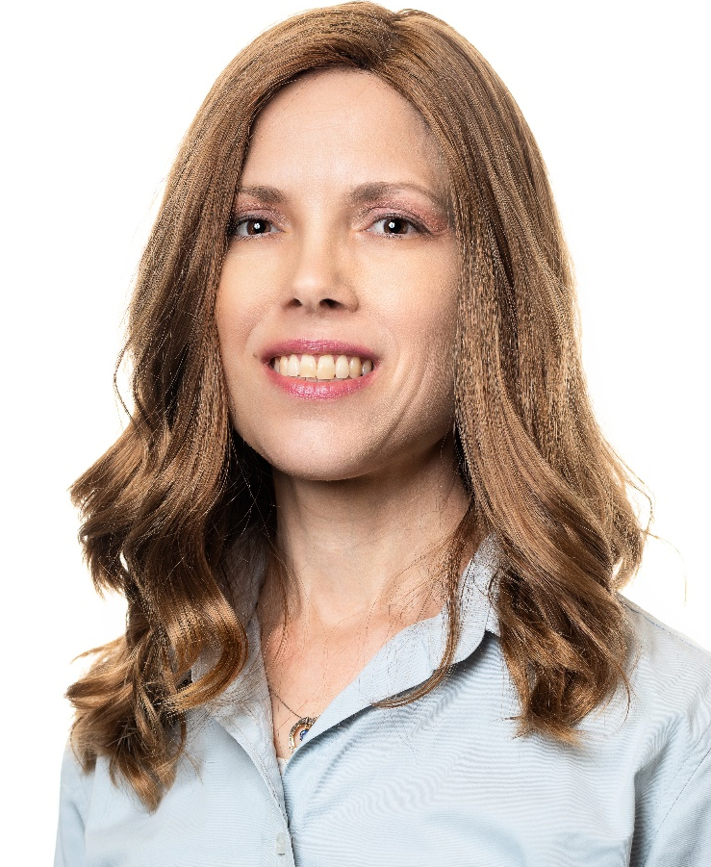
The SmartUp Team
Yonatan Stern
Founder
Libby Molad
COO
Ayala Dinur Turgeman
CFO

Slide 98

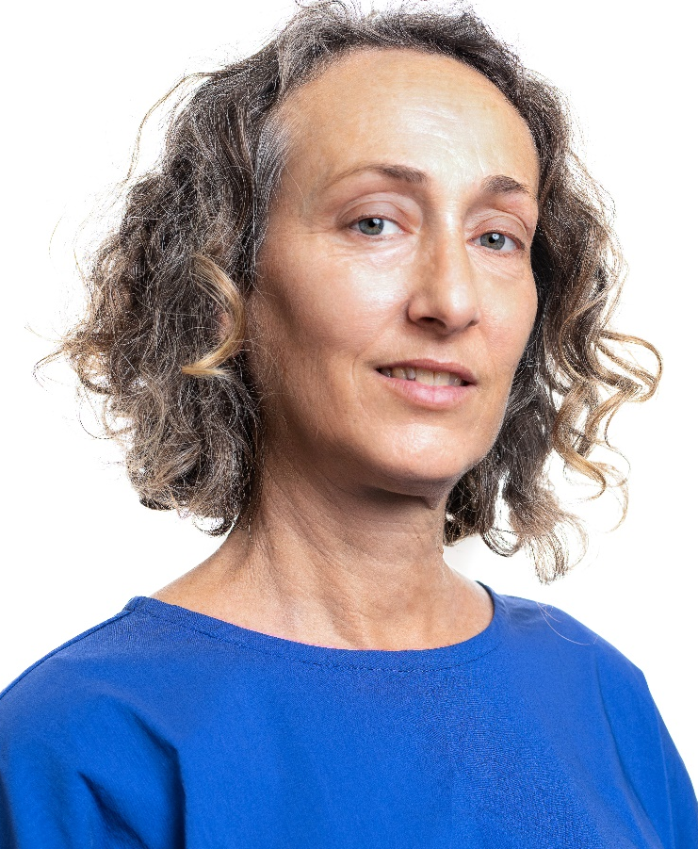
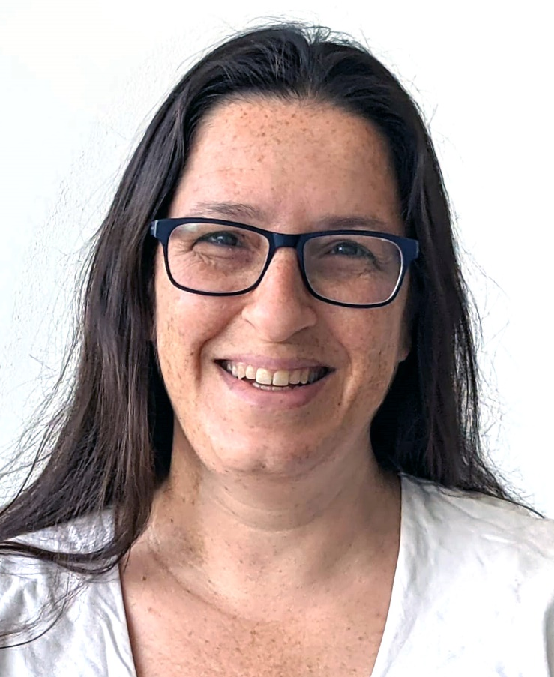
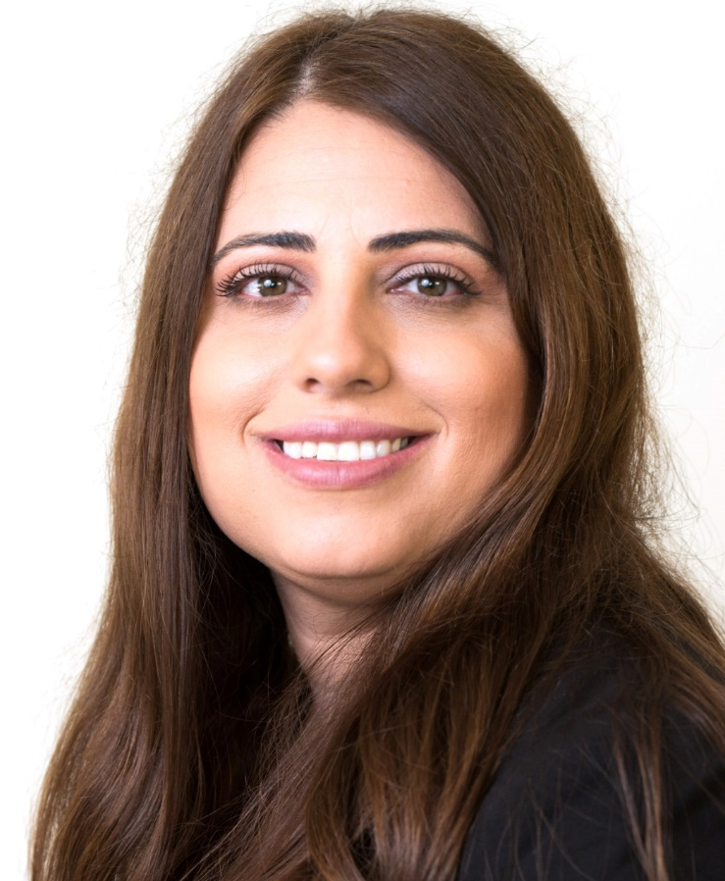
The SmartUp Team
Alex Yermakov
Software Engineer & Researcher
Batya Feldman
Content Writer & Researcher
Ruthie Surujon
Curriculum Developer
Dr. Renana Leviani
Marketing Manager

Slide 99
Questions ?

Slide 100
An alternative way to start your startup
The SmartUp Way
With a much higher success rate

